Slide 1
Low Power Listening Mode
Date: 08/31/22
Authors | Affiliations | Address | Email
Xiaogang Chen | ZEKU | 2479 E Bayshore Road, Suite 260. Palo Alto, CA | Xiaogang.chen@zeku.com
Ivan Yu
Bo Wang
Yanchao Xu
Yi-Hsiu Wang

Slide 2
Outline
Background
Listening mode power consumption
  Power consumptions break down
Low Power Listening (LPL)
  Power consumption comparisons;
  Considerations on the existing listening modes;
  Potential improvements in the standards.
Summary

Slide 3
Background
Device level power consumption was set as a KPI to optimize in the next gen:
  The Study Group will investigate technology which may improve reliability of WLAN connectivity, reduce latencies, increase manageability, increase throughput including at different SNR levels, and reduce device level power consumption…
Smartphones are becoming more powerful but also suffering from power consumptions due to more radios being integrated: cellular, Wi-Fi, BT, GNSS, UWB;
Wi-Fi power consumption is analyzed in this contribution.

Slide 4
Listening mode power consumptions (1/2)
Two commercial phones (different models on the higher end) are used in testing;
  11ax is supported on both AP and STA;
Testing was conducted for ~24 hours for each APP;
Every app has predefined operations in testing which is believed to mimic the daily usage.
Note:
Rx: Receiver needs to parse individual addressed or group addressed packets;
Listen: Waiting for packet.

Slide 5
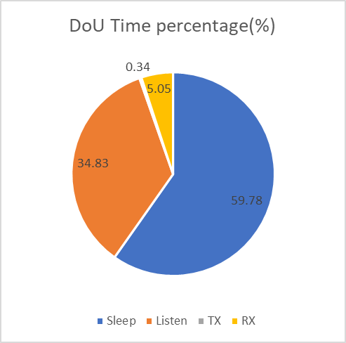
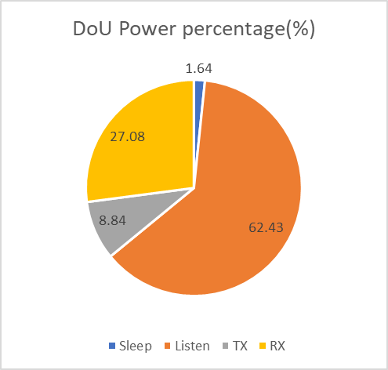
Listening mode power consumptions (2/2)
Listening mode contributes considerable amount of “time” overall.
Listening mode contributes more than half of the power consumption in testing.
Note: Sleep mode is also important but may not fit the bill for all applications. Sleep mode can be another direction to optimize for low power.

Slide 6
Power consumptions break down (1/2)
PLL and ADC contribute majority of the power consumptions in the RF.
  Stringent Rx EVM requirements for 4KQAM raise the power consumption of PLL;
  Larger BW also push for ADC power consumption.
Modules | 160MHz |  | 20MHz
 | 2 Chain | 1 Chain | 2 Chain | 1 Chain
PLL | 25% | 40% | 40% | 55%
ADC | 24% | 18% | 7% | 5%
Others (LNA, LO, LPF, etc.) | 51% | 42% | 53% | 40%
Total | 100% | 100% | 100% | 100%
Note 1: Power consumption is normalized per column. Note 2: Power consumption is measured on commercial platform.

Slide 7
Power consumptions break down (2/2)
If LPL (Low Power Listening) module is introduced in RF, the power consumption will be scaled down as in the table below:
Significant amount of power consumption can be saved in RF with a dedicated LPL mode.
 | 160MHz HP | 20MHz HP | 20MHz LP
 | 2 Chain | 2 Chain | 1 Chain
PLL | 100% | 100% | 7%
ADC | 100% | 19% | 3%
Others | 100% | 66% | 14%
Total | 100% | 63% | 9%
Note: Normalized per row based on 160MHz HP

Slide 8
Considerations on LPL (1/3)
Standardized solution: SMPS
False trigger: Non-AP STA cannot differentiate regular RTS/Trigger from the RTS/Trigger used to wake up the 2nd chain.
With the large power consumption from the PLL, disable one chain doesn’t provide significant power saving anymore.
 | 160MHz |  | 20MHz
 | 2 Chain | 1 Chain | 2 Chain | 1 Chain
Total Power consumption (Normalized by 2 Chian) | 100% | 65% | 100% | 73%
Saving with 1 chain off |  | 35% |  | 27%

Slide 9
Considerations on LPL (2/3)
Standardized solution: EMLSR
For a specific device category instead of a generic solution.
  STA support STR cannot leverage EMLSR on each link independently.
Flexible to implementation. Can be considered as a starting point to extend.

Slide 10
Considerations on LPL (3/3)
Dedicated low power listening module based on implementation
Example: Introducing a 20MHz LPL chain brings the power consumption down to 10%-20% relative to the regular power consumptions in RF (page 7). Further saving is feasible if baseband is also optimized for listening.
Challenge is the settling time of RF (PLL).
Standardization can provide more flexibilities to the implementation.

Slide 11
Standardization for LPL
All the existing listening modes (SMPS, EMLSR) are combination of standardization and implementation.
Potential improvements in standard
  During listening (initial frame exchange), provides more & accurate information for the coming PPDU which require high power processing:
    Number of spatial streams will help HP (high power) Rx to decide how many chains to power on;
    Bandwidth will help HP Rx to fine tune ADC/others to avoid unnecessary oversampling;
    MCS will help HP Rx to determine the required EVM on the Rx side.
  Configurable Padding in the initial frame exchange provides flexibility for Rx to tradeoff between power consumption and latency/efficiency.

Slide 12
Summary
Standardization aided listening mode is highly recommended for the next gen.
  A simplified version can be considered for Wi-Fi7.
Recommend to define a listening mode with reasonable complexity that can be mandatory supported by the AP.

