Slide 1
Virtual BSS And Multi AP Transmissions
Date: 2022-09-07
Authors:

Slide 2
Introduction
During the WNG session in July plenary meeting, a motion was passed to form the Ultra High Reliability (UHR) study group (SG) to develop PAR for new 802.11 amendment. The focus will be on
  Improve reliability of WLAN connectivity
  Reduce latencies
  Increase manageability
  Increase throughput including at different SNR levels
  Reduce device level power consumption
Multi-AP coordination scheme can address several of the above
  Improve Reliability
  Reduce Latency
  Increase Throughput

Slide 3
Introduction
There are many categories of multi-AP coordination such as joint processing, coordinated OFDMA, coordinated Spatial Reuse, coordinated beamforming etc.
Joint processing [1]
  Multiple APs simultaneously transmit to a given STA.
Coordinated OFDMA [1]
  Extend the 11-ax OFDMA concept from single BSS to multi-BSS scenarios.
Coordinated Spatial Reuse [2]
  Extend the 11-ax Spatial Reuse in a coordinated fashion.
Coordinated Beamforming [1]
  AP transmits signals to a STA in its own BSS while forming Signal Nulls to STAs from adjoining/interfering BSS. Can be used together with C-SR.

Slide 4
Proposal
We propose a method to collect necessary parameters from the network to help organize the network for multi-AP transmissions rooted on the virtual BSS (V-BSS) concept [3-5]

Slide 5
V-BSS concept and definitions
C-AP
V-BSSID
Stations (S01, … S28) are wirelessly connected to one or more Anchor APs (A-AP) in the Virtual BSS (V-BSS)
A-APs are connected to Multi AP Coordinator (coordinator AP or C-AP)
  C-AP controls the control path
  typically a wired connectivity
Link Quality Metric (LQM)
  Path loss between 2 entities.
S04
S08
S01
S02
S07
A-AP11
A-AP12
A-AP13
S03
S05
S06
S09
S10
S12
S14
S15
S11
S18
A-AP23
A-AP21
A-AP22
S17
S13
S16
S21
S19
S20
S23
S26
S22
S24
S27
A-AP33
A-AP31
A-AP32
S25
S28

Slide 6
V-BSS
A-APs in a V-BSS (AP11,.. AP33 from earlier slide) are fixed in location
STAs in a V-BSS (S01.. S28 from earlier slide) are generally static or slow moving
A-APs in the V-BSS are connected to the C-AP by a back-haul (often wired) connection
C-AP need not be a wireless Device;
  It may or may not be a separate device.
  It can be one of the A-APs
  C-AP will be pre-configured with the A-AP list in the V-BSS
Several V-BSS can be connected together with a backbone network to form an ESS (ref appendix)

Slide 7
V-BSS (Continued)
Different parts of the V-BSS can form separate “dynamic groups” [6]
  Dynamic multi-AP group
    A dynamic group is a sub-set of A-APs in a V-BSS that will participate in the same multi-AP transmission mode
    An A-AP in a V-BSS may belong to different dynamic groups.
    Each dynamic group is free to engage in its own multi-AP transmission mode.
In a V-BSS,
  there is one C-AP and multiple A-APs.
  there can have multiple dynamic groups
    each dynamic group will contain one or more A-APs and associated STAs.
  In each dynamic group, the multi-AP transmission mode is same.
  C-AP determines the dynamic groups within the V-BSS
    based on the relative spatial configuration (a.k.a network map) of the devices involved.
    This contribution describes a mechanism to determine the network map and how to use it to optimize the multi-AP operations.

Slide 8
LQM & Queue Size Metric
Two types of LQM Tables.
  LQM Table (A-AP to A-AP)
    Upon boot up (time zero) - each A-AP listens to beacons from the neighboring A-APs and creates a path-loss table.
    A-APs periodically updates their table and sends to C-AP
    C-AP reviews and modifies this table
  LQM Table (A-AP to STA)
    Each STA listens to beacons from the neighboring A-APs and creates a path-loss table
    STAs periodically updates its table and sends it to the A-AP that it is associated with.
    A-APs sends this to C-AP.
    C-AP reviews and modifies this table
UL & DL Queue Size
  STAs sends its Uplink Queue size to A-AP which in turn sends it to C-AP
  C-AP appends this table with the down stream Queue Size to each STA
If O(V)BSS is detected, interference table(s) can also be created

Slide 9
V-BSS: Operation
Coordinator AP decides the most suitable transmission mode for each dynamic group in a V-BSS
  To improve a performance metric such as
    Maximize Throughput of the V-BSS
      Increase the throughput to the vast majority of STAs in the V-BSS coverage area. (uniformly high data rate to most of the STAs)
  Minimize latency to a selected group of STAs.
    Queue size and SINR (interference level) can give an estimate of the Latency
Transmission modes selected by Coordinator AP are quasi-static:
  They will remain unchanged until the LQM/Queue Size is significantly changed.

Slide 10
V-BSS: Operation (Continued)
How does a C-AP makes the decision?
  From AP-to-AP LQM Table, C-AP learns the spatial configuration of A-APs in the V-BSS
    Implementation Specific.
  From AP-to-STA LQM table & UL&DL Queue size tables, C-AP maps out the most suited A-APs and multi-AP transmission modes for each STA in the network
    Implementation Specific.
  Perform coordinated transmissions according to the coordinated transmission protocols proposed for different modes [7]

Slide 11
Conclusion
In this contribution, we propose a method for collection and management of relevant features from the Wi-Fi network (Virtual BSS) that will help to configure the VBSS for multi-AP Transmissions – with a view to maximize (area) throughput (or any objective function of interest such as minimize packet delay etc.)

Slide 12
Reference
[1] 11-18/1926r2, “Terminology for AP Coordination”
[2] 11-19/1019r0, “AP Coordination in EHT”
[3] 11-19/1019r0, “Virtual BSS For Multi AP Coordination”
[4] 11-19/1451r1, “Virtual BSS for Multi-AP Coordination - Follow-up”
[5] 11-19/1972r1, “Operation of Virtual BSS for Multi-AP Coordination”
[6] 11-19/1961r4,”Multi-AP Group Establishment”
[7] 11-19/0804r0, “Multi-AP Transmission Procedure”

Slide 13
Appendix

Slide 14
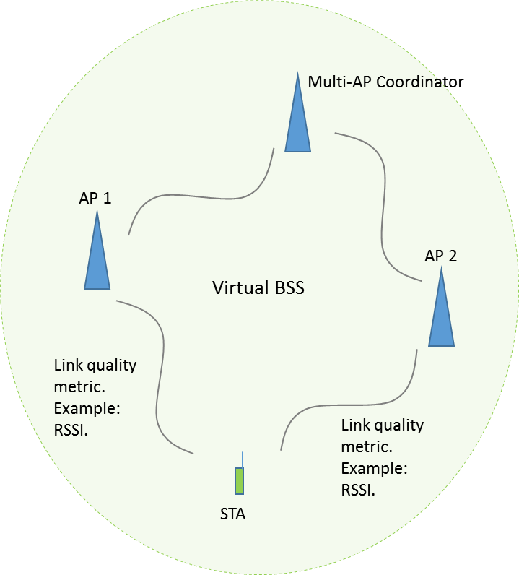
ESS, V-BSS, DS
ESS
Distribution System (Back Haul) (DS)
V-BSSID1
V-BSSID2
V-BSSID3

