Slide 1
Latency Reduction Scheme for UHR
Date: 2022-09-02
Authors:

Slide 2
Introduction
In [1], we listed the following latency reduction technologies
  Scheduling only channel (or limit EDCA as much as possible):
  Virtual BSS
  Preemptible PPDU or inserted/intercepted PPDU.
  Quick error recovery (for latency-sensitive traffic)
In this contribution, we provided the details of inserted PPDU or 2D-PPDU
We assume FD A-PPDU as a baseline

Slide 3
Recap: FD A-PPDU
In [2], forward compatible OFDMA was proposed
  Multiplexing between different generations of 802.11 PPDUs in the frequency domain
  To improve scheduling flexibility and efficiency
In [3], aggregated PPDU for large BW was proposed
  Multiplexing between different BW-capable STAs in a PPDU in the frequency domain
Aggregated PPDU
PPDU-3
80MHz
PPDU-2
80MHz
PPDU-1
160MHz

Slide 4
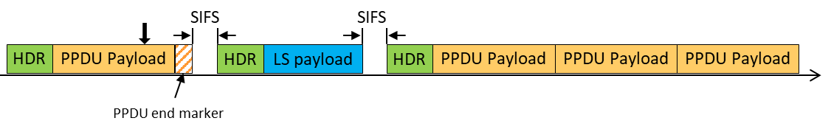
Recap: Preemptible PPDU Aggregation
In [4], preemptible PPDU aggregation was proposed
  Multiplexing between different PPDUs in the time domain
  To improve latency for time-sensitive packet
Detail mechanism is as follows
  The transmitter can end the ongoing PPDU after the nearest slot with a PPDU end marker, and then send latency-sensitive traffic within the TXOP.
  The PPDU end marker could be a rotation of L-LTF or some other predefined sequences.
Examples,
  When no latency-sensitive traffic arrived
  When latency-sensitive traffic arrived

Slide 5
Recap: 11ay A-PPDU
In section 28.3.2.2 of [5], EDMG A-PPDU is defined as follows
  Only to a single user and shall not be transmitted to multiple users.
  Each subsequent PPDU includes EDMG Header A and Data field only.
  Actual A-PPDU duration is unknown at the time of L-Header transmission.
  Each EDMG-Header-A includes PSDU length and Additional EDMG PPDU subfield.

Slide 6
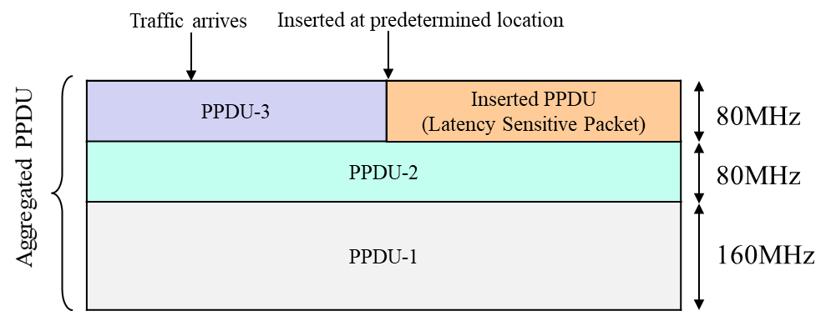
Inserted PPDU (Downlink)
Requirement of inserted PPDU
  Transparent to legacy STA including 11be STA
  We want to transmit latency-sensitive packets on ongoing PPDU including FD A-PPDU as much as possible so that we can reduce latency
  Terminating only necessary subchannel(s). The entire 320 MHz PPDU is quite wasteful given the size of latency-sensitive traffic is typically small
Example, two-dimensional (2D) A-PPDU

Slide 7
Considerations
We shall pursue no impact on the operation of the original PPDU receiver.
  Shall be no change in the original PPDU or RU reception procedure.
  Entire PPDU shall be ended as indicated by the L-Length.
  ACK or BA and other procedures followed by a PPDU shall remain the same. The original PPDU recipient can send ACK/BA as instructed.
Data portion of inserted PPDU will be failed. Already happens in IEEE 802.11 system, e.g. by OBSS interference. The transmitter can handle link adaptation accordingly.

Slide 8
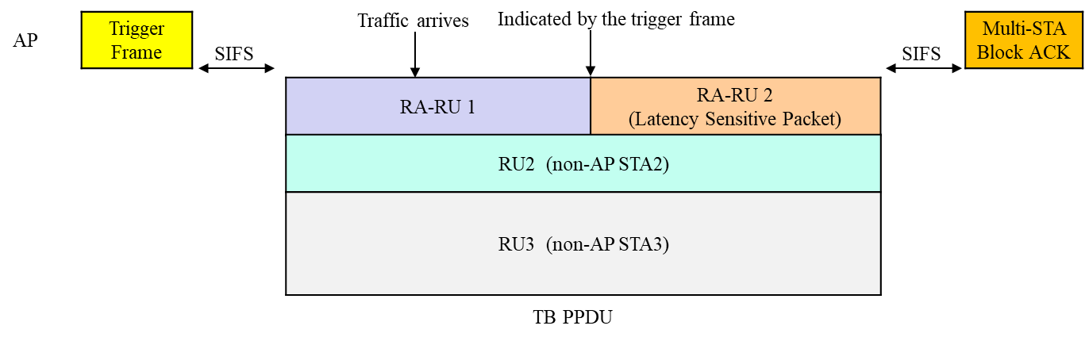
Two Dimensional Resource Unit (Uplink)
Similar to the downlink case, we want to allow transmitting latency-sensitive packets in the middle of ongoing TB PPDU so that we can reduce latency.
Useful for random access.
Example, the two-dimensional resource unit TB-PPDU

Slide 9
Conclusion
In this contribution, we introduced a potential PPDU format for UHR to reduce latency.

Slide 10
References
[1] 11-22/0932r0, “Thoughts on Beyond 802.11be”
[2] 11-20/674r3, “Forward Compatible OFDMA”
[3] 11-20/693r1, “Aggregated PPDU for Large BW”
[4] 11-21/670r0, “Further Improve Latency Performance in 11be”
[5] Draft P802.11ay_D5.0

