Slide 1
Beamforming Improvement for UHR
Date: 2022-09-02
Authors:

Slide 2
Introduction
During the WNG session in July plenary meeting, a motion was passed to form the Ultra High Reliability (UHR) study group (SG) to develop PAR for the new 802.11 amendment. The focus will be on
  Improve reliability of WLAN connectivity
  Reduce latencies
  Increase manageability
  Increase throughput including at different SNR levels
  Reduce device-level power consumption
Beamforming is a key solution that can achieve one of the goals for UHR - Increase throughput including at different SNR levels
  However, it still needs improvement for the following features.
    Smooth beamforming
    UL beamforming
  The features were partially discussed during the standardization meeting for 11n/ac/ax/be but were not adopted as a standard. (or postponed for further discussion)

Slide 3
Smooth Beamforming
Channel smoothing can enhance the PER performance by about 1~2dB especially for low (or mid) SNR regions, under the condition that channel frequency response is smooth.
  However, due to the discontinuity of the beamformed channel, beamforming cannot be compatible with channel smoothing.
    e.g.) If the Beamformed field is 1 in EHT-SIG, the receiver should not perform the channel smoothing.
It is known that discontinuity happens between two adjacent beamforming matrices when two singular values are closer to each other in the SVD operation [1].
  Until now, this problem has been solved by implementation specific methods.
    Smooth SVD [2][3]
    Smooth beamformer [4]

Slide 4
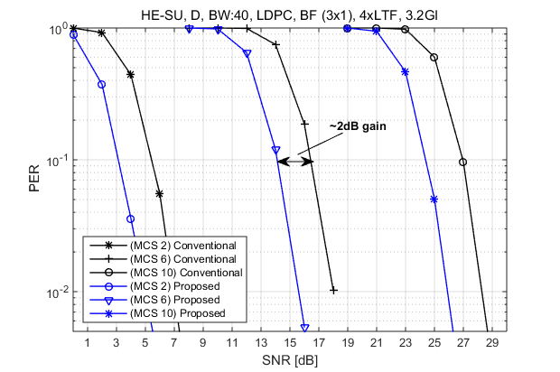
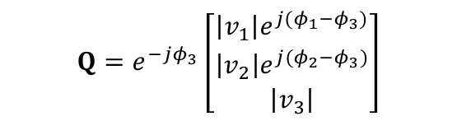
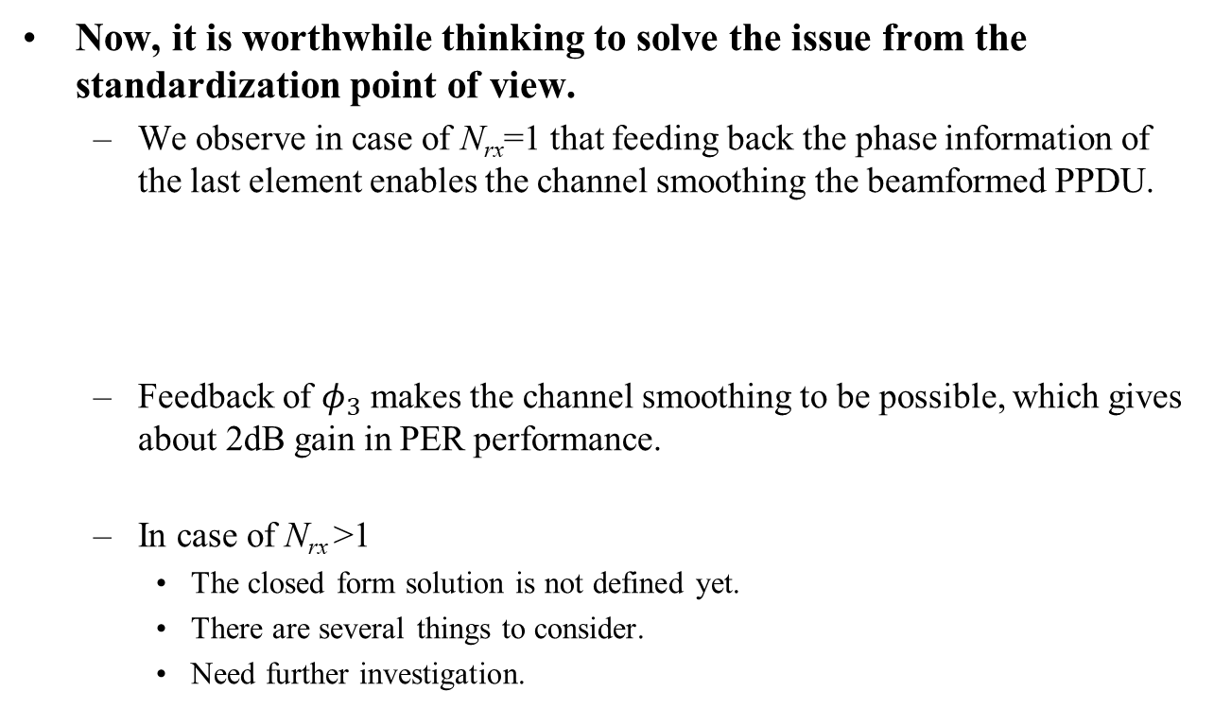

Example of Smooth Beamforming
Now, it is worthwhile thinking to solve the issue from the standardization point of view.
  We observe in case of N_{rx}=1 that feeding back the phase information of the last element enables the channel smoothing the beamformed PPDU.
  Feedback of $φ_{3}$ makes the channel smoothing to be possible, which gives about 2dB gain in PER performance.
  In case of N_{rx} >1
    The closed form solution is not defined yet.
    There are several things to consider.
    Need further investigation.
$$Q=\left[\begin{matrix}\left|v_{1}\right|e^{j(φ_{1}−φ_{3})} \\ \left|v_{2}\right|e^{j(φ_{2}−φ_{3})} \\ \left|v_{3}\right|\end{matrix}\right]$$
$$Q=e^{−jφ_{3}}\left[\begin{matrix}\left|v_{1}\right|e^{j(φ_{1}−φ_{3})} \\ \left|v_{2}\right|e^{j(φ_{2}−φ_{3})} \\ \left|v_{3}\right|\end{matrix}\right]$$

Slide 5
UL Beamforming
Several performance results were shown in [5], where the beamforming for TB PPDU is very effective in throughput improvement.
  A high-level design of sounding and channel information feedback protocols are based on the explicit way.
  However, in explicit feedback, the amount of feedback is larger as the number of non-AP STAs increases.
Thus, we are considering a UL “implicit” beamforming for TB PPDU.
  The implicit sounding was an implementation-specific solution for 11ac/ax.
  To help the channel smoothing operation in the AP (i.e., beamformee), it is desirable to define the operation in the standard.

Slide 6
Example of UL Beamforming
Option 1: Trigger frame-based UL implicit beamforming
  Non-AP STAs (beamformers) prepare the beam-steering matrix based on the Trigger frame and transmit the beamformed TB PPDU a SIFS after the Trigger frame.

Slide 7
Example of UL Beamforming
Option 2: Sounding frame-based UL implicit beamforming
  Non-AP STAs (beamformers) prepare the beam-steering matrix based on NDP and transmit the beamformed TB PPDU a SIFS after the (Basic) Trigger frame.
    If the BFRP Trigger frame follows after NDP, non-AP STAs (beamformees) return the compressed beamforming report (CBR) frame as defined TB sounding procedure. (i.e., explicit MU feedback)

Slide 8
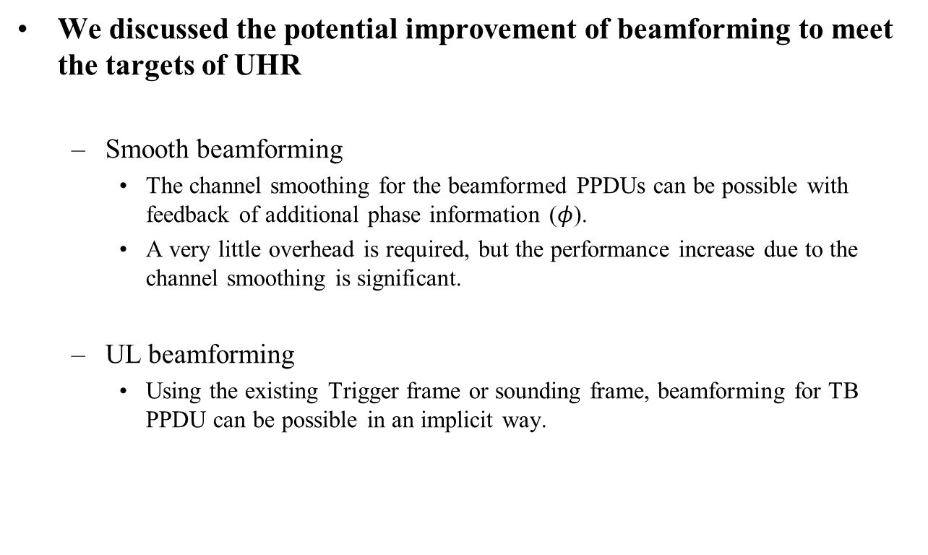
Summary
We discussed the potential improvement of beamforming to meet the targets of UHR
  Smooth beamforming
    The channel smoothing for the beamformed PPDUs can be possible with feedback of additional phase information ($φ$).
    A very little overhead is required, but the performance increase due to the channel smoothing is significant.
  UL beamforming
    Using the existing Trigger frame or sounding frame, beamforming for TB PPDU can be possible in an implicit way.

Slide 9
Reference
[1] J. S. Sadowsky, T. Yamaura, and J. Ketchem, “WWiSE Preambles and
MIMO Beamforming,” IEEE, Tech. Rep. 802.11-05/1635r1, Jan. 2005.
[2] C. Shen and M. P. Fits, “MIMO-OFDM Beamforming for Improved
Channel Estimation,” IEEE J. Selected. Areas Commun., vol.26, no.6, Aug. 2008.
[3] M. Sandell and V. Ponnampalam, “Smooth beamforming and efficient
beamforming weight computation,” in Proc. IEEE GLOBECOM, Nov. 2007.
[4] E. Jeon, M. Ahn, S. Kim, W. B. Lee, and J. Kim, “Joint Beamformer and Beamformee Design for Channel Smoothing in WLAN Systems,” in Proc. IEEE VTC-Fall, Sep. 2019.
[5] 802.11-20/1672r0, UL Beamforming for TB PPDUs in 11be, Huawei

