Slide 1
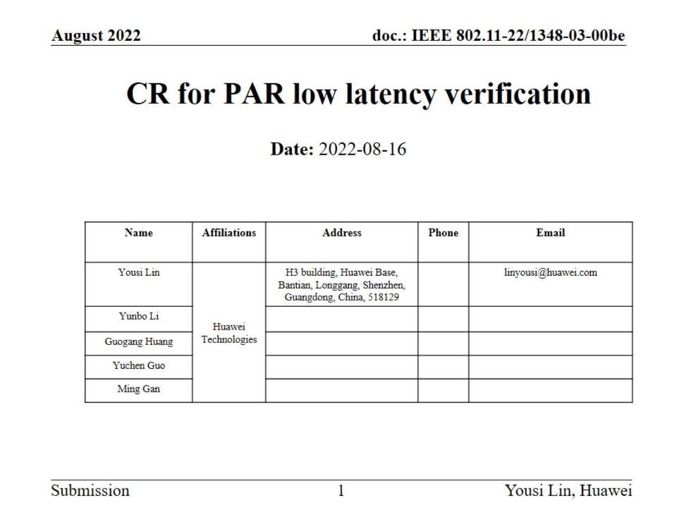

Slide 2
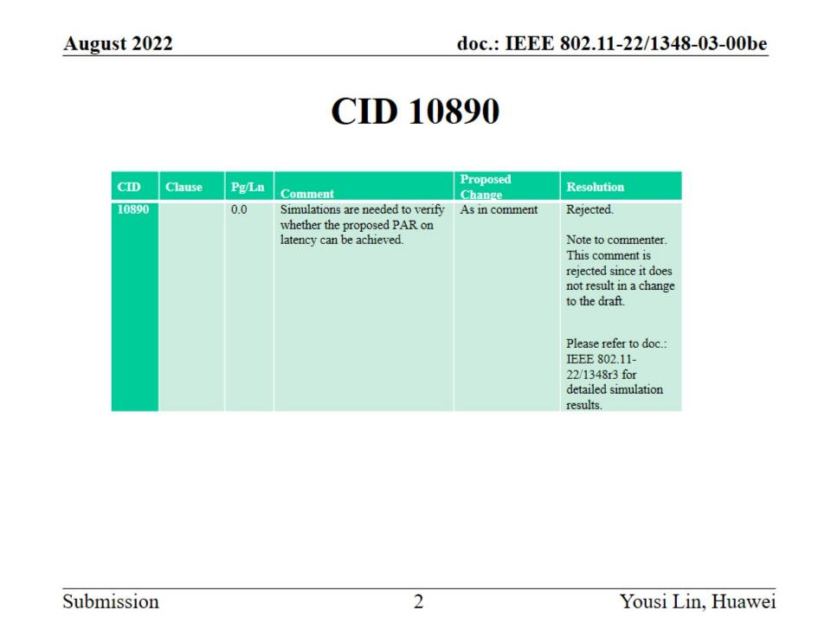
CID 10890

Slide 3
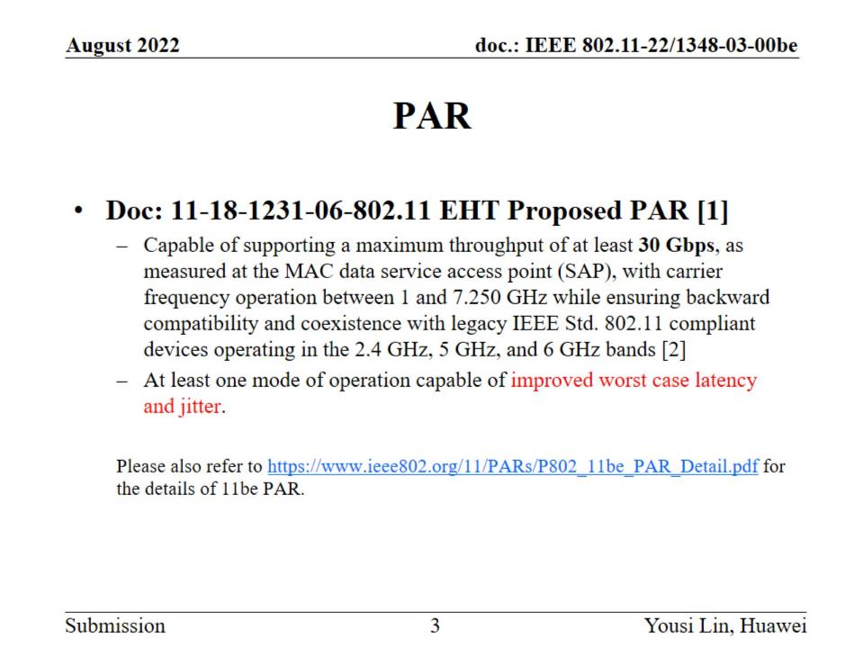
PAR

Slide 4
Latency verification

Slide 5
Simulation Setup Parameters

Slide 6
Simulation Case 1

Slide 7
Case 1: DL SU-MIMO, 11ax with 1 link of 160MHz v.s. 11be with 2 links of 80MHz

Slide 8
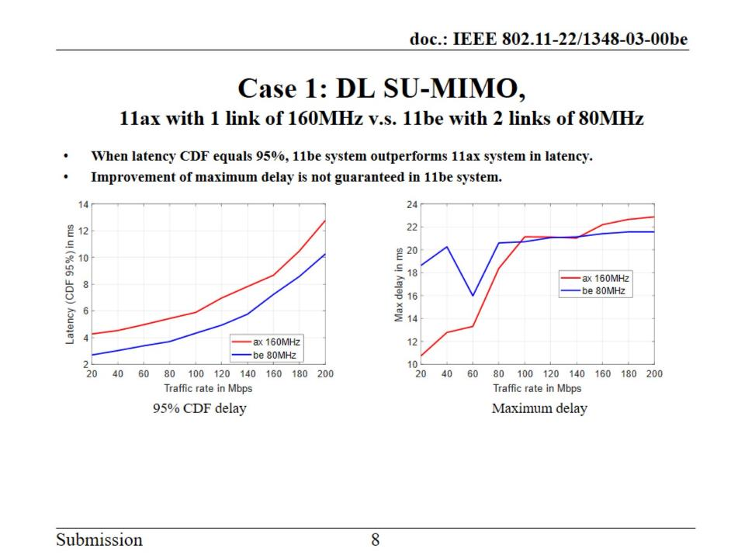
Case 1: DL SU-MIMO, 11ax with 1 link of 160MHz v.s. 11be with 2 links of 80MHz

Slide 9
Case 1: UL SU-MIMO, 11ax with 1 link of 160MHz v.s. 11be with 2 links of 80MHz

Slide 10
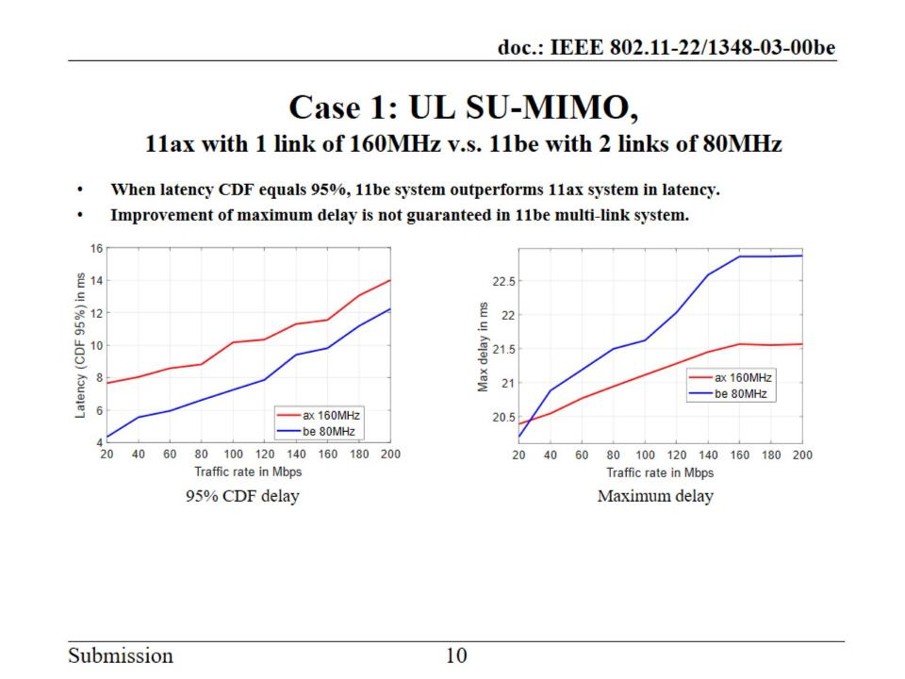
Case 1: UL SU-MIMO, 11ax with 1 link of 160MHz v.s. 11be with 2 links of 80MHz

Slide 11
Case 1: DL OFDMA, 11ax with 1 link of 160MHz v.s. 11be with 2 links of 80MHz

Slide 12
Case 1: DL OFDMA, 11ax with 1 link of 160MHz v.s. 11be with 2 links of 80MHz

Slide 13
Case 1: UL OFDMA, 11ax with 1 link of 160MHz v.s. 11be with 2 links of 80MHz

Slide 14
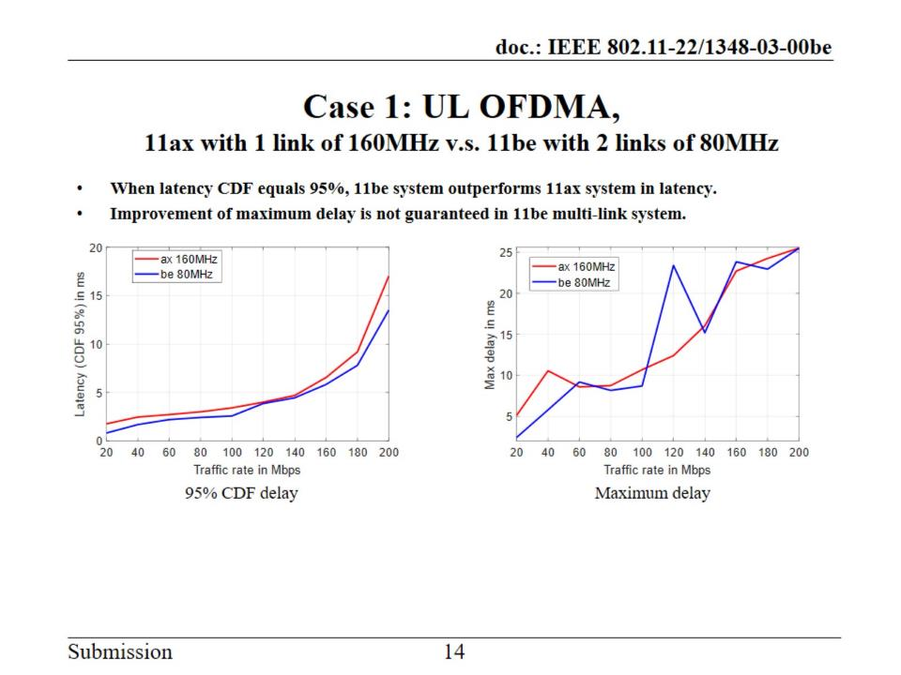
Case 1: UL OFDMA, 11ax with 1 link of 160MHz v.s. 11be with 2 links of 80MHz

Slide 15
Simulation Case 2

Slide 16
Case 2: DL SU-MIMO, 2 links, 80MHz

Slide 17
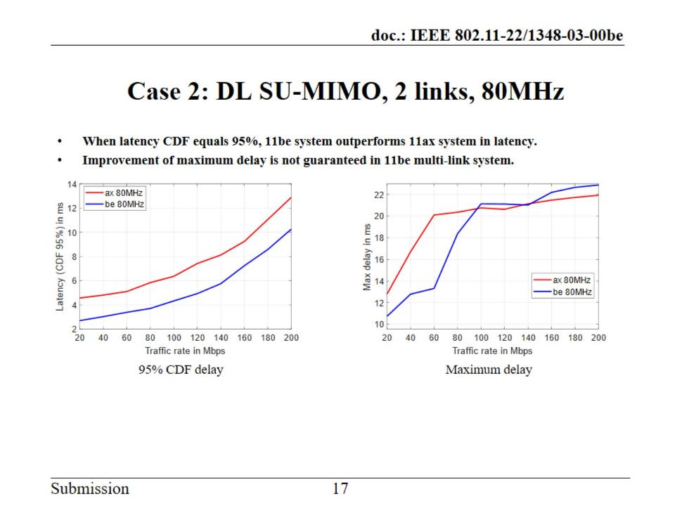
Case 2: DL SU-MIMO, 2 links, 80MHz

Slide 18
Case 2: DL SU-MIMO, 2 links, 160MHz

Slide 19
Case 2: DL SU-MIMO, 2 links, 160MHz

Slide 20
Case 2: UL SU-MIMO, 2 links, 80MHz

Slide 21
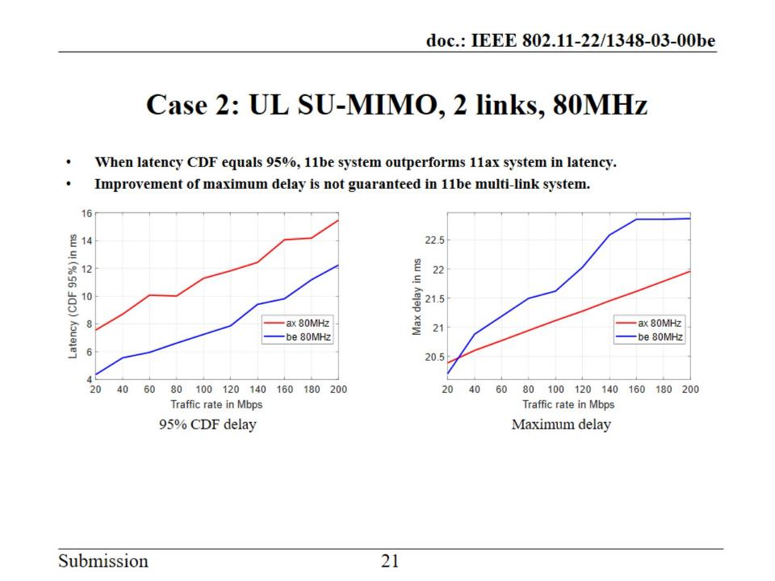
Case 2: UL SU-MIMO, 2 links, 80MHz

Slide 24
Case 2: DL OFDMA, 2 links, 80MHz

Slide 25
Case 2: DL OFDMA, 2 links, 80MHz

Slide 26
Case 2: DL OFDMA, 2 links, 160MHz

Slide 27
Case 2: DL OFDMA, 2 links, 160MHz

Slide 28
Case 2: UL OFDMA, 2 links, 80MHz

Slide 29
Case 2: UL OFDMA, 2 links, 80MHz

Slide 30
Case 2: UL OFDMA, 2 links, 160MHz

Slide 32
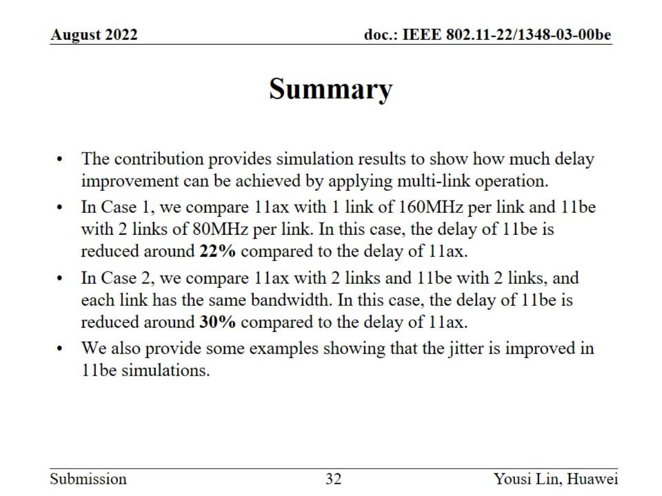
Summary

Slide 33
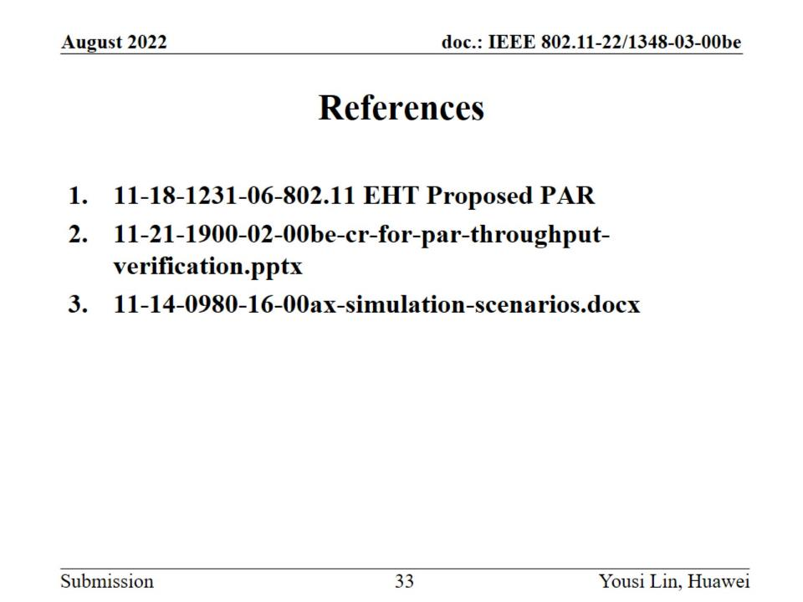
References

