Slide 1
CR for PAR low latency verification
Date: 2022-08-16
Name | Affiliations | Address | Phone | Email
Yousi Lin | Huawei Technologies | H3 building, Huawei Base, Bantian, Longgang, Shenzhen, Guangdong, China, 518129 |  | linyousi@huawei.com
Yunbo Li
Ming Gan
Yuchen Guo
Guogang Huang

Slide 2
CID 10890
CID | Clause | Pg/Ln | Comment | Proposed Change | Resolution
10890 |  | 0.0 | Simulations are needed to verify whether the proposed PAR on latency can be achieved. | As in comment | Rejected. Note to commenter. This comment is rejected since it does not result in a change to the draft. Please refer to doc.: IEEE 802.11-22/1348r1 for detailed simulation results.

Slide 3
PAR
Doc: 11-18-1231-06-802.11 EHT Proposed PAR [1]
Capable of supporting a maximum throughput of at least 30 Gbps, as measured at the MAC data service access point (SAP), with carrier frequency operation between 1 and 7.250 GHz while ensuring backward compatibility and coexistence with legacy IEEE Std. 802.11 compliant devices operating in the 2.4 GHz, 5 GHz, and 6 GHz bands [2]
At least one mode of operation capable of improved worst case latency and jitter.
Please also refer to https://www.ieee802.org/11/PARs/P802_11be_PAR_Detail.pdf for the details of 11be PAR.

Slide 4
Latency verification
It needs verifying to see whether there is an improvement in the delay of the data delivery
The delay is defined as the duration from the time when data is passed to the STA’s MAC layer for transmission, till the reception of its expected immediate response at the STA’s MAC layer.
Multi-link operation is considered as one of the most important features in 11be
The latency verification will be done using multi-link operation to see how much latency gain can be achieved.

Slide 5
Simulation Setup Parameters
The topology is based on a residential scenario from the 11ax simulation scenarios document [3].
2 floors, 3m height on each floor. 2 x 10 apartments on each floor. Apartment size:10m x 10m x 3m. 1/3 of apartments will be using the same channel.
In this simulation, 5 BSSs using the same channel are analyzed with 2 to 4 STAs in each BSS.
AP is at the center of the BSS. STA is randomly placed in the BSS.
Traffic rate is the packet generation rate for all links at the transmitter.
Simulation Setup Parameters | Default value
Traffic type | UL/DL traffic
Traffic Rate | 1-10 Mbps (Uniform distribution)
Packet size | 1500 Byte per MPDU
MCS | 11
NSS | 2 per STA
Max aggregation | 256 MPDU per AMPDU
CWmax | 15
CWmin | 7
AIFS | 34us
The number of links in MLO | 2
Retry limit | 10
MSDULifeTime | 20ms
RU size | 80MHz: 242 tone 160MHz: 484 tone
AP MLD scheduling algorithm | Round Robin
TXOP | on (4.096ms)
RTS/CTS | on
Notes:
需要杨老师确认1/3 BSS在同一信道是否可行

Slide 6
Simulation Case 1
Compare the latency performance for 11ax and 11be in DL/UL SU-MIMO and DL/UL OFDMA
11ax with single link of 160MHz v.s. 11be with two links of 80MHz
In this case, 5 BSSs are using the same channel, each BSS has 1 AP or AP MLD in it. In 11ax, each AP has 4 associated STAs. In 11be, each AP MLD has 4 associated non-AP MLDs.
Version | Link # | Bandwidth (MHz) per link
ax | 1 | 160
be | 2 | 80

Slide 7
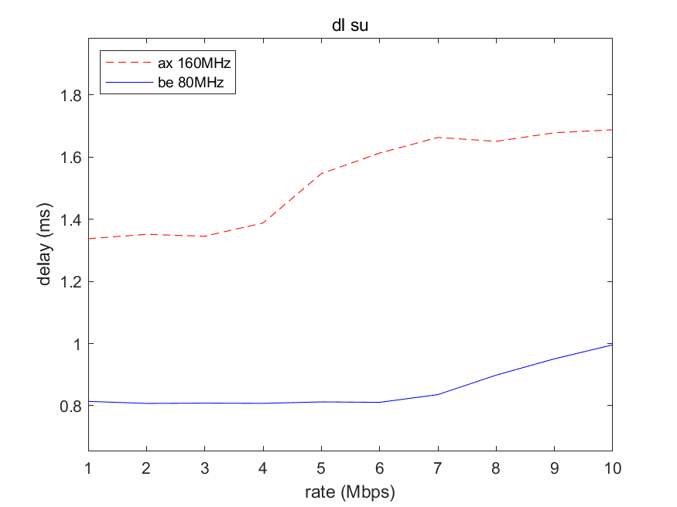
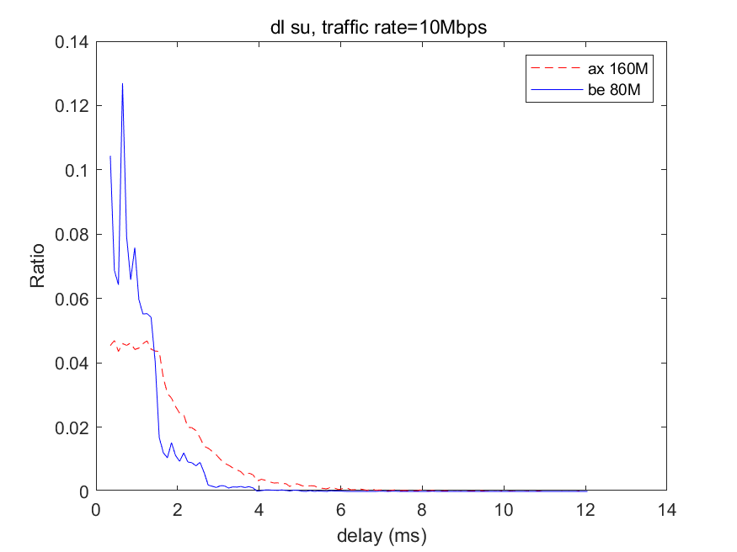
Delay performance comparison under DL SU-MIMO
The average delay for 11be using 80MHz achieves 44% gain compared with 11ax using 160MHz.
Latency and jitter are both improved in 11be simulations.
The timeout rate remains 0 when the traffic rate increases from 1 to 10 Mbps.
 | Timeout rate/%
Traffic rate/Mbps | ax 160MHz | be 80MHz
1~10 | 0 | 0
Average delay
Jitter when traffic rate equals 10 Mbps
$$Ratio=\frac{Number of frames that have the given delay }{Total number of frames}$$
Notes:
SU这部分我没写词，可以根据MU部分写，套进数据就可以，如果觉得不好解释，可以不show SU的结果

Slide 8
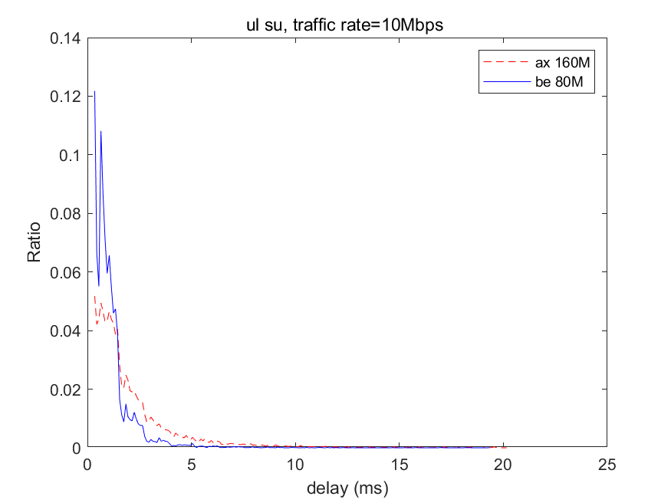
Delay performance comparison under UL SU-MIMO
The average delay for 11be using 80MHz achieves 47% gain compared with 11ax using 160MHz.
Latency and jitter are both improved in 11be simulations.
The timeout rate remains less than 1% when the traffic rate increases from 1 to 10 Mbps.
 | Timeout rate/%
Traffic rate/Mbps | ax 160MHz | be 80MHz
1~4 | 0 | 0
5 | 0.024 | 0
6 | 0.290 | 0
7 | 0.437 | 0
8 | 0.464 | 0
9 | 0.366 | 0
10 | 0.090 | 0.018
Average delay
Jitter when traffic rate equals 10 Mbps
$$Ratio=\frac{Number of frames that have the given delay }{Total number of frames}$$

Slide 9
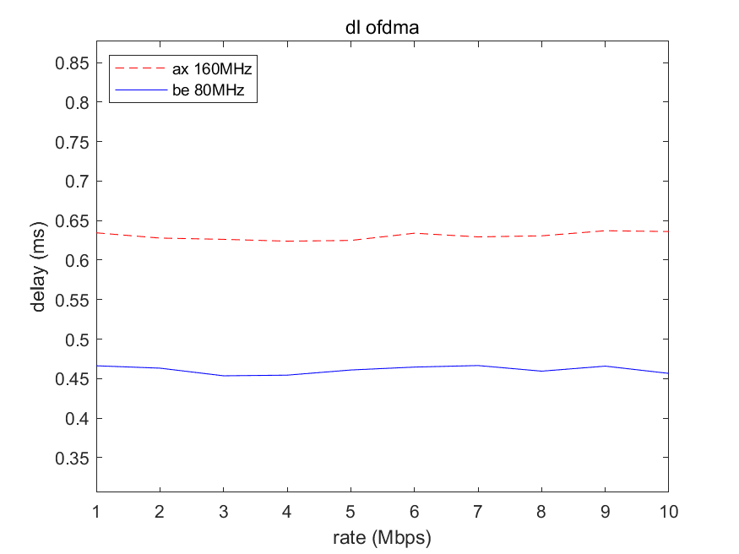
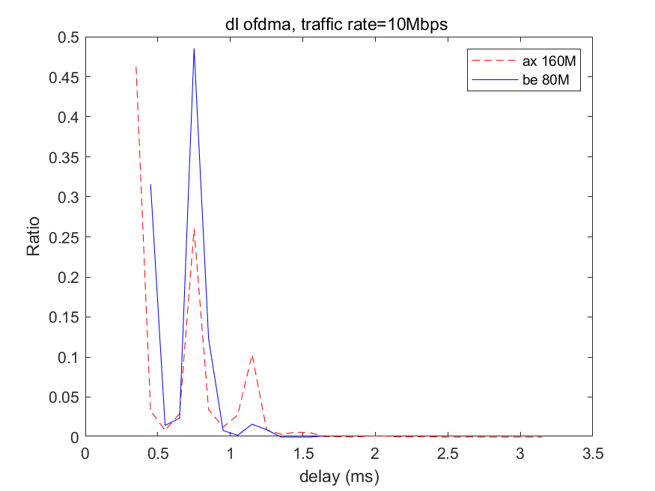
Delay performance comparison under DL OFDMA
The average delay for 11be using 80MHz achieves 27% gain compared with 11ax using 160MHz.
Latency and jitter are both improved in 11be simulations.
The timeout rate remains 0 when the traffic rate increases from 1 to 10 Mbps.
 | Timeout rate/%
Traffic rate/Mbps | ax 160MHz | be 80MHz
1~10 | 0 | 0
Average delay
Jitter when traffic rate equals 10 Mbps
$$Ratio=\frac{Number of frames that have the given delay }{Total number of frames}$$

Slide 10
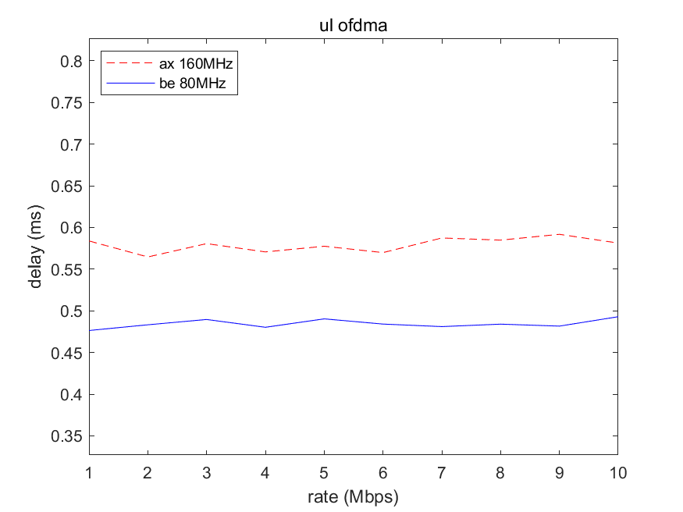
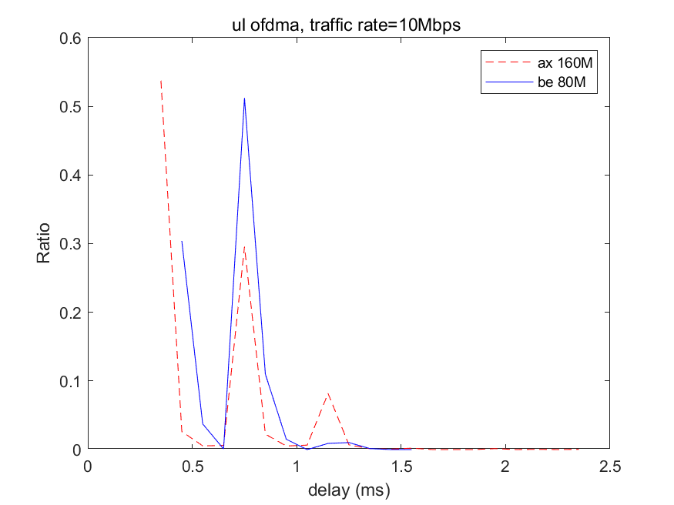
Delay performance comparison under UL OFDMA
The average delay for 11be using 80MHz achieves 17% gain compared with 11ax using 160MHz.
Latency and jitter are both improved in 11be simulations.
The timeout rate remains 0 when the traffic rate increases from 1 to 10 Mbps.
 | Timeout rate/%
Traffic rate/Mbps | ax 160MHz | be 80MHz
1~10 | 0 | 0
Average delay
Jitter when traffic rate equals 10 Mbps
$$Ratio=\frac{Number of frames that have the given delay }{Total number of frames}$$

Slide 11
Simulation Case 2
Compare the latency performance for 11ax and 11be in DL/UL SU-MIMO and DL/UL OFDMA
In the two settings, the total bandwidth in 11be is doubled compared to 11ax. To compensate for this, we set other parameters as follows:
5 BSSs are using the same channel, each BSS has 1 AP or AP MLD in it.
In 11ax, each AP has 2 associated STAs.
In 11be, each AP MLD has 4 associated non-AP MLDs.
Other simulation parameters are the same as in Case 1.
Setting 1
Setting 2
Version | Link # | Bandwidth (MHz) per link
ax | 1 | 80
be | 2 | 80
Version | Link # | Bandwidth (MHz) per link
ax | 1 | 160
be | 2 | 160

Slide 12
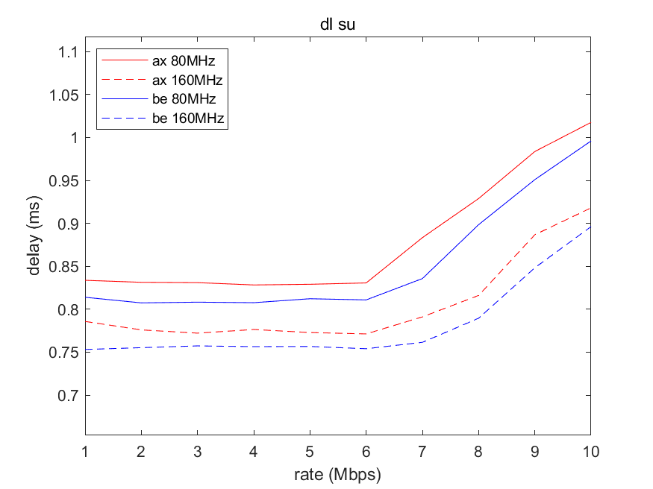
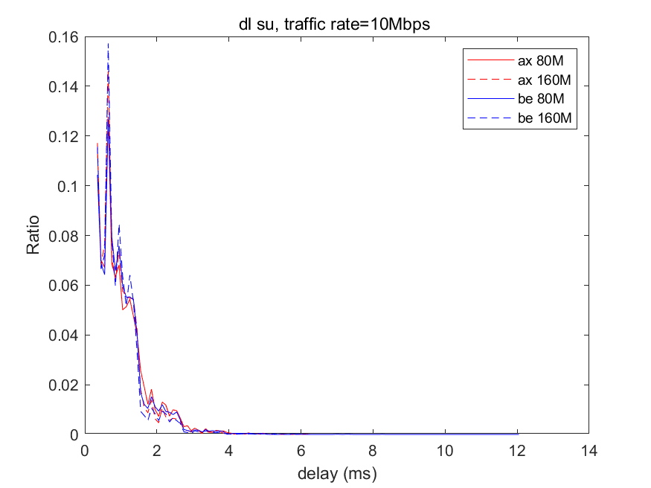
Delay performance comparison under DL SU-MIMO
The average delay for 11be using 80MHz achieves 3% gain compared with 11ax using 80MHz.
The average delay for 11be using 160MHz achieves 3% gain compared with 11ax using 160MHz.
The timeout rate remains 0 when the traffic rate increases from 1 to 10 Mbps.
Average delay
Jitter when traffic rate equals 10 Mbps
 | Timeout rate/%
Traffic rate/Mbps | ax 80MHz | be 80MHz | ax 160MHz | be 160MHz
1~10 | 0 | 0 | 0 | 0
The jitter is not clearly improved in this case, because the AP MLD in 11be simulation is associated with 4 non-AP MLDs, while the AP in 11ax simulation is associated with only 2 STAs.
Notes:
SU这部分我没写词，可以根据MU部分写，套进数据就可以，如果觉得不好解释，可以不show SU的结果

Slide 13
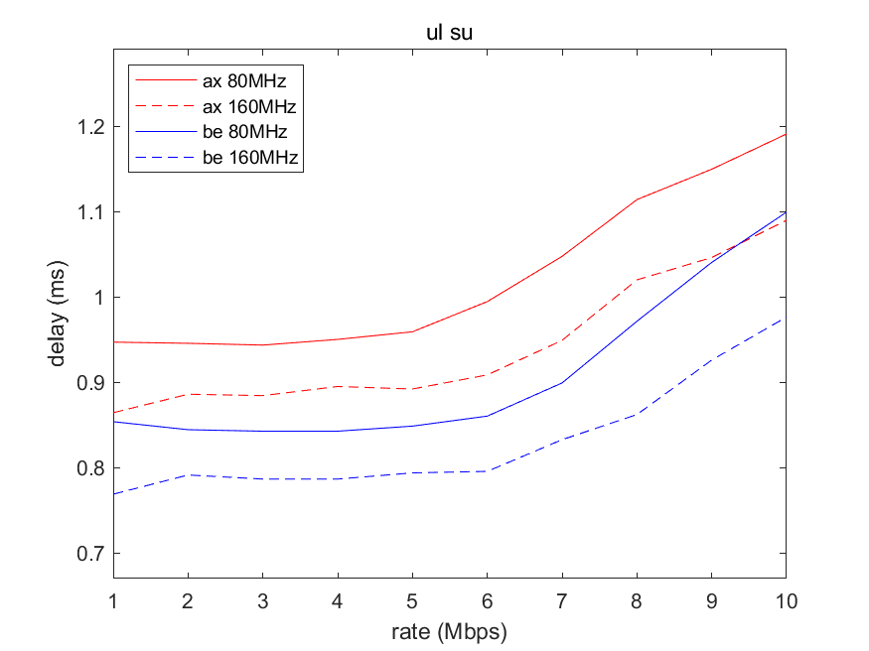
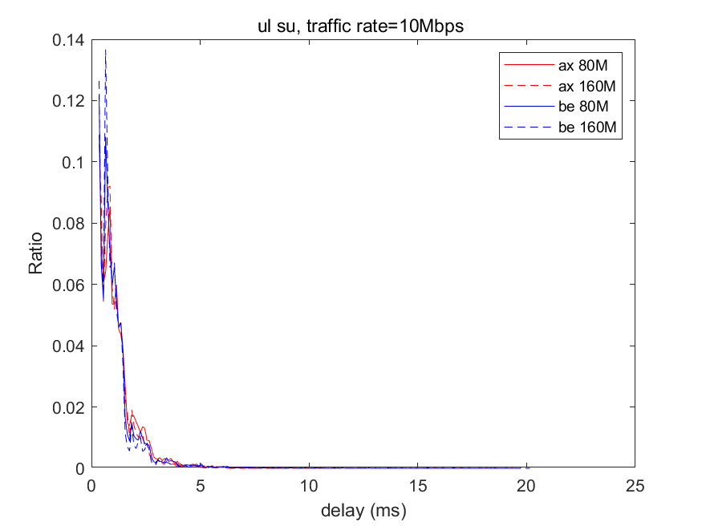
Delay performance comparison under UL SU-MIMO
The average delay for 11be using 80MHz achieves 11% gain compared with 11ax using 80MHz.
The average delay for 11be using 160MHz achieves 12% gain compared with 11ax using 160MHz.
The timeout rate remains less than 1% when the traffic rate increases from 1 to 10 Mbps.
Average delay
Jitter when traffic rate equals 10 Mbps
 | Timeout rate/%
Traffic rate/Mbps | ax 80MHz | be 80MHz | ax 160MHz | be 160MHz
1~8 | 0 | 0 | 0 | 0
9 | 0 | 0 | 0 | 0.027
10 | 0 | 0.018 | 0 | 0.006
The jitter is not clearly improved in this case, because the AP MLD in 11be simulation is associated with 4 non-AP MLDs, while the AP in 11ax simulation is associated with only 2 STAs.

Slide 14
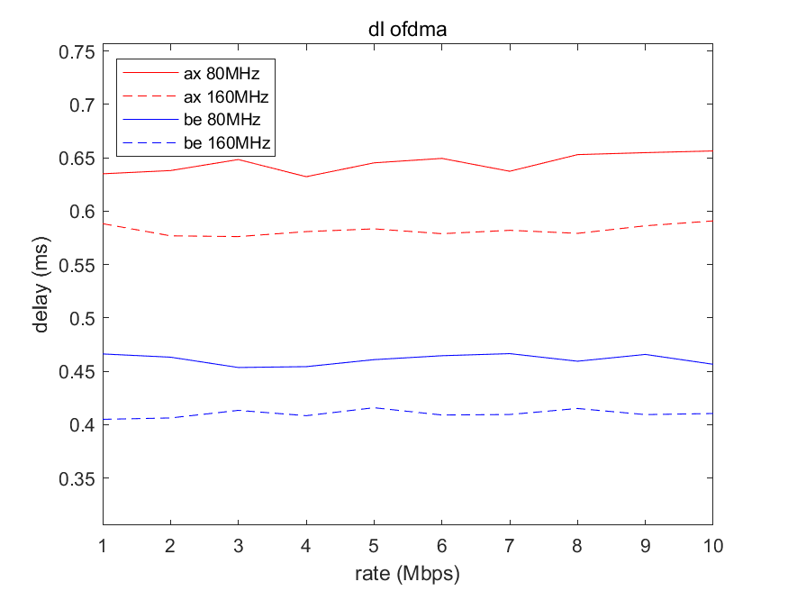
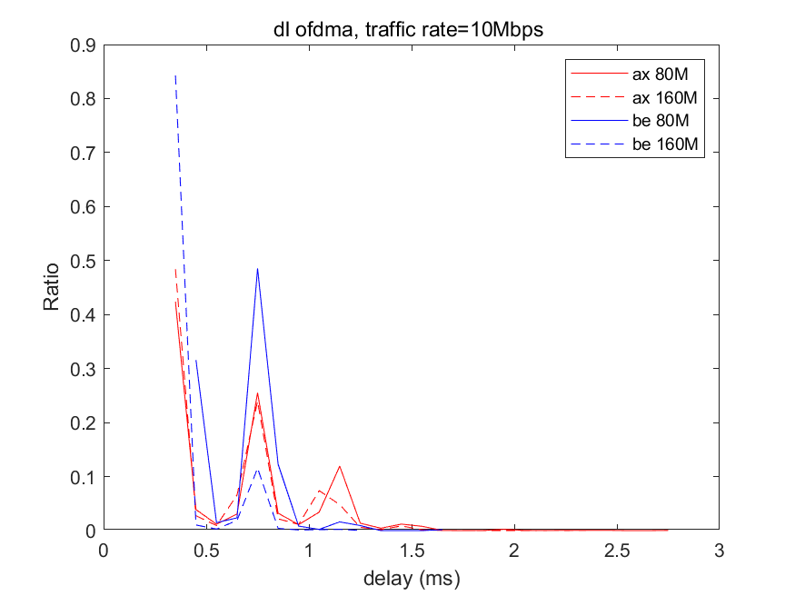
Delay performance comparison under DL OFDMA
The average delay for 11be using 80MHz achieves 28% gain compared with 11ax using 80MHz.
The average delay for 11be using 160MHz achieves 29% gain compared with 11ax using 160MHz.
Latency and jitter are both improved in 11be simulations.
The timeout rate remains 0 when the traffic rate increases from 1 to 10 Mbps.
Average delay
Jitter when traffic rate equals 10 Mbps
 | Timeout rate/%
Traffic rate/Mbps | ax 80MHz | be 80MHz | ax 160MHz | be 160MHz
1~10 | 0 | 0 | 0 | 0

Slide 15
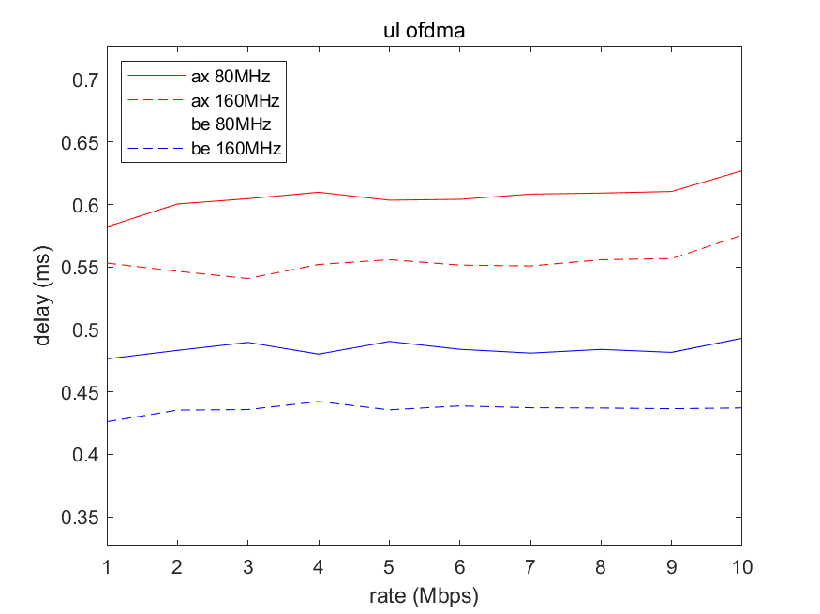
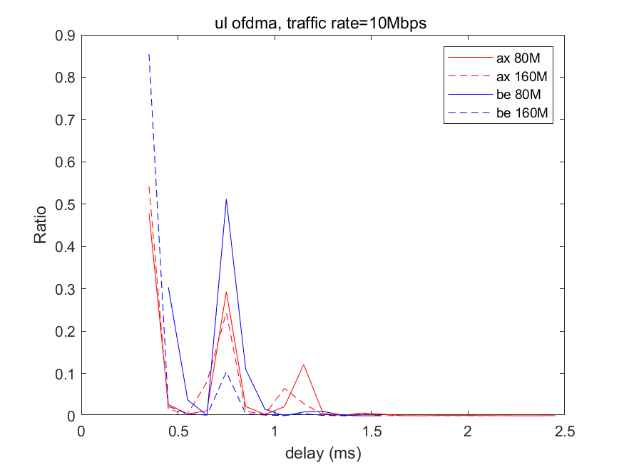
Delay performance comparison under UL OFDMA
The average delay for 11be using 80MHz achieves 20% gain compared with 11ax using 80MHz.
The average delay for 11be using 160MHz achieves 21% gain compared with 11ax using 160MHz.
Latency and jitter are both improved in 11be simulations.
The timeout rate remains 0 when the traffic rate increases from 1 to 10 Mbps.
Average delay
Jitter when traffic rate equals 10 Mbps
 | Timeout rate/%
Traffic rate/Mbps | ax 80MHz | be 80MHz | ax 160MHz | be 160MHz
1~10 | 0 | 0 | 0 | 0

Slide 16
Summary
The contribution provides simulation results to show how much delay improvement can be achieved by applying multi-link operation.
In Case 1, simulations on 11ax and 11be use the same bandwidth resource and the same number of STAs (non-AP MLDs in 11be), showing that the delay of 11be is reduced around 32% compared to the delay of 11ax.
In Case 2, the bandwidth resource used in simulations of 11be is twice the bandwidth used in simulations of 11ax, hence the number of STAs in 11ax simulations is reduced to half of the number of non-AP MLDs in 11be simulations, to compensate for the difference in bandwidth resources. In this case, the delay of 11be is reduced around 19% compared to the delay of 11ax.

Slide 17
References
11-18-1231-06-802.11 EHT Proposed PAR
11-21-1900-02-00be-cr-for-par-throughput-verification.pptx
11-14-0980-16-00ax-simulation-scenarios.docx

