Slide 1
Use Cases of Data Center Infrastructure Management
August 2022
Date: 2022-08-16
Authors:
Name | Affiliation | Address | Phone | Email
Harry Wang | Tencent | Tencent Binhai Towers, No.33 Haitian 2nd Road, Shenzhen, China |  | harryhwang@tencent.com
Terry Yan |  |  |  | terryxyan@tencent.com

Slide 2
Outline
August 2022
Data center infrastructure management (DCIM) overview
DCIM goes wireless and intelligent
DCIM network architecture
DCIM use cases
  Asset management;
  Facility monitoring;
  Data collection and visualization;
  Facility automation;
  Operation with AR devices;
Summary

Slide 3
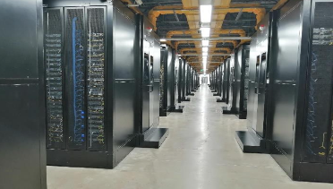
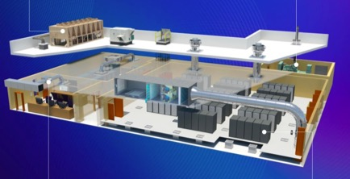
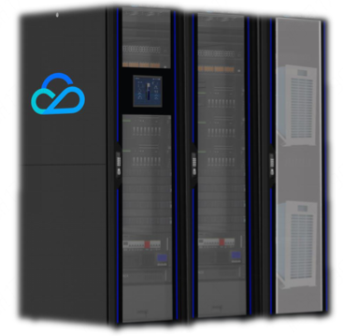
Data Centers are Unique
Data centers are unique from all other building types, that need to be managed intelligently and comprehensively.

Slide 4
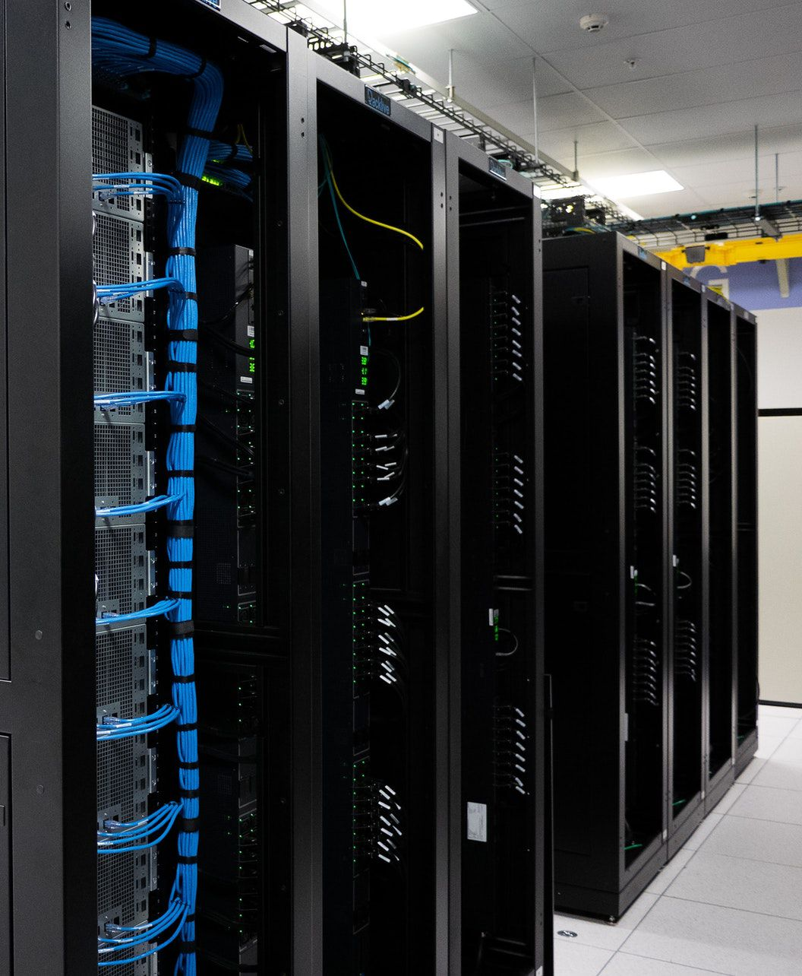
DCIM Overview (1)
August 2022
Data center is the bedrock of modern ICT infrastructure, running software and processing data. The management network is essential to improve the reliability and efficiency, thus guarantees its safe and reliable operating conditions.
Data center infra management
Environmental monitoring
Capture data on temperature, pressure, humidity and air flow etc, and highlight potential inefficiencies;
Facility monitoring
Provide visibility into the entire power chain from the generator down to a specific outlet on an intelligent cabinet power unit, and diagnose potential facility problems;
Asset management
Maintain a centralized database that houses all of the IT and facility asset information including where the asset is located and how it is connected to other assets

Slide 5
DCIM Overview (2)
Data analysis
AI engine
metric
status
warning
report
location
environment
Monitoring platform
Network

Slide 6
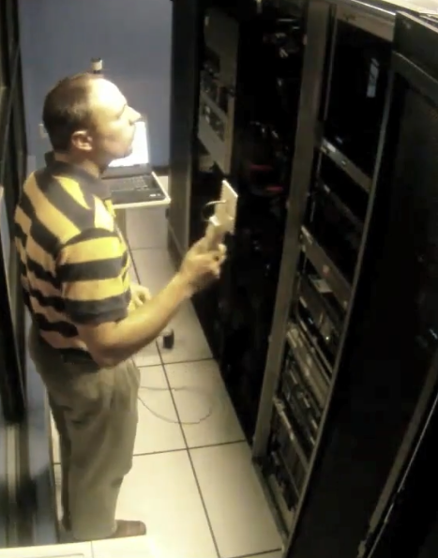
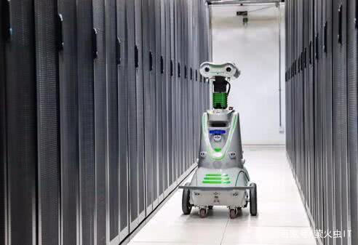
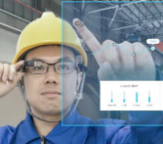
DCIM goes Wireless and Intelligent
Assets
Events
People
Cost
Information
Automation
Safety & Security
Efficiency
Full lifecycle management for assets and devices
Intelligent and agile action to handle alerts and incidents
Detection, tracking, recognition to ensure physical safety
Balance cost and capacity

Slide 7
DCIM Networks Architecture
Local Management
Servers
Core SW
Core SW
Central Management
Servers
Aggregate SW
Central Management
Access SW
Aggregate SW
Network of data center management is multi-layered heterogenous where data is generated with diverse format.
Data security and integrity is the major concern for wireless access deployment.
Collector
Access SW

Slide 8
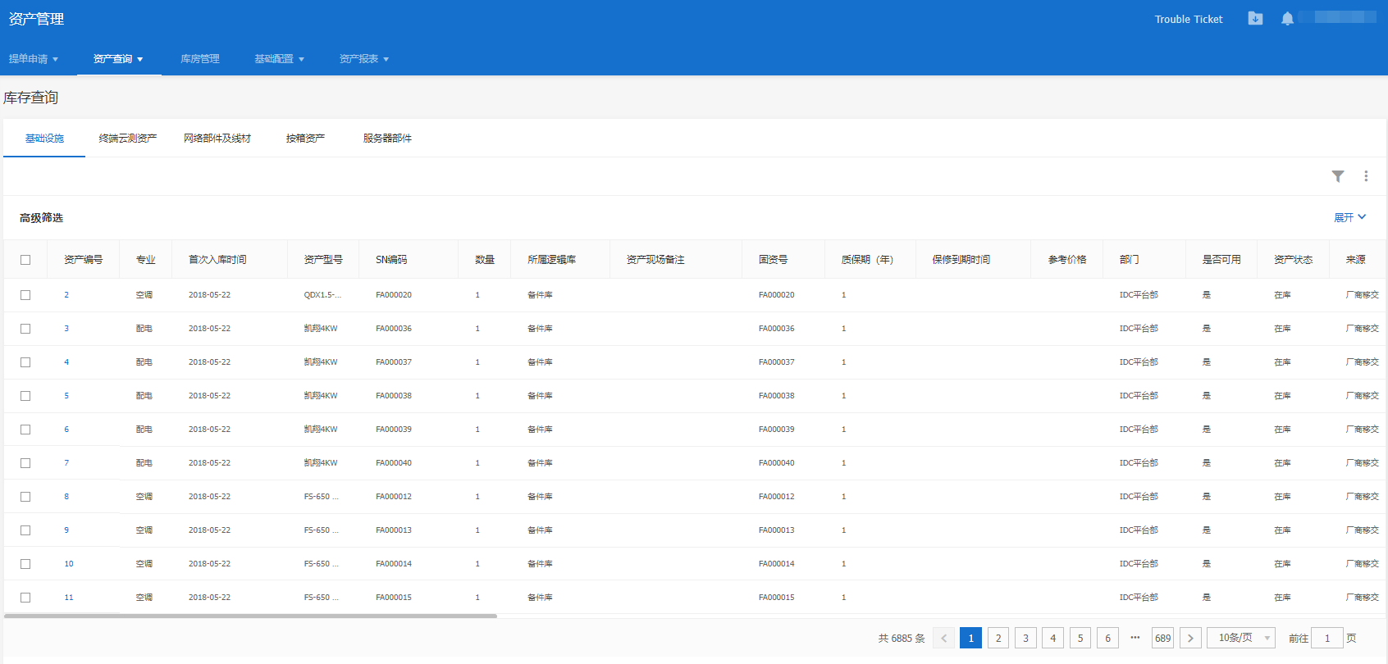
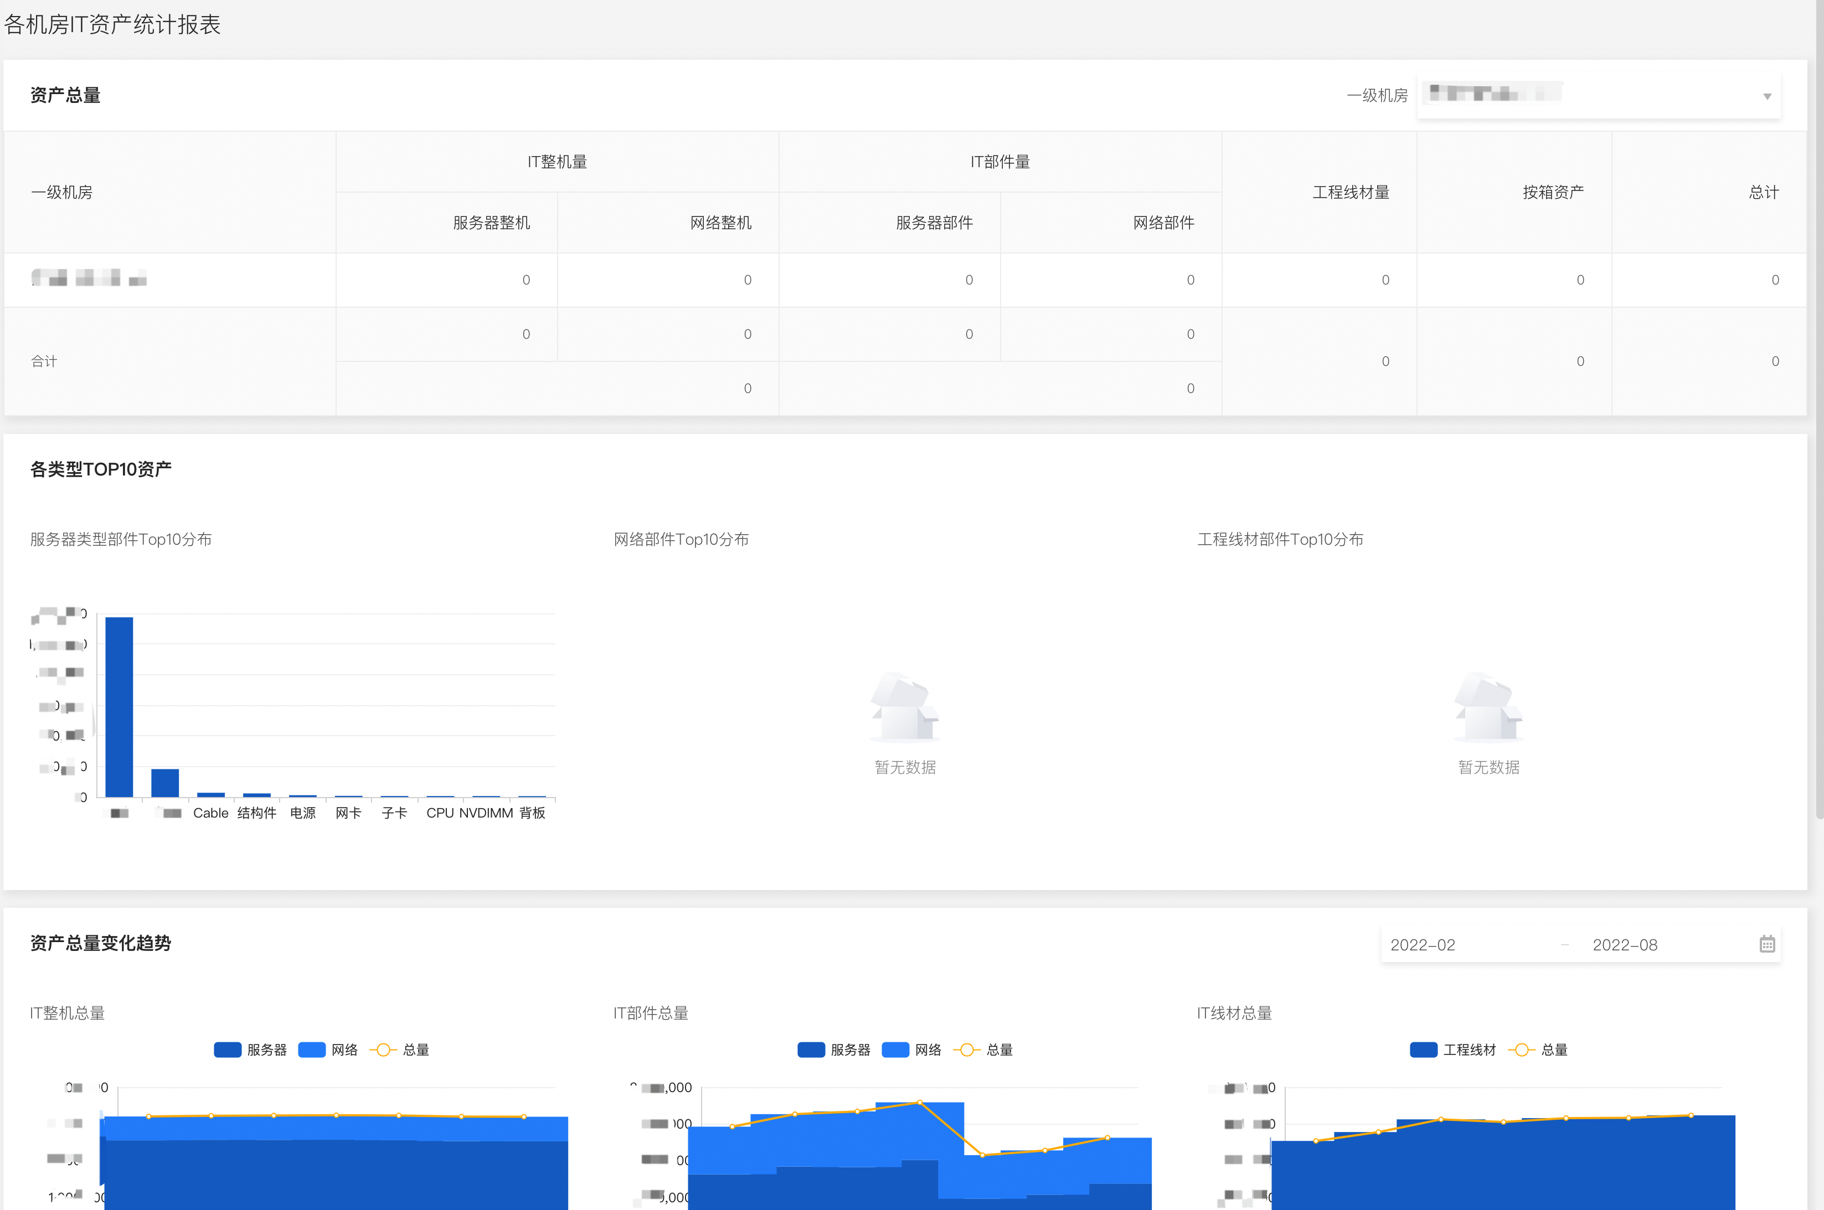
Use Case: Asset Management
Goal：
Keep an up-to-date record of all hardware and software within the data center
Track the real-time visibility and availability of the asset;
Requirements：
Bit rate: 1K-100K bps;
Low power transceiver;
Extreme low power for standby;
Support of localization;
Support of energy harvest or wireless power transfer;
Maintenance free;
Current Issues：
High cost and low efficiency for manually scanning the SN barcode;
Difficult to trace or locate assets;

Slide 9
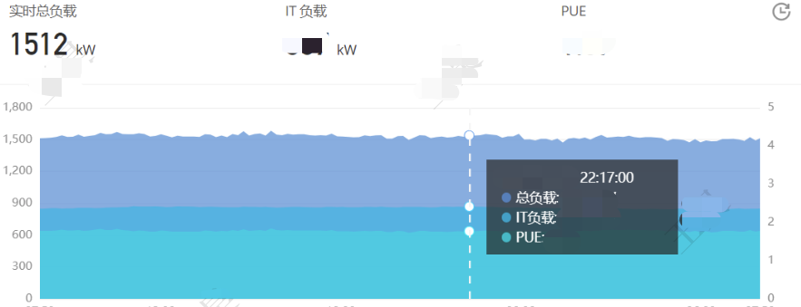
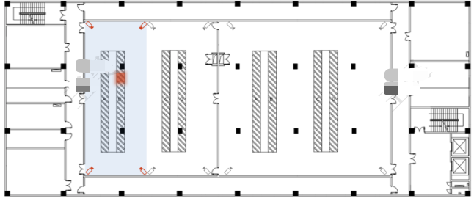
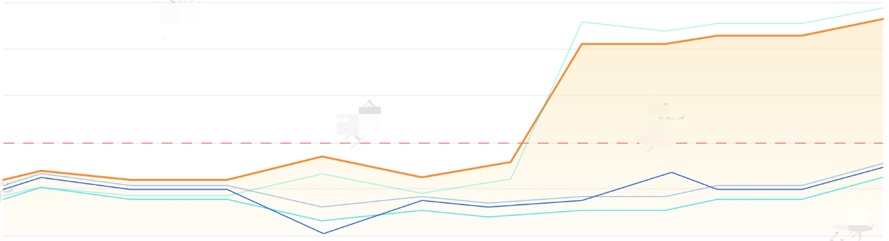
Use Case: Facility Monitoring
Goal：
Monitor the real-time operation, data and events of the DC facility, e.g power consumption, water supply, AC etc.;
Response to alerts and events, and issue tickets;
Requirements：
Bit rate: 100K-1M bps;
High security;
High reliability, connection failure ratio lower than 0.05%;
Support of QoS and differentiate alerts from regular data;
Current Issues：
Difficult (cable) deployment and installment;
High cost and long install period;

Slide 10
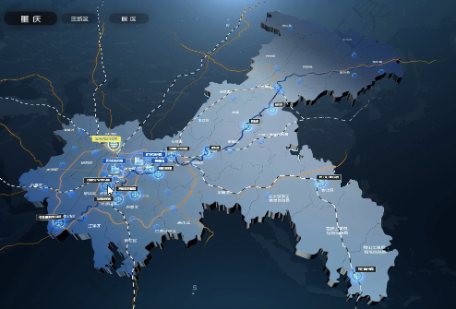
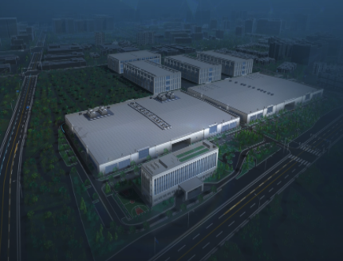
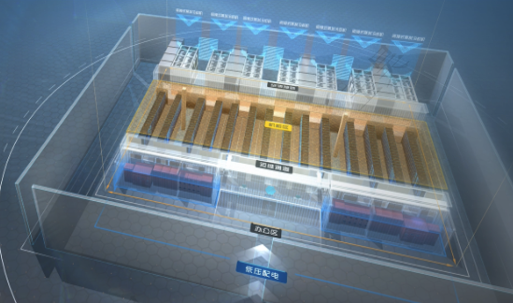
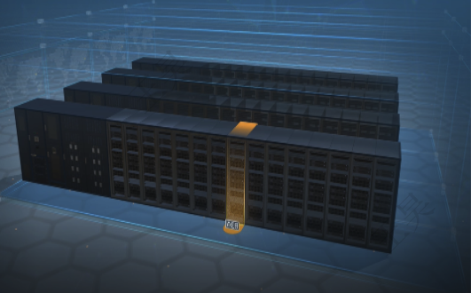
Use Case: Environmental Data Collection & Visualization
City View
Campus View
Goal：
Collect and visualize data from various sensors, e.g temperature, humidity, air condition, etc.;
Requirements：
Bit rate: 1K-100K bps;
High security;
High reliability, connection failure ratio lower than 0.1%;
Support of wireless power transfer or energy harvest;
Easy installment and connection;
Current Issues：
Difficult (cable) deployment and installment;
High cost and long install period;
Restrict to fixed locations;
Cabinet View
Rack View

Slide 11
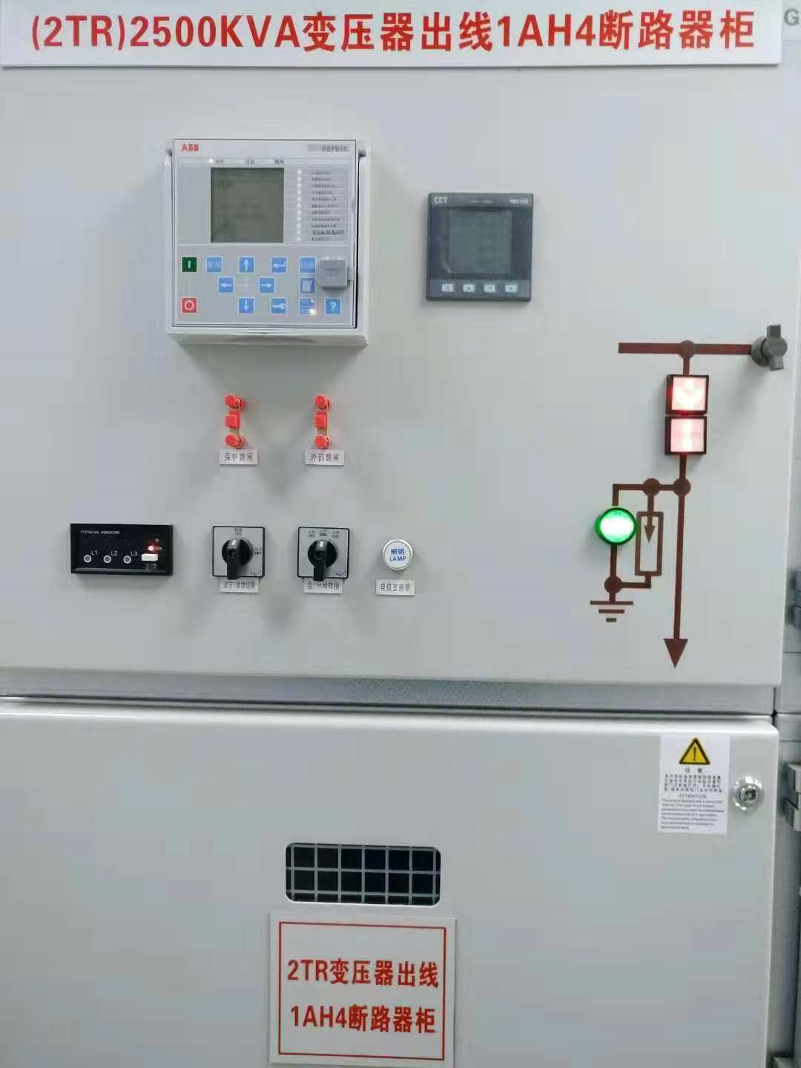
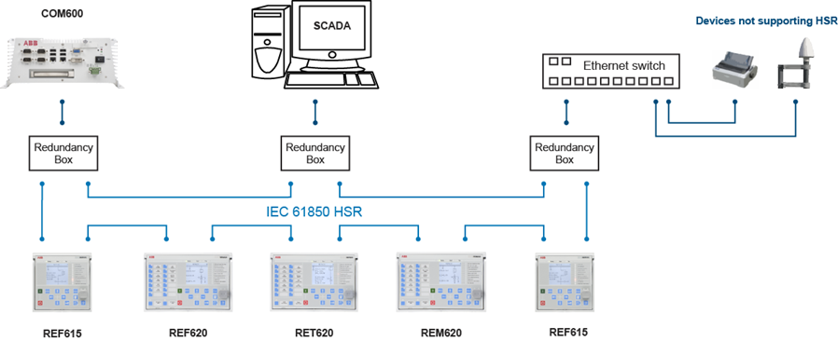
Use Case: Facility Automation
Goal：
The operation and maintenance tasks, workflows and processes are managed and executed automatically, without human intervention;
Requirements：
Bit rate: 100K-1M bps;
High security;
Extra high reliability, connection failure ratio lower than 0.005%;
Backup connection is preferred;
Current Issues：
Difficult (cable) deployment and installment;
High cost and long install period;

Slide 12
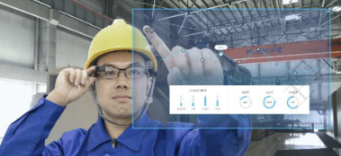
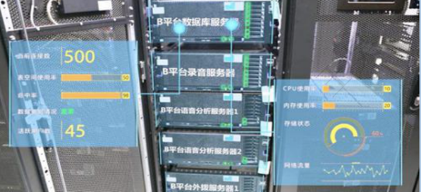
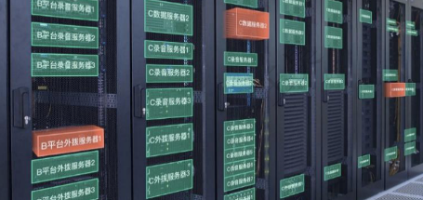
Use Case: Operation with AR Devices
Goal：
Real-time use of information in text, graphics, video, audio and other virtual enhancements integrated with real-world objects to enhance human interaction with DC environment;
Requirements：
Bit rate: 2M-10M bps;
Real-time streaming;
Low latency;
Support of localization;
High QoS;
Current Issues：
High cost of network and devices;

Slide 13
Summary
AMP IoT devices can be used to,
  Monitor data center facility, and real-time conditions, upgrading current wired-connected, and battery/cable powered sensors;
  Manage IT assets;
  Provide low cost localization;
General requirements for AMP IoT devices in DCIM
  Maintenance-free for power supply;
  Support of hundreds to thousands connections with high security;
  Coverage up to 200m;
  Bit rate up to 10M bps;
  Easy installment and less human administration;

