Slide 1
BPE Beaconing and discovery requirements
Date: 2022-08-09
Authors:

Slide 2
Abstract
This submission introduces encrypted PE Beacon and describes BPE BSS discovery operations.
The V1 clarifies one CPE requirement (slide 13) and lists the requirements in 802.11bi format.
This submission is related to proposed requirement:
11bi shall define a new type of encrypted Beacon frame and define a mechanism for the BPE AP to transmit the new type of encrypted Beacon frame.

Slide 3
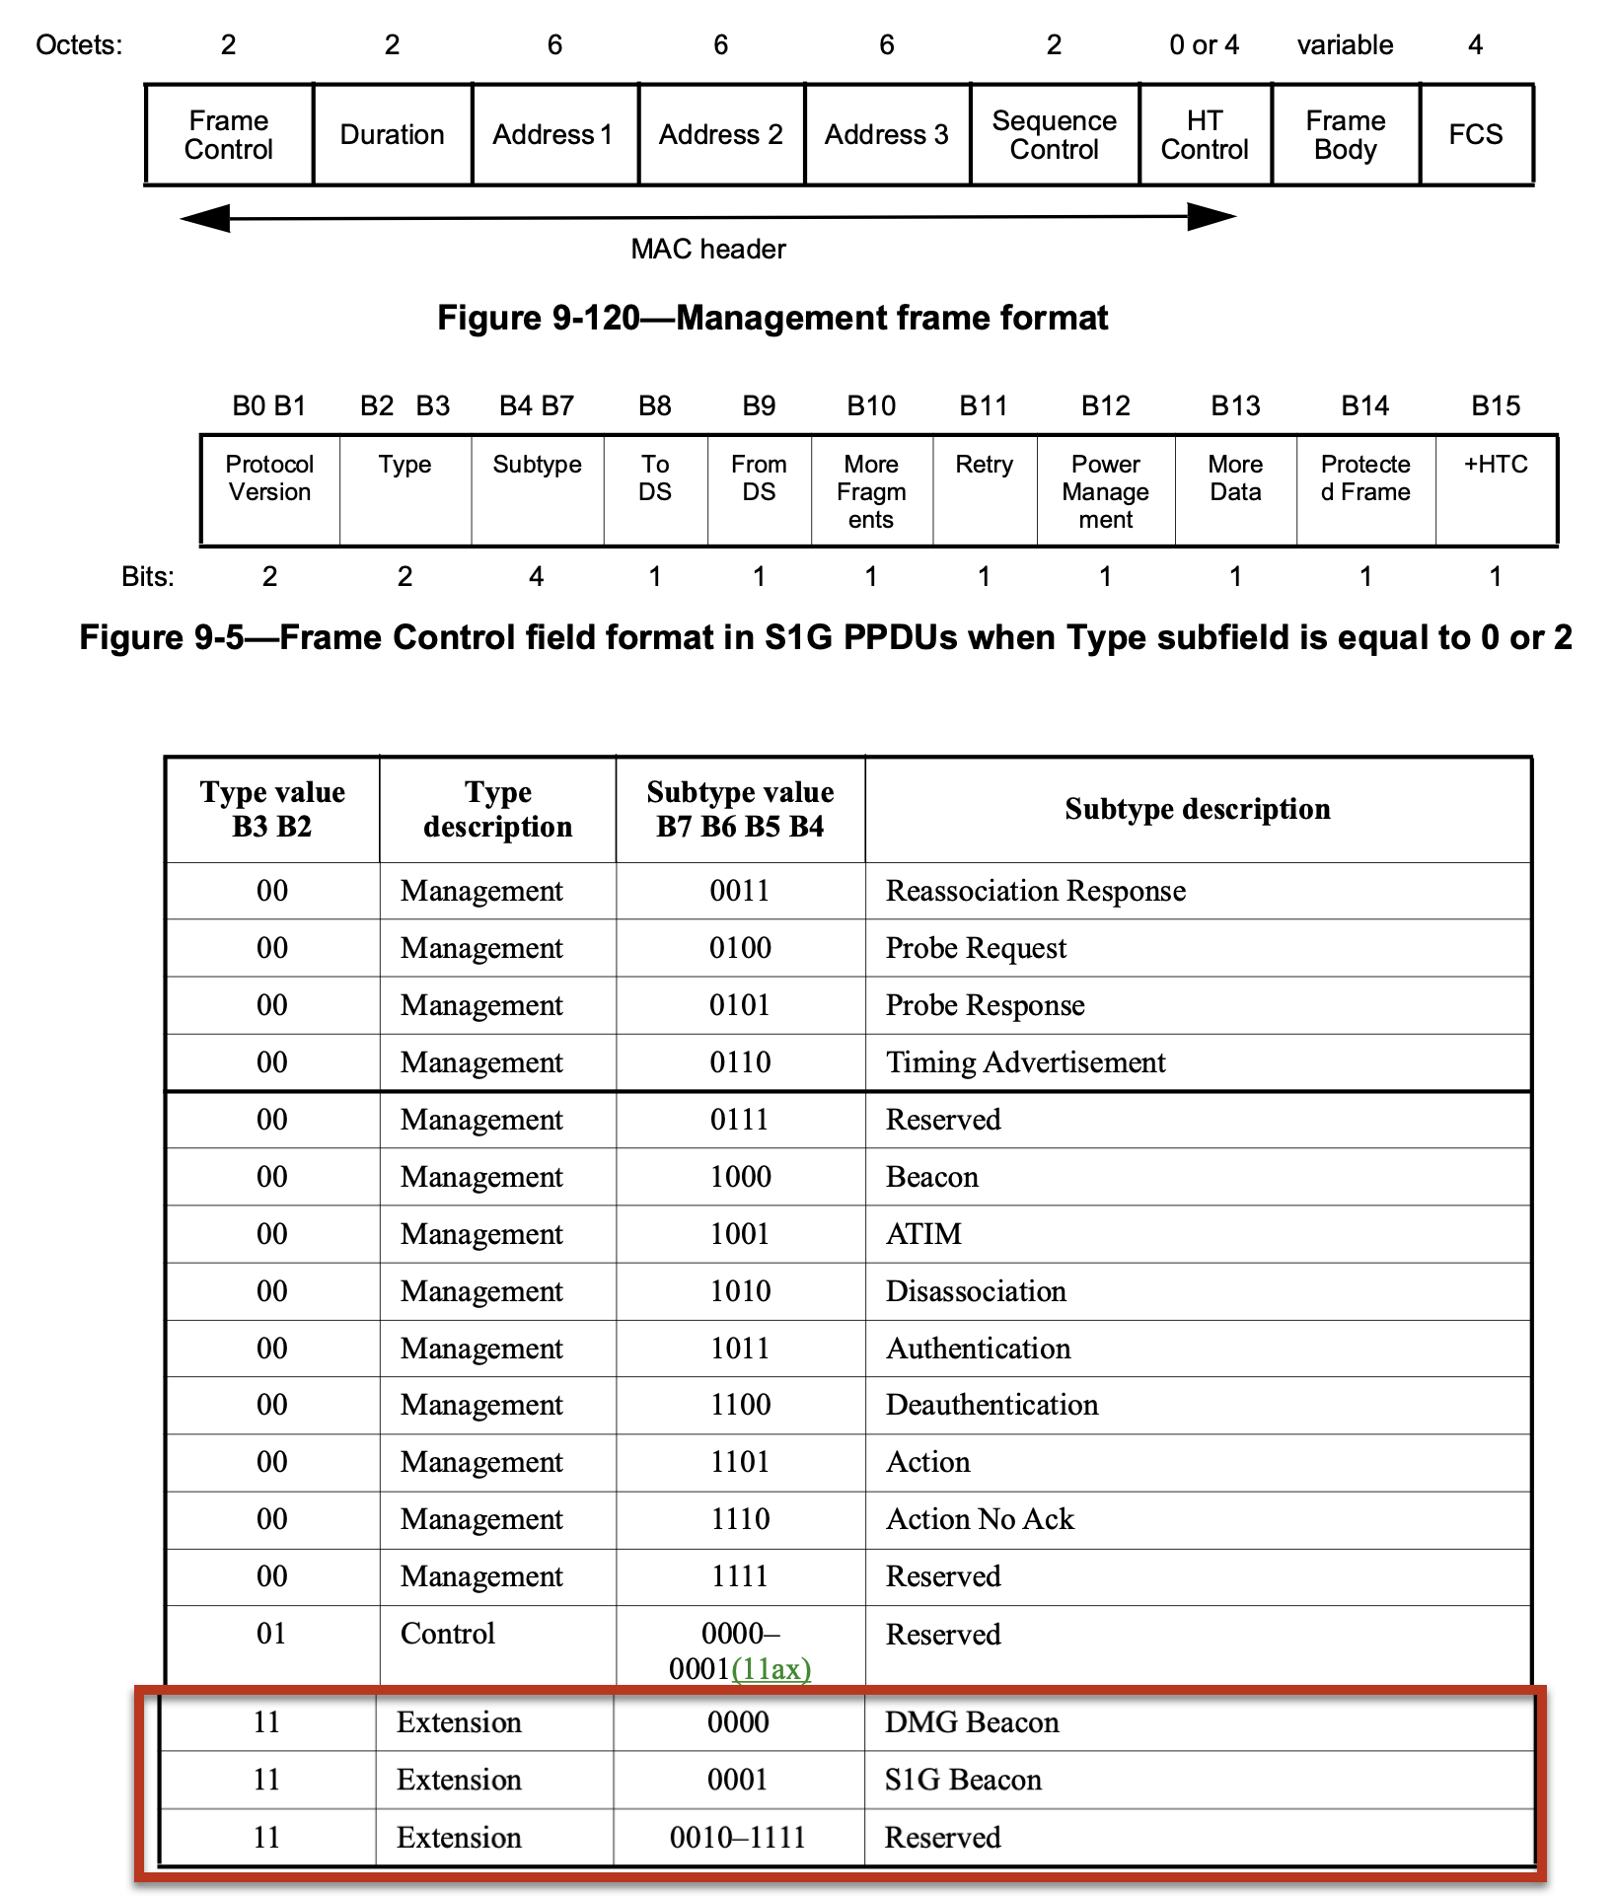
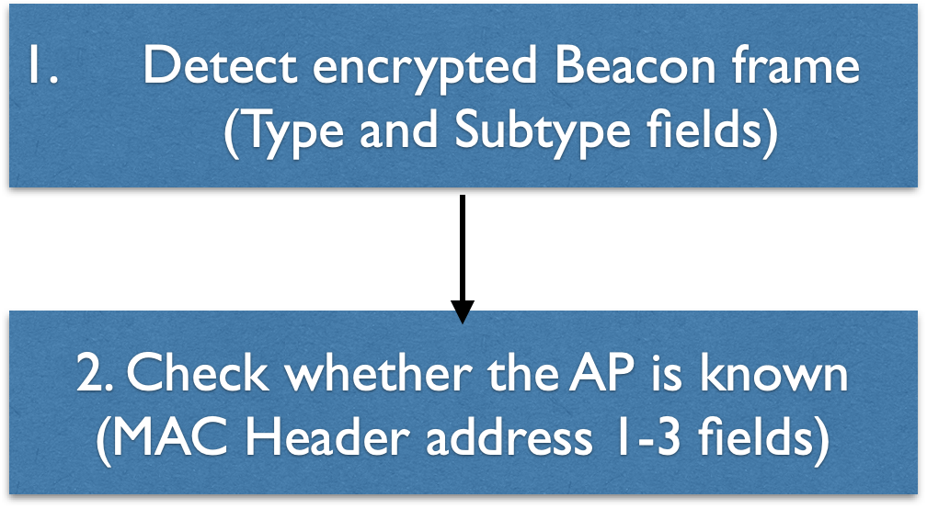
PE Beacon frame type detection
The PE Beacon frame is a new frame
  Extension Type (11) and Sybtype value 0010 is proposed for the PE Beacon
  Only BPE STAs will receive the PE Beacon frame

Slide 4
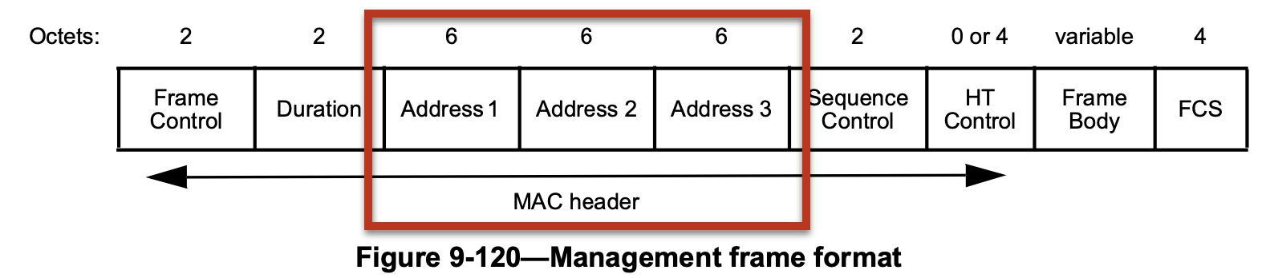
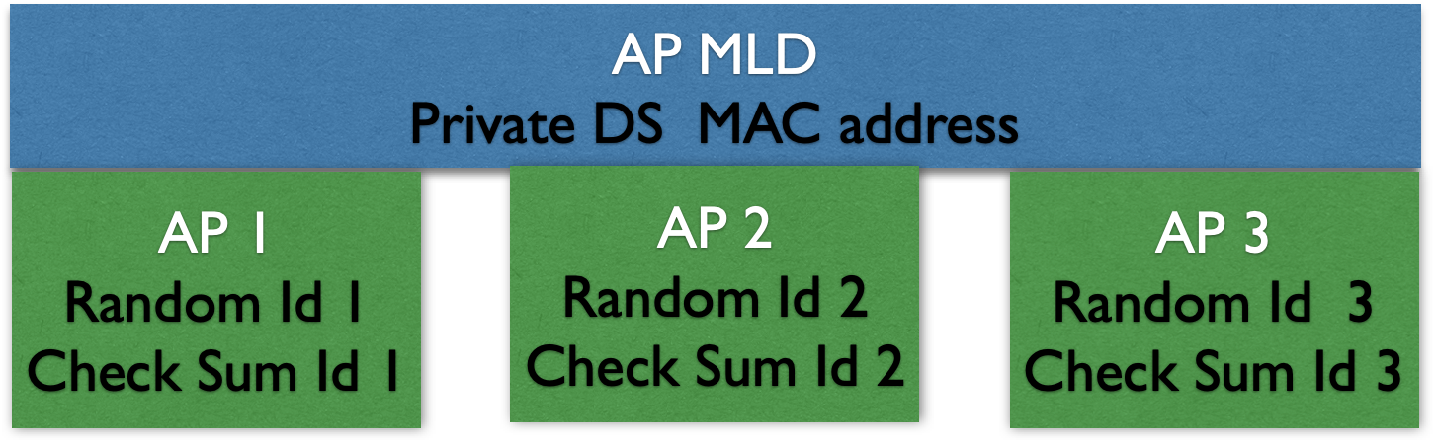
AP identifier
Proposed requirement:
  11bi shall define a new type of Beacon frame that includes a random identifier and a checksum identifier which may be used to identify the AP
Each AP has different Random Id and Check Sum Id value
  The Ids should be long and contain random value to prevent Id cracking
A1 | A2 (first 2 octets) | A2 (middle 2 octets) | A2 (last 2 octets) | A3
Random Id |  | Reserved | Check Sum Id

Slide 5
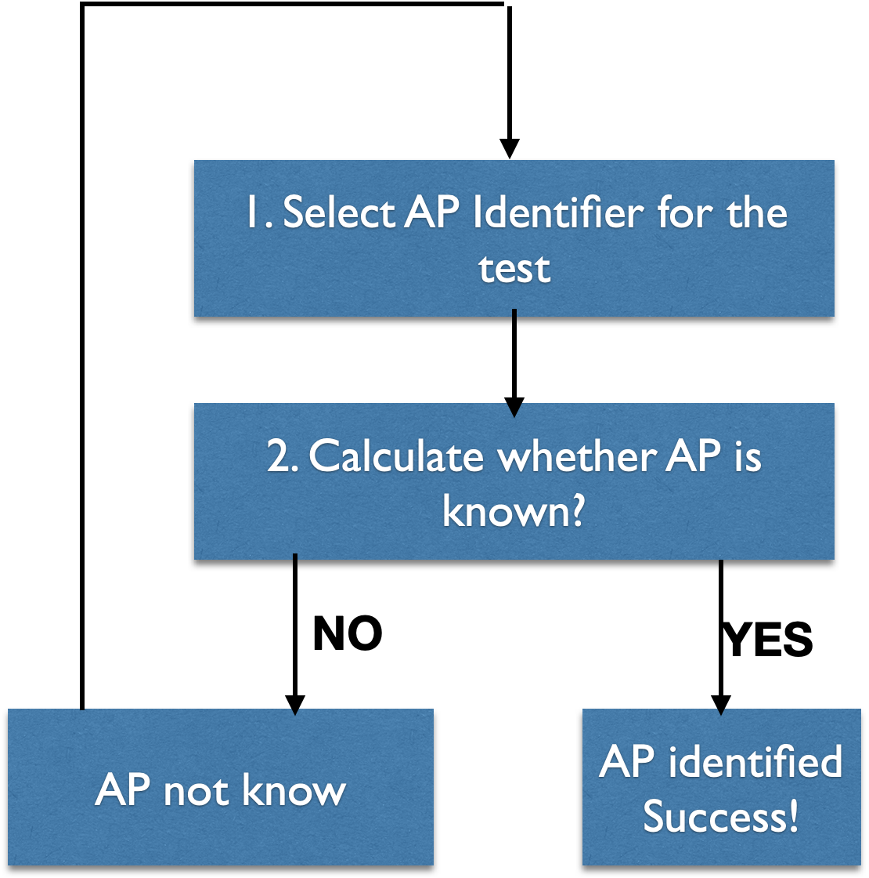
BPE AP identification
If the Check Sum Id and Random Id match on the following formula, then the STA knows the AP
  A STA may go through the known AP identifiers until it has verified whether it knows the AP
A STA may associate with known AP
Checksum ID = Truncate-64(HMAC-SHA-256(“Address resolution” , AP Identity, Random ID))
, where:
- AP Identity is 128 bit identifier of the tested AP MLD,
- Checksum ID = 64 bits Checksum Id
- Random ID = 64 bits Random Id

Slide 6
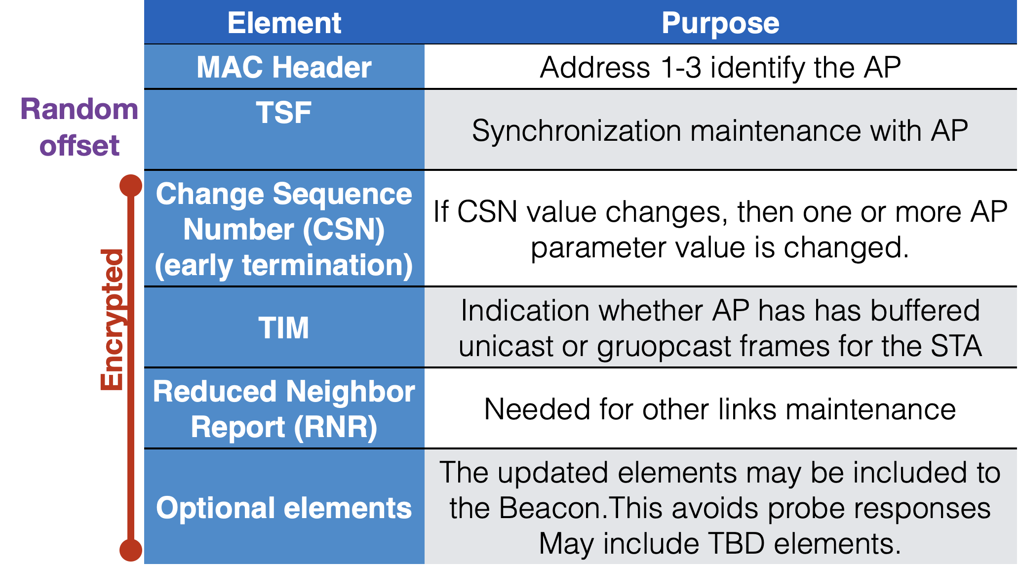
BPE Beacon
PE Beacon contains minimum information to maintain associations
  AP capabilities discovery is done by active scanning, or they are learned in association
  All AP parameters are transmitted in protected MGMT frames
  (PASN in pre-association)

Slide 7
TSF field handling
TSF has approved requirement:
  11bi shall define a mechanism for a BPE AP to change the OTA TSF (e.g., the TSF that is transmitted in the beacon) by a random value.
TSF field is 8 octets in length and contains a timestamp in units of µs
The TSF field value changes in real time
  Beacon transmitter may not be able to encrypt the whole PE Beacon at the transmission time
  TSF is typically created by hardware. The TSF handling should be updated to obfuscate the TSF field just before the Beacon transmission

Slide 8
BPE AP Beacon transmission time obfuscation
Proposed requirement:
  11be requires that PBE AP shall change its Beacon transmission interval when the AP identification information changes in the Beacon.
  Note, a BPE TBTT may occur at any OTA TSF value.
Legacy APs transmit beacons every 100 TUs
  The beacon transmission times are very deterministic
  It is easy to track the AP by checking the Beacon transmission times

Slide 9
TBTT not depending on OTA TSF
The internal (non-OTA) TSF schedules TWT SPs and low latency traffic transmission that use SCS + QoS Characteristics signaling
  A change of the internal/true TSF may seriously impact these mechanisms
The randomization of the OTA TSF field in the PE Beacon may be complicated, if a PE Beacon is transmitted only when OTA TSF mod(beacon interval) = 0
  Allowing transmission on any OTA TSF time simplifies the randomization
The PE Beacon transmission interval randomization should avoid too frequent and infrequent Beacon transmissions
  For instance, randomization of +-20% of the Beacon transmission interval maintains good efficiency and delay performance

Slide 10
PBE AP discovery
Proposed requirement:
  11bi shall define a mechanism for the BPE Client to send a broadcast non-encrypted request frame to solicit encrypted Beacons from the BPE APs in the channel.
The PBE AP is discoverable through its encrypted Beacons
  To reduce scanning time, the STA should be able to solicit encrypted Beacons from APs in proximity
  This mechanism is similar to the broadcast Probe Req/resp

Slide 11
Solicited Beacons from BPE AP
BPE STA
Broadcast Query Request
BPE AP
PE Beacon
A BPE STA may send unencrypted Broadcast Query Request frame to solicit encrypted Beacons from BPE APs
  The BPE AP may respond with PE Beacon

Slide 12
CPE/BPE AP discovery
Proposed Requirement:
  11bi shall define a mechanism for a 11bi non-AP MLD to request capabilities and operation parameters of APs affiliated with the associated 11bi AP MLD using a protected request/response action frame.
Currently ML probe request and response are used for this query
  These frames are not encrypted, but they may contain privacy sensitive information
  The Type and SubType fields of the frames reveal the type of the fame. Robust action frame may be also other type of the frame
  The new frames may be transmitted in post association or in PASN protection

Slide 13
PASN and infrastructure encryption on a CPE STA
Currently proposed requirement 28:
  “11bi shall define a mechanism for CPE APs and CPE Clients to use separate MAC addresses for ongoing sensing measurements versus data transmissions. (TGbf sensing, TGaz location determination)”
The current requirement is considered too broad
  The requirement is limited to enable a CPE STA PASN keys use and association with the AP
  Modified requirement: ”11bi shall define a mechanism for CPE Clients to use separate MAC addresses for ongoing PASN protected sensing measurements versus data transmissions with the same AP. (TGbf sensing, TGaz location determination)”

Slide 14
Summary of the modified and proposed requirements
Requirement number | Requirement Text | Issue | Status | Type
28 (updated) | 11bi shall define a mechanism for CPE Clients to use separate MAC addresses for ongoing PASN protected sensing measurements versus data transmissions with the same AP. (TGbf sensing, TGaz location determination | I2, I8 | proposed | CPE
NEW | 11bi shall define a new type of encrypted Beacon frame and define a mechanism for the BPE AP to transmit the new type of encrypted Beacon frame. | I6 | proposed | BPE
NEW | 11bi shall define a new type of Beacon frame that includes a random identifier and a checksum identifier which may be used to identify the AP | I6 | proposed | BPE
NEW | 11be requires that PBE AP shall change its Beacon transmission interval when the AP identification information changes in the Beacon. Note, a BPE TBTT may occur at any OTA TSF value. | I6 | proposed | BPE
NEW | 11bi shall define a mechanism for the BPE Client to send a broadcast non-encrypted request frame to solicit encrypted Beacons from the BPE APs in the channel. | I2, I6 | proposed | BPE
NEW | 11bi shall define a mechanism for a 11bi non-AP MLD to request capabilities and operation parameters of APs affiliated with the associated 11bi AP MLD using a protected request/response action frame. | I2, I6, I7 | proposed | BPE

