Slide 1
Wireless Power Transmission and Energy Harvesting for IoT Applications
August 2022
Doc.: IEEE 802.11-22/1294r0
Date: 2022-08-16
Authors:
Name | Affiliation | Address | Phone | Email
Boyce Bo Yang | Huawei | Nanjing, China |  | yangbo59@huawei.com
Chenhe Ji |  |  |  | jichenhe@huawei.com

Slide 2
Abstract
August 2022
Doc.: IEEE 802.11-22/1294r0
We discuss two challenges in ambient energy harvesting
Challenge 1: Ambient power is unstable
Challenge 2: The energy that can be harvested from RF is low
The reasonable scenarios considering those challenges are also discussed.

Slide 3
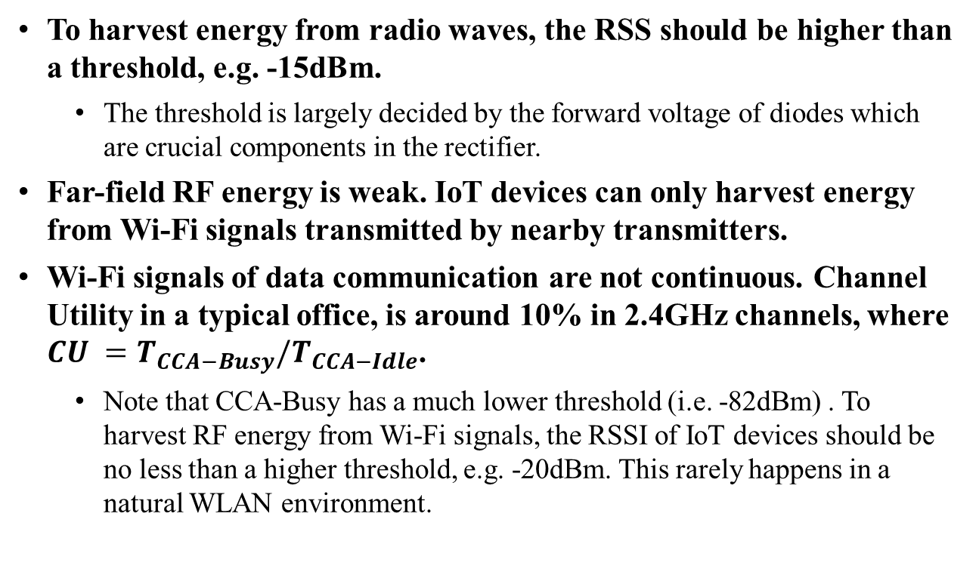
Challenge 1: Ambient power is unstable
August 2022
Doc.: IEEE 802.11-22/1294r0
  To harvest energy from radio waves, the RSS should be higher than a threshold, e.g. -15dBm.
    The threshold is largely decided by the forward voltage of diodes which are crucial components in the rectifier.
  Far-field RF energy is weak. IoT devices can only harvest energy from Wi-Fi signals transmitted by nearby transmitters.
  Wi-Fi signals of data communication are not continuous. Channel Utility in a typical office, is around 10% in 2.4GHz channels, where $CU =T_{CCA−Busy}/T_{CCA−Idle}$.
    Note that CCA-Busy has a much lower threshold (i.e. -82dBm) . To harvest RF energy from Wi-Fi signals, the RSSI of IoT devices should be no less than a higher threshold, e.g. -20dBm. This rarely happens in a natural WLAN environment.

Slide 4
A dedicated power signal is needed
August 2022
Doc.: IEEE 802.11-22/1294r0
  A dedicated energy source can improve energy harvesting efficiency greatly and make energy harvesting IoT devices more practical.
  A continuous wave or specified narrow band signal can be used for energy transfer.
  Note that there is no interference problem between different power signals.
  A communication protocol might be needed for wireless power transmission to certify the IoT devices and to enable on-demand power transfer.

Slide 5
Challenge 2: The energy that can be harvested from RF is low
August 2022
Doc.: IEEE 802.11-22/1294r0
  The power density of RF power transfer is 0.4 to 60 microwatts at typical working distances(3 ~ 15 meters)， assuming 30dBm tx power, 6dBi antenna gain and 20% RF-DC efficiency.
    Note that EIRP limit with antenna gain is only 27dBm at 2.4GHz band in China.
  The small amount of harvested energy limits the usage of ambient power only IoT devices.
307.4µW @ 3m
44.2µW
110.7µW @ 5m
15.9µW
27.66µW @ 10m
12.3µW @ 15m
6.9µW @ 20m
4µW
1.8µW
1µW
pathloss=-27.6+20*log10(f)+20*log10(d), f in MHz, d in meters
Notes:
Isotropic antenna

Slide 6
The IoT device with power storage is preferable
August 2022
Doc.: IEEE 802.11-22/1294r0
  IoT devices with capacitors as power storage are more suitable for energy harvesting, because IoT devices are not always in active mode. For most of time, IoT devices are in sleep mode.
  Typical IoT Sensors, such as temperature sensors, humidity sensors, light sensors etcetera, turn to active mode around every 30 seconds and turn back to doze mode several milliseconds later.
  A example:
    The power management unit of IoT devices can harvest energy at a slower rate, e.g. 10µW level during the long periods of doze state.
    The sensing and communication units can use the stored power at a much higher rate e.g. 10mW during the short period of active state.
    The IoT device can harvest energy for 10 seconds and work for 10ms (sensing and transmitting)
    The wireless power transmission distance would be greatly improved (10µW or -20dBm level in this example)

Slide 7
Possible IoT Applications for Energy Harvesting
August 2022
Doc.: IEEE 802.11-22/1294r0
Components of IoT devices |  | Average power | Peak power | Sleep power | Comments
Sensors | Door sensor [1] | 1µW | 5mW | 0.1µW | 5 events /second, 40us each
 | Humidity sensors [2] | 1µW | 1mW | 0.1µW | 1 event /second , 1ms each
 | Accelerometer [3] | 2µW | 2µW | 0.1µW | average power when output data rate is 100Hz
 | Temperature sensors [4] | 2µW | 400 µW | 0.2µW | 1 event/second, 5ms each
 | Light sensor [5] | 10µW | 10µW | 1µW | average power at full scale lux
 | Proximity sensor [6] | 10µW | 200µW | 10µW | capacitive sensor
 | Pressure sensor [7] | 20µW | 1mW+ | 2µW | 1measure/ second
MCU | ~ | ~ | 0.6 ~ 9mW | 1µW | varies for different clock frequencies
Wireless Radios | BLE [8] | 77mW * duty cycle | 77mW | 10µW | 2.4GHz@8dBm
 | Wi-Fi [9] | 429mW* duty cycle | 429mW | 40µW | 2.4GHz@8dBm
For IoT applications, the Wi-Fi protocol is too complex and the power consumption is high. A simple and low power Wi-Fi radio, e.g. a radio with narrower bandwidth, simplified coding and modulation schemes, simplified MAC/PHY format and less mandatory functions, is needed.
Notes:
Even the duty cycle is 0.1%,(one over a thousand), the average power of wifi component is more than 400 microwatts. Which is much higher than the energy that can be harvested in typical distances.

Slide 8
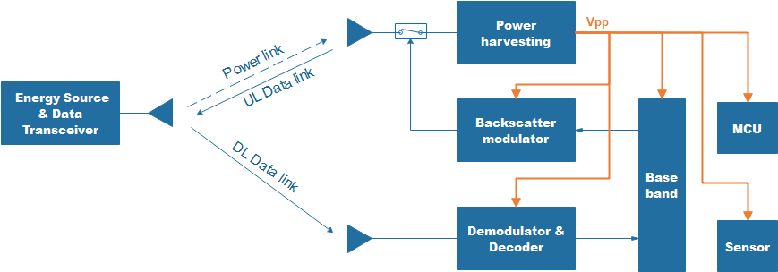
Anatomy of passive IoT devices
Type 1: Without Energy Storage (not recommended)
August 2022
Doc.: IEEE 802.11-22/1294r0
An AP is the Energy Source and Data Transceiver.
1, Receiving signal from the AP.
  The energy carried in power signal energizes the IoT devices and turns it on.
  The data carried in the same downlink signal controls how the uplink data is transmitted by the IoT devices.
2, Backscatter uplink data to the AP
  The energy source/transmitter needs to keep sending a downlink continuous wave when IoT devices are sending uplink data.
3, Sensing
  Sensor can only work when the power signal arrivals.
  Some energy would be wasted because
  Sensors and MCU’s working time is usually much longer than the RF transmitter’s working time.
  Sensors, MCU and transceivers have different power consumption. The power link has to provide the peak power all the time while only MCU is working during most of the active time.
Notes:
Consumes less energy for uplink transmission
Strongly dependence on the arrival of power signal.
DL power link and data link can be two separate links. Or DL power link and data link is a combined link and divided by the IoT devices with a power splitter.

Slide 9
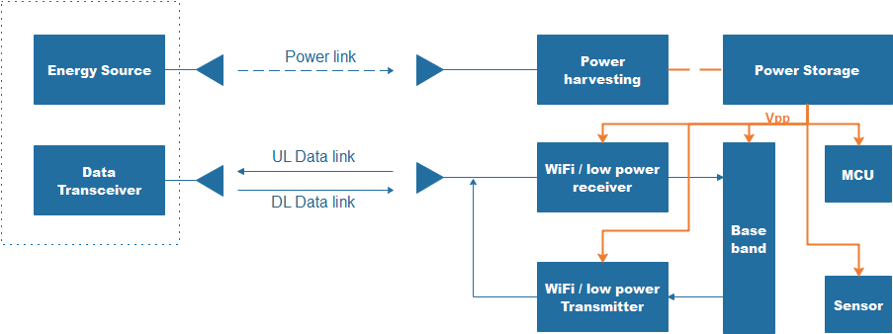
Anatomy of passive IoT devices
Type 2 : With Energy Storage (recommended)
August 2022
Doc.: IEEE 802.11-22/1294r0
1,Wireless charging
  IoT devices have a power storage component. The wireless charging can be done at any time.
  The energy harvesting circuit is simple and analog, so the cost is much lower than an independent radio.
2, Data transmission
  IoT devices can communicate with a normal AP using existing radio with an improved protocol (an protocol with the energy management function) or backscattering the incoming signal with a backscatter modulator.
  Charging and transmission can be on different bands or the same band (e.g. 900MHz/2.4GHz for charging and 2.4G/5GHz/6GHz for transmission)
3, Sensing
  Sensors can work without regard to the arrival of a power signal.
  The transmitter can send an uplink signal without regard to the arrival of a power signal(this is critical for time sensitive traffic).
Notes:
Need to split the incoming power if power link and dl data link are integrated into one link like RFID

Slide 10
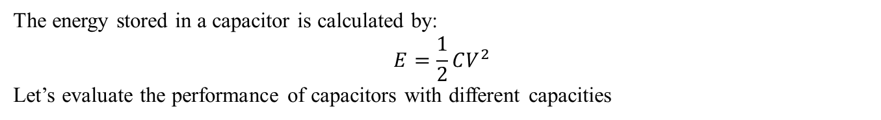
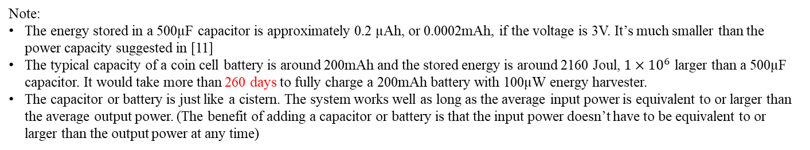
Candidate energy storage component: capacitor
August 2022
Doc.: IEEE 802.11-22/1294r0
The energy stored in a capacitor is calculated by:
$$E=\frac{1}{2}CV^{2}$$
Let’s evaluate the performance of capacitors with different capacities
Note:
The energy stored in a 500µF capacitor is approximately 0.2 µAh, or 0.0002mAh, if the voltage is 3V. It’s much smaller than the power capacity suggested in [11]
The typical capacity of a coin cell battery is around 200mAh and the stored energy is around 2160 Joul, $1×{10}^{6}$ larger than a 500µF capacitor. It would take more than 260 days to fully charge a 200mAh battery with 100µW energy harvester.
The capacitor or battery is just like a cistern. The system works well as long as the average input power is equivalent to or larger than the average output power. (The benefit of adding a capacitor or battery is that the input power doesn’t have to be equivalent to or larger than the output power at any time)

Slide 11
Summary
August 2022
Doc.: IEEE 802.11-22/1294r0
  Two challenges and suggested solutions are discussed and candidate solutions are provided.
  C1: Ambient power is unstable
  The AP provides energy through a dedicated power signal to passive IoT devices. (depends on implementations)
  A wireless charging protocol might be needed as part of Wi-Fi IoT standard. (standard related)
  C2: The energy that can be harvested from RF is low
  IoT devices with power storage can take more time to harvest and store energy, considering to the duty cycle work mode of IoT applications. (depends on implementations)
  A simplified and low power radio should be designed in the next Wi-Fi amendment for IoT devices. (standard related)

Slide 12
Straw Poll 1
August 2022
Doc.: IEEE 802.11-22/1294r0
  Do you agree that the AP should be capable of sending power signals to ambient power enabled IoT devices.
    Y
    N
    A

Slide 13
Straw Poll 2
August 2022
Doc.: IEEE 802.11-22/1294r0
  Do you agree that a simplified and low power radio should be considered in the next WLAN amendment
    Yes, in UHR SG
    Yes, in AMP SG
    Need more study
    Abstain
Notes:
I think it’s more appropriate to discuss simplified and low power radio in UHR, because it’s related to the MAC and PHY features

Slide 14
August 2022
Doc.: IEEE 802.11-22/1294r0
Reference
  Texas Instruments, DRV5032 datasheet
  Texas Instruments, HDC2080 datasheet
  Analog Devices, Inc., ADXL367 datasheet
  Sensirison, STS4x datasheet
  Texas Instruments , OPT3001 datasheet
  Analog Devices, Inc., AD715 datasheet
  ST, ILPS22QS datasheet
  Texas Instruments. MSP430 datasheet
  Silicon Labs, BGM111 datasheet
  Silicon Labs, RS9116 datasheet
  OPPO, 11-22-0962-00-0amp-potential-techniques-to-support-amp-iot-devices-in-wlan

