Slide 1
Sensing Measurement Report format Discussion
Date: 2022-08-02
Authors:
Name | Company | Address | Phone | Email
Rojan Chitrakar | Panasonic Corporation |  |  | rojan.chitrakar@sg.panasonic.com
Rajat Pushkarna

Slide 2
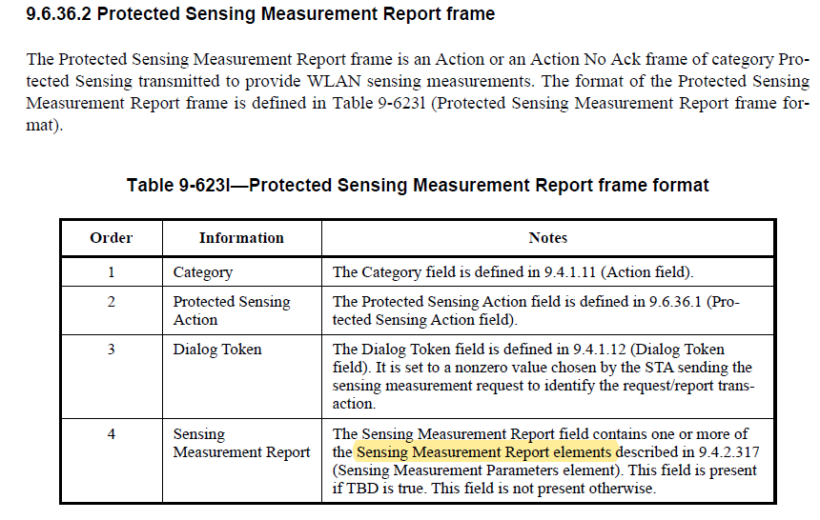
Background - 1
11bf D0.1 uses elements to carry the sensing measurement reports. [2]

Slide 3
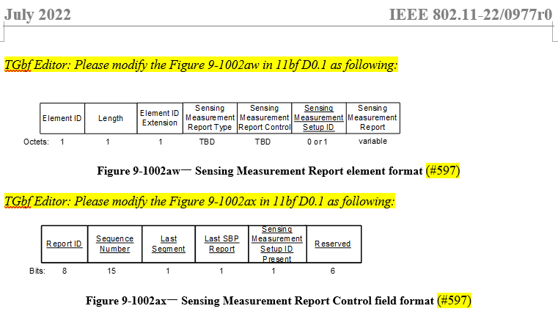
Background - 2
22/977 proposes mechanism to segment a sensing measurement report to be carried in two or more Sensing Measurement Report elements:

Slide 4
Related CC40 CID
CID 294 highlights this issue:
294 | Rojan Chitrakar | No | 9.4.2.318 | 34.01 | Since elements can only carry up to 255 octets, using elements to carry sensing measurement reports will limit the report size to 255 or less. It would be better to use fields instead as is done in HT/VHT/HT/EHT for the beamforming feedback. | Use field(s) to carry to carry the sensing measurement reports instead of element.

Slide 5
The Issue
11bf D0.1 uses elements to carry the sensing measurement reports. As per 22/1020r4 (PDT Formatting of CSI), the smallest Sensing Measurement Report field if the Sensing Measurement Report Type field is 0 is 42 octets, and the largest Sensing Measurement Report field if the Sensing Measurement Report Type field is 0 is 40416 octets.
Taking an example of a Sensing Measurement Report Size of 40096 octets, the number of elements required to carry the report = 162. (See Appendix 1 and 2 for details). This is equivalent to 1134 octets overhead*!
In general, using elements leads to 2.83% to 4.18% overhead (see Appendix 2) for the report parameters listed in Appendix 1 (BW = 80, Nb = 8, 10, Ng = 4, Nsc = 250).
Aside from the size overhead, use of elements also leads to large overhead in parsing due to the high number of segmentation (at Tx) and reconstruction (at Rx) of the Sensing Measurement Report.
Notes:
Note: Assumption: 1 element can carry 254 octets other than the ID, length and id extension, i.e., assuming 6 octets additional overhead, payload size = 248. Overhead due to 1 element = 7 octets.

Slide 6
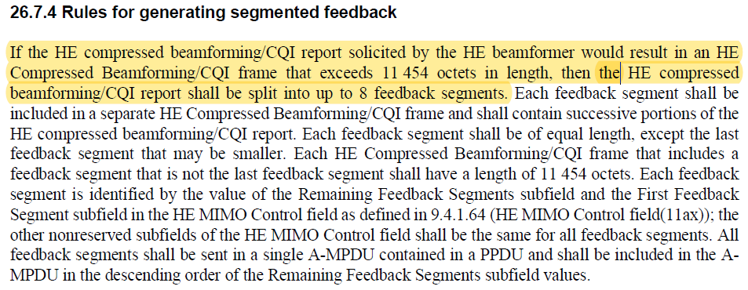
Baseline Reference (11ax)
This issue is not new at all, it also exists for beamforming feedback. In fact, the solution (segmented feedback + selective segment retransmission) already exists from the 802.11n days and is used for 11n, 11ac, 11ax and 11be sounding procedures and is time tested. [1]

Slide 7
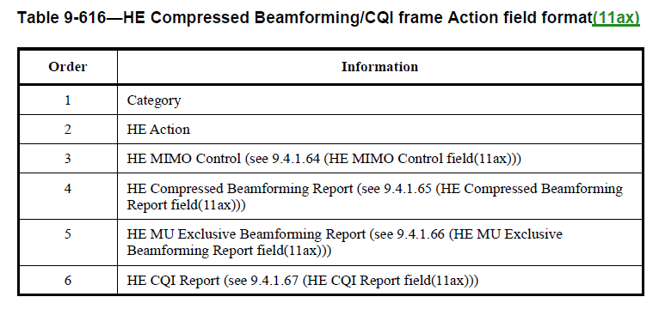
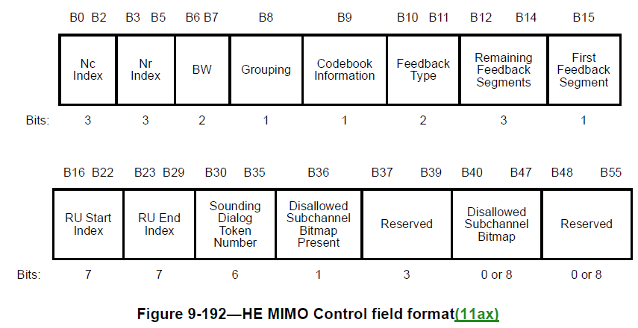
Baseline Reference (11ax)
9.6.31.2 HE Compressed Beamforming/CQI frame format [1]

Slide 8
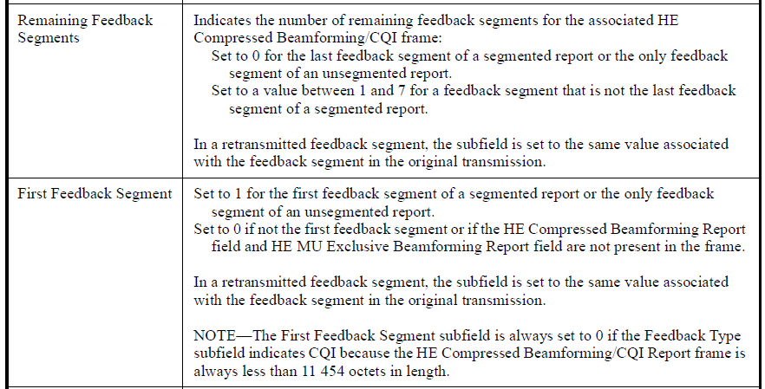
Baseline Reference (11ax)
HE MIMO Control field [1]

Slide 9
Proposal
Use field (instead of element) to carry the Sensing Measurement Report. An example format:
A 2 octet “Report Length” field at the start of the field is enough to indicate the maximum report length that can be carried in a single frame (11383 octets*).
Multiple reports can be carried in a single frame as long as they don’t cause the frame size to exceed 11454 octets.
Notes:
Note: Assuming MAC Header size = 28 octets, security overhead = 28 (8+16), frame body overhead = 3 octets, and report overhead = 8 octets, FCS = 4 octets, payload size = 11454 – 71 = 11383.

Slide 10
Benefits
Taking the same example of a Sensing Measurement Report Size of 40096 octets, the number of fields required to carry the report = 4. (See Appendix 3 for details). This is equal to 32 octets* overhead which is 1102 octets lesser than when using elements!
In general, using fields leads to 0.08% to 1.59% overhead (see Appendix 3) for the report parameters listed in Appendix 1 (BW = 80, Nb = 8, 10, Ng = 4, Nsc = 250).
Aside from the size overhead, use of fields also leads to lesser overhead in parsing due to the low number of segmentation (at Tx) and reconstruction (at Rx) of the Sensing Measurement Report.
Notes:
Note: Assuming per field overhead = 8 octets.

Slide 11
An example
An example (Dividing a 30699 octets CSI feedback into 3 segments):
Three segments are enough to carry a 30699 octets report.
If elements are used, 124 elements would be required.
Notes:
Note: Assuming MAC Header size = 28 octets, security overhead = 28 (8+16), frame body overhead = 3 octets, and report overhead = 8 octets, FCS = 4 octets, payload size = 11454 – 71 = 11383.

Slide 12
Straw Poll 1
Do you agree to replace the Sensing Measurement Report element with a field?
  Note: The content of the field is based on the content of the Sensing Measurement Report element.
  Y/N/A

Slide 13
References
IEEE P802.11-REVme_D1.3
IEEE 802.11be_D0.1
IEEE 802.11-11/0411r1, Selective Segment Retransmission of VHT Compressed Beamforming, Daewon Lee
IEEE 802.11-11/041r0, Sounding Protocol – Segmentation and Null Feedback, Simone Merlin
IEEE 802.11-16/1182r0, HE Sounding Segmentation, Hongyuan Zhang

Slide 14
Appendix - 1
Sensing Measurement Report size (based on Equation E of 22/1020r4):
BW = 80
Nb = 8, 10
Ng = 4
Nsc = 250
$$CSI Size= \left\lceil 1.5×N_{TX}×N_{RX}\right\rceil + \frac{N_{TX}×N_{RX}×N_{b}×N_{sc}}{4}$$
Nrx \ Ntx | 1 | 2 | 3 | 4 | 5 | 6 | 7 | 8
1 | 502 | 1003 | 1505 | 2006 | 2508 | 3009 | 3511 | 4012
 | 627 | 1253 | 1880 | 2506 | 3133 | 3759 | 4386 | 5012
2 | 1003 | 2006 | 3009 | 4012 | 5015 | 6018 | 7021 | 8024
 | 1253 | 2506 | 3759 | 5012 | 6265 | 7518 | 8771 | 10024
3 | 1505 | 3009 | 4514 | 6018 | 7523 | 9027 | 10532 | 12036
 | 1880 | 3759 | 5639 | 7518 | 9398 | 11277 | 13157 | 15036
4 | 2006 | 4012 | 6018 | 8024 | 10030 | 12036 | 14042 | 16048
 | 2506 | 5012 | 7518 | 10024 | 12530 | 15036 | 17542 | 20048
5 | 2508 | 5015 | 7523 | 10030 | 12538 | 15045 | 17553 | 20060
 | 3133 | 6265 | 9398 | 12530 | 15663 | 18795 | 21928 | 25060
6 | 3009 | 6018 | 9027 | 12036 | 15045 | 18054 | 21063 | 24072
 | 3759 | 7518 | 11277 | 15036 | 18795 | 22554 | 26313 | 30072
7 | 3511 | 7021 | 10532 | 14042 | 17553 | 21063 | 24574 | 28084
 | 4386 | 8771 | 13157 | 17542 | 21928 | 26313 | 30699 | 35084
8 | 4012 | 8024 | 12036 | 16048 | 20060 | 24072 | 28084 | 32096
 | 5012 | 10024 | 15036 | 20048 | 25060 | 30072 | 35084 | 40096
Nb = 8
Nb = 10

Slide 15
Appendix - 2
Number of Sensing Measurement report elements required and corresponding overhead (in %) for the report sizes listed in Appendix-1:
Number of elements
Overhead (in %)
Nrx \ Ntx | 1 |  | 2 |  | 3 |  | 4 |  | 5 |  | 6 |  | 7 |  | 8
1 | 3 | 4.18% | 5 | 3.49% | 7 | 3.26% | 9 | 3.14% | 11 | 3.07% | 13 | 3.02% | 15 | 2.99% | 17 | 2.97%
 | 3 | 3.35% | 6 | 3.35% | 8 | 2.98% | 13 | 3.63% | 13 | 2.90% | 16 | 2.98% | 18 | 2.87% | 21 | 2.93%
2 | 5 | 3.49% | 9 | 3.14% | 13 | 3.02% | 17 | 2.97% | 21 | 2.93% | 25 | 2.91% | 29 | 2.89% | 33 | 2.88%
 | 6 | 3.35% | 11 | 3.07% | 16 | 2.98% | 26 | 3.63% | 26 | 2.91% | 31 | 2.89% | 36 | 2.87% | 41 | 2.86%
3 | 7 | 3.26% | 13 | 3.02% | 19 | 2.95% | 25 | 2.91% | 31 | 2.88% | 37 | 2.87% | 43 | 2.86% | 49 | 2.85%
 | 8 | 2.98% | 16 | 2.98% | 23 | 2.86% | 38 | 3.54% | 38 | 2.83% | 46 | 2.86% | 54 | 2.87% | 61 | 2.84%
4 | 9 | 3.14% | 17 | 2.97% | 25 | 2.91% | 33 | 2.88% | 41 | 2.86% | 49 | 2.85% | 57 | 2.84% | 65 | 2.84%
 | 11 | 3.07% | 21 | 2.93% | 31 | 2.89% | 51 | 3.56% | 51 | 2.85% | 61 | 2.84% | 71 | 2.83% | 81 | 2.83%
5 | 11 | 3.07% | 21 | 2.93% | 31 | 2.88% | 41 | 2.86% | 51 | 2.85% | 61 | 2.84% | 71 | 2.83% | 81 | 2.83%
 | 13 | 2.90% | 26 | 2.91% | 38 | 2.83% | 64 | 3.58% | 64 | 2.86% | 76 | 2.83% | 89 | 2.84% | 102 | 2.85%
6 | 13 | 3.02% | 25 | 2.91% | 37 | 2.87% | 49 | 2.85% | 61 | 2.84% | 73 | 2.83% | 85 | 2.82% | 98 | 2.85%
 | 16 | 2.98% | 31 | 2.89% | 46 | 2.86% | 76 | 3.54% | 76 | 2.83% | 91 | 2.82% | 107 | 2.85% | 122 | 2.84%
7 | 15 | 2.99% | 29 | 2.89% | 43 | 2.86% | 57 | 2.84% | 71 | 2.83% | 85 | 2.82% | 100 | 2.85% | 114 | 2.84%
 | 18 | 2.87% | 36 | 2.87% | 54 | 2.87% | 89 | 3.55% | 89 | 2.84% | 107 | 2.85% | 124 | 2.83% | 142 | 2.83%
8 | 17 | 2.97% | 33 | 2.88% | 49 | 2.85% | 65 | 2.84% | 81 | 2.83% | 98 | 2.85% | 114 | 2.84% | 130 | 2.84%
 | 21 | 2.93% | 41 | 2.86% | 61 | 2.84% | 102 | 3.56% | 102 | 2.85% | 122 | 2.84% | 142 | 2.83% | 162 | 2.83%
In the worst case, the number of elements required to carry 40096 octets of report = 162. Causes 1134 octets overhead!
Notes:
Note: Assumption: 1 element can carry 254 octets other than the ID, length and id extension, i.e., assuming 6 octets additional overhead, payload size = 248. Overhead due to 1 element = 7 octets.

Slide 16
Appendix - 3
Number of Sensing Measurement report fields required and corresponding overhead (in %) for the report sizes listed in Appendix-1:
Number of fields
Overhead (in %)
Nrx \ Ntx | 1 |  | 2 |  | 3 |  | 4 |  | 5 |  | 6 |  | 7 |  | 8
1 | 1 | 1.59% | 1 | 0.80% | 1 | 0.53% | 1 | 0.40% | 1 | 0.32% | 1 | 0.27% | 1 | 0.23% | 1 | 0.20%
 | 1 | 1.28% | 1 | 0.64% | 1 | 0.43% | 1 | 0.32% | 1 | 0.26% | 1 | 0.21% | 1 | 0.18% | 1 | 0.16%
2 | 1 | 0.80% | 1 | 0.40% | 1 | 0.27% | 1 | 0.20% | 1 | 0.16% | 1 | 0.13% | 1 | 0.11% | 1 | 0.10%
 | 1 | 0.64% | 1 | 0.32% | 1 | 0.21% | 1 | 0.16% | 1 | 0.13% | 1 | 0.11% | 1 | 0.09% | 1 | 0.08%
3 | 1 | 0.53% | 1 | 0.27% | 1 | 0.18% | 1 | 0.13% | 1 | 0.11% | 1 | 0.09% | 1 | 0.08% | 2 | 0.13%
 | 1 | 0.43% | 1 | 0.21% | 1 | 0.14% | 1 | 0.11% | 1 | 0.09% | 1 | 0.07% | 2 | 0.12% | 2 | 0.11%
4 | 1 | 0.40% | 1 | 0.20% | 1 | 0.13% | 1 | 0.10% | 1 | 0.08% | 2 | 0.13% | 2 | 0.11% | 2 | 0.10%
 | 1 | 0.32% | 1 | 0.16% | 1 | 0.11% | 1 | 0.08% | 2 | 0.13% | 2 | 0.11% | 2 | 0.09% | 2 | 0.08%
5 | 1 | 0.32% | 1 | 0.16% | 1 | 0.11% | 1 | 0.08% | 2 | 0.13% | 2 | 0.11% | 2 | 0.09% | 2 | 0.08%
 | 1 | 0.26% | 1 | 0.13% | 1 | 0.09% | 2 | 0.13% | 2 | 0.10% | 2 | 0.09% | 2 | 0.07% | 3 | 0.10%
6 | 1 | 0.27% | 1 | 0.13% | 1 | 0.09% | 2 | 0.13% | 2 | 0.11% | 2 | 0.09% | 2 | 0.08% | 3 | 0.10%
 | 1 | 0.21% | 1 | 0.11% | 1 | 0.07% | 2 | 0.11% | 2 | 0.09% | 2 | 0.07% | 3 | 0.09% | 3 | 0.08%
7 | 1 | 0.23% | 1 | 0.11% | 1 | 0.08% | 2 | 0.11% | 2 | 0.09% | 2 | 0.08% | 3 | 0.10% | 3 | 0.09%
 | 1 | 0.18% | 1 | 0.09% | 2 | 0.12% | 2 | 0.09% | 2 | 0.07% | 3 | 0.09% | 3 | 0.08% | 4 | 0.09%
8 | 1 | 0.20% | 1 | 0.10% | 2 | 0.13% | 2 | 0.10% | 2 | 0.08% | 3 | 0.10% | 3 | 0.09% | 3 | 0.07%
 | 1 | 0.16% | 1 | 0.08% | 2 | 0.11% | 2 | 0.08% | 3 | 0.10% | 3 | 0.08% | 4 | 0.09% | 4 | 0.08%
In the worst case, the number of fields required to carry 40096 octets of report = 4. Causes 32 octets overhead.
Notes:
Note: Assuming MAC Header size = 28 octets, security overhead = 28 (8+16), frame body overhead = 3 octets, and report overhead = 8 octets, FCS = 4 octets, payload size = 11454 – 71 = 11383.
Overhead due to 1 fields = 8 octets.

Slide 17
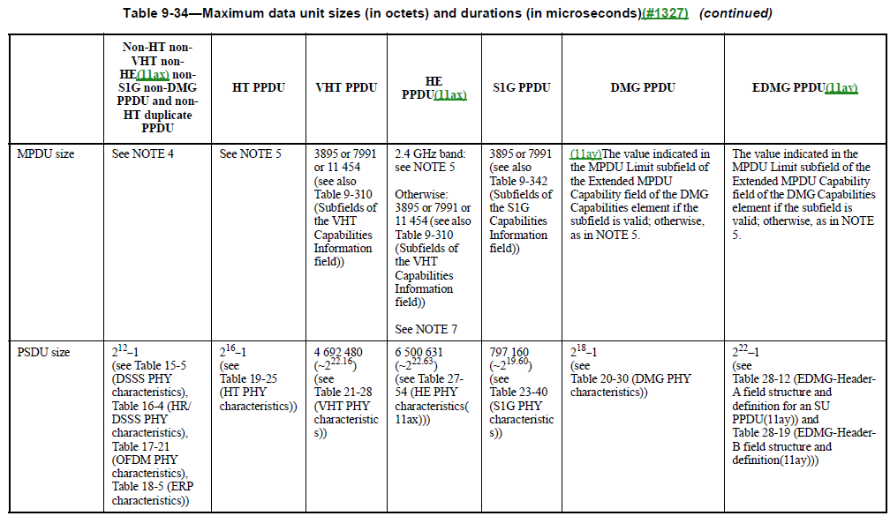
Appendix - 4
Notes:
Note: Assuming MAC Header size = 28 octets, security overhead = 28 (8+16), frame body overhead = 3 octets, and report overhead = 8 octets, FCS = 4 octets, payload size = 11454 – 71 = 11383.
Overhead due to 1 fields = 8 octets.

Slide 18
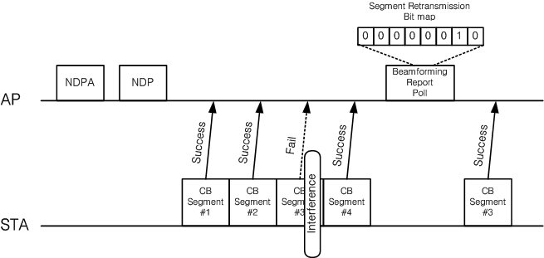
Appendix - 5
[3]:
Selective Segment Retransmission Protocol
Beamformee behavior
  A beamformee shall reply to a Beamforming Report Poll frame by either sending only the segments indicated in the Segment Retransmission Bitmap field in the Beamforming Report Poll fame or sending all the segments disregarding the Segment Retransmission Bitmap field in the Beamforming Report Poll fame

