Slide 1
Reducing the size of ML traffic indication element
Date: 2022-07-26

Slide 2
Comment in LB266
CID | Section | Page.Line | Comment | Proposed Change | Resolution
11586 | 35.3.12.4 | 433.11 | Even with a non-default TID-to-link mapping, the AP may sometimes have BUs for a non-AP MLD that can be fetched from any enabled link e.g. MMPDUs, BUs of TID which are mapped to all links. The spec needs to provide a mechanism for AP MLD to indicate if the currently buffered BUs can be fetched on any enabled link. Similarly with default TID-to-link mapping, if the AP MLD has no specific link recommendation, a mechanism to indicate the same is required. | To indicate that the buffered BUs can be fetched on any enabled link, the AP MLD shall: (i) set the bit corresponding to AID of nonAP MLD to 1 in the partial virtual bitmap of TIM (ii) Set all bits corresponding to this AID in the per-link traffic indication bitmap of multi-link traffic indication element to 0. | REVISED Agreed in principle. Presenter will bring forth a PDT based on straw-poll result.

Slide 3
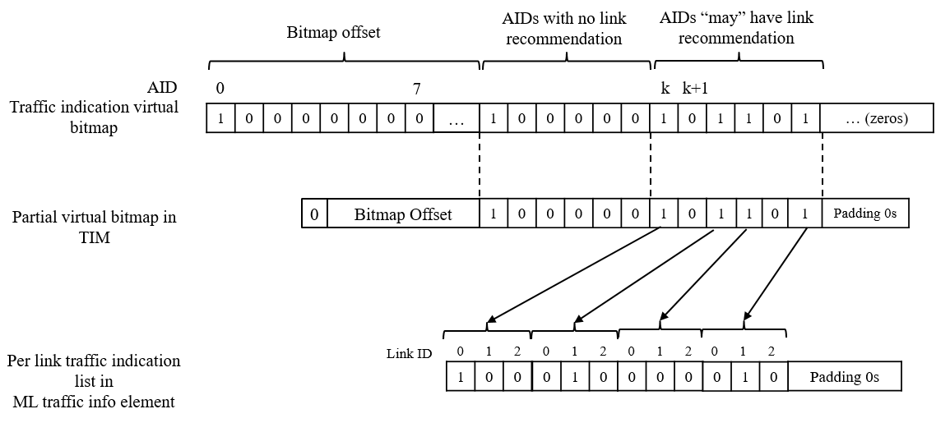
Motivation
Consider an AP MLD operating with $L$ links and having one or more associated non-APs MLDs with non-default TID-to-link mapping (T2LM).
For indicating the per-link buffered traffic, the spec provides a ‘multi-link traffic indication’ element which is included in beacon frames.
However, as per current spec, the ‘per-link traffic indication list’ subfield of the ‘multi-link traffic indication’ element has to provide traffic indication for all the AIDs with buffered traffic, starting from AID $k$.
The value of $k$ is indicated in the ‘AID offset’ subfield of the ‘ML traffic indication control’ field of the ‘multi-link traffic indication’ element.
Thus the size of this bitmap can be $LM$, where $M$ is number of AIDs after AID $k$ with buffered traffic.

Slide 4
Motivation contd.
Per-link traffic indication may not be required for many of these $M$ AIDs:
Many of these AIDs can have default T2LM. Note that T2LM mapping can be changed with time, so contiguous AIDs for non-default T2LM can’t be guaranteed.
Even for AIDs with non-default T2LM, link recommendation is not always required. For example, link recommendation is not required if the buffered traffic is MMPUs or belongs to TIDs mapped to all enabled links.
Thus there are many wasted bits in current ‘per-link traffic indication list’, which can cause beacon bloat issue, along with reduced efficiency.
Number of wasted bits is $\left(M−N\right)L$, where $N$ is number of AIDs for which the AP MLD intends to provide a link recommendation.
This can be significantly large, especially in future where number of links can potentially be increased beyond 3.

Slide 5
Proposed solution
Include in the ‘multi-link traffic indication’ element, an optional ‘Recommendation partial virtual bitmap’ field.
Presence of this field is indicated using a ‘Recommendation bitmap present’ subfield of the ‘ML traffic indication control’ field.
When present, the ‘Recommendation partial virtual bitmap’ identifies, among the AIDs with buffered traffic starting from the AID $k$, the AIDs for which the AP MLD desires to provide a per-link traffic indication.
Correspondingly when ‘Recommendation partial virtual bitmap’ is present, the ‘per-link traffic indication list’ only indicates traffic for the AIDs identified by the bitmap, i.e., size is reduced to $LN$.
When ‘Recommendation partial virtual bitmap’ is not present, the ‘per-link traffic indication list’ includes all AIDs with buffered traffic starting from the AID $k$ (i.e., baseline operation).
Size of the indication becomes $min⁡\left\{M+LN+1,ML+1\right\}$ (usually smaller than $ML$).

Slide 6
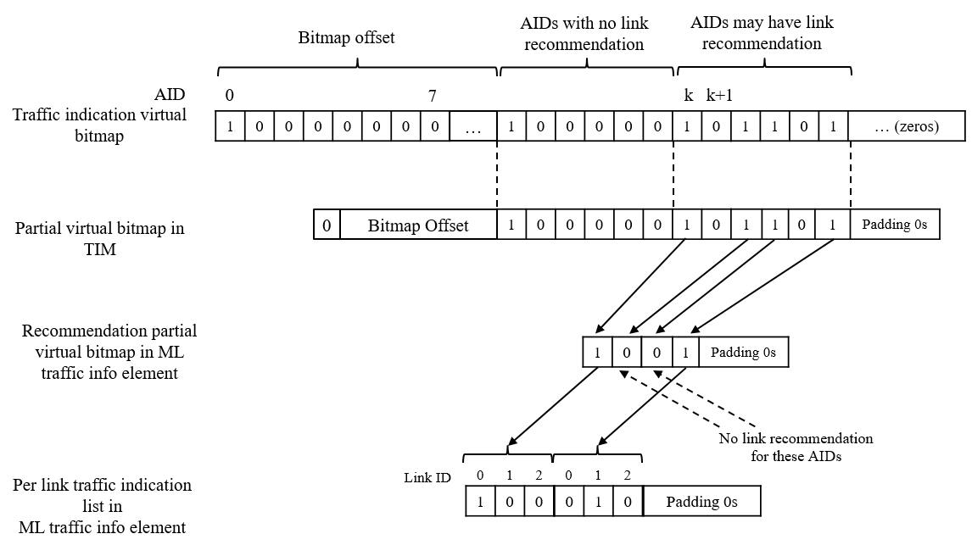
Proposed solution contd.
If the ‘Recommendation partial virtual bitmap’ is present and is set to 1 for an AID that has pending buffered traffic (indicated in TIM), the corresponding non-AP STA/MLD should use the link indicated in the ‘per link traffic indication list’ corresponding to its AID, to fetch the buffered traffic.
If the ‘Recommendation partial virtual bitmap’ is present but is set to 0 for an AID that has pending buffered traffic (indicated in TIM), the corresponding non-AP STA/MLD can use any enabled link to fetch the buffered traffic.

Slide 7
Straw polls
SP1: Do you agree with the need to reduce the size of the multi-link traffic indication element.
Result: Yes/No/Abstain
SP2: Do you agree to include a bitmap to identify the subset of AIDs for which per-link traffic indication is provided in the multi-link traffic indication element.
Result: Yes/No/Abstain

Slide 8
Background notes

