Slide 1
ML traffic indication using A-control
Date: 2022-07-26

Slide 2
Comment in LB266
CID | Section | Page.Line | Comment | Proposed Change | Resolution
11587 | 35.3.7.1.6 | 430.61 | When there are no reamining BUs for a nonAP MLD that mapped to the current link, the AP MLD sets the "More Data" subfield to 0 in a downlink PPDU, or transmits a QoS null data frame in reponse to a PS poll. The spec should provide a mechanism for the AP to also indicate, in the resposne frame, presence of pending traffic for the nonAP MLD that is mapped to other links. The AP should also utilize such a mechanism to indicate a need to check the beacon for critical update. | Define a mechanism where using either a new element or subfield in the response frame, or by transmitting an individually addressed frame, an AP MLD can indicate to an STA of the nonAP MLD if there is buffered traffic for another STA of the nonAP MLD or if there is a need to check the beacon for a critical updates. | REVISED Agreed in principle. Presenter will bring forth a PDT based on straw-poll result.

Slide 3
Motivation
Consider a non-AP MLD with a non-default TID-to-link mapping operating in power save mode on 2 links as shown.
Upon decoding an ML traffic indication element in beacon, non-AP MLD identifies that STA1 is a recommended link to fetch BUs.
By sending a PS poll, STA1 initiates a frame exchange with AP1 to fetch the BUs.
During this time, the AP may have received BUs of a TID that is only mapped to STA2.
Currently, no mechanism exists to indicate about such BUs to STA1 inside the frame exchange sequence.
Upon receipt of More Data subfield=0, STA1 may go to doze state for a listen interval.
Thus the BUs mapped to STA2 will only be retrieved after the next listen interval.
This can cause a high latency in recovering the newly arrived BUs.
Listen interval
Missed PPDUs
Awake
More data=0
Doze
Beacon
Beacon
Beacon
AP1
STA1
Beacon
PS poll
ACK
ACK
Beacon
Beacon
AP2
Awake
STA2
Doze
AP MLD
non-AP MLD

Slide 4
Proposed solution
Propose a new type of A-control sub-field called: “ML traffic indication” [See backup slides for notes on A-control].
An AP MLD can include this MLTI subfield in a QoS Data, QoS Null, and individually-addressed Management frames it transmits to the non-AP MLD to indicate that it has pending BUs for other STAs of the non-AP MLD.
STAs indicated in the MLTI should transmit a PS poll or U-APSD to retrieve the BUs.
Below figure depicts the reduction in latency of retrieving the BUs for STA2 in Scenario 1.
Listen interval
Awake
More data=0
MLTI included
Doze
Beacon
Beacon
Beacon
AP1
STA1
Beacon
PS poll
ACK
ACK
Beacon
Beacon
AP2
STA2
PS poll
ACK
Doze
non-AP MLD
AP MLD
Doze
Awake
Operation of scenario 1 with proposed solution
Control ID xxxx | Recommended link bitmap | Reserved | Padding
MLTI variant of A-control sub-field

Slide 5
Limited scope of AAR
Control ID 1001 of A-control sub-field is for AP assisted recovery which has a very similar format as the proposed MLTI.
Currently AAR is only transmitted by an NSTR non-AP MLD to indicate links which have lost medium synchronization and has buffered traffic, to solicit a trigger frame from the associated APs for UL transmission. It cannot be transmitted by an AP.
AAR use can potentially also extend to EMLSR and EMLMR (with spec changes), but still its scope is very limited.
At a high level, AAR is used by the non-AP MLD to indicate the links where it has buffered traffic, i.e., similar purpose as the proposed MLTI.
Since number of Control IDs for A-control are limited (only 5 left), we propose to rename and generalize AAR to MLTI.
Note: When transmitted by an NSTR non-AP MLD, the functionality shall remain as in baseline (unchanged).
Control ID 1001 | Assisting AP Link ID bitmap | Reserved | Padding
Bits: 4 16 4 6
AAR variant of the A-control field

Slide 6
Straw polls
SP1: Do you agree with the need for a mechanism for multi-link traffic indication to a non-AP MLD in an individually-addressed frame.
Result: Yes/No/Abstain
SP2: Do you agree to generalize AAR indicate the recommended link on which the transmitter intends to deliver the buffered traffic.
Result: Yes/No/Abstain

Slide 7
Background notes

Slide 8
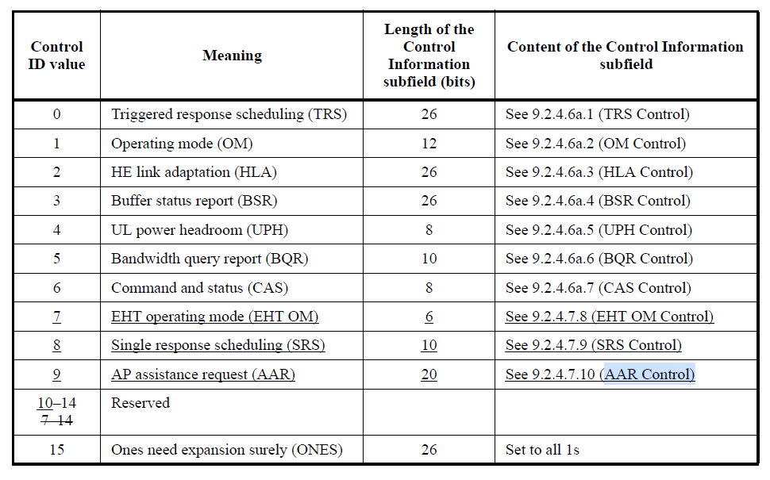
HE variant HT control field
Section 9.2.4.6:
The HT control field is always present in a control wrapper frame and is present in QoS Data, QoS Null, and Management frames as determined by +HTC bit of the Frame Control field.
The HT control field is also present in some control frames such as RTS+HTC, BlockAck+HTC.
The HT control field has 3 variants HT, VHT, VHT, indicated by bits B0-B1 with different formats as shown below.
In HE variant, the 4 bit control ID indicates the type of information carried and the table is given below.
Control ID | Control information | Padding
Bits: 4 26

Slide 9
AAR control subfield
Section 9.2.4.7.10:
Contains the information of the link identifier(s) of the assisting AP(s) affiliated with an AP MLD that are requested to assist the non-AP MLD to recover from medium synchronization.
The field is currently only transmitted by NSTR non-AP MLDs.
A value of 1 in bit position i of the Assisting AP Link ID Bitmap subfield means that the link ID i is the link identifier of the assisting AP affiliated with the AP MLD. A value of 0 in bit position i of the Assisting AP Link ID Bitmap subfield means that the link ID i is not the link identifier of the assisting AP affiliated with the AP MLD.
Each of the indicated AP(s) should transmit a Trigger frame to associated STAs of the non-AP MLD to solicit UL frame(s), if it does not have frame exchanges already scheduled with another STA.
Can potentially also be used by EMLSR and EMLMR devices (with spec changes).
Control ID 1001 | Assisting AP Link ID bitmap | Reserved | Padding
Bits: 4 16 4 6
AAR variant of the A-control field

