Slide 1
EC report for sending P802.11-2020/Cor1 to RevCom
Date: 2022-07-14
Authors:

Slide 2
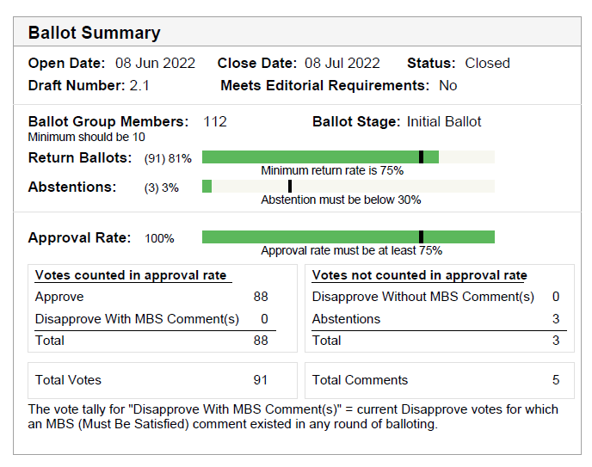
SA ballot details
P802.11-2020 passed its initial SA ballot with 100% approval
5 Comments were received
All 5 are rejected, 4 of which are editorial and will be forwarded to the publication editor

Slide 3
Mandatory Coordination
Coordination Entity | Draft | Date | Status
IEEE-SA Editorial (MEC) | D2.1 | June 2022 | “Ready for ballot.”
Quantities, Units and Letter Symbols (SCC14) |  |  | Not required
Terms and Definitions (SCC10) |  |  | Not required
Registration Authority Committee (RAC) |  |  | Not required

Slide 4
Editorial requirements
The initial MEC review did not find any issues. A subsequent review, IEEE SA found an issue with a reference to an outside organization. The expectation is that this issue will be fixed by the publication editor.

Slide 5
P802.11-2020/Cor1 Timeline
 | Open | Close
Initial WG ballot (D1.0) | Mar 15, 2022 | Apr 14, 2022
Recirc WG ballot (D2.1) | May 17, 2022 | June 1, 2022 (15 days)
EC Approval for SA Ballot | June 7, 2022
Initial SA Ballot (D2.1) | June 8, 2022 | July 8, 2022 (30 days)
EC to RevCom | July 2022
RevCom to SASB | Dec. 2022

Slide 6
EC motion
Motion
Approve sending IEEE P802.11-2020/Cor1/D2.1 to RevCom

