Slide 1
Ns-3 WiFi Working Group: Update on 802.11ax & .be models
Date: 2022-07-11
Authors:
Name | Affiliations | Address | Phone | Email
Sumit Roy | U Washington |  |  | sroy@uw.edu
T. R. Henderson | U Washington |  |  | tomhend@uw.edu
Hao Yin | U Washington |  |  | yinhao@uw.edu
Liu Cao | U Washington |  |  | liucao@uw.edu
Sian Jin | Princeton U. |  |  | sj2434@princeton.edu
Leonardo Lanante |  |  |  | leonardolanante@gmail.com

Slide 2

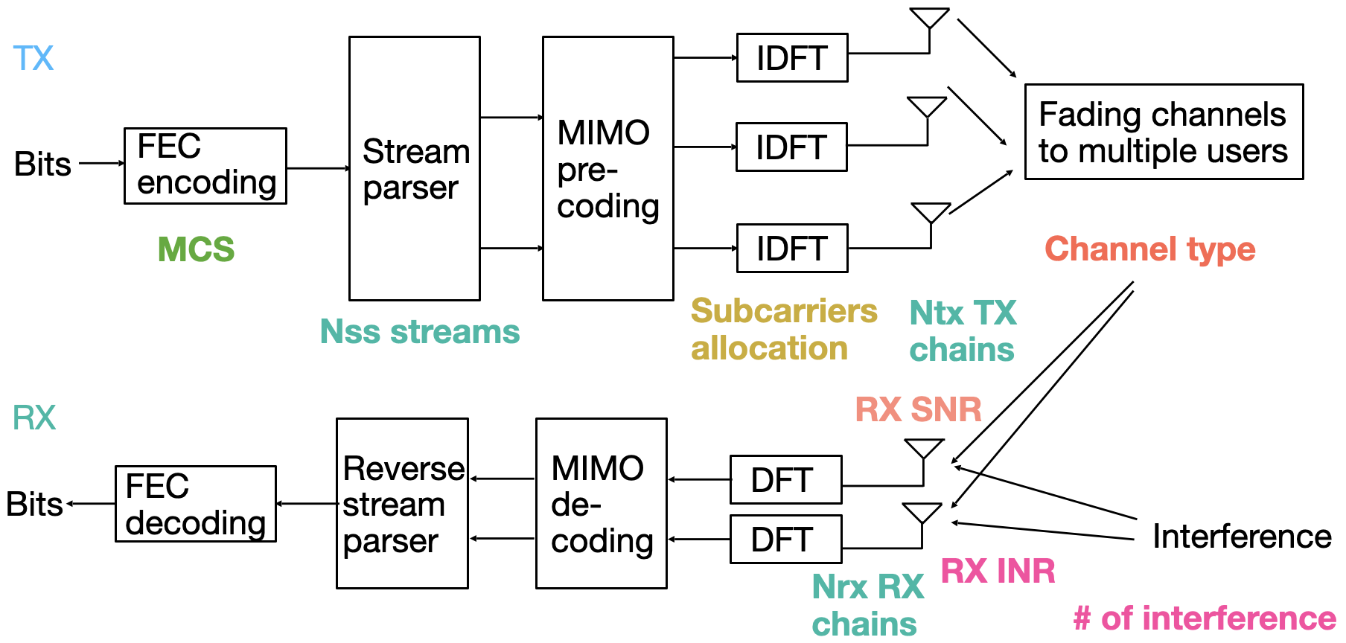

What is PHY abstraction?
PHY abstraction represents packet error rate (PER) as a function of
Channel type
MCS
Subcarriers allocation
MIMO dimension
RX SNR
RX INR
Compare
Packet error or success
Full PHY simulation block diagram

Slide 3
PHY abstraction for ns-3 : L2 Performance Evaluation
MAC layer
MacLow
SendPacket
Success/fail
PHY layer
Success/fail
WifiPhy
PHY entity
getReceptionStatus
getReceptionStatus
Success/fail
Interference helper
Configuration parameters
PER
Error model
ns-3 WifiNetDevice example

Slide 4
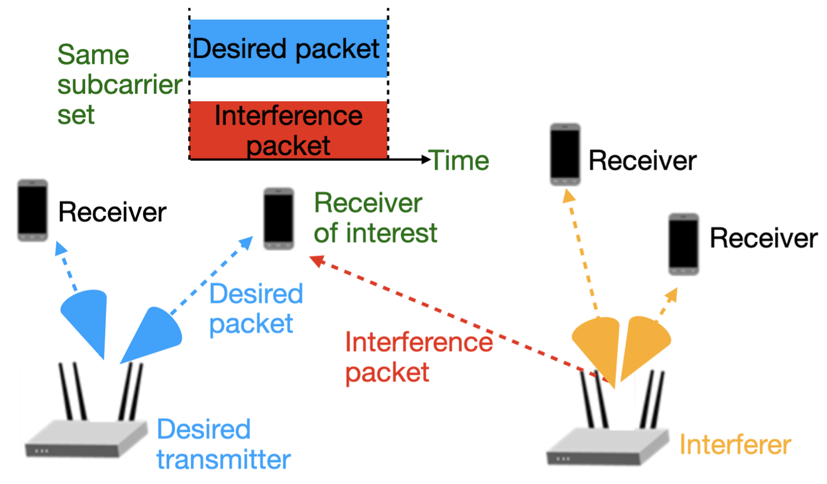
Issues with PHY layer abstractions
Exploding Complexity
Increasing MIMO dimensions
Higher Order Modulations
Complex channels
Greater co-channel interference (denser networks)
Numerous MU configurations
(# streams)

Slide 5
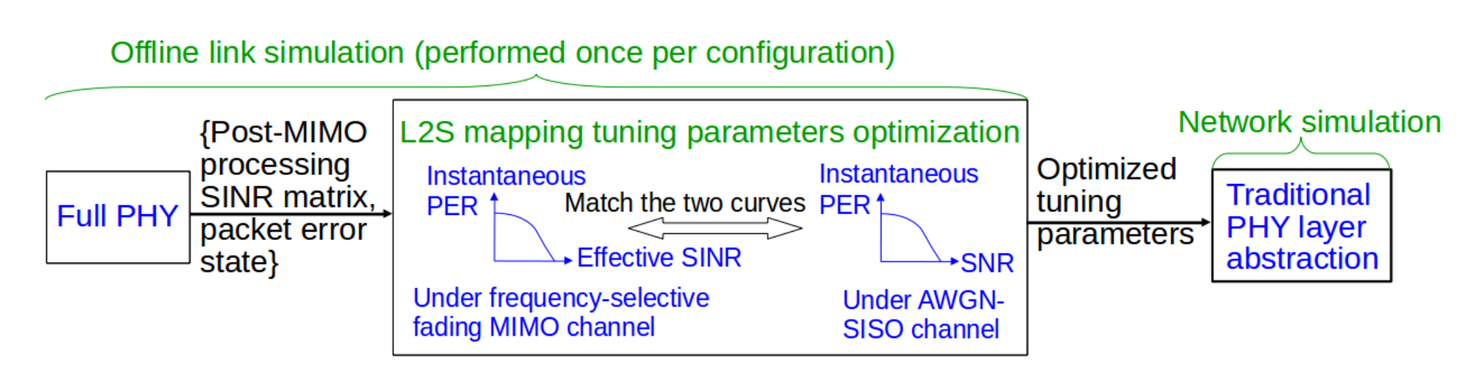
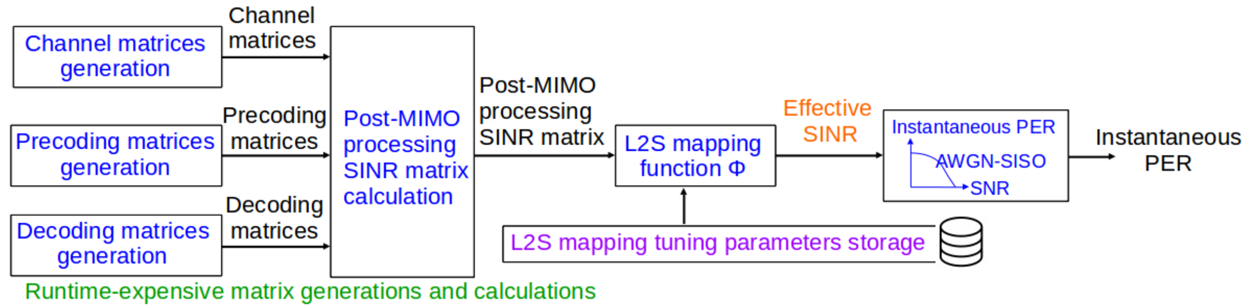
L2S Implementation: IEEE TGax
[*] Appendix A of 11ax Evaluation Methodology (11-14-0571-12-00ax-evaluation-methodology.docx)

Slide 6
Fast link-to-system (L2S) Mapping
Traditional link-to-system mapping approaches [*] (e.g RBIR, EESM) require generation of channel instances to map to SINR per subcarrier, which are then compressed to a scalar effective SINR
  While faster than pure link simulation, MIMO channel generation, MU operation, and matrix inversion still pose limits to computation effective SINR
Key insight: If effective SINR can be directly characterized from a link simulation campaign, channel generation and inversion can be bypassed!
[*] Appendix A of 11ax Evaluation Methodology (11-14-0571-12-00ax-evaluation-methodology.docx)

Slide 7

New PHY Link-to-System abstraction (log-SGN)
A log-skew generalized normal (log-SGN) distribution can characterize effective SINR distributions with only a few parameters
Rx Effective SINR after
path loss,
shadowing
Use random
variable to draw
effective SINR
Frame length
Use random
variable to draw
effective SINR
Eff.
SNR
AWGN SNR to
PER tables and
interpolation
Instantaneous
PER
AWGN SNR to
PER tables and
interpolation
Still need to conduct similar link simulation campaign
Modest increase in storage complexity (vs. EESM or RBIR parameters), yields dramatic runtime improvement
Table of
log SGN
parameters

Slide 8
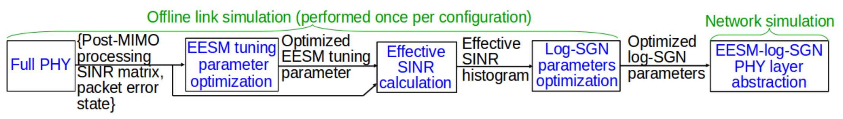
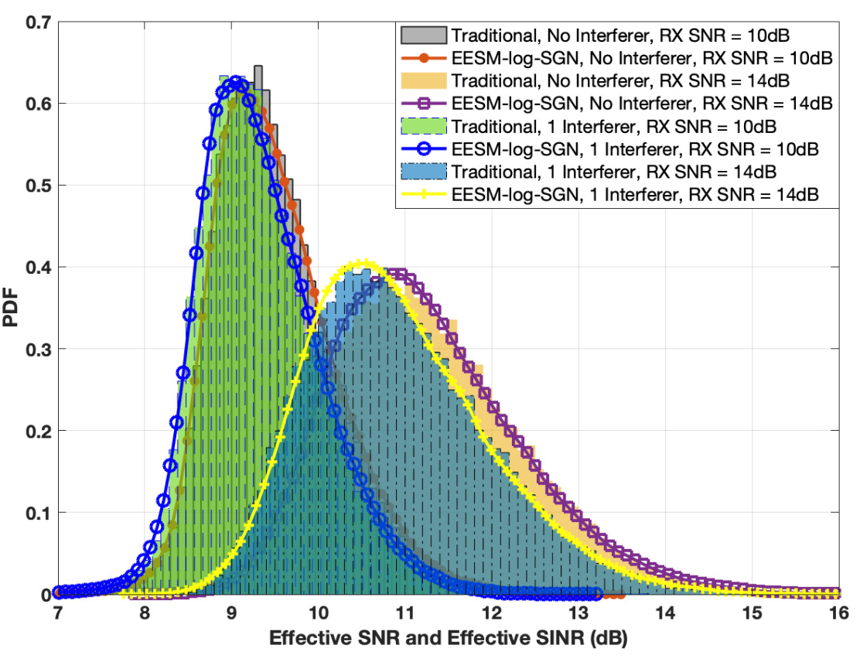

Implementation flow: Log-SGN L2S Method

Slide 9
PHY Configuration
Full PHY simulation
Communication system: IEEE 802.11ax
  Coding and modulation: LDPC at MCS 4
OFDM with 242 subcarriers
1×1 SISO with 1 stream
Channel type: TGax channel model-D
RX SNR = TX SNR - path loss (dB)
Interference-free case
Simulate 4000 packets

Slide 10
11ax subcarrier allocation
Full PHY simulation
MathWorks, “802.11ax Parameterization for Waveform Generation and Simulation,” https://www.mathworks.com/help//wlan/ug/802-11ax-parameterization-for-waveform-generation-and-simulation.html.

Slide 11
References, Code
MATLAB 2020b and WLAN Toolbox or later version
Matlab Code for 11ax PHY Abstraction : https://github.com/sianjin/EESM-log-SGN
ns-3 code: https://gitlab.com/sderonne/ns-3-11be/-/tree/log_sgn_ofdma_mu_mimo_phy_abstraction
https://depts.washington.edu/funlab/projects/improvements-to-ns-3- simulator/ns-3-scaling-for-next-g-wireless-networks/
S. Jin, S. Roy and T. R. Henderson, ``Efficient PHY Layer Abstraction for Fast Simulations in Complex System Environments," IEEE Trans. Comm., Aug.2021.
w-ns3 2021 Tutorial https://www.nsnam.org/wp-content/uploads/2021/tutorials/EESM-log-SGN-tutorial.pptx

Slide 12
Status
PHY Abstraction → SU-MIMO complete: with & without beamforming
PHY Abstraction → MU-MIMO
  Downlink complete: with beamforming under all DL MU-MIMO configurations
  Uplink in progress: with beamforming, support single-antenna UE (UL MU-SIMO)
Beamforming feedback: no delay and noise in channel sounding presently;
additive CSI error to model impact of channel sounding in progress
CCA
Conditions for CCA BUSY on primary 20 MHz channel (11ax 27.3.20.6.3)
CCA sensitivity for signals not on primary 20 MHz (11ax 27.3.20.6.4)
Per 20 MHz CCA sensitivity (11ax 27.3.20.6.5)
https://depts.washington.edu/funlab/projects/improvements-to-ns-3- simulator/ns-3-scaling-for-next-g-wireless-networks/

Slide 13
Performance Evaluation Case Studies

Slide 14
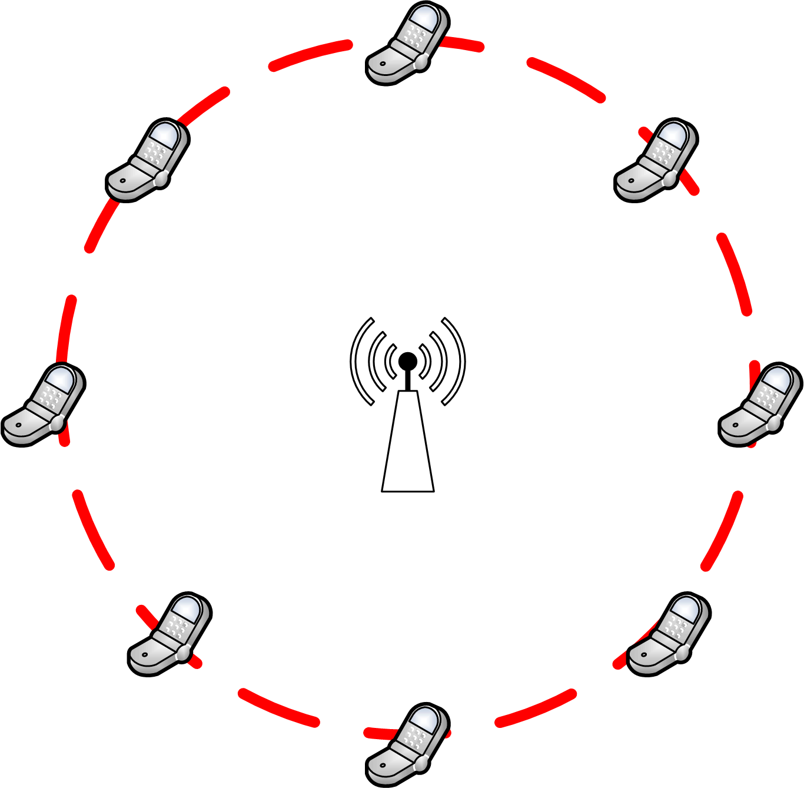
Validate modules in ns-3
Basic DCF validation
Simulation setup:
  Infrastructure mode: One AP and multiple stations
  Traffic: Uplink traffic only.
  Stations locate at the same distance (close) to the AP
  Transmission with same power and MCS
  Saturation mode
Key assumptions for the analytical model:
  No PHY errors → packet losses only caused by the collision
  STA all identical
DCF validation
  https://gitlab.com/nsnam/ns-3-dev/-/blob/master/src/wifi/examples/wifi-bianchi.cc
802.11ax OFDMA validation
  https://github.com/signetlabdei/ofdma-validation
[**] Davide Magrin, Stefano Avallone, Sumit Roy, and Michele Zorzi. 2021. Validation of the ns-3 802.11ax OFDMA implementation. In Proceedings of the Workshop on ns-3 (WNS3 '21). Association for Computing Machinery, New York, NY.

Slide 15
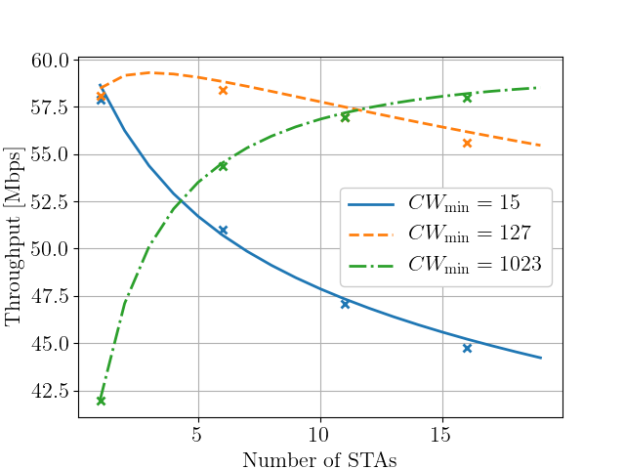
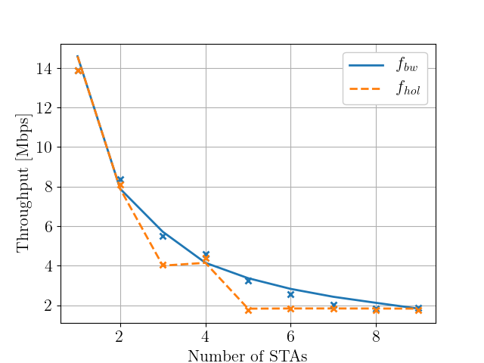
Validation results in ns-3
Codes https://github.com/signetlabdei/ofdma-validation
Fig. Single Cell Throughput with different station numbers and CW_{min}
Fig. OFDMA validation with different scheduler
ns-3 simulations correspond to well-regarded analytical models for system throughput.

Slide 16
Build new scenarios – 6 Ghz [*]
U.S Federal Communications Commission (FCC) has adopted new rules for 6 GHz bands unlicensed access - limits operation by a Power Spectral Density (PSD) limit in 6 GHz bands that differs from the total average power independent of the channel bandwidth in 5 GHz bands.
Unequal power of the Access Points (AP) and stations (STA) also impact the system performance.
Device type | Frequency | Max power for bandwidth
 |  | 20 MHz | 40 MHz | 80 MHz | 160 MHz
Low power AP Max 30 dBm (1 W) | 6 GHz | 18.01 dBm (63.2 mW) | 21.02 dBm (126.4 mW) | 24.03 dBm (252.8 mW) | 27.04 dBm (505.6 mW)
 | 5 GHz | 30 dBm | 30 dBm | 30 dBm | 30 dBm
Low power STA Max 24 dBm (250 mW) | 6 GHz | 12.04 dBm (16 mW) | 15.05 dBm (32 mW) | 18.06 dBm (64 mW) | 21.07 dBm (128 mW)
 | 5 GHz | 24 dBm | 24 dBm | 24 dBm | 24 dBm
* Hao Yin, Sumit Roy and Sian Jin. 2022. IEEE WLANs in 5 vs 6 GHz: A Comparative Study. In Proceedings of the WNS3 2022 (WNS3 2022). Association for Computing Machinery, New York, NY, USA.

Slide 17
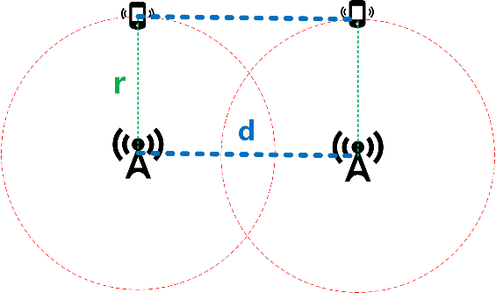
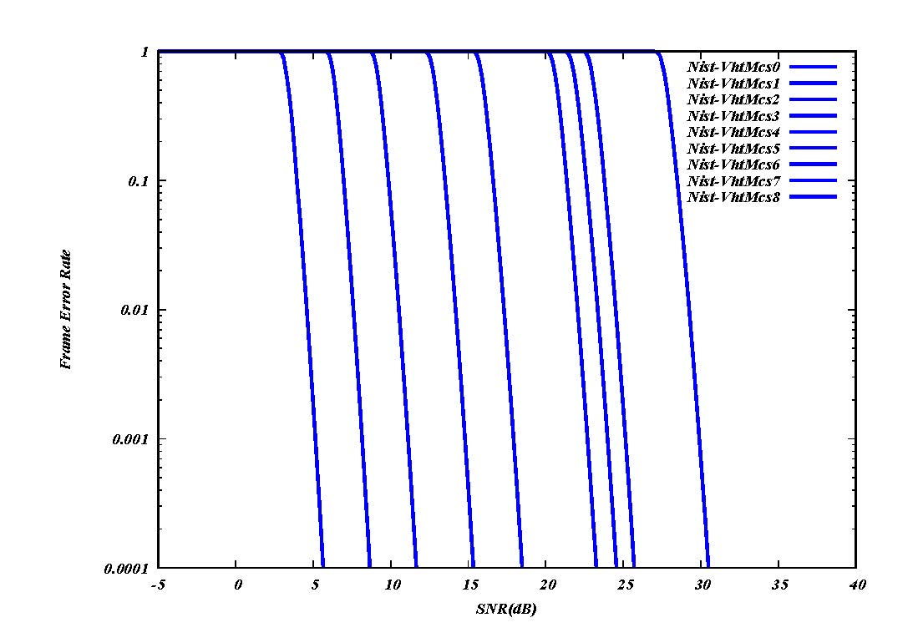


Build new scenarios – Multi BSS
Axis:
AP1 (0, 0) AP2 (d, 0)
STA1 (0, r) STA2 (d, r)
2 Overlapping BSS:
CCA: -82 dBm, TX power: 20 dBm
Log distance path loss (PL) model → PL is a function of distance: PL(dis)
Change d and r to simulate different cases.
Uplink Only
AP1
AP2
SINR = $\frac{P_{rx}}{(P_{in}+Noise)}$
$$P_{rx}=P_{tx} −PL\left(r\right)$$
$P_{in}=P_{tx} −PL(\sqrt{r^{2}+d^{2}}$)
Conditions that 2 STAs can transmit at the same time:
2 STAs are in different BSS
SINR > Threshold(MCS) ~ 5 dB SINR for MCS 0
SINR vs PER
R. Kajihara, H. Wenkai, L. Lanante, M. Kurosaki and H. Ochi, "Performance Analysis Model of IEEE 802.11 CSMA/CA for Multi-BSS Environment," 2020 IEEE 31st Annual International Symposium on Personal, Indoor and Mobile Radio Communications, 2020.

Slide 18
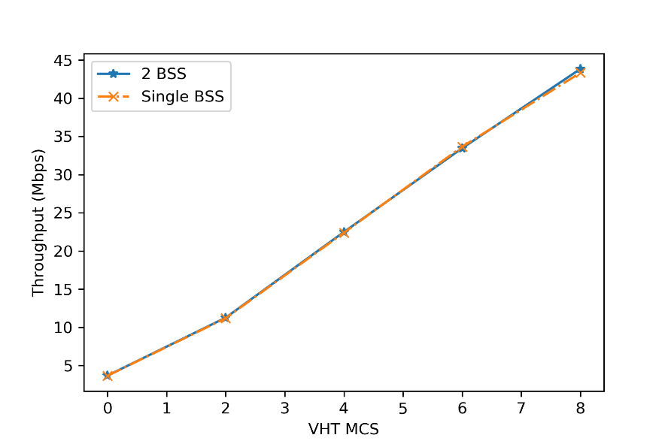
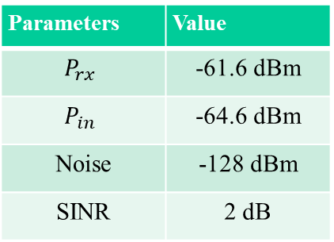
Build new scenarios – Multi BSS
Codes: https://gitlab.com/haoyinyh/ns-3-dev/-/tree/multibss
Case 1: r = 8m, d = 5m
  Every node is in the carrier sensing range (can sense each other)
  SINR = 2 dB → No simultaneous transmission for ALL MCS
  Expectation: 2 BSS is equivalent to one larger cell
Parameters | Value
$$P_{rx}$$ | -61.6 dBm
$$P_{in}$$ | -64.6 dBm
Noise | -128 dBm
SINR | 2 dB
2 BSS equivalent to one larger cell
All results validated against the Bianchi model
Total 50 STAs

Slide 19
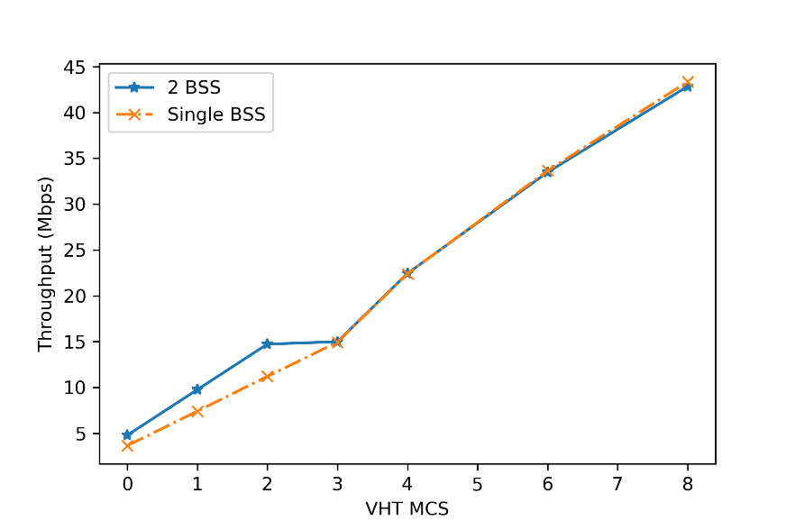
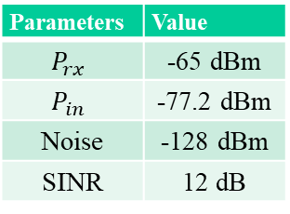
Build new scenarios – Multi BSS
Case 2: Simultaneous transmission r = 10m, d = 20m
  Every node is in the carrier sensing range (can sense each other)
  SINR = 12 dB → Can support simultaneous transmission at MCS 0/1/2
  Expectation: 2 BSS has larger throughput in MCS 0/1/2 than one large cell
Parameters | Value
$$P_{rx}$$ | -65 dBm
$$P_{in}$$ | -77.2 dBm
Noise | -128 dBm
SINR | 12 dB
Simultaneous transmission happens when MCS < 3
→ multi-BSS throughput is larger when MCS < 3
Total 50 STAs

Slide 20
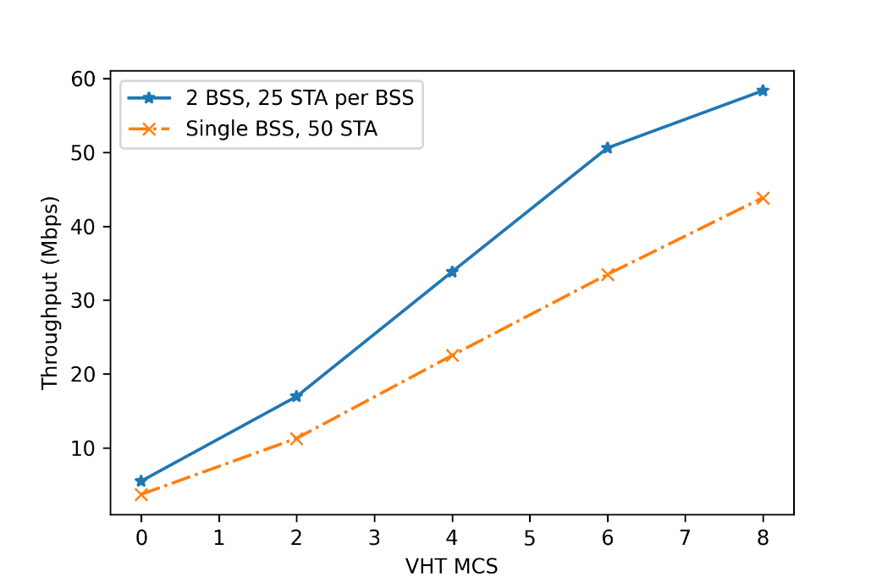
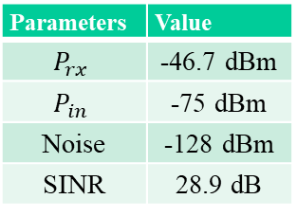
Build new scenarios – Multi BSS
Case 3: Simultaneous transmission r = 3m, d = 20m
  Every node is in the carrier sensing range (can sense each other)
  SINR = 28.9 dB -> Can support simultaneous transmission at all MCSs
  Expectation: 2 BSS has larger throughput in all MCSs than one large cell
Parameters | Value
$$P_{rx}$$ | -46.7 dBm
$$P_{in}$$ | -75 dBm
Noise | -128 dBm
SINR | 28.9 dB
Simultaneous transmission happens for all MCSs
→ multi-BSS throughput is larger !

