Slide 1
On the need for standardizing 802.11be 320 MHz mode ranging
Date: 2022-07-11
Authors:

Slide 2
Topics
Introduction
Importance of 320 MHz bandwidth mode ranging
Updated Market Context for 802.11 Fine Timing Measurement
Standardization options and recommendation

Slide 3
Introduction
The 802.11az ‘Next Generation Positioning’ project is nearing completion and is using 802.11ax as baseline and support up to 160 MHz ranging
802.11be is adding 320 MHz bandwidth operating modes, the use of which can further enhance accuracy of 802.11 FTM ranging
This submission briefly discusses:
  The benefits of adding 320 MHz FTM operation to the 802.11 set of standards
  Some recent additional market context for 802.11 FTM
  A recommended standardization path for 320 MHz ranging

Slide 4
Role of Frequency Bandwidth in Ranging Performance
Four performance drives for wireless ranging accuracy:*
  Frequency Bandwidth
  Use of Multi-Antenna Technology
  Transmit Power
  Receiver Sensitivity
Expanding the max frequency bandwidth assumed for 802.11az (160 MHz) to 320 MHz is expected to further improve accuracy of 802.11 ranging
  A conservative estimate is that based on Qualcomm internal analysis is that going from 160 Mode to 320 MHz will lead to a 30% increase in accuracy
    E.g. if the 90th percentile accuracy is 100 cm in the case of 160 MHz operation,
    it would be 70 cm for 320 MHz operation
* See: https://www.qualcomm.com/content/dam/qcomm-martech/dm-assets/documents/wi-fi_location_white_paper_finalv2.pdf

Slide 5
Updated Market Context for 802.11 Fine Timing Measurements
New market context that emerged since 802.11 Rev mc FTM was standardized and 802.11az got started:
Broader market and standards interest for the D2D ranging category from adjacent technology areas, e.g.:
  UWB, e.g. 802.15.4z and ongoing 802.15.4ab
  Bluetooth SIG - HADM (High Accuracy Distance Measurement)
  3GPP
  CCC (Connected Car Consortium)
Growing importance for 802.11 based technologies of the dimension of range / distance over which ranging measurements can be conducted
  Ability to measure range over longer distances sets 802.11 technologies apart from some of the other connectivity technologies
Important new use case emerging to assist in geo location for 6GHz Standard Power Access Points for AFC operation (Automated Frequency Coordination)

Slide 6
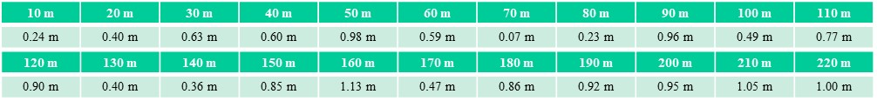
Some measured results of FTM ranging at larger distances
Wi-Fi 5 GHz VHT160 LoS ranging data was collected in Qualcomm Santa Clara campus from 10 meters to 220 meters at a step of 10 meters
RSSI dropped to around sensitivity point at 220 meters. At 230 meters, due to low RSSI, could not set up Wi-Fi 160 MHz connection
The RTT accuracy was consistent at all distances. Without averaging, the 90th percentile ranging error is 97 cm, and with 32x averaging, the 90th percentile ranging error is 20 cm
Below table shows the 90th percentile ranging error at each location. This is without averaging

Slide 7
Standard Power 6 GHz adds an important new Use Case for Wi-Fi FTM Ranging Technology
To operate in the 6GHz band at Standard Power Levels (Outdoor and Indoor), e.g.at up to 36 dBm in the US or Canada Automated Frequency Coordination (AFC) is required
To obtain the set of allowed frequencies from and AFC system, an AP needs to submit its geo location coordinates
The FCC rules prescribe that the geo location coordinates need to be determined by “either an internal geolocation capability or an integrated capability to securely connect to an external geolocation devices or service”*
GPS is seen as a likely candidate for providing internal geolocation capabilities, however:
  Not every AP will be able to obtain a GPS ‘fix’, e.g. when installed deep inside a building
  Not every 6GHz capable AP may come equipped with GPS capabilities
Wi-Fi Fine Timing Measurement Ranging capabilities for AP to AP distance measurement can assist in providing location data to AP’s that cannot obtain location information through other means
  Client to AP distance measurement may also be useful if a client is used as the source of geolocation data
*Source: FCC 2020 R&O, 15.407(k)(9)

Slide 8
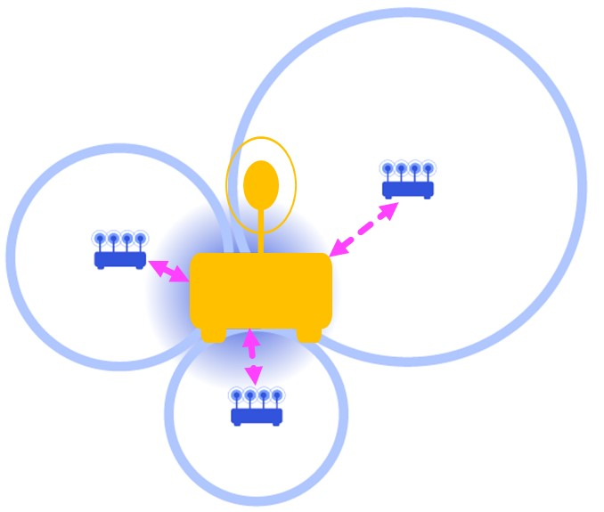

6GHz AFC FTM Ranging Use Case, Further explanation
= AP with known position
= AP that not able to generate its location
through ‘internal capabilities’
= Wi-Fi Fine Timing Measurement Ranging

Slide 9
320 MHz Standardization Options and Recommendation
Option | Considerations
TG az | Incompatible with the 802.11ax baseline requirement
TG me | Rev me does not include .11be, would have to wait for the Rev mf timeframe to address it as part of a maintenance project
TG bf | Focus of .11bf is sensing, a related but separate topic, would disrupt .11bf scope and timeline
TG be | Would be a distraction; would expand the scope of .11be and likely extend the timeline; workload is already very high
Stand Alone New Project | With the .11az work efforts wrapping up, a focused project as a follow on seems to make sense. Need for tight scope and timeline management
Recommendation is to develop a PAR and CSD for a stand alone Taskgroup for the
purpose of standardizing 320 MHz mode ranging operation

