Slide 1
802.19 July 2022 Liaison Report to 802.11
Date: 2022-07-10
Authors:

Slide 2
May IEEE 802 Wireless Interim Session
802.19 has 53 voting members as of July 2022
You must pay the registration fee in order to attend
If you have not already done so, you can register at:
http://802world.org/plenary/
If you do not intend to register for this session you must leave this meeting and, if you have logged attendance on IMAT, email the 802.19 chair or vice chair to have your attendance cancelled

Slide 3
Ballot on 802.11be Coexistence Assessment Document
The 802.19 WG voted on the 802.11be CA document
The ballot closed on June 30
The results were (Y/N/A) = 26/2/0
The document was approved
Nine comments were received, and were forwarded to the 802.11 WG

Slide 4
Discussion on 802.15.4ab and 802.11 Coexistence
There will be a discussion on coexistence between 802.15.4ab and 802.11 during the 802.11 WNG meeting
Tuesday July 12, 7:30 PM (ET)

Slide 5
IEEE 802 Wireless Standards Table of Frequency Ranges
12 Comments were received on the “IEEE 802 Wireless Standards Table of Frequency Ranges” document
The link to the Table of Frequency document is,
https://mentor.ieee.org/802.18/dcn/22/18-22-0009-00-0000-ieee-802-wireless-standards-table-of-frequency-ranges.xlsx
The link to the comment spreadsheet is,
https://mentor.ieee.org/802.18/dcn/22/18-22-0050-00-0000-comment-spreadsheet-of-ieee-802-wireless-standards-table-of-frequency-ranges.xlsx
There was no meeting in June due to schedule issues
Comment resolutions will be performed on the Wireless Frequency Table Ad Hoc, which meets on the fourth Tuesday of the month, at 3 PM Eastern Time
Webex info can be found on the 802.18 Calendar

Slide 6
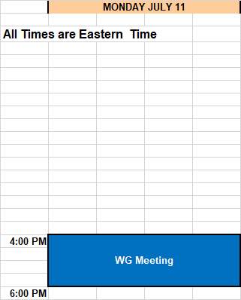
Schedule

