Slide 1
LB266 CR for latency sensitive traffic delivery
Date: 2022-07-10
Authors:
Name | Affiliation | Address | Phone | Email
Liuming Lu | OPPO |  |  | luliuming@oppo.com
Liuming Lu (OPPO)

Slide 2
Introduction
The urgencies for the delivery of the data frames belonging to r-TWT TID(s) during r-TWT SPs are not considered in current 11be draft, which would result that the data frames pending for urgent transmission can not be delivered timely.
This document proposes a candidate mechanism to ensure that more urgent QoS Data frames belonging to r-TWT TIDs are firstly delivered during a restricted TWT SP.

Slide 3
Issues
CID | Clause | Pg/Ln | Comment | Proposed Change
10437 | 35.9.5 Traffic delivery | 512.44 | It has been specified that QoS Data frames of r-TWT TID(s) are first delivered during a restricted TWT SP. It is not enough for the delivery of latency sensitive traffic as QoS Data frames of different r-TWT TIDs may have different latency requirements or different time to delay expire based on the delay bound, which means that the urgencies for the delivery of the different data frames are different. Therefore the rule or mechanism is needed to ensure that more urgent QoS Data frames of different r-TWT TIDs are firstly delivered during a restricted TWT SP. | The mechanism needs to be specified to ensure that more urgent QoS Data frames of different r-TWT TIDs are firstly delivered during a restricted TWT SP.

Slide 4
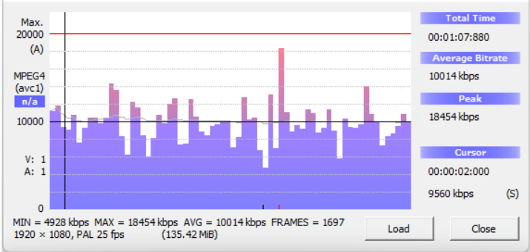
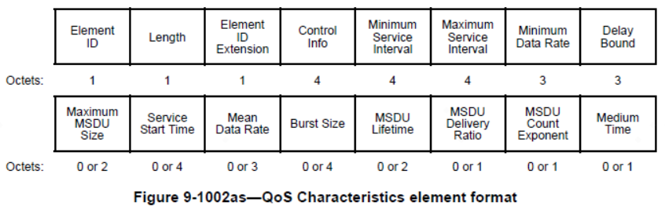
Discussion
11be has currently specified latency sensitive traffic which has stringent requirements in terms of latency and its jitter along with certain reliability constraints, and typically shows periodic pattern with burst arrival of packets.
An EHT STA establishes SCS stream with an EHT AP by transmitting an SCS Request frame containing a QoS Characteristics element, which includes a set of parameters defines the characteristics and QoS expectations of a requested traffic flow, such as Delay Bound, Minimum Data Rate, Mean Data Rate, etc.
As a reference for the AP’s scheduling the QoS Characteristics element just gives the rough data rate of the traffic. For a typical video traffic the real-time bitrate fluctuates between the minimum bitrate and the maximum bitrate, and the difference is non-negligible.
Figure. The minimum, average, and maximum bitrates of a typical video stream

Slide 5
Discussion
For the delivery of latency sensitive traffic during r-TWT SPs the QoS Data frames of different r-TWT TIDs corresponding to their respective latency sensitive traffic may have different latency requirements, which means that the urgencies for the delivery of the different data frames are different.

Slide 6
Discussion
The mechanism needs to be specified to ensure that more urgent QoS data frames of different r-TWT TIDs are firstly delivered during a restricted TWT SP. Therefore AP needs to know the urgency-based BSR information for different r-TWT TIDs of r-TWT member STAs before scheduling.
But the currently specified BSRP trigger frame and BSR frame doesn't consider the urgency-bases BSR information, which would lead to the imprecise scheduling of the delivery of the QoS data frames of latency sensitive traffic for AP.
Suggest to specify Urgency-based BSRP (U-BSRP) and Urgency-based BSR (U-BSR), both of which take the latency requirements of buffered traffic into account.

Slide 7
Candidate Solution
Measure of urgency for the delivery of an MSDU or A-MSDU with delay bound
TimetoDelayExpire(Time to delay expire): specifies the time duration from current time (T1) to the transmission delay expiration time (T2) for an MSDU or A-MSDU with the transmission requirement of delay bound belonging to a traffic flow
the transmission delay expiration time (T2) is the time marking the arrival of the MSDU, or the first MSDU of the MSDUs constituting an A-MSDU, at the local MAC sublayer from the local MAC SAP (T0) plus delay bound.
for an MSDU or A-MSDU in the buffer if its transmission delay expiration time (T2) is later than the current time (T1), its transmission delay time has not expired (denoted as TimetoDelayExpire > 0)
for an MSDU or A-MSDU in the buffer if its transmission delay expiration time (T2) is equal to or earlier than the current time (T1), its transmission delay time has not expired (denoted as TimetoDelayExpire ≤ 0)
a)A MSDU or A-MSDU with its transmission delay time having not expired
b)A MSDU or A-MSDU with its transmission delay time having expired

Slide 8
Candidate Solution
The urgency for the delivery of MSDUs or A-MSDUs belonging to r-TWT TID(s) for different STAs associated with an AP can be measured based on the parameter of TimetoDelayExpire
An example for measuring the urgency for the delivery of MSDUs or A-MSDUs at a specific time (current time)

Slide 9
Candidate Solution
Measure of the urgency for the delivery of MSDUs or A-MSDUs
(1) Based on TimetoDelayExpire Bound
TimetoDelayExpire Bound indicates the range of the urgency for the delivery of MSDUs or A-MSDUs
if the current TimetoDelayExpire of an MSDU or A-MSDU is equal to or less than TimetoDelayExpire Bound, it satisfies the condition within the range of the urgency for MSDUs or A-MSDUs in the buffer

Slide 10
Candidate Solution
Measure of the urgency for the delivery of MSDUs or A-MSDUs
(2) Based on whether the transmission delay time expires in a given time
if the transmission delay time of an MSDU or A-MSDU will expire in a given time (i.e. the TimetoDelayExpire of the MSDU or A-MSDU in the given time is equal to or less than 0) it satisfies the condition within the range of the urgency for MSDUs or A-MSDUs in the buffer

Slide 11
Candidate Solution
AP needs to schedule the delivery of the QoS data frames of the latency sensitive traffic according to their urgencies based on the current time and the delay bound of the traffic to ensure that more urgent QoS Data frames of different r-TWT TIDs are firstly delivered during a restricted TWT SP.
U-BSRP contains the information of the given urgency range, such as TimetoDelayExpire Bound, to trigger the BSR which satisfies the urgency condition.
U-BSR contains the BSR information within the given urgency range, such as the buffer status of Qos data frames with the given TID(s) of the latency sensitive traffic, which would expire within TimetoDelayExpire Bound.

Slide 12
Summary
This document proposes a candidate mechanism to ensure that more urgent QoS Data frames belonging to r-TWT TIDs are firstly delivered during a restricted TWT SP.
The formats of urgency-based BSRP (U-BSRP) and Urgency-based BSR (U-BSR) need to be further specified.

Slide 13
SP
SP1: Do you support to ensure that more urgent QoS Data frames belonging to r-TWT TIDs are firstly delivered during a restricted TWT SP?
SP2 : Do you support to specify urgency-based BSRP (U-BSRP) and Urgency-based BSR (U-BSR)?
Liuming Lu (OPPO)

