Slide 1
Clear Channel Assessment (CCA) behavior of commercial Wi-Fi equipment
Date: 2022-07-14
Authors:

Slide 2
Abstract (1)
In 2020, Federal Communications Commission (FCC) made available 5.925 GHz to 7.125 GHz for license-exempt use in the USA [1]
In 2020, Electronic Communications Committee (ECC) permitted European countries to make available 5.945 GHz to 6.425 GHz for license-exempt use [2]
In 2021, the European Commission (EC) mandated all European Union (EU) member states to implement this decision [3]

Slide 3
Abstract (2)
The ECC and subsequent EC decisions explicitly permit Narrowband Frequency Hopping (NB FH) as one mode of operation in 6 GHz
Known as EN 303 687 [4], the European Telecommunication Standards Institute (ETSI) [5] Technical Committee (TC) Broadband Radio Access Networks (BRAN) [6] develops a Harmonised Standard (HS) that specifies requirements for operation in 6 GHz
HSs enable manufacturers to put products on the EU market without type approval
The conditions for consideration of NB FH in EN 303 687 are under discussion
In this presentation, we analyze how commercial Wi-Fi products react to NB FH signals present in the same frequency channel

Slide 4
Frequency Hopping Traffic
Emulation of future NB FH radio signals
A 2 MHz band limited additive gaussian noise (BLAGN) signal is produced in baseband
BLAGN signal transmitted into Wi-Fi channel at different offsets from the Wi-Fi channel center frequency
Transmitted as pulses with varying dwell times and duty cycles, emulating hopping in and out of the specified Wi-Fi channel

Slide 5
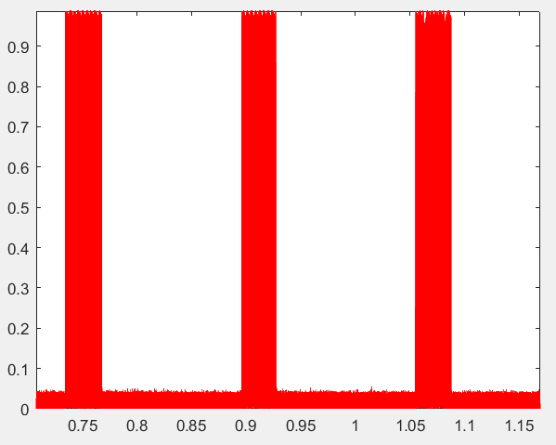
NB FH Signals in Time Domain
20 % Duty Cycle, 60 ms dwell time NB FH Signal
Dwell Time
Duration that signal is active
T
Periodicity of the signal
Duty Cycle
Ratio of dwell time to period
Dwell Time
Normalized absolute magnitude
T
Time (s)

Slide 6
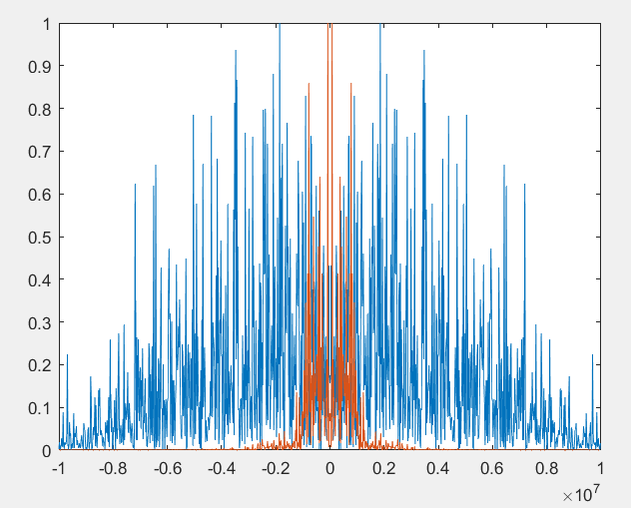
PSD of NB FH and Demodulated Wi-Fi link
PSD of NB FH & Wi-Fi Channel
Power Spectral Density (PSD) of NB FH transmission shown in red
PSD of demodulated Wi-Fi transmission (captured by software defined radio) shown in blue
Normalized Power/Frequency
Frequency (Hz)

Slide 7
Test setup
Monitor UDP traffic (iperf) from source to sink over Wi-Fi link
Measured throughput averaged over 60 s
Measuring impact on throughput
As percentage of throughput of un-interfered Wi-Fi link (nominal throughput)
NB FH signal strength is 6 dB lower than Wi-Fi
Wi-Fi signal strength at receiving station: −52 dBm
NB FH signal strength at receiving station: −58 dBm
Various combinations of NB FH duty cycle, dwell time, and frequency offset
Automated testing of 245 combinations

Slide 8
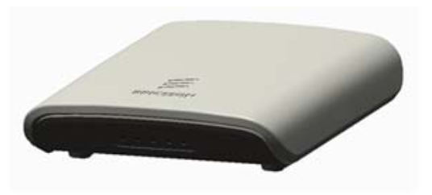
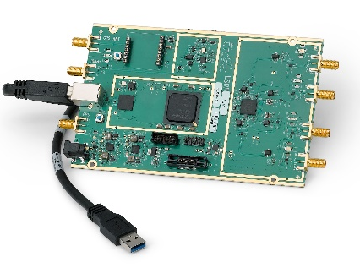
Test Setup (Diagram)
Ethernet cable
Co-axial cable
Co-axial power splitter
Emulating Competing Traffic
AP #1
AP #2
Attenuator
Attenuator
PC: Traffic source (iperf client, UDP)
PC: Traffic sink (iperf server, UDP)
USRP B210 [7] #1: Configured to transmit NB FH signals
USRP B210 #2: Configured to observe the channel
RF-Isolation Chamber

Slide 9
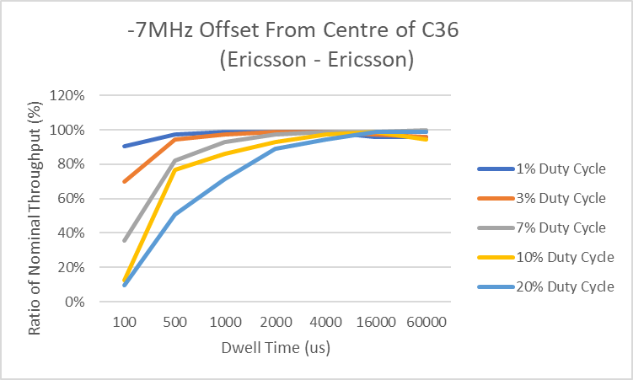
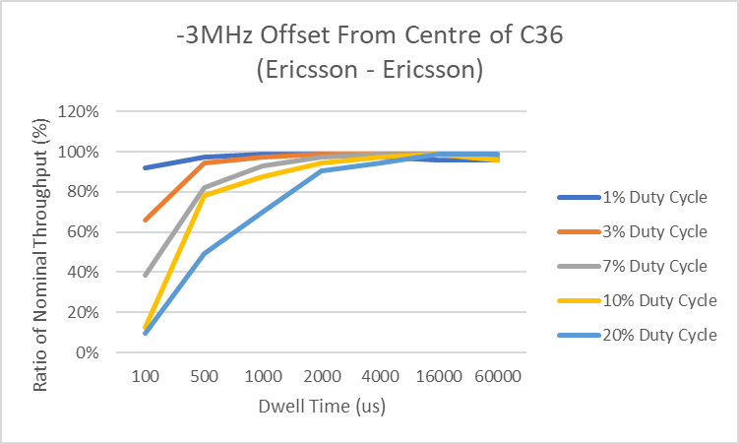
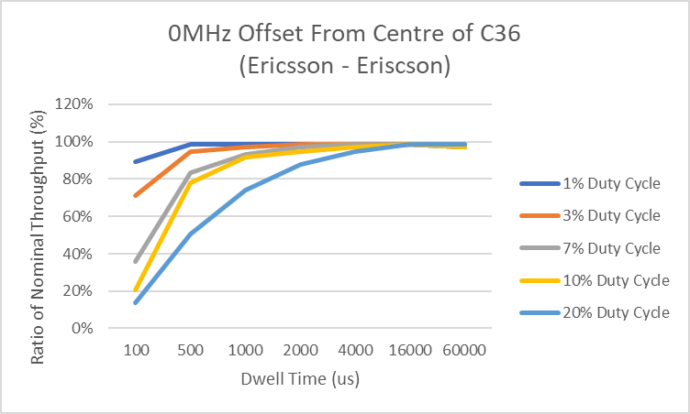
2 MHz NB FH Signals—Impact on Wi-Fi Throughput

Slide 10
Detailed Analysis of Impact on Wi-Fi Throughput
Results show consistently:
Higher duty cycle and less dwell time has the highest impact on the Wi-Fi channel
Throughput ∝ Dwell time
Worst case throughput less than 20 % of maximum Wi-Fi throughput
Very little impact on Wi-Fi throughput at longer dwell times for each duty cycle tested
Across all scenarios, short dwell time has largest impact on Wi-Fi throughput
Increased duty cycle results in decreased throughput

Slide 11
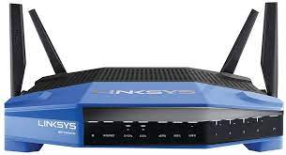
Impact of NB FH Signals on other commercial Wi-Fi Devices
Experiments repeated with Linksys device
Same 245 test cases as in previous setup
Linksys device used as traffic sink
Linksys WRT3200ACM

Slide 12
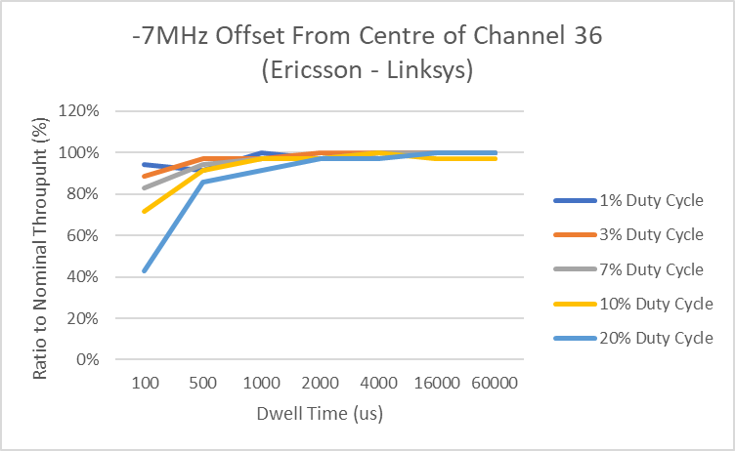
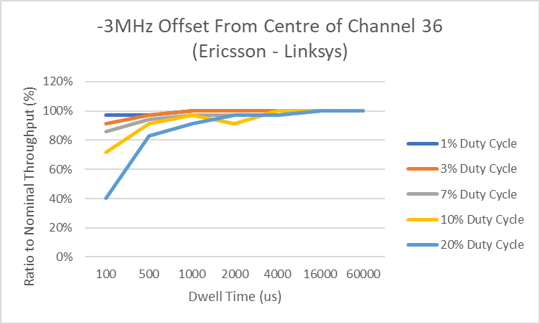
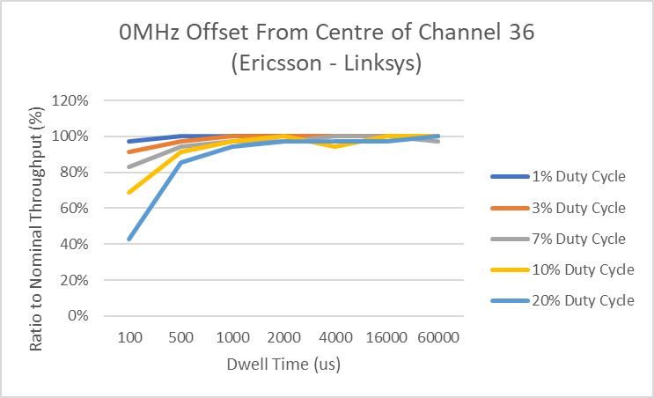
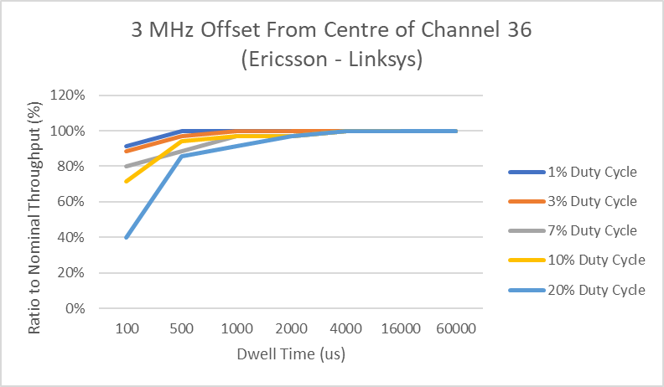
2 MHz NB FH Signals—Impact on Wi-Fi Throughput (Linksys device as receiver)

Slide 13
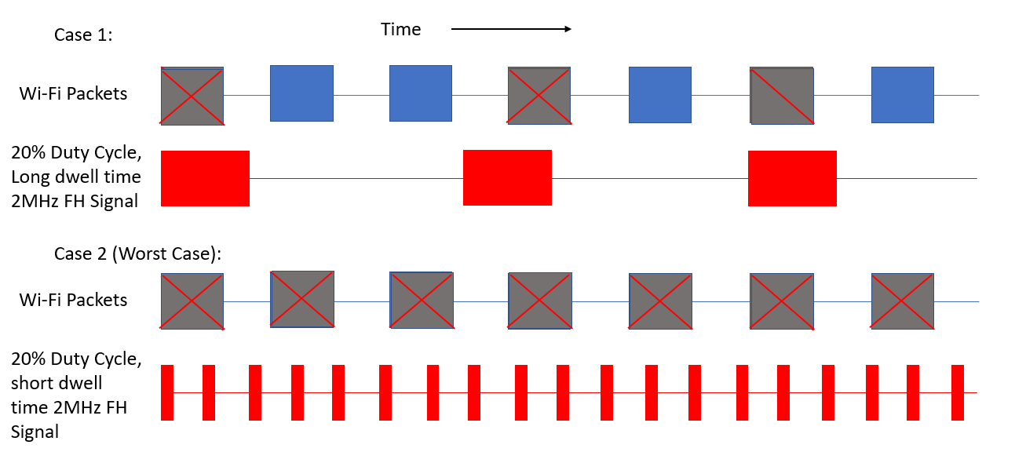
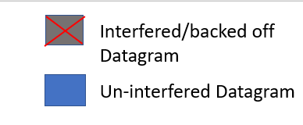
Impact of Dwell Time on Wi-Fi throughput
Case 1:
Time

Slide 14
Impact of Dwell Time on Wi-Fi throughput
Case 1:
Time

Slide 15
Reason for Wi-Fi performance impact?
Wi-Fi fails to detect NB FH signals via CCA
Wi-Fi datagrams are transmitted over NB FH transmissions, thus resulting in reception errors
Wi-Fi detects NB FH signals via CCA
Wi-Fi will back-off and delay its transmission, thus reducing throughput

Slide 16
Assumption: Wi-Fi has issues consistently detecting all NB FH transmissions
Two additional measurements conducted
Observation of radio channel
Identify concurrent transmissions (Wi-Fi and NB FH)
Modify Wi-Fi product’s firmware to output CCA internal states
Busy and idle states

Slide 17
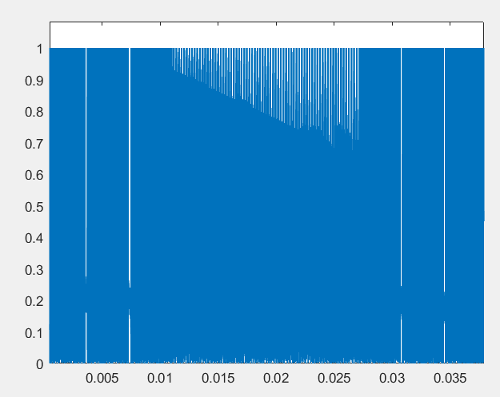
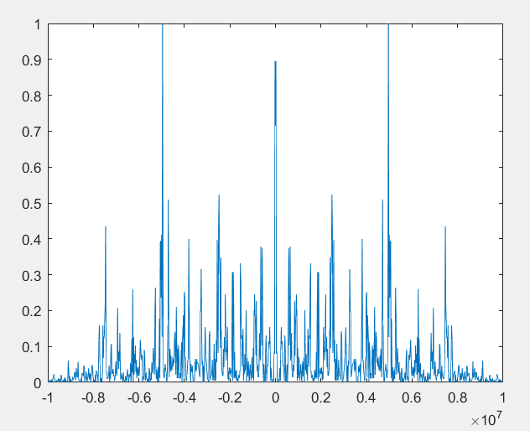
1. Observing the Channel
Recording of Wi-Fi and NB FH transmissions
PSD during NB FH transmission
Normalized Amplitude of recorded Signal
Normalized Power/Frequency
NB-FH Transmission
Time (s)
Frequency (Hz)

Slide 18
2. Observing CCA Mechanism’s Internal States
Modified access point
Capable of logging the internal state of CCA mechanism
Records duration that AP deems channel to be occupied
No Wi-Fi traffic (generation of beacons and all other management traffic disabled)
Pure passive monitoring
Compare
Known transmission duration
with
Channel occupation duration as determined by Wi-Fi CCA mechanism
Modified AP
RF-Isolation Chamber
Attenuator
USRP B210 configured to transmit NB FH signals

Slide 19
Detectability of NB FH Transmissions
NB FH signal setup
Signal strength of −45 dBm at Wi-Fi receiver
20 % duty cycle
Varying dwell times
CCA mechanism fails to reliably detect NB FH signals transmitted at longer dwell times
Dwell Time | Detection ratio
100 µs | 54.05 %
500 µs | 13 %
1000 µs | 6.65 %
2000 µs | 3.4 %
4000 µs | 1.7 %
16 000 µs | 0.44 %
60 000 µs | 0.125 %

Slide 20
Summary
Dwell time of NB FH signals impacts Wi-Fi throughput
Wi-Fi CCA mechanism is unable to reliably detect NB FH signals
Results are consistent across many portions of the Wi-Fi channel
Offset from centre frequency has no observable impact
Results are consistent across multiple Wi-Fi devices
Although Linksys device is less affected than Ericsson device

Slide 21
DEMO
One moment please…

Slide 22
References
Federal Communications Commission, “FCC adopts new rules for the 6 GHz band, unleashing 1,200 Megahertz of spectrum for unlicensed use,” Apr. 23, 2020. [Online]. Available: https://docs.fcc.gov/public/attachments/DOC-363945A1.pdf
Electronic Communications Committee, “On the harmonised use of the frequency band 5945-6425 MHz for Wireless Access Systems including Radio Local Area Networks (WAS/RLAN),” ECC Decision (20)01, Nov. 20, 2020. [Online]. Available: https://docdb.cept.org/download/1448
European Commission, “On the harmonised use of radio spectrum in the 5 945-6 425 MHz frequency band for the implementation of Wireless Access Systems including Radio Local Area Networks (WAS/RLANs),” Commission implementing decision (EU) 2021/1067, Jun. 17, 2021. [Online]. Available: https://eur-lex.europa.eu/legal-content/EN/TXT/PDF/?uri=CELEX:32021D1067
ETSI, “6 GHz WAS/RLAN; Harmonised Standard for access to radio spectrum,” Draft ETSI EN 303 687, Apr. 2022. [Online]. Available: https://www.etsi.org/deliver/etsi_en/303600_303699/303687/01.00.00_20/en_303687v010000a.pdf
European Telecommunication Standards Institute (ETSI), “About ETSI,” accessed Jul. 2022. [Online]. Available: https://www.etsi.org/about
ETSI Technical Committee (TC) Broadband Radio Access Networks (BRAN), “BRAN Summary,” accessed Jul. 2022. [Online]. Available: https://portal.etsi.org/TB-SiteMap/BRAN/Summary
Ettus Research, “Universal Software Radio Peripheral Board 210,” accessed Jul. 2022. [Online]. Available: https://www.ettus.com/all-products/ub210-kit/

