Slide 1
Applying ML to 802.11: Current Research and Emerging Use Cases
Date: 2022-07-13
Authors:

Slide 2
Abstract
In this contribution, we give an overview of recent research into applying ML to improve 802.11 performance. Then, we define emerging use cases and discuss how they can be supported by the 802.11 standard.

Slide 3
Presentation Scope
Based on recent survey [1]
Only 802.11 performance improvement
Out-of-scope areas
  Security (e.g., detecting attacks)
  Energy efficiency (e.g., power saving)
  Dedicated applications of 802.11
    Device positioning
    Human activity detection
    Wireless sensing
[1] S. Szott et al., "Wi-Fi Meets ML: A Survey on Improving IEEE 802.11 Performance with Machine Learning," in IEEE Communications Surveys & Tutorials, doi: 10.1109/COMST.2022.3179242.

Slide 4
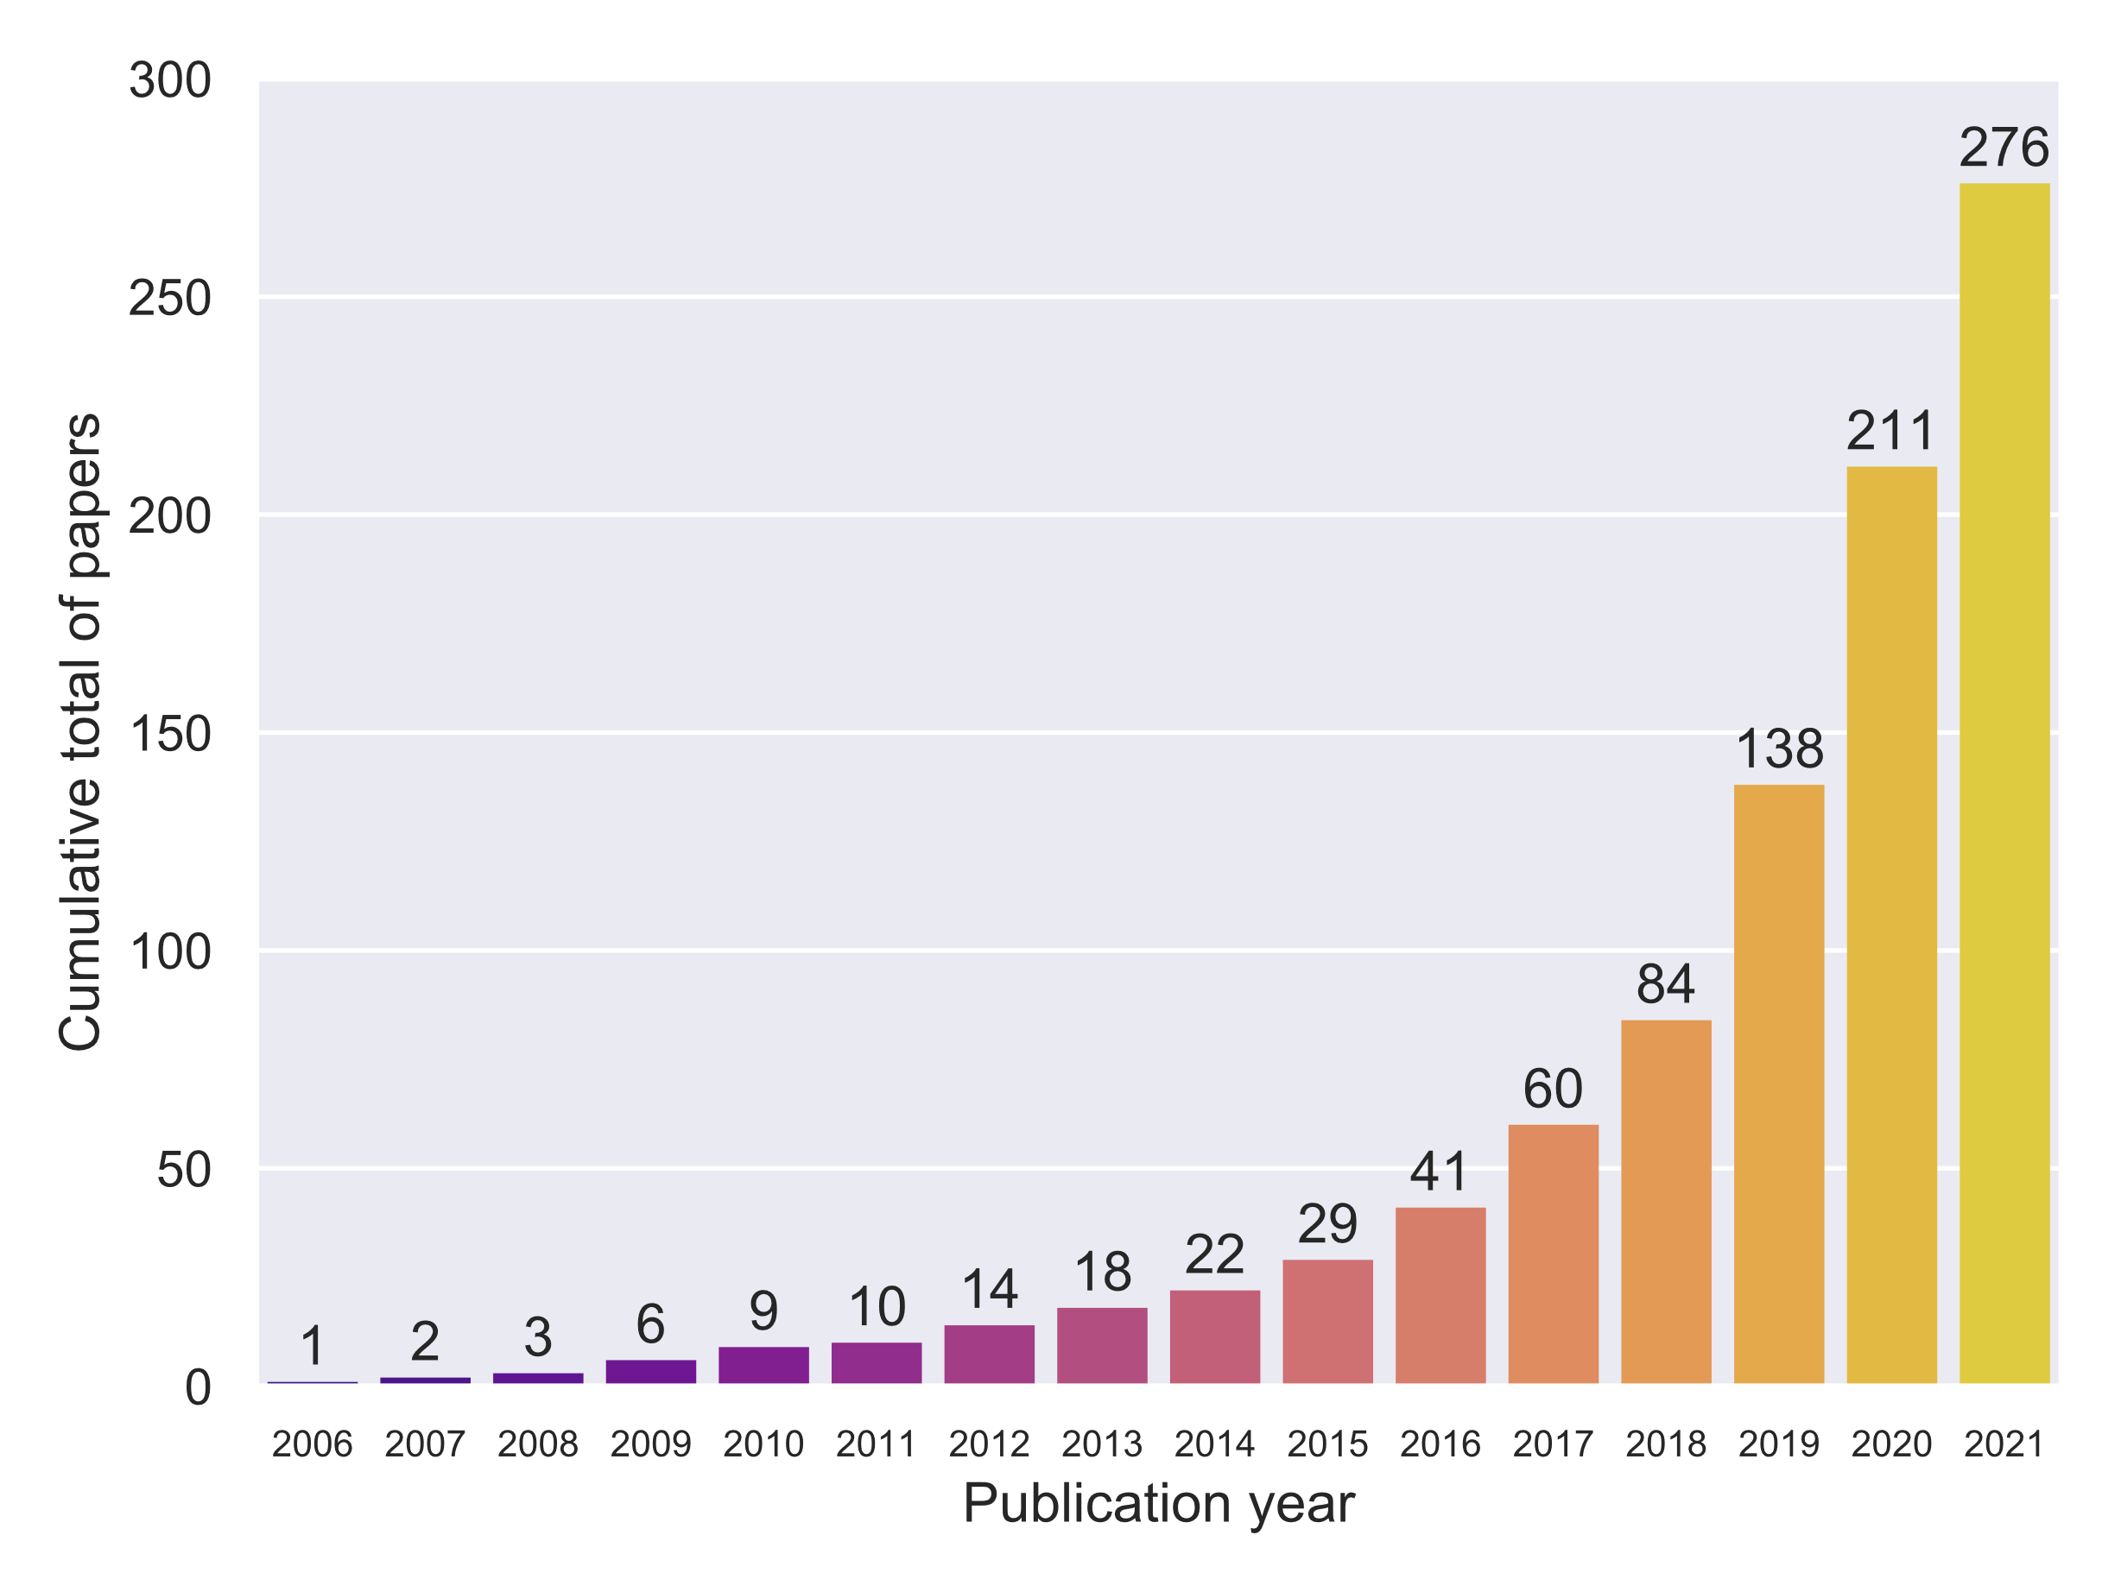
Research Interests ML & 802.11
Increased research interest in applying ML to improve 802.11 performance, especially since 2019

Slide 5
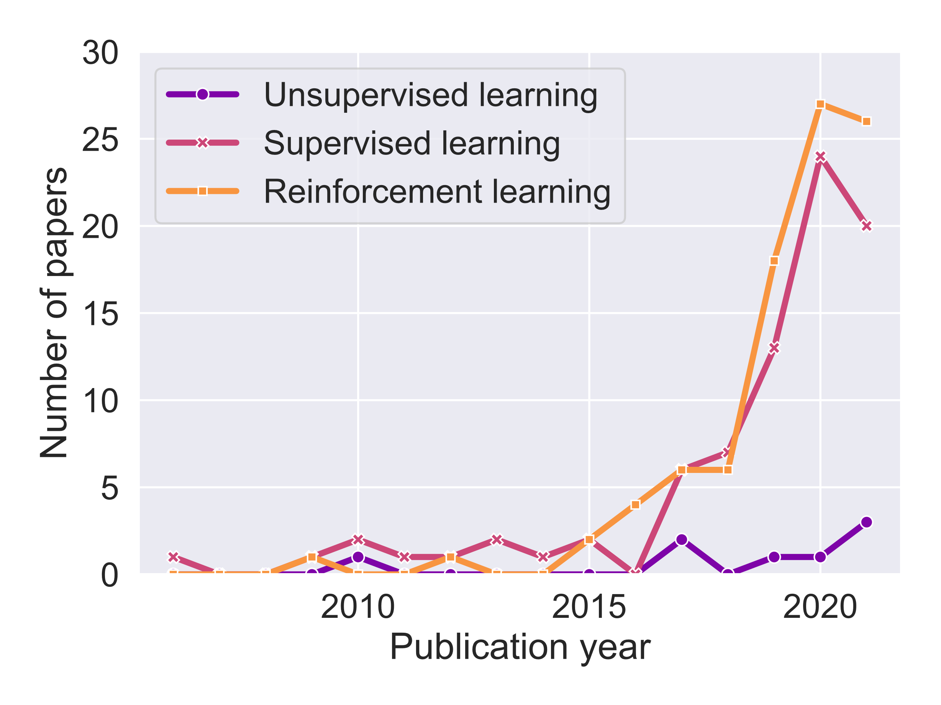
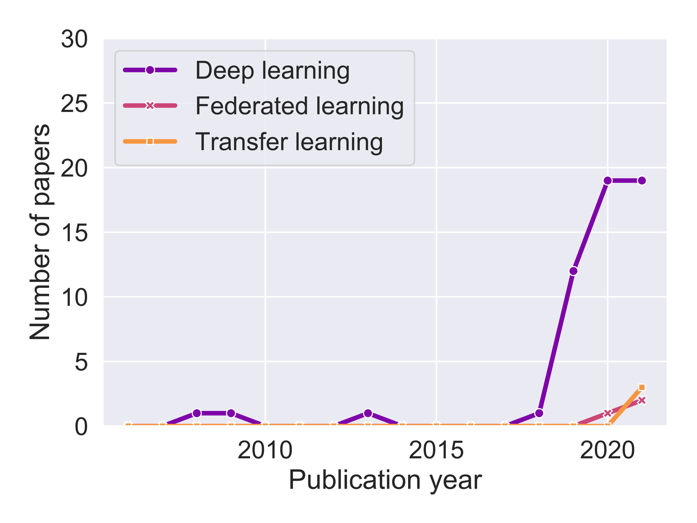
Which ML areas are used?
SL and RL are frequently used, while UL is less popular.
The most often used ML mechanisms are Q-learning, multi-armed bandit, as well as different neural network types (mostly ANN, DNN, and CNN), usually implemented to optimize a constrained set of 802.11 parameters.
With the increase in available computing power, DL methods are gaining in popularity.
Federated learning and transfer learning are a recent introduction in the 802.11 domain.

Slide 6
How is ML used?
Core 802.11 features
Channel access (e.g., collision reduction)
Link configuration (e.g., rate adaptation)
PHY-related (e.g., interference management)
Recent 802.11 features
Beamforming (e.g., beam selection)
Multi-user communication (e.g., RU scheduling)
Spatial reuse (e.g., select transmit power)
Channel bonding (e.g., select channel and bandwidth)

Slide 7
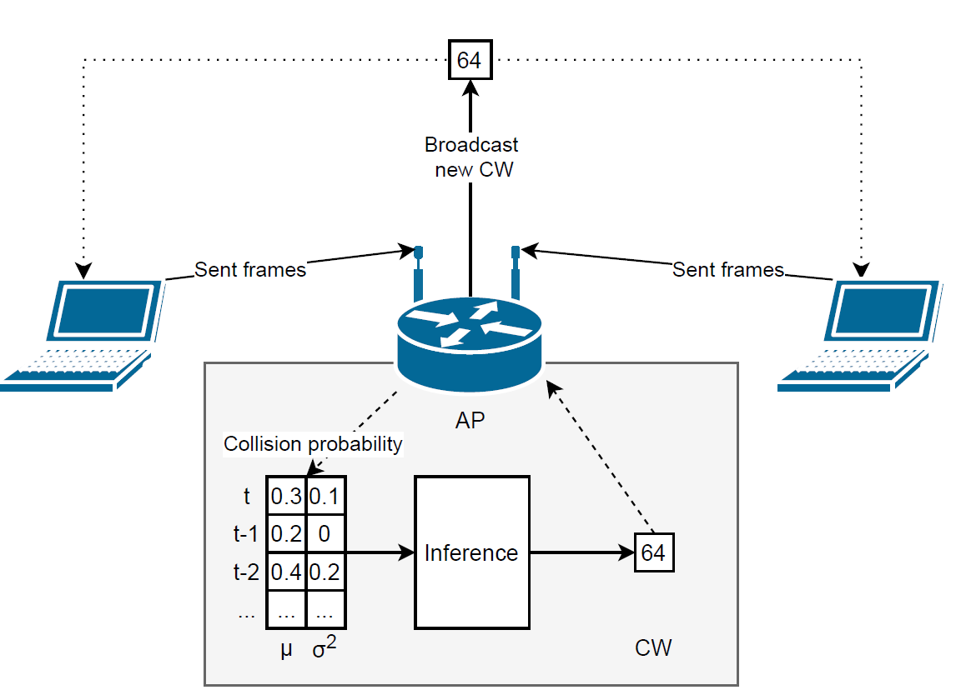
Example Deep Reinforcement Learning Use Case [2]
An agent at the AP configures CW values (action) based on collision probability measurements (observation) to increase network throughput (reward).

Slide 8
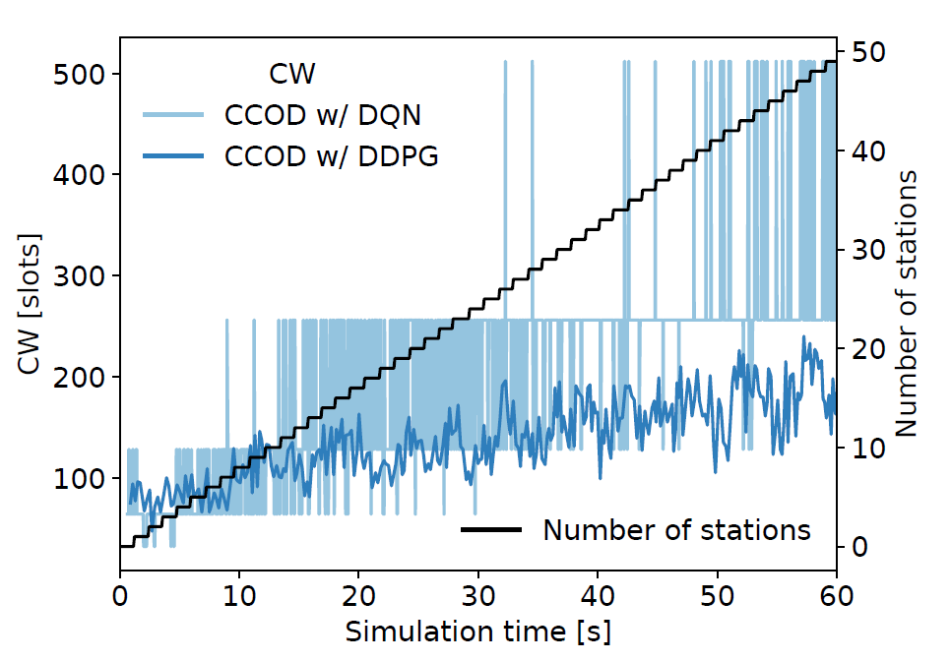
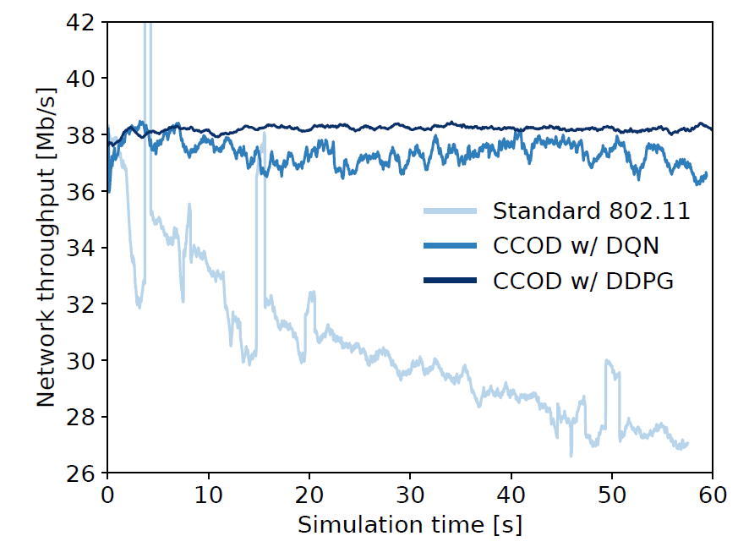
Example Use Case Cont’d [2]
“As the number of contending stations steadily increases over time (left), the AP monitors the collision probability and uses RL to select the CW value for all associated stations to maintain throughput higher than under legacy operation (right). The example shows two RL algorithms that use different types of output (DQN – discrete, DDPG – continuous) and which explore the available parameter space in search of better CW values (left).” [1]

Slide 9
Channel Access Control
Popular area of research
Application of ML
  Select CW value
    Or CWmin
    Together with AIFS
  Select CW update rule
  Select time slot for transmission
ML category: mostly RL
ML improvement: higher throughput

Slide 10
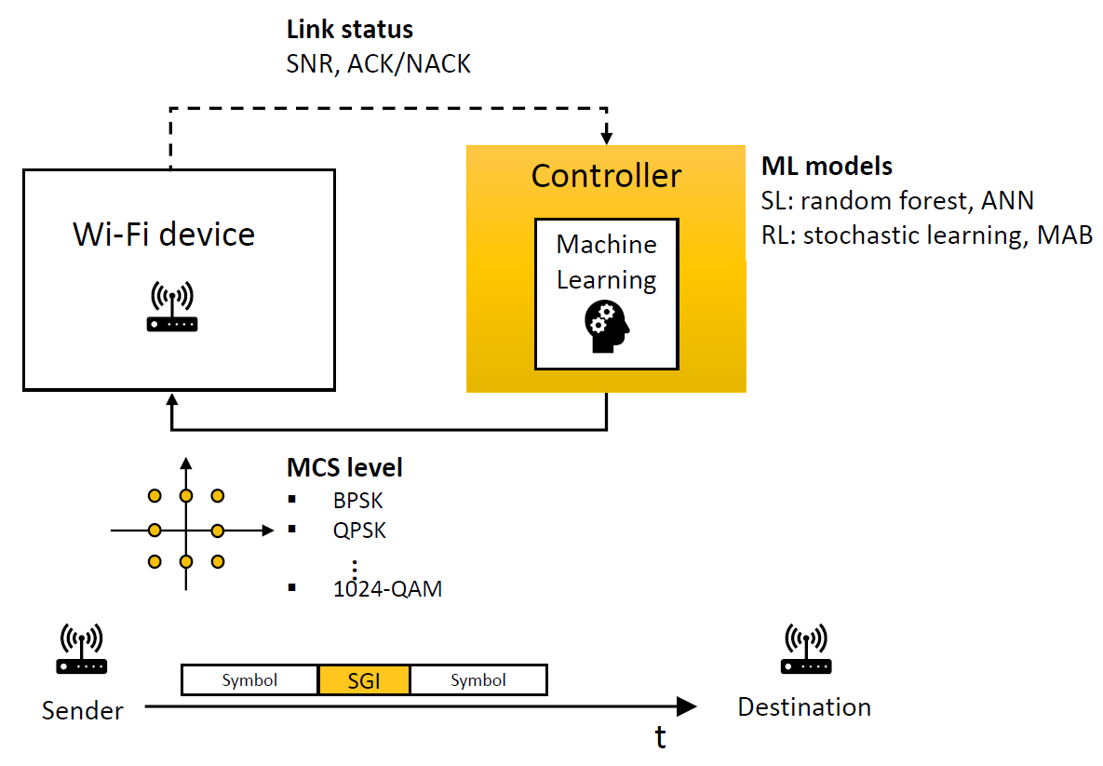
Link Adaptation
Application of ML
  Select transmission rate
  Classify channel type
  Predict link-layer throughput
ML category
  Mostly RL but also SL (e.g., Random Forest)
ML improvement: higher throughput

Slide 11
PHY Features
Application of ML
  Decode frames
  Classify signal source
  De-noise signals
  Estimate interference level
ML category: mostly SL
ML improvement: high accuracy

Slide 12
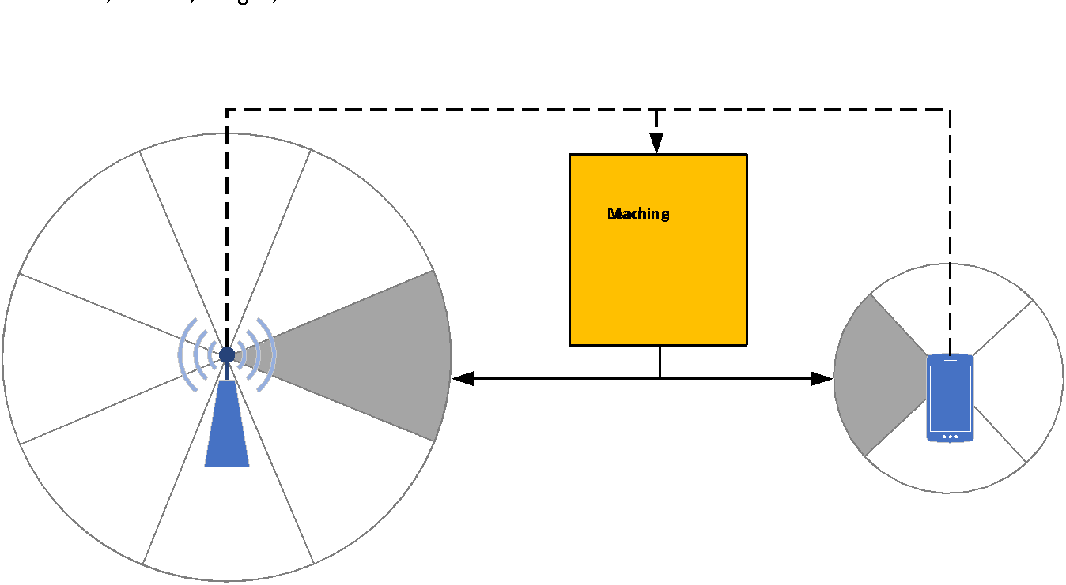
Beamforming
Application of ML
  Select
    Beam sector
    Beamwidth
    Transmit power
    AP
  Classify channel type
  Predict channel characteristics
  Select transmission rate
ML category: mostly SL
ML improvement
  higher throughput, reduced exploration time

Slide 13
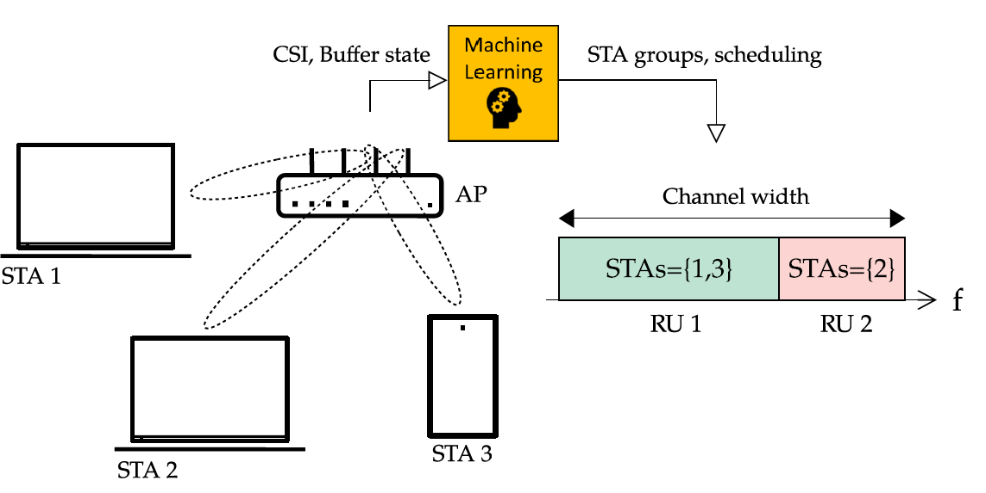
Multi-User Communication
Application of ML
  Select users, spatial mode, transmission rate
  Schedule RUs
  Select MU-MIMO group
ML category: both SL and RL
ML improvement: higher throughput

Slide 14
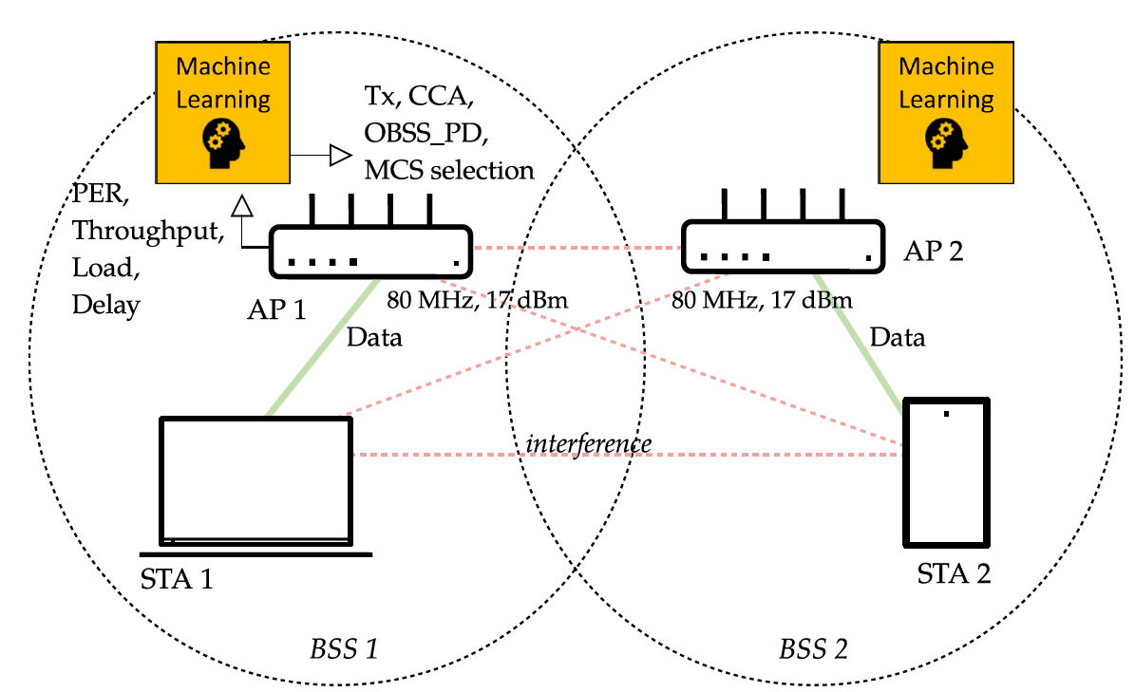
Spatial Reuse
Application of ML
  Select channel and transmit power
  Select carrier sense threshold, transmission rate and power
  Decide whether to transmit concurrently
ML category: mostly RL
ML improvement: higher throughput, lower latency

Slide 15
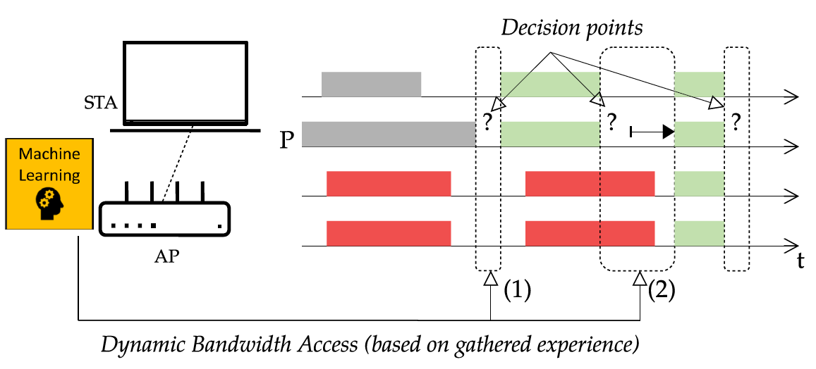
Channel Bonding
Application of ML
  Select channel and bandwidth
  Predict throughput
  Decide whether to transmit concurrently
ML category: mostly RL
ML improvement
  Higher throughput
  Lower latency

Slide 16
Other Areas
Predicting traffic and link quality
Channel sharing with other technologies (LAA, NR-U)
Multi-hop networks
  Ad hoc (e.g., routing)
  Mesh (e.g., AP selection)
  Sensor (e.g., select 802.11ah RAW values)
  Vehicular (e.g., location prediction-based scheduling)
More details in [1]

Slide 17
Future Research Directions
Optimizing new 802.11 features
  802.11be multi-link operation
Joint parameter optimization
  E.g., transmit power and carrier sensing threshold
Embedding ML in 802.11 features
ML-based architectures and standardized interfaces
Reference evaluation scenarios
Distributed learning

Slide 18
Emerging Use Cases
Use case #1. ML-based 802.11 parameter selection
  Observe/monitor network
  Select (quasi-static) values
  Use/disseminate new values
Use case #2. ML-based logic installation
  Install pre-trained agents
    Network controllers → APs
    AP → STAs
Control loop

Slide 19
802.11 Support for ML Use Cases (1)
Use case #1. ML-based 802.11 parameter selection
Example of good support: rate selection
Well defined action space (set of MCS values)
Independent behavior of each STA
Small possibility of misuse
Example of poor support: CW selection
Clear but rigid behavior in 802.11 spec
No room for independent behavior
Possibility for misuse – select CW selfishly [3]

Slide 20
802.11 Support for ML Use Cases (2)
Use case #1. ML-based 802.11 parameter selection
Questions for TIG:
Rate selection has good interface → Does the 802.11 std provide sufficient interfaces for configuring other parameters?
CW selection is rigid → Can parameter selection rules be relaxed in the standard?
Proposal: define an API for RL applications optimizing 802.11
ns3-gym, the interface between ns-3 (802.11 simulator) and OpenAI Gym (RL) has been successful [4]

Slide 21
802.11 Support for ML Use Cases (3)
Use case #2. ML-based logic installation
Requires support for SDN-like behavior [5, 6, 7]
Questions for TIG:
Is distributing logic in the scope of the 802.11 std?
If so, how do we define the supporting architecture?
Related Work in other SDOs
IETF’s Autonomic Networking (RFC 7575)
ETSI’s Generic Autonomic Networking Architecture [8]

Slide 22
Summary
A survey of the research on applying ML for improving 802.11 performance leads to two use cases:
1. ML-based parameter selection
2. ML-based logic installation (dissemination)
The TIG should address the technical feasibility of supporting these use cases within the 802.11 standard.

Slide 23
References
[1] S. Szott et al., "Wi-Fi Meets ML: A Survey on Improving IEEE 802.11 Performance with Machine Learning," in IEEE Communications Surveys & Tutorials, doi: 10.1109/COMST.2022.3179242.
[2] W. Wydmański and S. Szott, "Contention Window Optimization in IEEE 802.11ax Networks with Deep Reinforcement Learning," 2021 IEEE Wireless Communications and Networking Conference (WCNC), 2021, pp. 1-6, doi: 10.1109/WCNC49053.2021.9417575.
[3] S. Szott, M. Natkaniec, and A.R. Pach. "An IEEE 802.11 EDCA model with support for analysing networks with misbehaving nodes." EURASIP Journal on Wireless Communications and Networking 2010 (2010): 1-13.
[4] P. Gawłowicz and A. Zubow. "Ns-3 meets OpenAI gym: The playground for machine learning in networking research." In Proceedings of the 22nd International ACM Conference on Modeling, Analysis and Simulation of Wireless and Mobile Systems, pp. 113-120. 2019.
[5] G. Bianchi et al.. "MAClets: active MAC protocols over hard-coded devices." In Proceedings of the 8th international conference on Emerging networking experiments and technologies, pp. 229-240. 2012.
[6] R. Chaparadza et al., "SDN enablers in the ETSI AFI GANA Reference Model for Autonomic Management & Control (emerging standard), and Virtualization impact," 2013 IEEE Globecom Workshops (GC Wkshps), 2013, pp. 818-823, doi: 10.1109/GLOCOMW.2013.6825090.
[7] P. Gallo et al., "CADWAN: A Control Architecture for Dense WiFi Access Networks," in IEEE Communications Magazine, vol. 56, no. 1, pp. 194-201, Jan. 2018, doi: 10.1109/MCOM.2017.1601097.
[8] R. Chaparadza et al., "Implementation Guide for the ETSI AFI GANA model: A Standardized Reference Model for Autonomic Networking, Cognitive Networking and Self-Management," 2013 IEEE Globecom Workshops (GC Wkshps), 2013, pp. 935-940, doi: 10.1109/GLOCOMW.2013.6825110.

