Slide 1
Use Cases for AMP IoT Devices
July 2022
Doc.: IEEE 802.11-22/0963r0
Date: 2022-07-08
Authors:
Name | Affiliation | Address | Phone | Email
Shengjiang Cui | OPPO
Weijie Xu
Lei Huang
Zhisong Zuo |  |  |  | zuozhisong@oppo.com
Chuanfeng He
Rongyi Hu
Zhi Zhang

Slide 2
Background(1)
July 2022
Doc.: IEEE 802.11-22/0963r0
IEEE 802.11 has achieved great success in wireless communication area
  Series of standards for wireless broadband communication including (802.11b/a/g/n/ac/ax/be) have been developed and specified, which have well met the market need and brought in excellent user experience.
  Series of technologies targeting for verticals including 802.11ah have been developed and specified.
Battery-free communication---A new market chance
  Generally, one conventional battery is needed to power the STA for currently technologies. However, in more and more use cases battery-free devices are required, which opens one new market.
  Technologies needs to be investigated and developed to support battery-free communication.

Slide 3
Background(2)
July 2022
Doc.: IEEE 802.11-22/0963r0
Why battery-free communication is urgent?
  User experience has been significantly affected by the limited battery life of legacy communication technologies
  There would be huge amount of expenditure in maintaining fast growing IoT network driven by conventional battery(including labor cost and battery cost)
  For extreme environmental conditions, it is challenging and difficult to maintain the IoT network
  Battery-free communication would be much more environmentally friendly and more safer for kids and the elder
  By getting rid of the battery, the size and the cost of the device can be significantly reduced. Therefore, expansion to much more applications can be expected

Slide 4
Background(3)
July 2022
Doc.: IEEE 802.11-22/0963r0
Current battery-free technologies
  RFID, as one typical battery-free technology, has been widely adopted in areas such as retail, logistics and supply chain, healthcare, manufacturing etc.
Explosive market growth is predicted for battery-free tags and sensors
  The RFID Market is projected to reach USD 35.6 billion by 2030 from USD 14.5 billion in 2022 and it is expected to grow at a CAGR of 11.9% from 2022 to 2030[1].
  The RFID sensor market is expected to expand from an output of 18,836.5 million units in 2021 and surpass 49,116.4 million units by 2031[2].

Slide 5
Motivation of support AMP IoT devices in WLAN
July 2022
Doc.: IEEE 802.11-22/0963r0
Ambient power-enabled IoT (AMP IoT) [3]
  AMP IoT is an IoT service with IoT devices powered by energy harvesting from radio waves, solar/light, or any other possible power sources.
Advantages of support AMP IoT in WLAN
  WiFi has been widely deployed all over the world . It has a large user base and mature ecosystem.
  WiFi has low deployment cost thanks to concise network architecture, low-cost AP and free frequency bands.
  Legacy WiFi technologies have already been widely deployed in verticals, such as manufacturing, smart home, etc. But further success is restricted due to the cost of the device, limited battery life and maintenance cost.
  The competitiveness of WiFi can be improved if ultra-low cost device, maintenance-free network can be supported
  Compared with RFID, obvious advantages of AMP IoT can be expected:
    Kinds of ambient power besides radio waves can be utilized thus it can adapt to more deployment scenarios
    have longer communication distance and improved system capacity by proper design

Slide 6

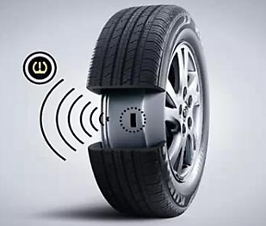
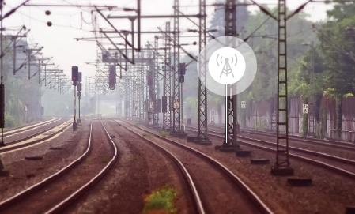
Use case #1: Industrial Wireless Sensor Network
July 2022
Doc.: IEEE 802.11-22/0963r0
AMP IoT can be used for
  Industrial environment/production line monitoring
  Asset tracking/positioning
Requirements
  Maintenance-free IoT network, long service life. Battery-less IoT device (i.e., not using a conventional battery).
  Coverage: up to 30m for indoor case, up to 100m for outdoor case
  Data rate: 100kbps

Slide 7
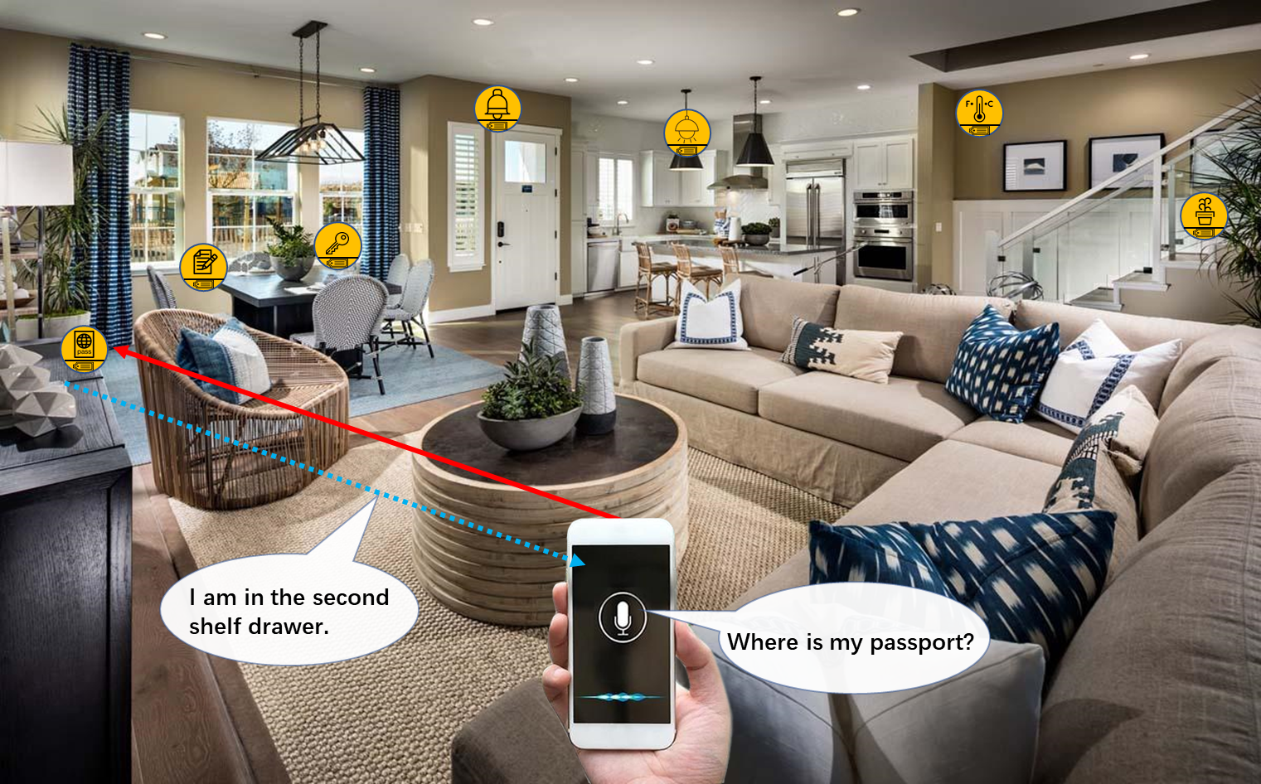
Use case #2: Smart home
July 2022
Doc.: IEEE 802.11-22/0963r0
    AMP IoT can be used in the following applications:
  Asset management: finding home belongings
  Home environment monitoring: e.g., temperature, humidity, gas leakage etc.
  Home security: intruder detection.
    Requirements
  Low complexity and small size, e.g., thickness of 1mm and area of several cm²
  Long service life., e.g., more than 10 years.
  No need to replace/recharge a conventional battery, e.g. Maintenance-free for battery
  Coverage up to 10m
  Positioning accuracy of 1~3m

Slide 8
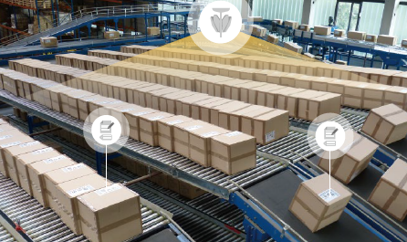
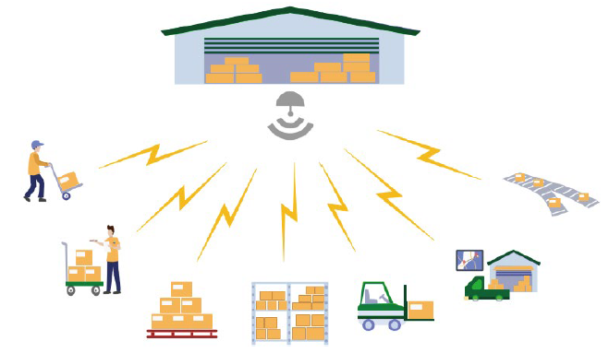

Use case #3: Logistics and warehousing
July 2022
Doc.: IEEE 802.11-22/0963r0
    AMP IoT device can be attached on the packet for goods tracking when they are being transferred, stored, loaded/unloaded, and inventoried for logistics and warehousing.
    Requirements of the IoT devices:
  Battery-less, thus no need to use a battery
  Low complexity and small size, e.g., thickness of 1mm and area of no larger than several cm²
  Coverage: up to 30m for indoor case, up to 100m for outdoor case
  Processing (i.e., reading IDs) hundreds to thousands of devices per second.

Slide 9
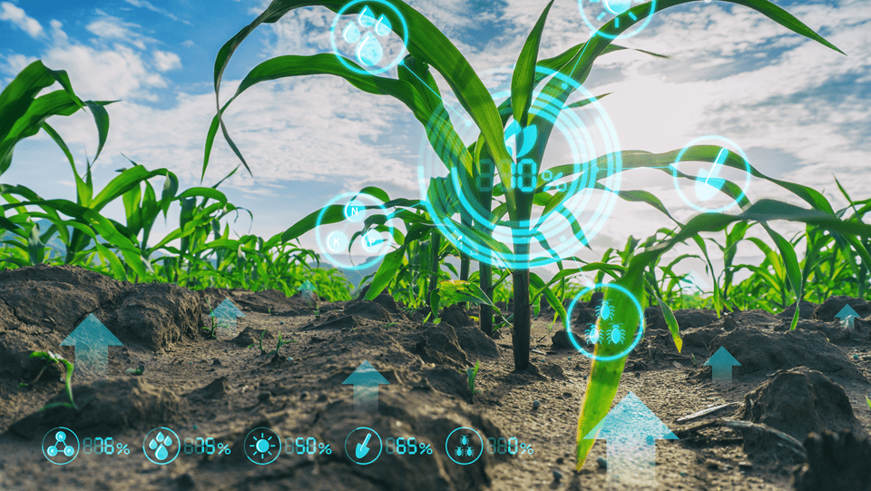
Use case #4: Smart Agriculture
July 2022
Doc.: IEEE 802.11-22/0963r0
    AMP IoT devices can be used to monitor soil moisture, soil fertility, temperature, wind speed, plant growth etc. It can also be used to control the agricultural facilities such as irrigation system.
    Requirements of the AMP IoT devices:
  Maintenance-free for battery, e.g., no battery replacement/recharging
  Support hundreds to thousands of device connections
  Coverage: up to 200m
  Data rate: 100kbps~1Mbps

Slide 10
Summary
July 2022
Doc.: IEEE 802.11-22/0963r0
This submission presents
  Motivation of supporting AMP IOT devices in WLAN
  Four typical use cases for AMP IoT devices, including
    Industrial Wireless Sensor Network
    Smart Home
    Logistics and warehousing
    Agriculture

Slide 11
Reference
July 2022
Doc.: IEEE 802.11-22/0963r0
11-22-0645-00-0wng-ambient power enabled IoT for Wi-Fi
https://www.marketsandmarkets.com/Market-Reports/rfid-market-446.html?gclid=EAIaIQobChMI1KnTy-Tl-AIVydeWCh1CqArgEAAYASAAEgJhX_D_BwE
https://www.transparencymarketresearch.com/rfid-sensor-market.html

