Slide 1
Potential Techniques to Support AMP IoT Devices in WLAN
July 2022
Doc.: IEEE 802.11-22/0962r0
Date: 2022-07-08
Authors:
Name | Affiliation | Address | Phone | Email
Weijie Xu | OPPO |  |  | xuweijie@oppo.com
Lei Huang
Chuanfeng He
Zhisong Zuo
Shengjiang Cui
Rongyi Hu
Zhi Zhang

Slide 2
Outline
July 2022
Doc.: IEEE 802.11-22/0962r0
Challenges of support AMP IoT devices
AMP IoT device types
Potential functional requirements
Potential technologies
Summary
Reference

Slide 3
Challenges of support AMP IoT devices
July 2022
Doc.: IEEE 802.11-22/0962r0
  In order to support AMP IoT devices in Wi-Fi system, there may be some challenges:
  Devices with extremely-low complexity need to be supported
    e.g., simplified RF and baseband architecture, limited memory etc.
    e.g., may not be able to support OFDM
  Devices with ultra-low power consumption need to be supported
    e.g., only several to tens of micro-Watt power can be harvested using wireless radio waves
    e.g., less than 1 mill-Watt power can be harvested using solar panel of 1cm²
  Power-hungry operation due to non-ideal power supply using energy harvester
    e.g., only small amount of power can be harvested in most of the use cases
    e.g., the harvested power is not stable
  Compatibility and coexistence with legacy Wi-Fi system is still required

Slide 4
Possible AMP IoT device types
July 2022
Doc.: IEEE 802.11-22/0962r0
AMP-only IoT device
  has ultra-low complexity (e.g., small bandwidth less than 1 MHz, not support OFDM etc.), ultra-low power consumption (e.g., maximum power consumption of less than 1mw).
  uses power harvested from ambient power source(s) and can be battery-less or has very limited power storage capability (e.g., less than 20mAh).
  can be used for asset management, tracking etc. in use cases such as smart home, logistics and warehouse, manufacturing etc.
AMP-assisted IoT device
  May be similar to legacy 802.11 (e.g., 802.11n/11ah) device, but with enhanced MAC features (e.g., enhanced power management & power saving) to well adapt to operation with kinds of ambient power.
  can use power harvested from ambient power source(s) and have higher power storage capability than AMP-only IoT device (e.g., larger than 300mAh)
  can be used for sensor data collection, monitoring etc. in use cases such as IWSN, agriculture etc.

Slide 5
Potential functional requirement
July 2022
Doc.: IEEE 802.11-22/0962r0
For AMP-only IoT device , the potential function requirements include:
  Supported operation band:
    Sub 1GHz and 2.4GHz
  Constraints of power consumption
    1mw
  Coexistence
    Support backward compatibility and coexistence with legacy devices
  Support energy harvesting
  Coverage
    up to 30m for indoor case and up to 100m for outdoor case
For AMP-assisted IoT device, the potential function requirements include:
  Supported operation band:
    2.4GHz and sub 1GHz
    Further optimized power saving and power management
  Support energy harvesting
  Coverage
    up to 30m for indoor case and up to 200m for outdoor case

Slide 6
Potential Technologies (1)
July 2022
Doc.: IEEE 802.11-22/0962r0
  Narrow bandwidth operation
  One of the Target frequency bands could be Sub 1GHz, i.e. the same band as 802.11ah, where the channel bandwidth can be as small as 1MHz
      Narrow bandwidth is beneficial to reduce the complexity and achieve low power consumption
  In other frequency band, e.g., 2.4GHz, where only 20MHz channel bandwidth is allowed, IoT device using narrow bandwidth can also be supported
    e.g., UL/DL PPDU format (may be similar to WUR PPDU) which enables transceiver operating using narrow bandwidth

Slide 7
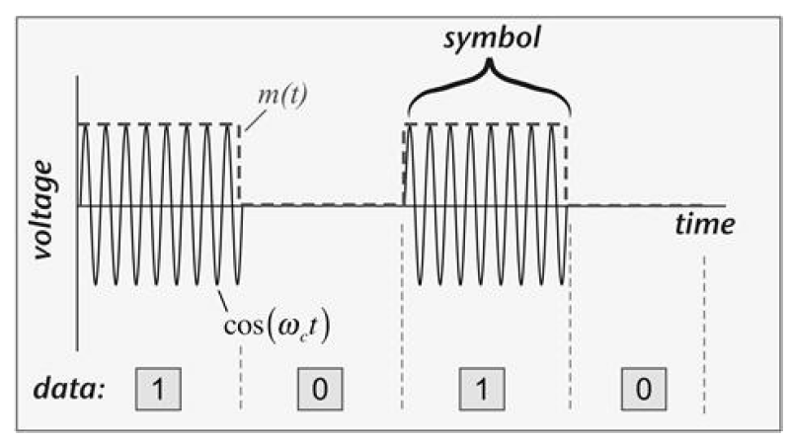
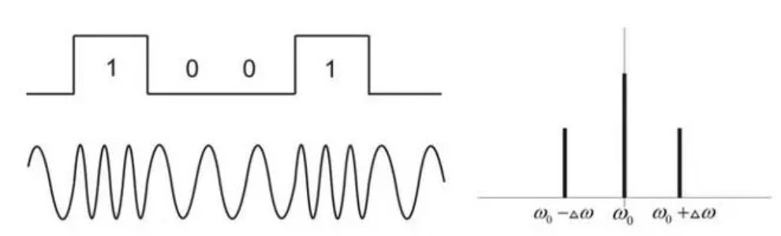
Potential Technologies (2)
July 2022
Doc.: IEEE 802.11-22/0962r0
  Simpler waveform/modulation/coding scheme, e.g., OOK/FSK, Manchester coding, especially for data transmission
  It enables ultra-low complexity data transmission, e.g., envelope detection in the DL [1][2][3] and low power transmitter in UL [4][5][6], which can achieve ultra-low power consumption (e.g., lower than 1 mill-Walt)
  OOK has already been supported in WUR thus less PHY specification impact
  OOK/FSK can be generated using backscattering, which further reduce the device complexity and power consumption
  Active transmitter with ultra-low power consumption [4][5][6] can also be supported

Slide 8
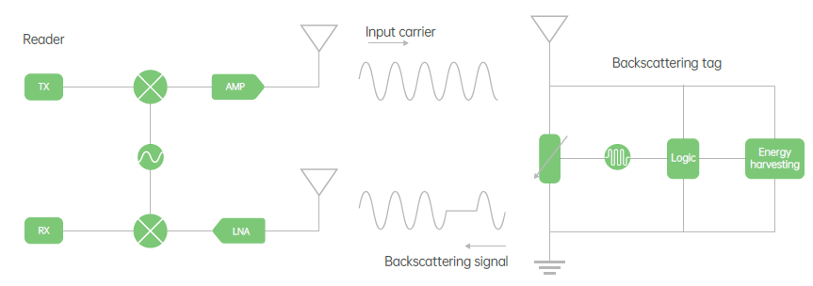
Potential Technologies (3)
July 2022
Doc.: IEEE 802.11-22/0962r0
  Backscattering
  It enable ultra-low complexity implementation, e.g., can eliminate the high frequency oscillator, use very low complexity baseband and enable ultra-low complexity RF chain (i.e., using impedance modulation)
  It enables ultra-low power consumption (e.g., lower than 1 mill-Walt)
  Can support OOK/FSK
  It is beneficial for co-existence with legacy devices, e.g., by backscattering the preamble send by the AP[9]
  LNA can be used to boost the backscattering signal [7][8]

Slide 9
Potential Technologies (4)
July 2022
Doc.: IEEE 802.11-22/0962r0
  Simplified MAC protocol design and enhanced power saving/management
  e.g., support further simplified MAC on top of 802.11 ah
  e.g., schemes to support ultra-low power operation
    e.g., further power saving considering the constraint of the power supply from energy harvester
    e.g., communication procedure which take into account proper power management
      There may be even relaxed latency requirement for AMP-IoT devices
  e.g., schemes to adaptation to operation with ambient power by taking into account the characteristics of ambient power source, e.g., not stable, limited amount of harvested power
  Support coexistence schemes with legacy devices
  please see the detail discussion in [9]

Slide 10
Potential Technologies for AMP-only IoT devices (5)
July 2022
Doc.: IEEE 802.11-22/0962r0
Ultra-low power receiver + Backscattering
  It can utilize techniques such as narrow bandwidth operation for AMP portion (e.g., 187.5 kHz in sub-1 GHz), simpler waveform/modulation/coding scheme (e.g., OOK/FSK), backscattering, simplified MAC protocol design and enhanced power saving.
Ultra-low power receiver + Ultra-low power active transmitter
  It can utilizes techniques such as narrow bandwidth operation for AMP portion (e.g., 187.5 kHz in sub-1 GHz), simpler waveform/modulation/coding scheme (e.g., OOK/FSK), simplified MAC protocol design and enhanced power saving.
  The difference with the above is it has active transmitter.
Others are not precluded

Slide 11
Potential Technologies for AMP-assisted IoT devices (6)
July 2022
Doc.: IEEE 802.11-22/0962r0
  Follow legacy PHY design with MAC enhancement
  Similar to legacy STA, but possibly with simplified MAC protocol design and/or enhanced power saving/management
  New PHY design enabling ultra-low power transceiver with MAC enhancement
  Narrow bandwidth operation for AMP portion
  Ultra-low power receiver + Ultra-low power transmitter
  Simplified MAC protocol design and/or enhanced power saving/management
  Others are not precluded

Slide 12
Summary
July 2022
Doc.: IEEE 802.11-22/0962r0
  In this presentation, the following topics are discussed
  Challenge of supporting AMP IoT devices
  Possible AMP IoT device types
  Potential functional requirements
  Potential technology in order to support AMP IoT devices
  Potential techniques for different AMP IoT device types
  In order to tackle the challenge of supporting AMP IoT devices, the following techniques can be considered:
  Narrow bandwidth operation
  Low complexity modulation and coding
  Backscattering
  Simplified MAC protocol design and enhanced power saving/management
  etc.

Slide 13
July 2022
Doc.: IEEE 802.11-22/0962r0
Reference
  J. Im, H. -S. Kim and D. D. Wentzloff, "A 470µW −92.5dBm OOK/FSK Receiver for IEEE 802.11 WiFi LP-WUR," ESSCIRC 2018 - IEEE 44th European Solid State Circuits Conference (ESSCIRC), 2018, pp. 302-305, doi: 10.1109/ESSCIRC.2018.8494331.
  J. Im, H. Kim and D. D. Wentzloff, "A 217µW −82dBm IEEE 802.11 Wi-Fi LP-WUR using a 3rd- Harmonic Passive Mixer," 2018 IEEE Radio Frequency Integrated Circuits Symposium (RFIC), 2018, pp. 172-175, doi: 10.1109/RFIC.2018.8428988.
  R. Liu et al., "An 802.11ba-Based Wake-Up Radio Receiver With Wi-Fi Transceiver Integration," in IEEE Journal of Solid-State Circuits, vol. 55, no. 5, pp. 1151-1164, May 2020, doi: 10.1109/JSSC.2019.2957651.
  K. Tang et al., "A 75.3 pJ/b Ultra-Low Power MEMS-Based FSK Transmitter in ISM-915 MHz Band for Pico-IoT Applications," 2021 IEEE International Symposium on Circuits and Systems (ISCAS), 2021, pp. 1-4, doi: 10.1109/ISCAS51556.2021.9401715
  M. S. Jahan, J. Langford and J. Holleman, "A low-power FSK/OOK transmitter for 915 MHz ISM band," 2015 IEEE Radio Frequency Integrated Circuits Symposium (RFIC), 2015, pp. 163-166, doi: 10.1109/RFIC.2015.7337730.
  J. Bae and H. Yoo, "A low energy injection-locked FSK transceiver with frequency-to-amplitude conversion for body sensor applications," 2010 Symposium on VLSI Circuits, 2010, pp. 133-134, doi: 10.1109/VLSIC.2010.5560325
  J. Kimionis, A. Georgiadis, Sangkil Kim, A. Collado, K. Niotaki and M. M. Tentzeris, "An enhanced-range RFID tag using an ambient energy powered reflection amplifier," 2014 IEEE MTT-S International Microwave Symposium (IMS2014), 2014, pp. 1-4, doi: 10.1109/MWSYM.2014.6848653.
  D Matos, R Correia,NB Carvalho, ”Dual-Band FET-Based Reflection Amplifier for Backscatter Modulator Performance Enhancement” URSI Radio Science Letters, 202
  11-22-0970-00-0amp-feasibility of supporting AMP IoT devices in WLAN

