Slide 1
Reply to 11-22/0831r0
Date: 2022-07-14
Authors:

Slide 2
Abstract
This presentation contains questions and answers related to the 802.11 working group letter ballot of TGbb, summarized in doc. 11-22/0831r0. Answers to the questions are in italic letters. In case draft text is reused, it has been updated to most recent D2.1 of TGbb. Note that there are significant changes in D3.0 to address the WG questions, see doc. 11-22/1108r3.

Slide 3
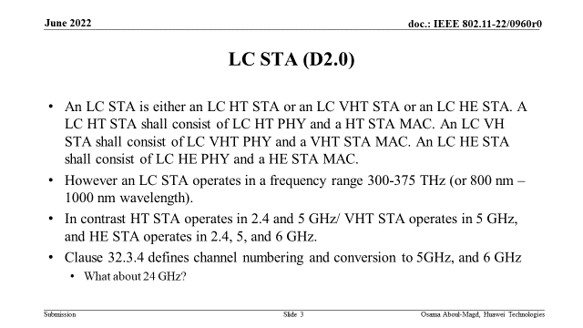

Slide 4
LC STA (D2.1)
An LC STA is a STA with an OFE.
An LC STA is either an LC HT STA or an LC VHT STA or an LC HE STA. An LC HT STA consists of an LC HT PHY and an HT MAC. An LC VHT STA consists of an LC VHT PHY and a VHT MAC. An LC HE STA consists of an LC HE PHY and an HE MAC.
Simultaneous or separate communications using RF and LC PHYs is supported in multi-band capable devices (see 4.9.4 (Reference model for multi-band operation)). Simultaneous use of multiple transmit chains and multiple receive chains within the LC PHY is supported per 32.3.5 (Multiple transmit chains and multiple receive chains).

Slide 5
LC Light Interface Example
  The HT, VHT or HE PHY TX signal is down-converted from RF to LC IF signal and transmitted transparently over LC channel.
  The signal received from the LC channel is up-converted from LC IF to RF and detected by using the HT, VHT or HE RX.
  The LC PHY TX box is essentially an HT/VHT or HE TX and the two boxes together make an LC STA.
  The light communication channel essentially functions like a wireless cable.

Slide 6
LC-STA - Observations
Is there any channelization applicable to the LC range? Is it needed?
How the proposed mapping (Clause 32.3.4) is performed?
  a fixed radio frequency f = f_{c} – f_{LC IF} , where f_{c} is the center frequency in the 5 or 6 GHz band and f_{LC IF} is the LC IF frequency, is used to down-convert a channel from 5 and 6 GHz band and transport the resulting LC IF signal transparently over the optical channel
  2.4 GHz operation is not used by LC
  for details which channels are used over LC, refer to 32.3.4 in TGbb D2.1

Slide 7
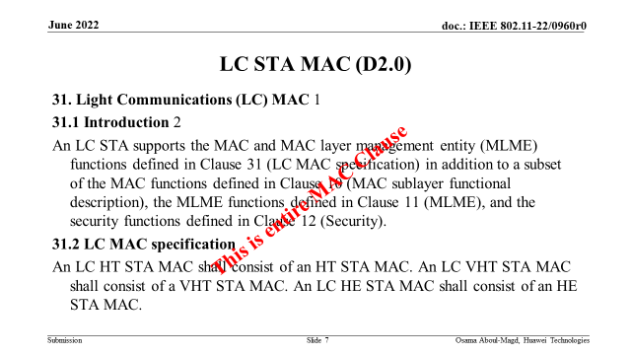

Slide 8
LC STA MAC (D2.1)
31. 31.2 LC MAC specification
The MAC of an LC HT STA shall consist of an HT MAC. The MAC of an LC VHT STA shall consist of a VHT MAC. The MAC of an LC HE STA shall consist of an HE MAC.
LC uses the HT, VHT and HE waveforms in a transparent manner over the LC channel.
I.e., the existing MAC features are fully reused.
Likewise, future features may be supported.
D3.0 will not contain the LC MAC specification anymore
This is entire MAC Clause

Slide 9
LC STA MAC - Observations
Is the Beacon frame sent by the LC STA?
  Yes
Is there an LC Capability IE?
  No.
What about the other MAC functions – Association, De-Association, probe Request/Response, Power management, Channel Switching, media access, etc.
What about other specific MAC functions – Bandwidth Signaling, Two NAV Counters, Spatial Reuse, Quiet Time, etc.
Security
  All the three above are the same as in the HT, VHT and HE STA.

Slide 10
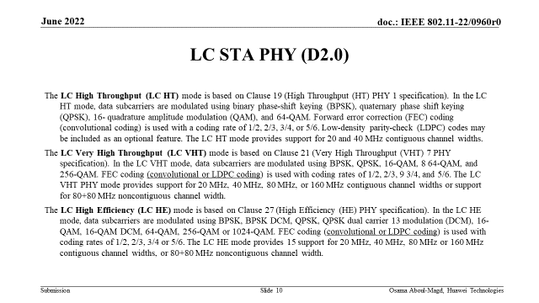

Slide 11
LC HT PHY (D2.1)
In the LC HT mode, data subcarriers are modulated using binary phase-shift keying (BPSK), quaternary phase shift keying (QPSK), 16-quadrature amplitude modulation (QAM), and 64-QAM. Forward error correction (FEC) ccoding (convolutional coding) is used with a coding rate of 1/2, 2/3, 3/4, or 5/6. Low-density parity-check (LDPC) coding is included as an optional feature. The LC HT mode provides support for 20 and 40 MHz contiguous channel widths.
The LC HT mode PHY shall be the same as Clause (High-throughput (HT) PHY specification) and behavior specified for a HT STA shall apply to an LC STA using the LC HT PHY mode, except when the specifications in 32.3.2.2 (LC High Throughput (LC HT) mode) supersede corresponding text in Clause 19 (High-throughput (HT) PHY specification).
The subclause 19.3.14 (Regulatory requirements) does not apply to the LC HT PHY mode. For channel numbering, refer to 32.3.4 (Channel numbering).
(similar for VHT and HE, see D2.1)
Text is removed in D3.0

Slide 12
LC STA PHY - Observations
Are timing related constants (Table 19-6, Table 21-5) still applicable?
  Yes
Is there a need for TXVECTOR/RXVECTOR?
  Same as for HT, VHT and HE
RU sizes supported similar to HE?
  All the same.
LDPC is not mandatory for 11ac and is mandatory for 11ax when the RU is greater than certain number (I think 106 tones).
  This is the same for LC STA.

Slide 13
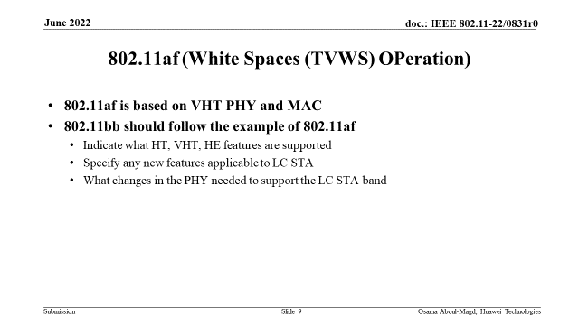

Slide 14
802.11af (White Spaces (TVWS) OPeration)
802.11af is based on VHT PHY and MAC
  802.11af purpose is operation of 802.11 in TV white space. This means operating WLAN as secondary user in spectrum owned by a primary user (broadcasting). This implies that certain conventions (e.g. channelization) in the TV spectrum are also satisfied by 802.11af PHY. Moreover, the 802.11af MAC needs to sense the radio utilization and is allowed to transmit only in case the primary spectrum can be considered unused. Therefore, substantial changes were needed in both, 802.11af PHY and MAC.
  There is no such constraint for LC, as LC operates in unused optical spectrum. Thus, the existing channelization from 802.11 can be reused. Of course, LC IF frequencies have to be standardized. Also the 802.11 MAC can be reused. 802.11bb adds an optional LC repetition mechanism allow the existing CCA mechanism to be used within non-AP LC STAs with the assistance of the LC AP. Also the realization of MIMO over LC has been specified.
802.11bb should follow the example of 802.11af
  Indicate what HT, VHT, HE features are supported - all
  Specify any new features applicable to LC STA – none, except operating in optical spectrum
  What changes in the PHY needed to support the LC STA band – operation of 802.11 on LC IF signal

Slide 15
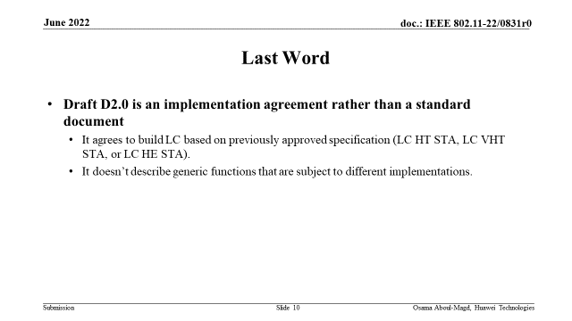

Slide 16
Last Word
11bb D2.0 is more than an implementation agreement
  It agrees to build LC based on previously approved specifications (LC HT STA, LC VHT STA, or LC HE STA).
  It describes the new features to be agreed upon between different vendors
    Transparent operation of 802.11 over LC
    800 nm to 1000 nm wavelength range of operation
    Channelization on the optical spectrum
    MIMO operation of 802.11 over LC
    LC repetition mechanism in the LC PHY to aid CCA in 802.11 MAC

Slide 17
References
doc. 11-22/0678r7 comment resolution against 11bb D2.0
IEEE P802.11bb™/D2.1 June 2022
doc. 11-22/0949r5 comment resolution against 11bb D2.1
doc. 11-22/1108r3 (referenced in 11-22/0949r5)

