Slide 1
Thoughts on Beyond 802.11be
Date: 2022-07-08
Authors:

Slide 2
Abstract
In this presentation, we share our thoughts on the next generation 802.11 beyond 802.11be.

Slide 3
Evolution of 802.11 PHY Rates
802.11b-802.11ac: peak PHY rate of each 802.11 amendment increased by 5x or 11x.
802.11ax: focused on efficiency improvement.
802.11be: peak PHY rate increased by 3.5x by 320MHz, 4KQAM and MLO.
 | Max PHY rate | PHY rate enhancement | Bandwidth/ number of spatial streams (SS) | Operating bands
802.11b | 11 Mbps |  | 22 MHz, 1 SS | 2.4 GHz
802.11a/g | 54 Mbps | 5x | 20 MHz, 1 SS | 5 GHz (.a)/2.4 GHz(.g)
802.11n | 600 Mbps | 11x | 40 MHz, 4 SS | 2.4/5 GHz
802.11ac | 6.9 Gbps | 11x | 160 MHz, 8 SS | 5 GHz
802.11ax | 9.6 Gbps | 1.4x | 160 MHz, 8 SS | 2.4/5/6 GHz
802.11be | > 34 Gbps | > 3.5x | 320 MHz, 8 SS + 160 MHz, 8 SS | 2.4GHz+5GHz+6GHz

Slide 4
Improving Throughput (1/2)
Do we want to increase peak throughput?
Even if we increase peak throughput, it does not always translate to improvement in real-life experience.
  Number of antennas at STA is limited.
  Not all devices are capable of large bandwidth. Many enterprise APs continue to use 40 MHz BSS in 5GHz and 80 MHz BSS in 6GHz.
Instead, we want to improve performance in non-optimal but real-life condition, e.g. medium to low SNR range and OBSS scenario
  Improved mobility and reliability performance
  Better QoS assurance
  Improved power efficiency

Slide 5
Improving Throughput (2/2)
AP 1
AP 2
Desired
Throughput
STA
STA
STA
Still connected to AP1

Slide 6
Examples of Enabling Technologies
Joint Transmission
  Joint transmission to a single STA. Increase edge user throughput.
  Joint transmission to multiple STAs. Increase overall area throughput.
Resource Sharing and Coordination
  Better resource utilization.
  C-OFDMA (e.g. support small bandwidth capable STAs in different BSSs)
  C-SR (e.g. near STA + near STA)
  Time-domain resource coordination (e.g. coordinated TWT schedules [6])
Coordinated Beamforming
  Reduce interference.
  Can be used together with C-SR.

Slide 7
Examples of Enabling Technologies (Contd.)
Enhanced link adaptation
  Fast CQI feedback (e.g. using BA) [1].
  Dense MCS level for finer link adaptation [2].
Enhanced Beamforming
  In both downlink and uplink including 16 antenna support.
Virtual BSS [3-4]
  Receive packets from any AP in the VBSS.
  Solve sticky STA problem.
    Sticky STA: a STA which connects to an AP and not changing the AP even if the connection is slow and there is a better connection that it could use.

Slide 8
Reducing Latency
More and more applications require low latency.
Examples of enabling technologies.
  Scheduling only channel (or limit EDCA as much as possible):
    AP determines proper length of DL and UL PPDU so that the system can meet latency requirement.
    STA can send short packet or BSR in EDCA channel (different link).
    AP schedules uplink random access channel for low latency STA.
  Virtual BSS
    Any nearby AP whoever gets opportunity first can send low latency packet to a STA.
    STA may send its low latency packet to the random access channel of nearby APs.
    VBSS also can help to reduce roaming latency. It will allow seamless operation within VBSS.
  Preemptible PPDU [5] or inserted/intercepted PPDU (appendix for concept).
  Quick error recovery (for latency sensitive traffic) [7]
    Enable shorter retransmission time using different links

Slide 9
Multi-device Connectivity Coordination
With the proliferation of IoT devices, wearables, AR/VR applications, future Wi-Fi networks need to support a large number of devices with varying traffic types—both P2P and UL/DL, and QoS requirements
There needs to be a tighter coordination between the P2P STAs/non-AP MLDs and the APs/AP-MLDs
AP-MLD
Single link DL/UL
Device 3
Multi-link DL/UL
Single link P2P
Device 1
Multi-link P2P
Device 2

Slide 10
Example of Enabling Technologies
AP-MLD – STA/non-AP-MLD coordination
  Share additional information from STAs: location, traffic pattern, power save/latency requirements etc.
  AP can utilize these additional information to learn optimum traffic management in the network (e.g. T2LM)
Mobile AP-MLD with integrated access and backhaul
  Interference reduction between access and backhaul links
  Latency reduction for traffic of non-AP MLDs associated with Mobile AP MLD
P2P related enhancements
  P2P STAs can share additional information as part of P2P link establishment to better coordinate the utilization of AP’s resources
AI based solutions
  User-side AI applications to enhance user experience.
  Network manager-side AI applications to enhance network performance.

Slide 11
Conclusions
In this contribution, we discussed improving throughput, reducing latency, and multi-device connectivity coordination.
For improving throughput, we proposed to improve medium to low SNR throughput rather than peak throughput.
For multi-device connectivity coordination, we proposed to support tighter coordination between the P2P and the UL/DL traffic.
We provided examples of enabling technologies.

Slide 12
References
[1] 11-20/1035r1, “Follow up on Feedback Enhancement”
[2] 11-19/2120r0, “Link Adaptation Improvement”
[3] 11-19/1019r0, “Virtual BSS for Multi-AP Coordination”
[4] 11-19/1451r1, “Virtual BSS for Multi-AP Coordination Follow-up”
[5] 11-21/670r0, “Further Improve Latency Performance in 11be”
[6] 11-21/1046r3, “Multi-AP: TWT Information Sharing”
[7] 11-22/0371r1, “Quick Recovery for MLO”

Slide 13
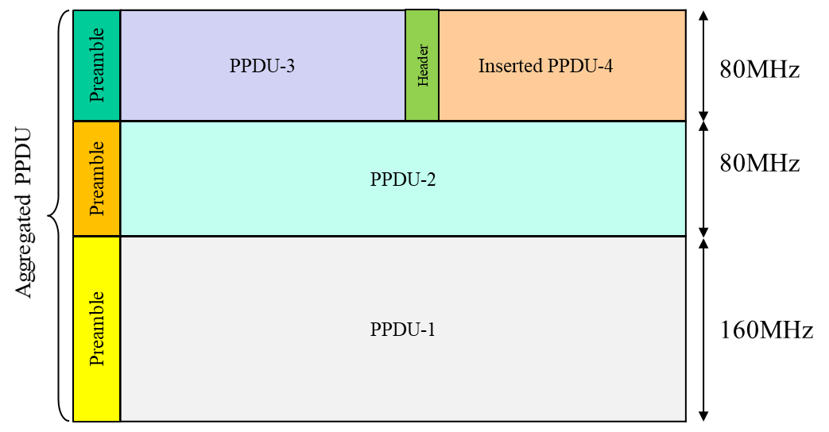
Appendix - inserted/intercepted PPDU

