Slide 1
IEEE 802 Tech Talk
Coexistence of IEEE 802.11 & 5G:
Wi-Fi & other technologies in unlicensed spectrum
22 June 2022
Authors:
Name | Company | Phone | email
Andrew Myles | Cisco | +61 418 656587 | amyles@cisco.com

Slide 2

Introducing Dr Andrew Myles ...
  Dr Andrew Myles has been involved in
  international standards development for a
  variety of networking technologies since 1988.
  He has been with Cisco since 2001, which he
  joined via the acquisition of Radiata, an
  Australian technology start-up that developed
  the world’s first IEEE 802.11a chip. He is
  currently responsible at Cisco for Wi-Fi
  standards strategy, and standards coordination
  across Cisco more generally.
  For the last 20 years, he has mainly focused on the development of IEEE 802.11 (Wi-Fi) standards and certifications as a participant, an editor and a chair in various sub-groups of IEEE 802 and the Wi-Fi Alliance. He is currently the Chair of the IEEE 802 JTC1 SC and the IEEE 802.11 Coexistence SC.

Slide 3

Introducing Dr James Gilb ...
Dr. James P. K. Gilb has 28 years experience in a
variety of areas including; radar absorbing materials,
RFIC, RF system specification and architecture
development, and MAC protocols. He joined
General Atomics Aeronautical Systems, Inc., in
2016 as a Principal RF Systems Engineer.
He has been a contributor to international
communications standards for 21 years, primarily
in IEEE 802. IEEE 802 is responsible for the
development of many technically relevant, widely
implemented standards. He has held a variety of
leadership positions in IEEE 802 and is currently the IEEE 802 LMSC Executive Committee First Vice Chair and the IEEE 802.15 Working Group Technical Editor.
He has 9 issued patents, been the technical editor of 9 standards and specifications, written 3 books, and has many papers in refereed journals and at symposia.

Slide 4
Before we start, some important caveats …
Caveats
  The IEEE-SA Standards Board Operation Manual makes it clear any opinions expressed today are those of the individual speakers …
  … and not the IEEE
    At lectures, symposia, seminars, or educational courses, an individual presenting information on IEEE standards shall make it clear that his or her views should be considered the personal views of that individual rather than the formal position of IEEE
  In addition, the speakers would like to make it clear any opinions expressed today are theirs alone …
  … and may (or may not) represent the views of their employers or anyone else

Slide 5
What technologies should we use to make the best use of unlicensed & licensed spectrum?
Today’s agenda
  Today, we will hear story about coexistence between Wi-Fi & LTE-U/LAA/NR-U in unlicensed spectrum (5/6 GHz) …
  … on the way, highlighting the dangers of relying too much on claims based purely on simulations
  … and leading to a conclusion that expecting good coexistence between heterogeneous systems might not be the best approach
  Instead, maybe a better approach is to …
    Leverage Wi-Fi in unlicensed spectrum
    … while leveraging NR in licensed spectrum
    … and integrating Wi-Fi & NR together as part of an overall solution

Slide 6
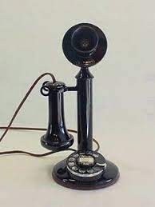
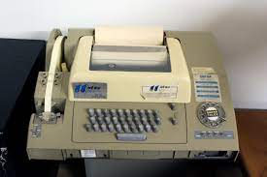
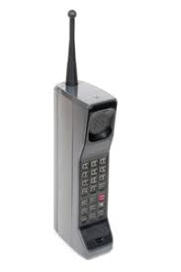

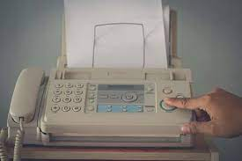
Not so long ago most means of communications were expensive, complicated & out of user’s hands …

Slide 7

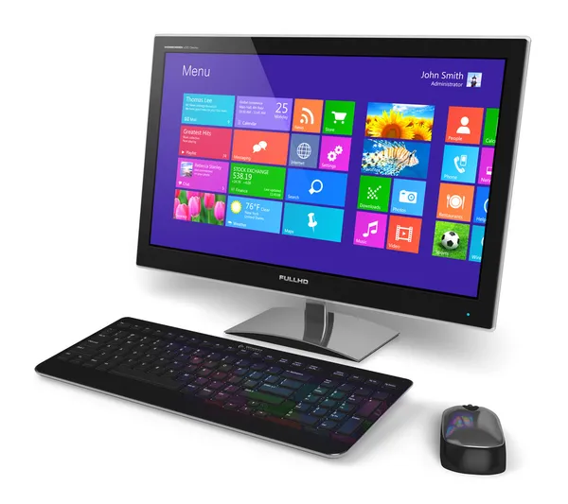
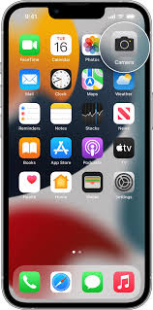



… but now we live in a world where comms are cheap & simple, often bypassing traditional wireless SPs
Using unlicensed spectrum
95%
5%
Using licensed spectrum
The past!
Today!

Slide 8
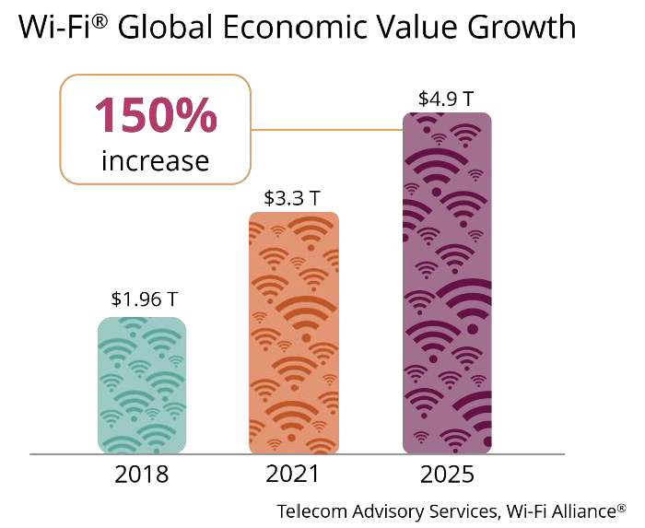
… and the revolution enabled by the wide availability of unlicensed spectrum is partly responsible
  The FCC started the revolution in 1987 with an experiment that opened up the
  2.4 GHz junk band for unlicenced use …
  … which put unlicensed technologies, later including Wi-Fi & Bluetooth, into the hands of users (as well as traditional SPs)
  … so that anyone, any time, anywhere could easily set up & operate a cheap network that just works, in a growing variety of devices & applications
  This experiment (later supported by the release of 5 GHz & now 6 GHz) continues to be wildly successful …
  … and has spread globally!
Wi-Fi is economically important
Wi-Fi is socially vital!
  Surveys 15 years ago suggested people would rather give up beer & coffee than Wi-Fi – it is probably more true today!

Slide 9
Coexistence chaos has been avoided by use of different channels, sharing mechanisms & self interest!
The reality today …
The historical Wi-Fi focused answer …
The success of the FCC’s “unlicensed experiment” after 25+ years is real, huge & undeniable …
Different channels: Wi-Fi doesn’t compete with other technologies; technologies like Bluetooth in 2.4 GHz generally avoid Wi-Fi by operating between & beyond the usual Wi-Fi channels
Sharing mechanisms: Wi-Fi includes a variety of mechanisms (eg LBT, exponential backoff, Preamble Detection, NAV, RTS/CTS, etc) that are specifically designed to enable reasonable coexistence between independently managed Wi-Fi networks
Self interest: The IEEE 802.11 WG & Wi-Fi Alliance have a vested interest in managing coexistence with the deployed Wi-Fi base as new Wi-Fi generations are specified
An interesting question …
Why does the use of multiple technologies (inc. Wi-Fi) controlled by a multitude of unmanaged users in the same spectrum not result in coexistence chaos?

Slide 10
Wi-Fi uses LBT mechanisms to promote reasonable coexistence between independent networks
Layer | Wi-Fi uses LBT sharing mechanisms
PHY | Robust preamble reserves channel as “busy” at any rx’er for the frame length when an 802.11 preamble is received above -82 dBm
 | Backup mechanism whereby a channel is reserved as “busy” at any rx’er when energy (of any sort) received is above -62 dBm
MAC | CSMA/CA, using PHY “listening” mechanisms, with exponential backoff to … … enable “fair” access … for limited length tx opportunities
 | NAV to allow reserving the channel across multiple transmissions eg NAV is the basis of the RTS/CTS based hidden station mitigation mechanism
The result is an effective compromise …
… good enough albeit
not perfect
These PHY & MAC mechanisms operate reasonably well to provide
“fair” coexistence between independent systems operating in same channel
… but they do represent a compromise because access is mostly based on the state of the medium (“busy” or “free”) at the tx’er) rather than where a tx might cause interference
Listening
Sharing

Slide 11
The opportunity of unlicensed spectrum was too great for the cellular community to ignore
  Even now, unlicensed spectrum (especially 5 GHz & even 6 GHz) is often called “Wi-Fi spectrum”, despite being available to anyone
  However, some cellular stakeholders decided that unlicensed 5/6 GHz spectrum was an opportunity too valuable (or too cheap) to ignore …
  … and so, over the last few years, there have been a series of initiatives to specify cellular based alternatives to Wi-Fi in unlicensed spectrum
    LTE-U from LTE-U Forum
    MulteFire from MulteFire Alliance
    LAA & NR-U from 3GPP
  The “asserted” benefits of these technologies are they also have better:
    Performance (throughput, latency, reliability)
    Integration with licensed spectrum technologies
Discussions for another time!

Slide 12
LTE-U sharing with Wi-Fi was controversial from the start … but highlighted a need for distributed sharing
Goal: fast LTE entry
Lesson: distributed sharing vital
LTE-U was a technology introduced by the LTE-U Forum in about 2015, with a goal of providing fast entry for LTE technology into unlicensed bands
The controversy emphasised the importance of some sort of distributed Listen Before Talk (LBT) mechanism for multi-technology sharing
Controversy: centralised sharing caused the LTE-U to miss its market window
LTE-U shared the 5 GHz band with Wi-Fi by taking what it wanted … and allowing Wi-Fi to use the leftovers
LTE-U was unpopular with a Wi-Fi community that historically “fairly” shared using a distributed LBT sharing protocol … where there was no one in charge
The FCC was dragged into the controversy (unwillingly!) and the time taken to resolve the issues with a test plan meant LTE-U missed its market window

Slide 13
LAA’s & NR-U’s use of a Wi-Fi like access scheme seemed to provide a good basis for “fair” coexistence
  LAA & NR-U are two more recent unlicensed spectrum technologies specified by 3GPP
    LAA = License Assisted Access, provides downlink unlicensed access only
    NR-U = New Radio-Unlicensed, has similar use cases to Wi-Fi
  LAA & NR-U are different … but similar in terms of basic access
    After much debate, 3GPP decided to use LBT with backoff, just like Wi-Fi
    The decision was partially forced by European rules & work in ETSI BRAN
    However they chose a different way to “listen”; energy detection only!
  The open question is whether LAA & NR-U access mechanisms enable/encourage good coexistence between LAA/NR-U & Wi-Fi?
    Extensive simulations in 3GPP suggested … yes!
    Extensive discussion in ETSI BRAN suggested … yes!
    … but is yes really the answer?

Slide 14
It appears that LAA sharing with Wi-Fi is an even worse compromise than Wi-Fi/Wi-Fi sharing
  Simulation & discussions are nice and showed reasonable LAA/Wi-Fi coex … but what about LAA/Wi-Fi coex in real deployments?
  The University of Chicago undertook tests of Wi-Fi with early LAA deployments in Chicago during 2020 & 2021 …
  … that showed that in the various deployment scenarios under test, LAA had a significant adverse impact on Wi-Fi operation
  The University of Chicago provided reports on their coex measurement work to the IEEE 802.11 Coexistence Standing Committee during 2021
    LAA/Wi-Fi Coexistence Issues: Wi-Fi Client Association and Data Transmission, Vanlin Sathya, Muhammed Iqbal Rochman & Monisha Ghosh, 13 Jan 2021
    (see 11-20-1973)
    LAA/Wi-Fi Coexistence Experiments: preliminary results, Monisha Ghosh & Muhammed Iqbal Rochman, 15 Nov 2021 (see 11-21-1858)

Slide 15
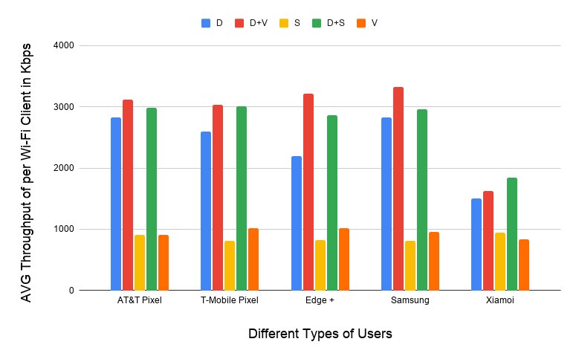
It appears that LAA sharing with Wi-Fi is an even worse compromise than Wi-Fi/Wi-Fi sharing
An example … 5 Wi-Fi AP/client pairs on one channel, LAA not operating
Most traffic at
about 3Mb/s
Lower throughout because using 802.11n

Slide 16
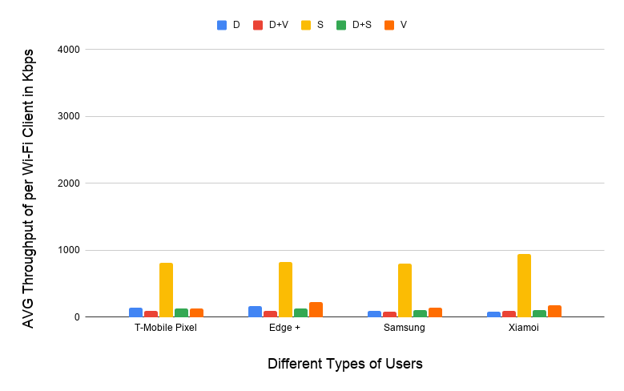
It appears that LAA sharing with Wi-Fi is an even worse compromise than Wi-Fi/Wi-Fi sharing
An example … 5 Wi-Fi AP/client pairs on one channel, LAA operating
LAA operating in same channel causes Wi-Fi traffic to collapse
Streaming traffic still OK because it was using licensed spectrum

Slide 17
Aside: simulations have been overused & misused during recent coexistence debates
An important lesson from the Wi-Fi/LAA coex debate …
  Detailed simulations were widely used in 3GPP RAN1 & ETSI BRAN to “prove” good/acceptable/bad coexistence …
  … but simulations have a weaknesses that mean results should be treated with caution when used to “prove” good coexistence …
    Poor emulation of real world environments & complexities
    Inaccurate models of systems, especially systems not yet specified
    They often “show” what people want them to show
    A lot of complexity is “hidden behind averages”
  … although simulations do have a place in “understanding” coexistence issues & mechanisms
    Insights into coexistence problems … and possible solutions
    Proving something does not work!

Slide 18
The underlying issue is the LAA/NR-U access approach is a compromise of the original Wi-Fi compromise
Layer | Wi-Fi coexistence mechanism | Cross technology applicability
PHY | Robust preamble reserves channel as busy at any rx’er for the frame length when received above -82 dBm | LAA/NR-U do not use or recognise 802.11 preamble, which means listening never occurs below -72 dBm
 | Backup mechanism whereby channel reserved as busy at any rx’er when energy (of any sort) received above -62 dBm | LAA/NR-U uses a lower threshold at -72 dBm
MAC | CSMA/CA with exponential backoff to … … enable “fair” access … for limited length tx opportunities | LAA/NR-U uses Wi-Fi like LBT
 | NAV to allow reserving the channel across multiple transmissions eg NAV is the basis of the RTS/CTS based hidden station mitigation mechanism | LAA/NR-U do not use NAV field in 802.11 MAC frames, which means no hidden station mitigation (or other NAV based features)

Slide 19
The good news is that LAA/Wi-Fi coex issues may be unimportant because LAA rollout is very slow
Only 9 SPs have deployed LAA – with no change for 2+ years
Source: GSA

Slide 20
How do we promote good coexistence between Wi-Fi & NR-U in unlicensed spectrum (5/6 GHz)?
Could be a coex issue …
… but we don’t know yet!
So now we are left with a potential coexistence issue between
NR-U & Wi-Fi in 5/6 GHz …
… but it is unclear if there ever will be a problem because there are currently no known NR-U commercial deployments
What happens next? At least a couple of options
Option 1: NR-U deploys at scale!
Option 2: NR-U doesn’t really deploy
Keep working to solve the associated coex issues!
(currently the default option)
Breath a sign of relief!
Focus on integration of Wi-Fi (unlicensed) & 5G/6G (licensed)

Slide 21
Option 1: If NR-U deploys at scale then more work is required to understand & mitigate coex issues
Option 1: NR-U deploys at scale!
  If NR-U deploys at scale then we almost certainly still have a serious coexistence problem to solve
    NR-U simply lacks the multi-level coexistence mechanisms refined & proven by Wi-Fi over the last 30 years …
    … putting the ongoing success of unlicensed spectrum at risk
  Under Option 1, more work is required to understand & mitigate the coex issues that will arise in heterogenous deployments
    It is still not clear what needs to be done …
    … or whether any solution will be based on cooperation vs a “fight to the death”
Wi-Fi (unlicensed) + NR-U (unlicensed) = Risk to unlicensed spectrum!

Slide 22
Option 2: if NR-U doesn’t really deploy at scale then we can focus on integrating Wi-Fi & 5/6G solutions
Option 2: NR-U doesn’t really deploy
  Recognise that …
    …. Wi-Fi can make the best use of unlicensed spectrum because multi-level coex has been built into Wi-Fi from the beginning … and it works
    … NR-U has not adopted similar mechanisms and so risks significantly damaging the global economic & social impact of unlicensed spectrum
  With this recognition it then becomes obvious…
    Wi-Fi should focus on making the best of unlicensed spectrum
    NR should focus on making the best of licensed spectrum, ie no NR-U!
    Using both Wi-Fi and NR together, users can achieve their communications goals using the best of both worlds, whatever those goals are!
Wi-Fi (unlicensed) + NR (licensed) = Likely benefit to humanity!

Slide 23
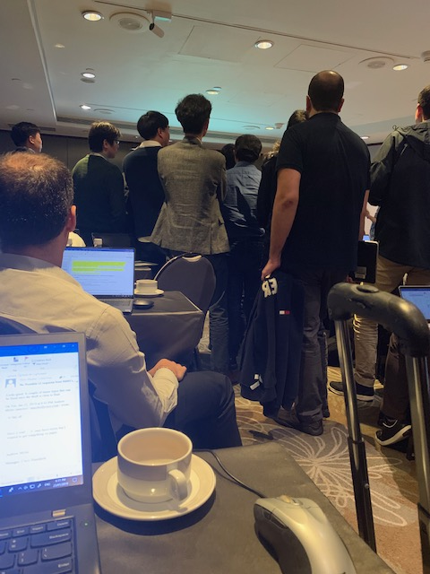
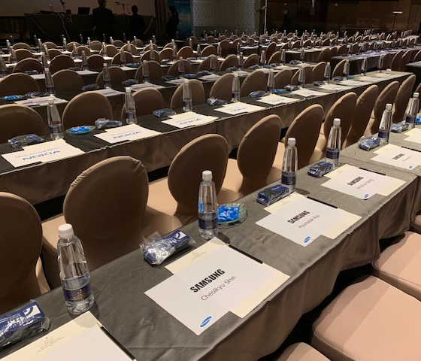
Aside: 3GPP RAN1 & IEEE 802.11 WG culturally align with their protocols ☺
In RAN1, every single seat was reserved for the week …
… which is aligned with the scheduled philosophy of 3GPP based technologies
In RAN1, the Chair is a technical decision maker rather than a process facilitator…
… which is aligned with the centralised control philosophy of 3GPP based technologies
Reservations
Unseen Chair leading technical discussions
Whereas, in the 802.11 WG, seats are only reserved while they are occupied (for limited periods) …
… just like the 802.11 protocol!
Whereas the 802.11 WG distributes control with the Chair playing a coordinating role …
… just like the 802.11 protocol!

Slide 24
There is still a lot to be done to promote good coexistence in unlicensed spectrum … get involved!
Coex is best achieved by not mixing heterogenous systems
The best way to achieve coexistence in unlicensed spectrum is focus on:
Good coexistence between similar systems, such as those based on Wi-Fi …
… and don’t attempt the extraordinarily difficult feat of achieving good coexistence between heterogenous systems, such as NR-U & Wi-Fi
But coex is not yet solved …
… and you can be involved!
There are ongoing issues related to good coex in unlicensed spectrum
NB FH proposals
Low Power Indoor (LPI) vs Standard Power (SP) coex in 6 GHz
UWB coex
…
If you interested in issues related to coex in unlicensed spectrum …
… please participate in the ongoing work of the IEEE 802.11 Coex Standing Committee

Slide 25
Extension: more unlicensed spectrum is required to satisfy community needs
Situation
Answer!
There is a claim in many parts of the world that about half of the 6 GHz band should be allocated to licensed operation
No, all of the 6 GHz band should be specified as unlicensed spectrum
Using Europe as an example:
    Available unlicensed & licensed spectrum is roughly equal in Europe today …
        More than 1000 MHz in low/mid-band for licensed operation,
        About 1000 MHz for unlicensed operation (ex. upper 6 GHz)
    … & yet licensed spectrum only delivers about 5% of data traffic
      Most of the remaining 95% is delivered by Wi-Fi
  Clearly more unlicensed spectrum is required
  This is not because there is any problem with licensed technologies …
  … indeed licensed technologies work extremely well
  … but it does highlight the flexibility of Wi-Fi to deliver to anyone, any time, anywhere!
Question?
Does a conclusion that Wi-Fi should be the main unlicensed solution make this claim stronger?

