Slide 1
Follow up on NDP Transmission in TF Sounding Phase
Date: 2022-06-30
Authors:

Slide 2
Abstract
In a previous contribution [1], we discussed several methods for how the NDPs may be multiplexed from responder transmitters in the TF sounding phase of the TB Measurement Instance
In this contribution, we follow up on the discussion and show the pros and cons of multiplexing the NDPs in the spatial domain and the frequency domain. We also show an analysis of how many responders may be triggered in one TXOP

Slide 3
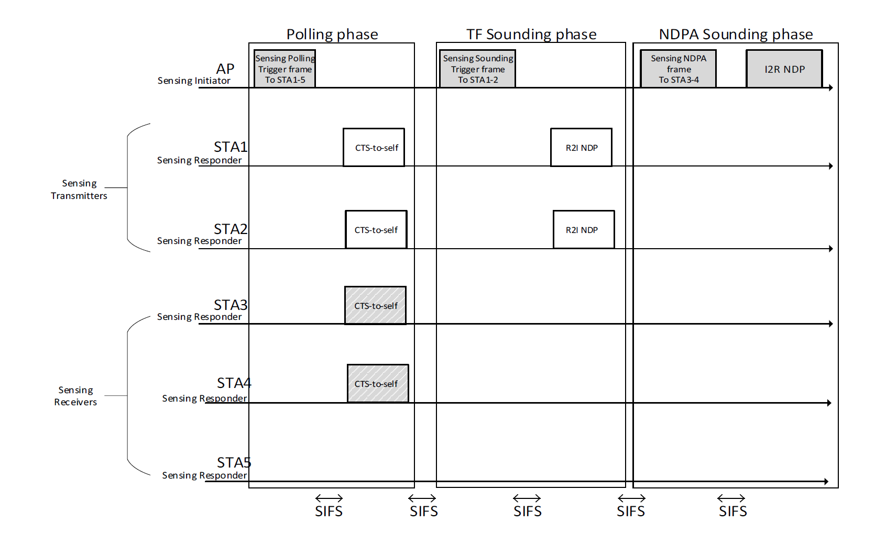
Recap of TF Sounding Phase
TB Measurement Instance[2]
  In TF Sounding phase:
    The AP shall transmit a Sensing Sounding TF to solicit R2I NDP transmissions
    The Sensing Sounding Trigger frame shall allocate uplink resources for one or more STA’s R2I NDP transmission covering the full bandwidth
    NOTE—If the number of available sensing transmitters exceeds the available uplink resources, multiple sequential trigger frames can be transmitted within the acquired TXOP

Slide 4
Methods to Transmit R2I NDP in TF Sounding Phase
Method 1: Sensing Responder Transmitters transmit the NDP sequentially
  The NDP PPDU covers the full bandwidth
Method 2: Sensing Responder Transmitters transmit the NDP parallelly
  a) The NDP PPDUs are sent at the same time and multiplexed in the spatial domain
  b) The NDP PPDUs are sent at the same time and multiplexed in the frequency domain
Method 3: Sensing Responder Transmitters transmit the NDP parallelly
  The NDP PPDUs are sent at the same time using the same frequency and spatial resource
Method 4: Combination of Methods 1-3

Slide 5
Methods to Transmit R2I NDP in TF Sounding Phase

Slide 6
Methods to Transmit R2I NDP in TF Sounding Phase

Slide 7
Method 2a (Spatial Domain Multiplexing) - Pros
Provides a simple way to multiplex multiple NDPs in the uplink
  This mode of multiplexing the NDP transmission has been specified in 11az
  The HE TB NDP format is defined and no additional PHY changes are needed to enable this mode
Would allow up to 8 responder transmitters to transmit NDPs simultaneously
  Assuming that the number of the receive antennas at the initiator AP is 8
  In case of large number of responders, the initiator AP may need to solicit the NDP transmission in multiple triggering sequences

Slide 8
Method 2a (Spatial Domain Multiplexing) - Cons
TXOP duration will limit the number of responder transmitters that can be triggered
  Long TXOP duration for sensing may be not desirable for communication services and would disrupt other traffic in the BSS such as low latency traffic
  In a later contribution, we may discuss how long should be the TXOP duration for sensing
Limit the use of the available bandwidth if any of the responder transmitters is 20 or 80 MHz operating STAs
  The initiator AP needs to set the UL BW of the Common field of the trigger frame in the TF Sounding phase to a single value
  All responders shall use the same bandwidth when transmitting their NDPs
  We may need to group the responders based on their operating bandwidth and trigger each group in one triggering sequence

Slide 9
Numerical Analysis – TB Measurement Instance Phases
In this numerical analysis, we estimate how many responders may be triggered in one TXOP
  Only Polling phase and TF Sounding phase are considered.
Polling Phase
Polling TF
SIFS
CTS-to-Self
SIFS
$$T_{Polling}=T_{P−TF}+T_{CTS−to−Self}+2SIFS$$
NDPA Sounding
Phase
SIFS
SIFS
NDPA
I2R-NDP
$$T_{NDPA_P}=T_{NDPA}+T_{I2R−NDP}+2SIFS$$
TF Sounding
Phase
SIFS
SIFS
Sounding TF
R2I-NDP
$$T_{TF_P}=T_{S−TF}+T_{R2I−NDP}+2SIFS$$
Reporting
Phase
SIFS
SIFS
Reporting TF
Report
$$T_{Repoting_P}=T_{R−TF}+T_{Report}+2SIFS$$

Slide 10
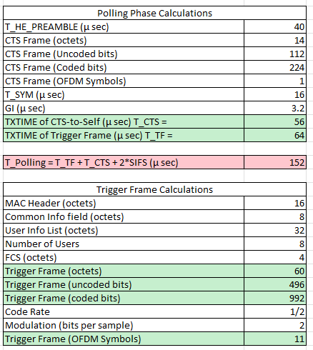
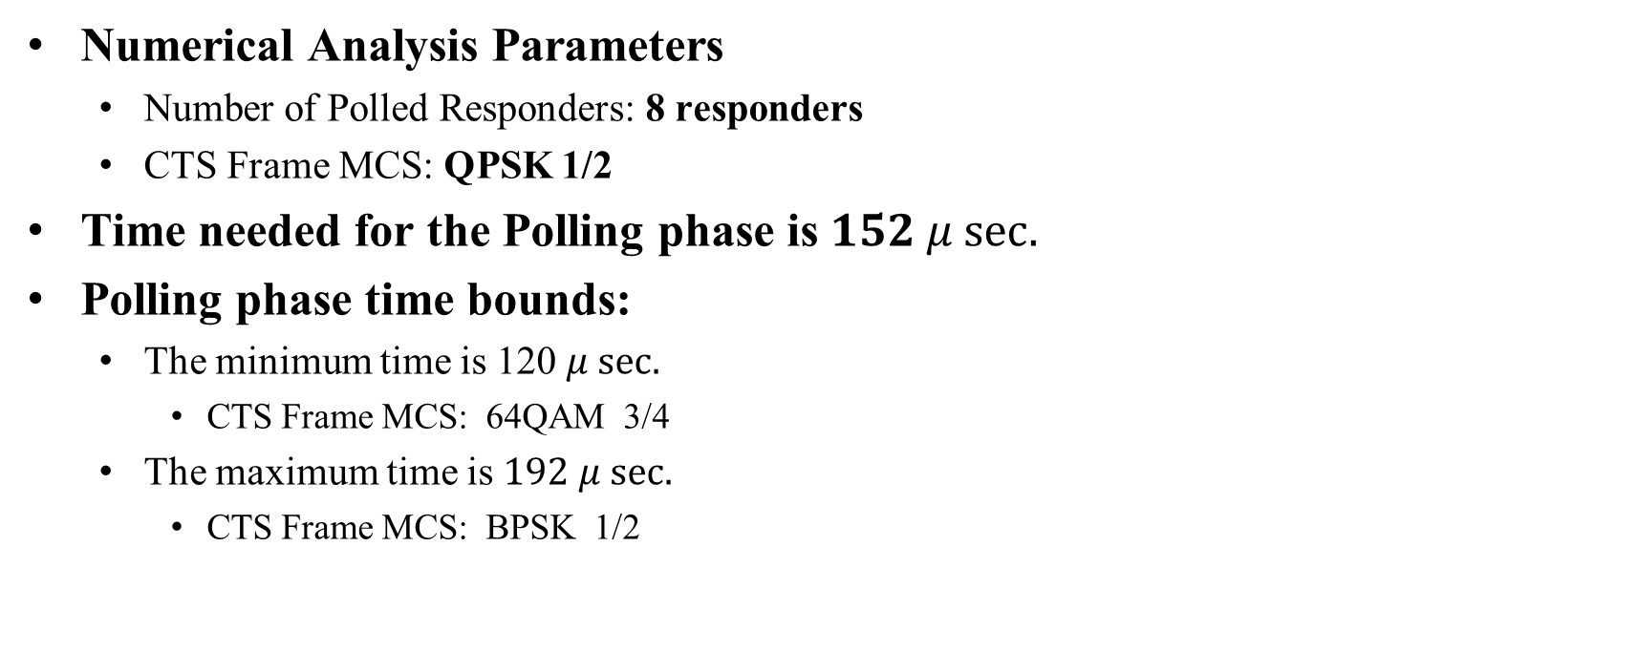
Method 2a Numerical Analysis (Polling Phase)
Numerical Analysis Parameters
  Number of Polled Responders: 8 responders
  CTS Frame MCS: QPSK 1/2
Time needed for the Polling phase is $152 μ sec.$
Polling phase time bounds:
  The minimum time is 120 $μ sec.$
    CTS Frame MCS: 64QAM 3/4
  The maximum time is $192 μ sec.$
    CTS Frame MCS: BPSK 1/2

Slide 11
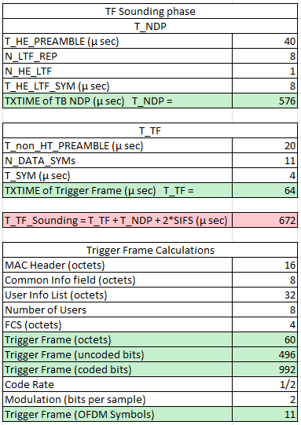
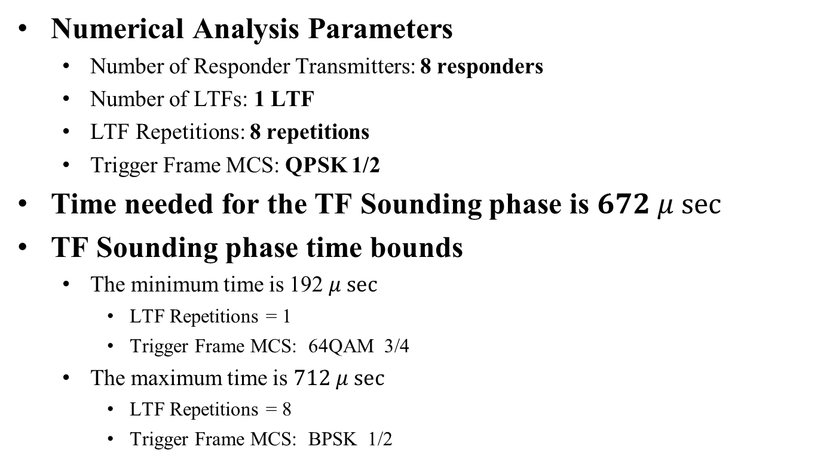
Method 2a Numerical Analysis (TF Sounding Phase)
Numerical Analysis Parameters
  Number of Responder Transmitters: 8 responders
  Number of LTFs: 1 LTF
  LTF Repetitions: 8 repetitions
  Trigger Frame MCS: QPSK 1/2
Time needed for the TF Sounding phase is $672 μ sec⁡$
TF Sounding phase time bounds
  The minimum time is 192 $μ sec$
    LTF Repetitions = 1
    Trigger Frame MCS: 64QAM 3/4
  The maximum time is $712 μ sec$
    LTF Repetitions = 8
    Trigger Frame MCS: BPSK 1/2

Slide 12
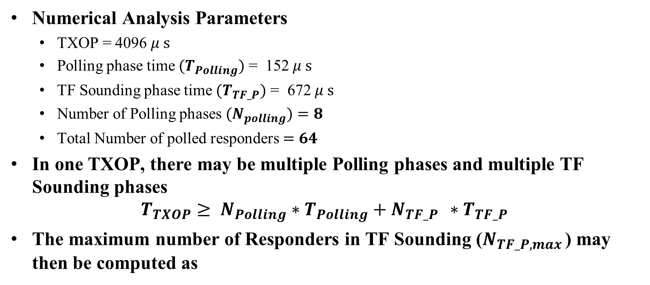
Method 2a Numerical Analysis (Number of Responders)
Numerical Analysis Parameters
  TXOP = 4096 $μ s$
  Polling phase time ${(T}_{Polling})$ = 152 $μ s$
  TF Sounding phase time ${(T}_{TF_P})$ = 672 $μ s$
  Number of Polling phases ${(N}_{polling})$ $=8$
  Total Number of polled responders$=64$
In one TXOP, there may be multiple Polling phases and multiple TF Sounding phases
$$T_{TXOP}≥ N_{Polling}∗T_{Polling}+N_{TF_P } ∗T_{TF_P }$$
The maximum number of Responders in TF Sounding ($N_{TF_P,max }$) may then be computed as
$$N_{TF_P, max }=32 Responders$$

Slide 13
Method 2a Numerical Analysis
The NDPA Sounding phase and the Reporting phase are not considered in the analysis
  If the NDPA Sounding phase and the Reporting phase are both taking place in the same TXOP, this would reduce the time available for the TF Sounding phase, and hence the number of Responder transmitters participating in the TF Sounding phase

Slide 14
Method 2b (Frequency Domain Multiplexing) - Pros
EHT Trigger frames may support partial bandwidth allocation
  Up to 8 users can be multiplexed on 320 MHz (Each user will be allocated 40 MHz)
  The sensing operation over a smaller bandwidth may provide coarse sensing results
Punctured channel sensing may be supported
  Sensing on larger bandwidths is desirable

Slide 15
Method 2b (Frequency Domain Multiplexing) - Cons
Requires Support for Uplink OFDMA NDP
  11az does not support OFDMA NDP
  Uplink OFDMA NDP is not defined yet in 11ax and 11be
Multiple low-end devices (20 MHz-only STAs) cannot be triggered to send the NDP multiplexed in the frequency domain since all the 20 MHz-only STAs will be operating on the same primary channel of the BSS
  There are many restrictions for the allowed RUs for 20 MHz operating non-AP STAs in EHT [3]

Slide 16
A Comparison between Method 2a and Method 2b
 | Method 2a | Method 2b
Multiplexing | Space Domain | Frequency Domain
Legacy Use | HE TB Ranging NDP | Not used in the current standard
Support in the Standard | Supported | Not Supported
Pros | Simplicity Supported in the specs Allows multiple responders (up to 8) to transmit their NDPs concurrently | Support of punctured channel sensing May be supported by EHT NDP and TF
Cons | Power Control Limited number of sensing responders in the same TXOP Limit the use of the available bandwidth | Complex allocation of uplink resources Limited number of sensing responders in the same TXOP Less sensing accuracy (smaller bandwidth is used for sensing) Not supported in the current specs

Slide 17
Conclusions
Multiplexing the NDP in Spatial domain or Frequency domain is discussed and the pros and cons of each scheme are presented
The numerical analysis shows that a limited number of responder transmitters may participate in the TF Sounding phase in one TXOP
Better techniques are required to improve the sensing efficiency in the TF Sounding phase

Slide 18
SP 1
Do you agree that in TF Sounding phase, considering scenarios with large number of responders determined in the association, the TXOP duration will limit the number of Responder transmitters that can be triggered in the TF Sounding phase considering Method 2a in Slide 5.
Yes
No
Abstain

Slide 19
References
[1] 802.11-22/0654r0, Discussion on NDP Transmission in TF Sounding Phase, April 2022.
[2] “IEEE P802.11bf™/D0.01, Amendment 2: Enhancements for WLAN Sensing”, March 2022.
[3] “IEEE P802.11be™/D2.0, Amendment 8: Enhancements for extremely high throughput (EHT)”, March 2022.

Slide 20
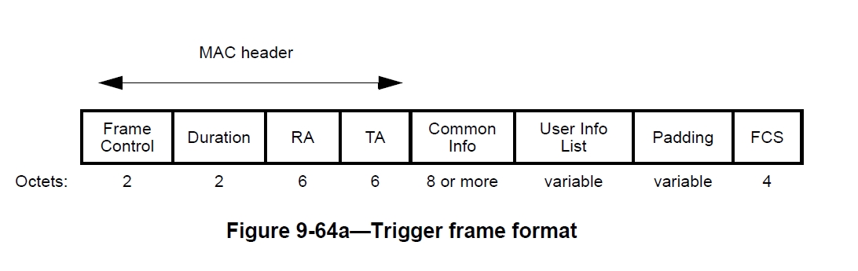
Trigger Frame Format

Slide 21
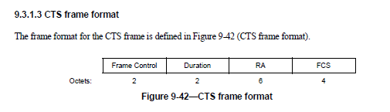
CTS-to-Self

Slide 22
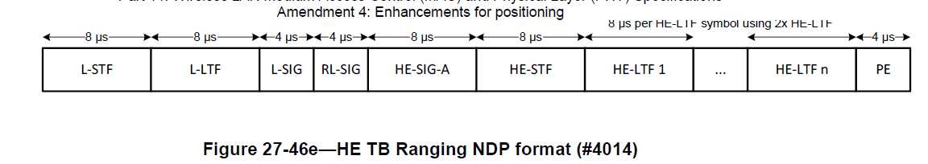
HE TB Ranging NDP Format

Slide 23
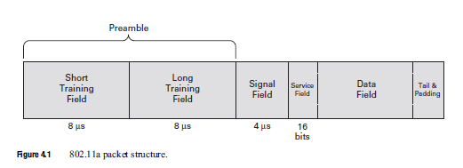
Non-HT Packet Structure

Slide 24
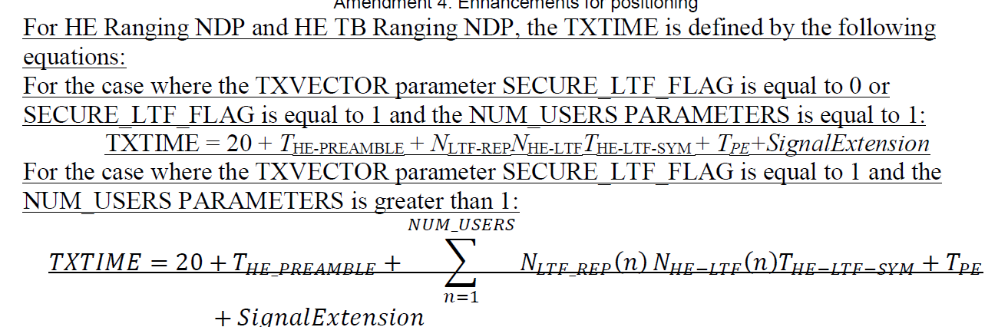
TXTIME for HE Ranging NDP

Slide 25
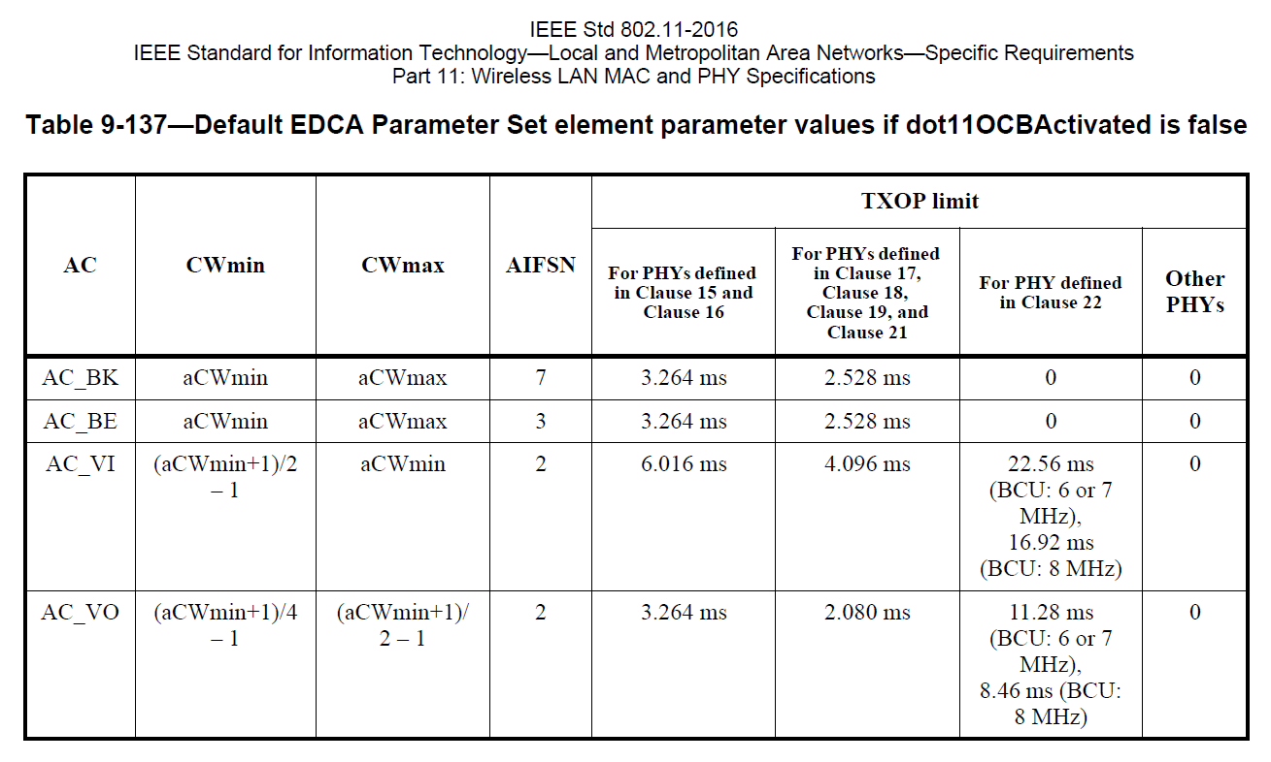
TXOP Limits

Slide 26
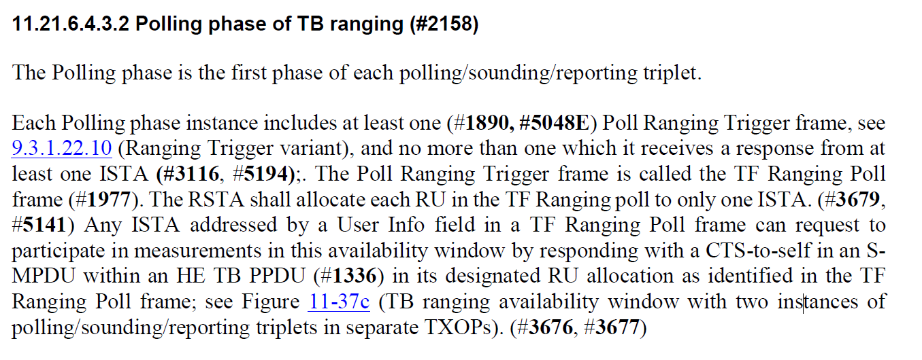
Polling Phase of TB Ranging

