Slide 1
SBP Reporting Procedure
Date: 2022-6-9
Authors:
Name | Affiliation | Address | Phone | Email
Chaoming Luo | OPPO |  |  | luochaoming@oppo.com
Lei Huang
Pei Zhou
Chaoming Luo (OPPO)

Slide 2
Introduction
In current D0.1, the whole subclause ‘11.21.19.3 SBP procedure reporting’ is TBD, so the overall SBP procedure is incomplete.
This contribution clarifies the SBP reporting procedure.

Slide 3
Discussion: SBP Reporting
It’s straightforward that AP send the SBP report to the SBP initiator in reporting phase of a measurement instance.
  No matter the SBP initiator participates or not in the measurement phases, it shall be triggered in polling phase unless not assigned to be polled.
In order to receive the SBP report, the SBP initiator should know the scheduling information of the TB measurement instances.
PN and replay counter for SBP report:
  Since the SBP report frame is part of the fixed frame sequence of TF reporting phase now, it encounters the same ‘out of order’ problem as measurement report frame [3], and shall use the same replay counter as measurement report frame.

Slide 4
Discussion: A-MPDU in SBP Reporting
According to D0.1, measurement report element is fragmentable, however one MMPDU may not be long enough to carry one report. (see the backup slides)
According to D0.1, for delayed reporting, sensing measurement reports of multiple sensing measurement setups of a sensing responder may be included in a single Sensing Measurement Report frame.
For SBP reporting, measurement reports of one measurement instance from multiple sensing receivers may be aggregated into one A-MPDU by AP.
  An HE A-MPDU should be long enough (around 6 500 631 octets) to carry up to around 162 measurement reports (assume 39888 octets each).
  Measurement reports of small size may be carried in multiple report elements of one MMPDU, e.g., report from receiver 1, 2 and 3 are carried in one MMPDU 1.
  Measurement report of larger size may be carried in another MMPDU, e.g., report from receiver 4 is carried in MMPDU 2.

Slide 5
Proposal: SBP procedure reporting
Case 1: AP may send SBP report frames sequentially to the SBP initiator. A ‘last report’ bit indicates the completion of the reporting.

Slide 6
Proposal: SBP procedure reporting-Cont.
Case 2: AP may send SBP report frames in one A-MPDU. Identification of different reports in one SBP report frame should be considered.

Slide 7
SP 1
Do you agree with the following procedures?
  SBP responder may transmit multiple SBP report frames sequentially to the SBP initiator in reporting phase as shown in slide 5.
  SBP responder may transmit one A-MPDU carrying all SBP report frames to the SBP initiator in reporting phase as shown in slide 6.
  Y/N/A
Chaoming Luo (OPPO)

Slide 8
Reference
[1] P802.11bf_D0.1
[2] P802.11REVme_D1.2
[3] 11-22-0556-05-00bf-PN-and-SN-for-sensing
Chaoming Luo (OPPO)

Slide 9
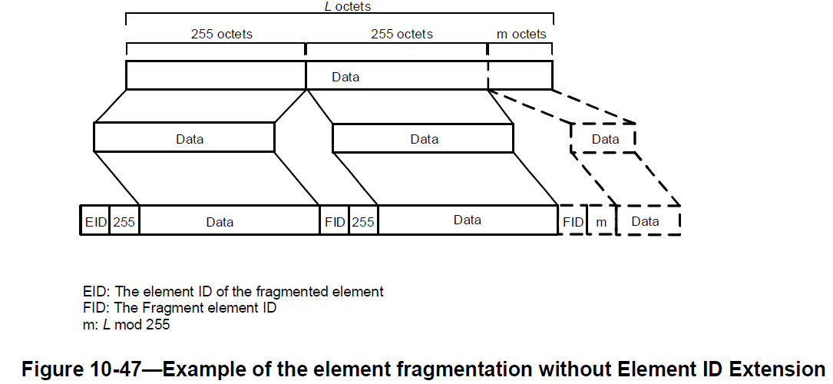
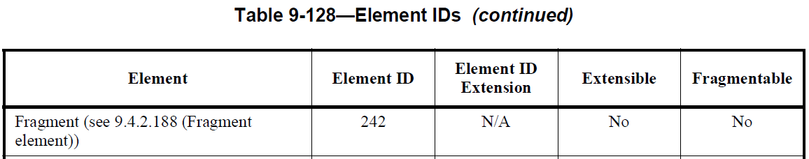
Element fragmentation
10.28.11 Element fragmentation:
A STA may transmit information that is too large to fit in a single element by fragmenting the element into a series of elements consisting of the element that the information does not fit, immediately followed by one or more Fragment elements.
All the information for a fragmented element shall be in the same MMPDU.
9.4.2.188 Fragment element
Table 9-128—Element IDs
Chaoming Luo (OPPO)

Slide 10
Frame length
9.2.4.8 Frame Body field
Table 9-34—Maximum data unit sizes (in octets) and durations (in microseconds)
HT MMPDU size: 2304
VHT MMPDU size: 3895 or 7991 or 11 454 (Note 1)
HE MMPDU size: 3839 or 7935 for 2.4G (Note 5), Otherwise 3895 or 7991 or 11 454 (Note 7)
NOTE 1—No direct constraint on the maximum MMPDU size; indirectly constrained by the maximum MPDU size (see 9.3.3.1 (Format of (PV0) Management frames)).
NOTE 3—No direct constraint on the maximum A-MSDU size; indirectly constrained by the maximum MPDU size.
NOTE 4—No direct constraint on the maximum MPDU size; indirectly constrained by the maximum MSDU/MMPDU or (for HT STAs only) A-MSDU size.
NOTE 5—No direct constraint on the maximum MPDU size; indirectly constrained by the maximum A-MSDU size.
NOTE 7—The maximum MPDU size might be greater than the size declared as supported by the recipient if the MPDU is an HE Compressed Beamforming/CQI frame.
9.7 Aggregate MPDU (A-MPDU)
The maximum length of an A-MPDU in an HT PPDU is 65 535 octets. The maximum length of an AMPDU in a DMG PPDU is 262 143 octets. The maximum length of an A-MPDU pre-EOF padding in a VHT PPDU is 1 048 575 octets. The maximum length of an A-MPDU pre-EOF padding in an HE PPDU is 6 500 631 octets. The maximum length of an A-MPDU in an EDMG PPDU is 4 194 303 octets. The length of an A-MPDU addressed to a particular STA can be further constrained as described in 10.12.2 (A-MPDU length limit rules).
10.12.2 (A-MPDU length limit rules)
MPDUs in an A-MPDU carried in an HT PPDU shall be limited to a maximum length of 4095 octets.
Chaoming Luo (OPPO)

Slide 11
CSI report size
Calculate size of CSI (Per-link Fractional Scaling) as below:
For each TX/RX Antenna Pair, two bits are used for signaling the value of 𝜶 and four bits are used for signaling the value of 𝜷.
The size of CSI matrix for each carrier is 2×Nb×Ntx×Nrx bits.
The size of the CSI Report field is Nsc× (2×Nb×Ntx×Nrx) + 6×Ntx×Nrx bits.
Some typical examples are:
BW | Ng | Nsc | Nb | Ntx | Nrx | Size (bits) | Size (octets)
20MHz | 16 | 242÷16 | 10 | 2 | 2 | 1304 | 163
20MHz | 4 | 242÷4 | 10 | 2 | 2 | 4824 | 804
40MHz | 4 | 484÷4 | 10 | 2 | 2 | 9704 | 1213
80MHz | 4 | 996÷4 | 10 | 2 | 2 | 19920 | 2490
80MHz | 4 | 996÷4 | 10 | 4 | 4 | 79776 | 9972
160MHz | 8 | 2×996÷8 | 10 | 6 | 6 | 179496 | 22437
160MHz | 8 | 2×996÷8 | 10 | 8 | 8 | 319104 | 39888
An HE MMPDU may not be long enough (around 3839 or 7935 octets for 2.4GHz, 3895 or 7991 or 11 454 octets for 5GHz or 6GHz) to carry one CSI report.
Ref: 11-22-0533-03-00bf-updated-proposal-on-csi-formatting-for-the-sensing-measurement-report
Chaoming Luo (OPPO)

Slide 12
Segmented CBF report
26.7.4 Rules for generating segmented feedback
  If the HE compressed beamforming/CQI report solicited by the HE beamformer would result in an HE Compressed Beamforming/CQI frame that exceeds 11 454 octets in length, then the HE compressed beamforming/CQI report shall be split into up to 8 feedback segments. Each feedback segment shall be included in a separate HE Compressed Beamforming/CQI frame and shall contain successive portions of the HE compressed beamforming/CQI report. Each feedback segment shall be of equal length, except the last feedback segment that may be smaller. Each HE Compressed Beamforming/CQI frame that includes a feedback segment that is not the last feedback segment shall have a length of 11 454 octets. Each feedback segment is identified by the value of the Remaining Feedback Segments subfield and the First Feedback Segment subfield in the HE MIMO Control field as defined in 9.4.1.64 (HE MIMO Control field(11ax)); the other nonreserved subfields of the HE MIMO Control field shall be the same for all feedback segments. All feedback segments shall be sent in a single A-MPDU contained in a PPDU and shall be included in the AMPDU in the descending order of the Remaining Feedback Segments subfield values.
  An HE beamformer that sends a BFRP Trigger frame, in its first attempt to retrieve an HE compressed beamforming/CQI report from an HE beamformee, shall solicit all possible feedback segments by setting all of the bits in the Feedback Segment Retransmission Bitmap subfield to 1 in the User Info field identifying the HE beamformee.
  An HE beamformer that fails to receive the first feedback segment (identified by the First Feedback Segment field set to 1), may solicit the selective retransmission of the missing feedback segments assuming the HE compressed beamforming/CQI report is split into 8 feedback segments. The HE beamformer may also solicit the retransmission of all feedback segments by setting all of the bits in the Feedback Segment Retransmission Bitmap subfield to 1 in the User Info field identifying the HE beamformee.
Chaoming Luo (OPPO)

Slide 13
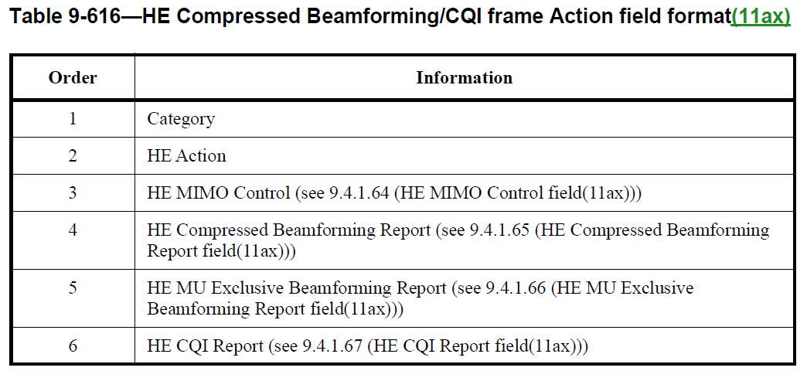
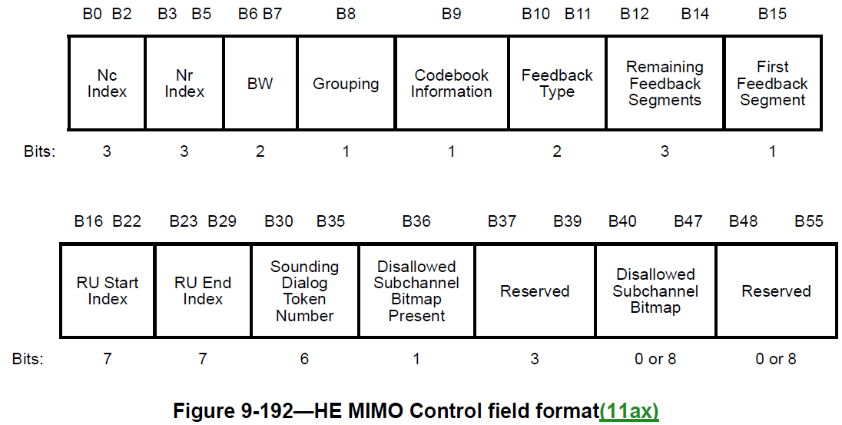
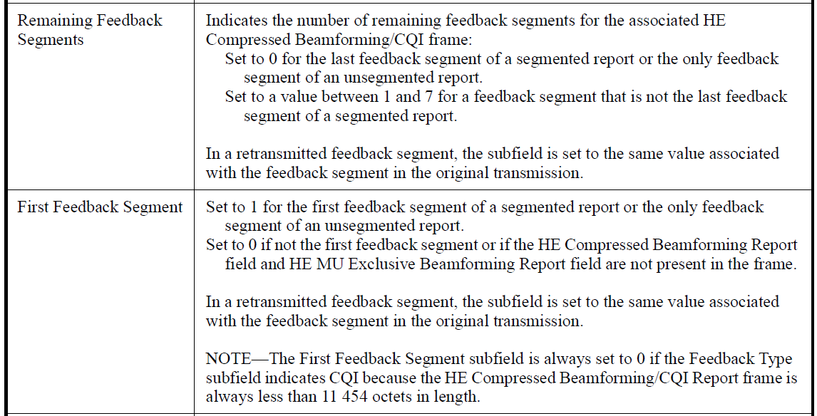
CBF report
Chaoming Luo (OPPO)

Slide 14
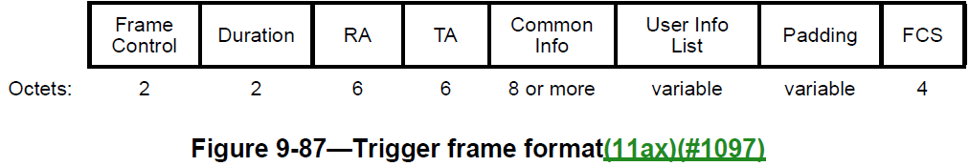
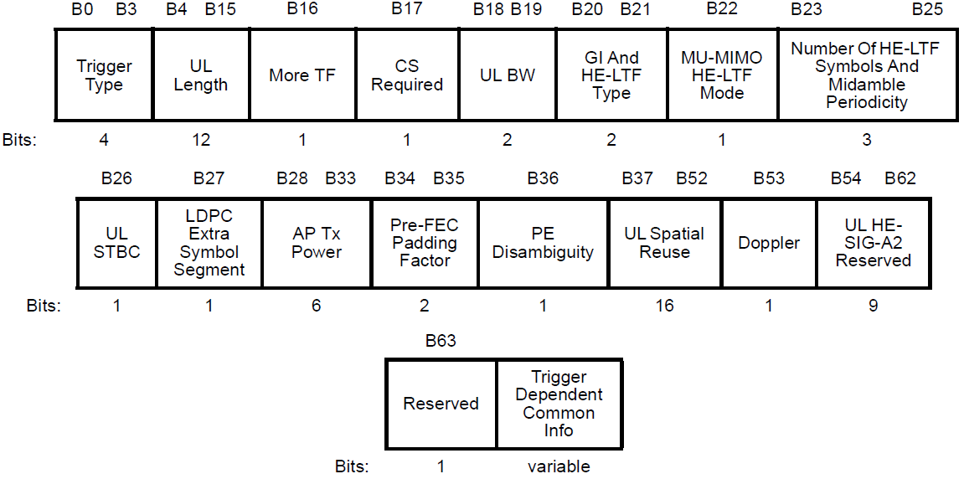
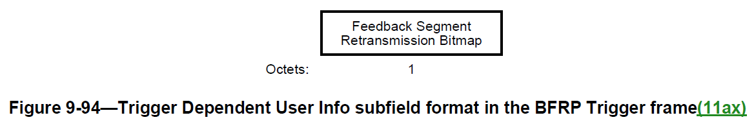
BFRP
Chaoming Luo (OPPO)

