Slide 1
Agenda for IEEE 802.11 Coexistence SC virtual meeting in July 2022
8 July 2022
Authors:
Name | Company | Phone | email
Andrew Myles | Cisco | +61 418 656587 | amyles@cisco.com

Slide 2
Welcome to the first hybrid meeting of the IEEE 802.11 Coexistence SC in July 2022
IEEE 802.11 PDED ad hoc
1 | Warsaw | Sep 2016
2 | San Antonio | Nov 2016
3 | Atlanta | Jan 2017
4 | Vancouver | Mar 2017
5 | Daejeon | May 2017
IEEE 802.11 Coexistence SC
9 | Bangkok | Nov 2018
10 | St Louis | Jan 2019
11 | Vancouver | Mar 2019
12 | Atlanta | May 2019
13 | Vienna | Jul 2019
14 | Hanoi | Sep 2019
15 | Hawaii | Nov 2019
16 | Irvine | Jan 2020
17 | Virtual 1 | Jul 2020
18 | Virtual 2 | Sep 2020
19 | Virtual 3 | Nov 2020
20 | Virtual 4 | Jan 2021
21 | Virtual 5 | Mar 2021
22 | Virtual 6 | May 2021
IEEE 802.11 Coexistence SC
23 | Virtual 7 | Jul 2021
24 | Virtual 8 | Sep 2021
25 | Virtual 9 | Nov 2021
26 | Virtual 10 | Jan 2022
27 | Virtual 11 | Mar 2022
28 | Virtual 12 | May 2022
29 | Montreal/H | Jul 2022
IEEE 802.11 Coexistence SC
1 | Berlin | July 2017
2 | Hawaii | Sep 2017
3 | Orlando | Nov 2017
4 | Irvine | Jan 2018
5 | Chicago | Mar 2018
6 | Warsaw | May 2018
7 | San Diego | July 2018
8 | Hawaii | Sep 2018

Slide 3
Registration is required for the IEEE 802.11 WG electronic plenary session in July 2022
  This meeting is part of the July IEEE 802 plenary session
  You must pay the registration fee in order to attend
  If you have not already done so, you can register here
  If you do not intend to register for this session you must leave this meeting and, if you have logged attendance on IMAT, email the IEEE 802.11 WG Chair or Vice Chairs to have your attendance cancelled
  Note
    The IEEE 802.11 WG Chair has approved a waiver for Dorin Viorel (Cablelabs) for this session

Slide 4
Coex SC minutes today will be kept by our permanent SC secretary
  It is important to keep proper minutes of all Coexistence SC meetings …
  … and fortunately, way back in July 2017 in Berlin in a time pre-COVID
  … Guido Hiertz (Ericsson) agreed to be appointed the IEEE 802.11 Coexistence SC’s permanent Secretary

Slide 5
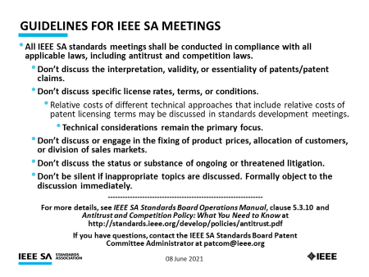
The Coex SC will review the official IEEE-SA patent material for pre-PAR groups
Approved slide

Slide 6
Participant behavior in IEEE-SA activities is guided by the IEEE Codes of Ethics & Conduct
Approved slide
  All participants in IEEE-SA activities are expected to adhere to the core principles underlying the:
    IEEE Code of Ethics
    IEEE Code of Conduct
  The core principles of the IEEE Codes of Ethics & Conduct are to:
    Uphold the highest standards of integrity, responsible behavior, and ethical and professional conduct
    Treat people fairly and with respect, to not engage in harassment, discrimination, or retaliation, and to protect people's privacy.
    Avoid injuring others, their property, reputation, or employment by false or malicious action
  The most recent versions of these Codes are available at
    http://www.ieee.org/about/corporate/governance

Slide 7
Participants in the IEEE-SA “individual process” shall act independently of others, including employers
Approved slide
  The IEEE-SA Standards Board Bylaws require that “participants in the IEEE standards development individual process shall act based on their qualifications and experience”
  This means participants:
    Shall act & vote based on their personal & independent opinions derived from their expertise, knowledge, and qualifications
    Shall not act or vote based on any obligation to or any direction from any other person or organization, including an employer or client, regardless of any external commitments, agreements, contracts, or orders
    Shall not direct the actions or votes of other participants or retaliate against other participants for fulfilling their responsibility to act & vote based on their personal & independently developed opinions
  By participating in standards activities using the “individual process”, you are deemed to accept these requirements; if you are unable to satisfy these requirements then you shall immediately cease any participation

Slide 8
IEEE-SA standards activities shall allow the fair & equitable consideration of all viewpoints
Approved slide
  The IEEE-SA Standards Board Bylaws (clause 5.2.1.3) specifies that “the standards development process shall not be dominated by any single interest category, individual, or organization”
    This means no participant may exercise “authority, leadership, or influence by reason of superior leverage, strength, or representation to the exclusion of fair and equitable consideration of other viewpoints” or “to hinder the progress of the standards development activity”
  This rule applies equally to those participating in a standards development project and to that project’s leadership group
  Any person who reasonably suspects that dominance is occurring in a standards development project is encouraged to bring the issue to the attention of the Standards Committee or the project’s IEEE-SA Program Manager

Slide 9
Participants are required to adhere to the IEEE SA Copyright Policy
Approved slide
  By participating in this activity, you agree to comply with the IEEE Code of Ethics, all applicable laws, and all IEEE policies and procedures including, but not limited to, the IEEE SA Copyright Policy.
    Previously Published material (copyright assertion indicated) shall not be presented/submitted to the WG nor incorporated into a WGdraft unless permission is granted.
    Prior to presentation or submission, you shall notify the WG Chair of previously Published material and should assist the Chair in obtaining copyright permission acceptable to IEEE SA.
    For material that is not previously Published, IEEE is automatically granted a license to use any material that is presented or submitted.

Slide 10
Participants are required to adhere to the IEEE SA Copyright Policy
  The IEEE SA Copyright Policy is described in the IEEE SA Standards Board Bylaws and IEEE SA Standards Board Operations Manual
    IEEE SA Copyright Policy, see:
      Clause 7 of the IEEE SA Standards Board Bylaws
      Clause 6.1 of the IEEE SA Standards Board Operations Manual
  Other material
    IEEE SA Copyright Permission
    IEEE SA Copyright FAQs
    IEEE SA Best Practices for IEEE Standards Development
    Distribution of Draft Standards (see Clause 6.1.3 of the SASB Operations Manual)

Slide 11
The Coex SC will only meet once during the hybrid IEEE 802.11 WG plenary meeting in July 2022
Schedule
  Wednesday, 20 July 2022 @ 4-6pm ET
Webex details
  Join the Webex meeting here:
    https://ieeesa.webex.com/ieeesa/j.php?MTID=m97e35ea686b17229bc8ae86519a78426
  Meeting number: 2338 981 2561
  Meeting password: wireless

Slide 12
The Coex SC will consider a proposed agenda for its hybrid meeting in July 2022
Planned agenda
  Bureaucratic stuff
    Scope of IEEE 802.11 Coex SC
    Approve minutes from May 2022
  What is happening this week? (in no particular order)
    Coex Tech Talk report
    LAA deployment update
    Impact of LAA/NR-U on Wi-Fi
    ETSI BRAN update
      EN 301 893 (5 GHz)
        Next steps for 802.11be
      EN 303 687 (6 GHz)
        Next steps for 802.11ax/be
        NB FH
        C2C
      Future BRAN meetings
    IEEE 802.15.4ab coex discussion
      After WNG
    Bluetooth coex discussion
    SL-U coex discussion
      Dorin Viorel (CableLabs)
    The battle for 6 GHz
    60 GHz coex update
    Plans for meeting in Sept 2022?

Slide 13
  Scope of IEEE 802.11 Coexistence SC

Slide 14
The Coex SC scope was revised in Sept 2020
IEEE 802.11 Coex SC Scope
  The Coex SC shall promote, within the 802.11 WG and externally, an environment that enables IEEE 802.11 technologies to have equitable access to unlicensed spectrum globally
  The Coex SC should focus particularly on coexistence of 802.11ax & 802.11be with LAA & NR-U in the 5 GHz & 6 GHz bands globally
  The Coex SC may consider coexistence with other technologies and in other bands as directed by the Chair of the 802.11 WG
IEEE 802.11 Coex SC close down criteria
  802.11 WG Chair has authority to close down SC

Slide 15
The scope of the Coex SC was expanded in March 2021 to include 60 GHz coexistence issues
  It was noted during the March 2021 plenary that ETSI BRAN is working on 60 GHz Harmonised Standards that may impact IEEE 802.11ay coexistence
  Subsequently, the 802.11 Chair directed the Coex SC to consider 60GHz coexistence within scope
    At today's WG11 Opening Plenary, the comment was made that ETSI BRAN is also considering operational and coexistence requirements related to 57-71 GHz (60GHz) spectrum, relevant of course to 802.11ad and 11ay
    The scope of the Coex SC focuses on, "coexistence of 802.11ax & 802.11be with LAA & NR-U in the 5 GHz & 6 GHz bands globally". However, it "may consider coexistence with other technologies and in other bands as directed by the Chair of the 802.11 WG". So the Coex SC can consider 60 GHz issues if directed by the WG Chair
    I have directed the Coex SC to additionally consider coexistence topics for 60GHz operation

Slide 16
  Minutes

Slide 17
The Coex SC will consider the approval of its virtual meeting minutes from May 2022
  The draft minutes for the Coex SC at the virtual meeting in May 2022 are available on Mentor:
    See 11-22-0875-00
  Proposed motion:
    The IEEE 802 Coex SC approves 11-22-0875-00 as the minutes of its virtual meeting in May 2022
    Moved:
    Seconded:
    Result:

Slide 18
Coex SC
Key messages for July 2022

Slide 19
There are few key message for the Coex SC that arise out of today’s session
Key messages from today’s session include …
  There is not much LAA/NR-U yet …
    … but any LAA/NR-U will not coexist well with Wi-Fi
    … which means we might or might not have a coex problem
  EN 301 893 (5 GHz) protects Wi-Fi …
    … but the compromise may result in 802.11be suffering
  IEEE 802.11 WG needs to decide how to respond to the rules …
    … in both EN 301 893 (5 GHz) & EN 303 687 (6 GHz)
  There are ongoing coex threats/issues …
    … including from SL-U, 802.15.4ab, Bluetooth and lack of 6 GHz
  And we are still tracking 60 GHz coex
… you can leave if you are not interested in the details ☺

Slide 20
  Agenda items
  IEEE 802 Tech Talk on Coex report

Slide 21
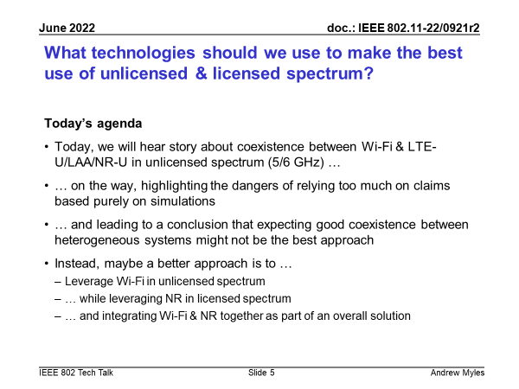
An IEEE 802 Tech Talk on coexistence on 22 June 2022 advocated for Wi-Fi as “the” unlicensed technology
  During the last few meetings, requests were made for assistance to develop material for an IEEE 802 Tech Talk on coexistence issues
  No one volunteered … and so Andrew Myles developed & delivered the
  his own material on 22 June 2022
    See 11-22-0921-02
    See here for recording
  The talk noted that Wi-Fi & LAA
  (& NR-U?) do not appear to coexist
  very well, in real deployments despite
  all the simulations & handwaving …
  … and advocated for Wi-Fi to be
  “the” unlicensed spectrum technology
  … working with NR as “the” licensed
  spectrum technology

Slide 22
  Agenda items
  What is exposure of Wi-Fi to coex issues
  with LAA/NR-U deployments?

Slide 23
There was a significant LAA deployment in
Chicago as early as Jan 2020
No update
Chicago LAA deployment (Jan 2020)
  A study in Chicago in Jan 2020 shows a significant LAA deployment … that was expanding rapidly
    In Jan 2020, AT&T mostly used channel 149 & Verizon mostly used channel 36, avoiding intra-LAA coex issues
  See Measurement-based coexistence studies of LAA & Wi-Fi deployments in Chicago
    Vanlin Sathya, Muhammad Iqbal Rochman, & Monisha Ghosh (Uni of Chicago)
AT&T
Verizon
T-Mobile

Slide 24
We have tracked the use of 5G by SPs in unlicensed bands to highlight the importance of coexistence work
No update
Tech | Stage | GSMA¹ (July ‘18) | GSA² (Oct ‘18) | GSA³ (Jan ‘19) | GSA⁴ (Jul ‘19) | GSA⁵ (Nov ‘19) | GSA⁶ (Dec ‘19) | GSA⁷ (Mar ‘20) | GSA⁸ (Aug ‘20)
LAA | Trials/plans | 23 | 22 | 26 | 29 | 30 | 29 | 29 | 28
 | Deployed | 4 | 6 | 6 | 8 | 8 | 8 | 9 | 9
LWA | Trials/plans | ? | 2 | 2 | 2 | 2 | 2 | 2 | 2
 | Deployed | ? | 1 | 1 | 1 | 1 | 1 | 1 | 1
LTE-U | Trials/plans | ? | 8 | 8 | 8 | 8 | 9 | 9 | 9
 | Deployed | ? | 3 | 3 | 3 | 3 | 3 | 3 | 3
GSMA (July 2018)
GSA: Evolution from LTE to 5G: Global Market Status (Nov 2018)
GSA: LTE in unlicensed and shared spectrum (Jan 2019)
GSA: Evolution from LTE to 5G: Global Market Status (Aug 2019)
GSA: LTE Unlicensed - LTE in Unlicensed and Shared Spectrum (Nov 2019
GSA: LTE and 5G Market Statistics (Dec 2019)
GSA: LTE in Unlicensed Spectrum and Shared Spectrum (Mar 2020)
GSA: LTE and 5G in Unlicensed Spectrum: Trials, Deployments & Devices (Aug 2020)

Slide 25
We have tracked the use of 5G by SPs in unlicensed bands to highlight the importance of coexistence work
No update
Tech | Stage | GSA⁹ (Oct ‘20) | GSA¹⁰ (Jan ’21) | GSA¹¹ (Feb ’21) | GSA^{12, 13} (Mar ’21) | GSA¹⁴ (Jun ’21) | GSA¹⁵ (Aug ’21) | GSA¹⁶ (Dec ’21) | GSA¹⁸ (Feb ’22) | GSA¹⁹ (Apr ’22)
LAA | Trials/plans | 27 | 27 | 27 | 27 | - | 27 | 27 | 27 | 27
 | Deployed | 9 | 9 | 9 | 9 | - | 9 | 9 | 9 | 9
LWA | Trials/plans | 2 | 2 | 2 | 2 | - | 2 | - | - | -
 | Deployed | 1 | 1 | 1 | 1 | - | 1 | - | - | -
LTE-U | Trials/plans | 9 | 9 | 9 | 9 | - | 9 | - | - | -
 | Deployed | 3 | 3 | 3 | 3 | - | 3 | - | - | -
LWA & LTE-U seem to be dead in terms of operator deployment!
GSA: LTE and 5G Market Statistics (Oct 2020)
GSA: LTE and 5G Market Statistics (Jan 2021)
GSA: Networks, Technologies & Spectrum Snapshot: LTE and 5G Market Statistics (Feb 2021)
GSA: LTE Ecosystem Status (Mar 2021)
GSA: LTE 5G Market Statistics (Mar 2021)
GSA: LTE Ecosystem Report (Status Update Jun 2021)
GSA: NTS Stats Update (Aug 2021)
GSA: NTS database snapshot: LTE and 5G Market Statistics (Dec 2021)
GSA: NTS Statistics (Dec 2021)
GSA: NTS Statistics (Feb 2022)
GSA: NTS Statistics (Apr 2022)

Slide 26
We have tracked the use of 5G by SPs in unlicensed bands to highlight the importance of coexistence work
Updated
Tech | Stage | GSA²⁰ (May ‘22) | GSA²¹ (Jun ‘22)
LAA | Trials/plans | 27 | 27
 | Deployed | 9 | 9
LWA | Trials/plans | - | -
 | Deployed | - | -
LTE-U | Trials/plans | - | -
 | Deployed | - | -
GSA: NTS Database Snapshot (May 2022)
GSA: NTS Database Snapshot: LTE and 5G Market Statistics (June 2022)

Slide 27
The number deployed LAA networks is steady … suggesting less need for concern about coex
Suggests maybe LAA is going nowhere fast?
No NR-U data!

Slide 28
The number of LAA devices is still growing … suggesting some need for concern about Wi-Fi coex
Tech | GSA¹ (Mar ’21) | GSA² (Jun ’21) | GSA³ (May ’22)
LAA | 247 | 329 | 480
LWA | 16 | 16 | 17
LTE-U | 46 | 46 | 46
Suggests LAA is still growing – at least in terms of client devices
GSA: LTE 5G Market Statistics (Mar 2021)
GSA: LTE Ecosystem Report (Status Update Jun 2021)
GSA: LTE Device Ecosystem (Status Update May 2022)
No NR-U data!
LWA/LTE-U seem dead in term of devices!

Slide 29
  Agenda items
  What is impact on Wi-Fi of
  LAA/NR-U deployments?

Slide 30
The Coex SC heard about an LAA/Wi-Fi coexistence studies in Chicago throughout 2021
Refined from
Nov 2021
  One of concerns with many of the conclusions drawn in relation to coexistence is that they are based on simulation studies …
  … which have been used over the years to provide evidence for just about any conclusion one might want to draw
  A good complement to simulation studies is measurements of actual deployments …
  … recognising they also have limitations
  During 2021, the Coex SC heard about various LAA/Wi-Fi coexistence measurements undertaken in the in the Chicago area
    See 11-20-1973 (Jan 2021)
    See 11-21-1858 (Nov 2021)

Slide 31
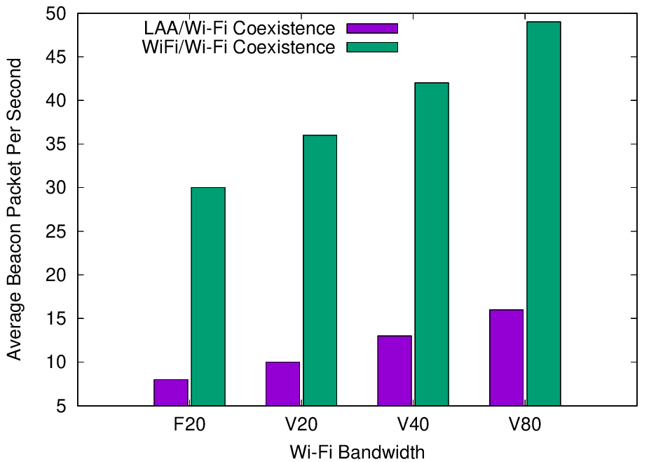
Experiments reported in Jan 2021 showed LAA has a significant adverse impact on Wi-Fi Beacons
Refined from
Mar 2021
  The Uni of Chicago study (11-20-1973) investigated the effect of LAA on Wi-Fi operation in various typical configurations, including hidden nodes
  The work showed that LAA
  caused significant interference
  to Wi-Fi Beacons in the tested
  configuration
    Probably because LAA is:
      Using ED @ -72 dBm
      Rather than PD @ - 82 dBm
    Also because LAA typically uses
    long TxOPs (~8 ms)
Addition of a single LAA system to five Wi-Fi systems causes successful Beacon rate to reduce by > 75%
Pushing Wi-Fi APs into the same channel also causes successful Beacon rate to reduce, but by less than LAA

Slide 32
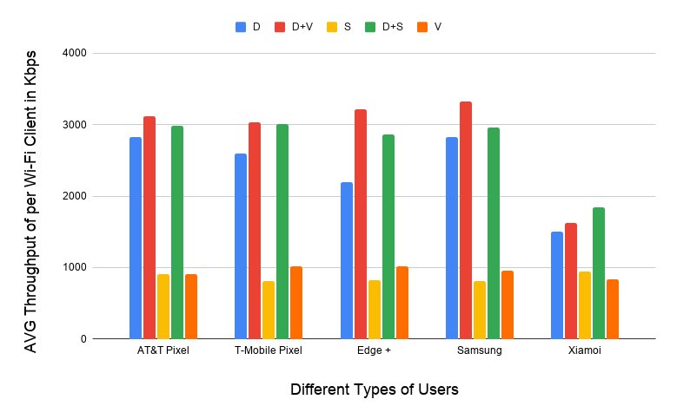
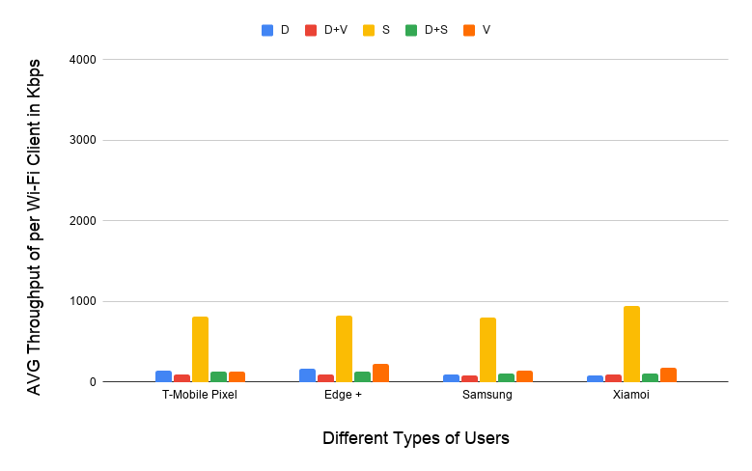
Experiments reported in Jan 2021 showed LAA also has a significant adverse impact on Wi-Fi data
Refined from
Mar 2021
  The Uni of Chicago study (11-20-1973) showed that LAA caused significant interference to data traffic in the tested configuration
    Probably because LAA is using ED @ -72 dBm rather than PD @ - 82 dBm
    Also because Wi-Fi’s hidden station mitigation mechanisms based on RTS/CTS have no effect on LAA
5 Wi-Fi APs on one channel, no LAA
5 Wi-Fi APs on one channel, one LAA
11-20-1973 slide 16
All client close
to Wi-Fi APs
Addition of LAA caused all Wi-Fi traffic to collapse …
… except streaming because LAA uses licensed for streaming

Slide 33
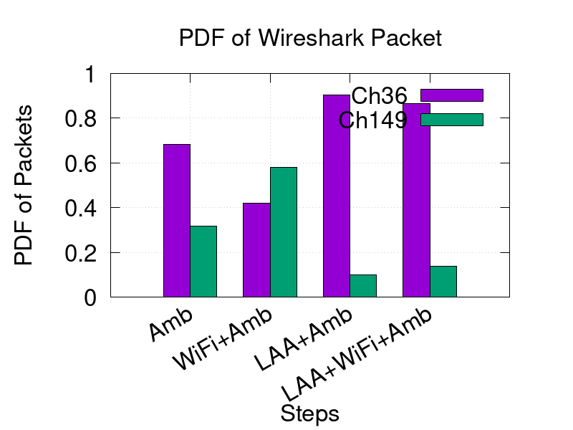
New measurements reported in Nov 2021 seem to confirm the adverse impact of LAA on Wi-Fi
Refined from
Jan 2022
  The latest Uni of Chicago results (11-21-1858-01) confirmed previous results …
  … that LAA seems to block most Wi-Fi traffic on an LAA channel
    The problem appears to be that LAA doesn’t back off because it is hidden from the indoor Wi-Fi APs
  It doesn’t help that deployed LAA & Wi-Fi systems are typically quite static in their choice of channels
    Neither system are sharing by avoiding using the same channels

Slide 34
It is not clear whether or not the industry needs to solve a serious coex problem …
Situation
The Uni of Chicago measurements suggest there is a real & ongoing coexistence issue between Wi-Fi & LAA (and maybe NR-U too) in actual deployments!
Are these measurements confirmed?
LAA (& NR-U) rarely needs to coexist with Wi-Fi
Suggesting we can breath a big sigh of relief …
… and continue with Wi-Fi’s success
Path 1
Which path are we going to follow?
LAA (& NR-U) frequently needs to coexist with Wi-Fi
Suggests we have a serious coex problem we need to solve …
… or Wi-Fi’s long term success is at risk
Path 2

Slide 35
The Wi-Fi industry needs to decide if we have a problem … and possibly how to solve it
Some (still open) questions …
  Does anyone expect LAA and/or NR-U to go away?
    We probably need to assume the worst … until shown otherwise
  If not, can we get new measurements related to NR-U/LAA/Wi-Fi coex?
    The University of Notre Dame is planning to continue the Uni of Chicago work, but results will not be available for some time
      Monisha Ghosh (UniND) is applying for NSF funding for a 6 GHz testbed
      … but industry funding and equipment donations will speed the process
      … particularly equipment where low level parameters can be adjusted
    During our March 2022 meeting, at least one attendee volunteered to undertake measurements if equipment or deployments could be identified …
  If not, are there any mitigations to avoid NR-U/LAA/Wi-Fi coex issues?
    eg the hidden station issues highlighted by the Uni of Chicago measurements

Slide 36
  Agenda items
  What is happening in ETSI BRAN?

Slide 37
Note that ESTI BRAN documents are available to IEEE 802.11 WG members
  Today’s material references ETSI BRAN documents
  They are (or should be) available in the IEEE 802.11 WG members area
    See http://www.ieee802.org/11/private/ETSI_documents/BRAN
  Please remember that these documents are not public …
  … and have only been made available to IEEE 802.11 WG members under special arrangement

Slide 38
  Agenda items
  What is happening in ETSI BRAN?
  EN 301 893 (5 GHz)

Slide 39
The latest revision of EN 301 893 (5 GHz) is likely to be sent to ENAP ballot soon
Document status
  Draft EN 301 893 v.2.1.48 (stable draft)
Commentary
  v2.1.48 was published after BRAN#114 with mostly editorial changes
    Compromise for adaptivity (& associated testing) remains, as originally agreed way back in BRAN#109
  BRAN #114c on 30 Aug 2022 and BRAN #114d on 1 Sep 202 will be considering issues related to EN 301 893
    But not coexistence
  Hopefully, this means the ENAP ballot and hopefully approval of the next revision of EN 301 893 (5 GHz) is close-ish!

Slide 40
The EN 301 893 journey wrt coexistence has been long & interesting … with risks for 802.11be!
Refined from
May 2022
V1.8.1
Standard
Mar 2015
802.11a/n/ac conformant devices use access mechanisms in 802.11 standard
Other devices followed weird rules with little connection to anything
Very 802.11 focused …
… as only game in town
… but unclear there was good sharing between Wi-Fi/LAA/…
V2.1.1
Standard
May 2017
EDCA based adaptivity
  802.11a/n/ac conformant devices can use using use EDT at -62 dBm
  Other devices use EDT @ -72 dB
Enabled reasonable sharing, using LBT with exponential backoff …
… but a compromise, with different thresholds for Wi-Fi & LAA/NR-U/…
V2.1.8
Stable draft
Sep 2018
EDCA based adaptivity
  Any devices using 802.11 defined PD may use EDT at -62 dBm
  Otherwise use EDT @ -72 dB
Enabled any technology to use either of the two options …
… but 3GPP community were unhappy as they did not want to use 802.11’s PD
V2.1.48
Stable draft
Jun 2022
EDCA based adaptivity
  802.11a/n/ac/ax conformant devices may use ED @ -62 dBm
  Other devices use ED @ -72 dB
Allows traditional Wi-Fi operation …
… but forces 802.11be to use ED-only
@ -72 dBm, with potential coex issues (only way to make progress)
Likely end point, wrt coex
Potential coex issues

Slide 41
The Coex SC reviewed issues related to 802.11be in 5 GHz in Europe in Mar 2022, without conclusion
Refined from
May 2022
  A summary of future issues related to 802.11be in 5 GHz in Europe was discussed during the March 2022 meeting
    See 11-22-0180
  Various options for how to deal with 802.11be operations in 5 GHz under European rules were discussed, with limited consensus
    Option A: 802.11be specified to use PD/ED @ -82/-72 dBm, with NAV
      Poor coex with 802.11 & other technologies; probably no need to modify 802.11 std
    Option B: 802.11be specified to use ED-only @ -72 dBm, with NAV
      Uncertain coex with 802.11ax & other technologies; need to modify 802.11 std
    Option C: 802.11be does not operate in 5 GHz
      Objections voiced, at least partially because it would disable aspects of MLO
    Option D: Persuade BRAN to enable PD/ED @ -82/-62 dBm for 802.11be
      Unlikely to be accepted by BRAN, at least in the short term
    Option E: Ask BRAN to enable ED-only @ -62 dBm for 802.11be
      Poor coex with other technologies, assuming they are deployed

Slide 42
Should the Coex SC recommend the 802.11 spec be refined to allow operation with ED-only @ -72 dBm?
  The current situation is that 802.11be in Europe will need to operate within an ED-only @ -72 dBm constraint
    Whereas 802.11ax is allowed to operate using tadeonal ED/PD @-62/-72 dBm
  There have been some studies that claim this is acceptable … and others that claim it is not!
    See following slides reporting on work from May 2021, July 2021 & May 2022
  Those who assert it is unacceptable have suggested that EN 301 893 adopt ED-only @ -62 dBm
  In reply, others have asserted ED-only @ -62 dBm is a bad idea
    We know from 3GPP RAN simulations some years ago that this results in poor coexistence, especially for Wi-Fi!
    Once EN 301 893 goes down this route, there is no way back
    A better (albeit politically unacceptable) solution would be for EN 301 893 to allow 802.11be to operate just like 802.11ax/ac/n/a

Slide 43
In May 2021, the Coex SC heard claims for the optimum path for 5 GHz (& 6 GHz) coexistence
No update from
Nov 2021
  In May 2021, two submissions started the discussions about the optimum future path for coexistence in 5 GHz, especially in relation to the use of 802.11be with legacy equipment… …
    11-21-0705-00
      Simulation and Evaluation of the Impact of Varying ED Thresholds
      Gaurav Patwardhan (HPE), Eldad Perahia (HPE), Stuart Strickland (HPE)
      Uniform use of EDT @ -72 dBm likely to have a positive impact on sharing
      EDT @ -72 dBm in 5 GHz will sometimes disadvantage 802.11be compared to legacy using EDT @ -62 dBm, with some mitigation from RTS/CTS
      Specification work is probably required in both TGme (for 802.11ax) and TGbe
    11-21-0851-00 (Word document)
      5 GHz ED Analysis
      Menzo Wentink (Qualcomm)
      EDT @ -72 dBm in 5 GHz will sometimes disadvantage 802.11be compared to legacy
      Use of EDT @ -72 dBm limits spectral reuse
      EDT of -62 dBm may be a better long-term approach
  … suggesting more work is required!

Slide 44
In Jul 2021, the Coex SC heard further claims for the optimum path for 5 GHz (& 6 GHz) coexistence
No update from
Nov 2021
  In July 2021, Stuart Strickland (HPE) presented a discussion on possible next steps in relation to 5 GHz coexistence, especially in relation to the use of 802.11be with legacy equipment…
    11-21-1179-00
      Similar submission to 11-21-0705-00 in May 2021
      Focused on coexistence between legacy 802.11 using EDT of -62 dB & 802.11be using EDT of -72 dBm
      Concluded that ~10% of 802.11be traffic may suffer a disadvantage, compared to legacy traffic
      Noted that in managed networks a common EDT of -72 dBm may benefit both 802.11be & legacy equipment
      However, highlighted that the simulations used to draw these conclusion are relatively simple … and more work is required
  … suggesting more work is required!

Slide 45
In May 2022, it was highlighted again that more work is required to choose a path
  Stuart Strickland (HPE) reported in May 2022 that
    … we haven’t done any further research, but still don’t find merit in moving to ED-only at -62dBm.
    An ED at -72dbm and an adjustable PD depending on local conditions seems like a promising path.
  It seems more work is required but no one has undertaken it

Slide 46
In Jun 2022 at BRAN #114, an ambit claim to change EN 301 893 to ED-only @ -62 dBm was not accepted
  BRAN(22)114022 from Qualcomm proposed to loosen the constraint in EN 301 893 for all technologies to ED-only @ -62 dBm
  The document did not provide an evidence to support this change or to mitigate the concerns expressed …
  … particularly that it would essentially enable LAA/NR-U to ignore Wi-Fi in most situations, leading to poor coexistence outcomes
  The document was noted …
  … but not accepted!

Slide 47
The discussion at BRAN #114 just showed more work is required …
  The bottom line is that more work is needed to resolve the ongoing question of coex in 5 GHz …
    Between Wi-Fi & LAA/NR-U (assuming either of LAA/NR-U ever exist)
    Between 802.11ax & 802.11be (we know 802.11ax/be will exist)
  …. because it just won’t go away
  The work could involve:
    Showing ED-only @ -62 dBm causes no harm when coexisting with LAA/NR-U
      Technical work
      Unlikely?
    Showing that Wi-Fi will not need to interoperate with other technologies?
      Marketing work
      Unlikely?

Slide 48
How should the 802.11 spec be refined to allow operation with ED-only @ -72 dBm?
  The current situation is that EN 301 893 requires 802.11be to operate with the ED-only @ -72 dBm constraint
  Two options suggested so far:
    The simplest/safest short term approach might be to refine the 802.11be spec to define a mode of operation in 5 GHz using ED-only @ -72 dBm
      This approach has the advantage it is aligned with the ED-only @ -72 dBm rules in Europe in 6 GHz; the 802.11 std needs to be refined for 6 GHz operation too!
    A comment was received that seemed to support a change to the 802.11 standard to allow operation with ED/PD = -72/(< -72) dBm
      A good option may be to enable spatial reuse with ED set to -72 and PD varying between [-72, -72 - delta]
      This allows the most aggressive option of ED/PD = -72/-72, while letting a system select a lower PD based on fairness or network characteristics
      Spatial reuse hasn’t really taken off in 11ax due to lack of optimization; so maybe the ETSI situation will spur Wi-Fi companies to start looking into it more seriously
  Others?

Slide 49
  Agenda items
  What is happening in ETSI BRAN?
  EN 303 687 (6 GHz)

Slide 50
The latest revision of EN 303 687 (6 GHz) has been sent to ENAP ballot closing in late July 2022
Document status
  Draft EN 303 687 v1.0.0 (final draft for approval)
Commentary
  v0.0.20 was completed after BRAN#113
    Adaptivity based on ED-only at -72 dBm included
    Some aspects of NB FH in 4.3.3.2 (specification) & 5 (testing) included
    All support for C2C features removed, at least for the moment
  v1.0.0 was sent for review by NSOs in an ENAP ballot, closing 26 Jul 22
    It appears resources for a review by EC appointed consultant were unavailable
    ETSI Secretariat completed its editorial checks
  Hopefully, this means approval of the next revision of EN 303 687
  (6 GHz) is close-ish!

Slide 51
There are some open issues in EN 303 687 that will probably be addressed in the next revision
NB FH operations
  The next version of EN 303 687 will specify that NB FH uses the LBE/FBE channel access mechanisms & channelization’s
  Future revisions of EN 303 687 may extend NB FH further
    See BRAN(21)112011 (Apple) - Narrow Band Channel Access in 6 GHz for some initial discussions
  The plan is for the Coex SC to monitor any future discussions …
  … but in the meantime, NB FH is partially enabled by EN 303 687
C2C operations
  Various efforts were made to specify requirements in EN 303 687 for C2C operations to be enabled by “hearing” any AP in any channel
  There was no agreement on a sufficient level of “hearing” and so the issue has probably been deferred to the next revision
  The plan is for the Coex SC to monitor any future discussions …
  … but in the meantime C2C is not enabled by EN 303 687

Slide 52
Coex SC/TGbe/TGme needs to decide how to specify 802.11ax/be in context of 6 GHz rules in Europe
  In EN 303 687, the EDT is -72 dBm for both 802.11ax & 802.11be
  This is different to traditional 802.11 operations, which generally uses an PD/ED @ -82/-62 dBm
  The Coex SC/TGbe/TGme need to decide how to handle this difference for 802.11ax/be in 6 GHz in Europe
    Use PD/ED @ -82/-72 dBm (which may disadvantage Wi-Fi compared to NR-U)
    Allow ED-only @ -72 dBm (like NR-U), at least when NR-U/LAA is around
    Something else
  The decision could be:
    Reflected in the standard
    Handled outside the standard
  Thoughts?

Slide 53
Coex SC will park the issue of 802.11be compatibility with EN 301 893 (5 GHz) & EN 303 687 (6 GHz)
  Both EN 301 893 (5 GHz) & EN 303 687 (6 GHz) are based on EDCA style access, which was suitable for 802.11ax (Wi-Fi 6/6E)
    Actually, given the EN 301 893 draft, anything in 802.11ax is allowed in 5 GHz
  802.11be is being developed now, with new features that might not all be aligned with the existing HS’s adaptivity assumptions
  This suggests two tasks/options for the Coex SC/TGbe
    Identify any likely 802.11be features that may not be allowed by EN 301 893
    (5 GHz) and EN 303 687 (6 GHz)
    Plan to make a case to ETSI BRAN to refine EN 301 893 (5 GHz) and EN 303 687 (6 GHz) to allow these features
  So far, discussions with 802.11be experts have not identified any features not aligned with EN 301 893 (5 GHz) & EN 303 687 (6 GHz)
    Maybe MLO & AP Coordination?????
  It is proposed we park this issue until such issues are identified …

Slide 54
  Coex SC
  Future ETSI BRAN meetings

Slide 55
ETSI BRAN has agreed its 2022 schedule?
Meeting schedule for 2022
  BRAN #115
    5 Sep 2022 until 9 Sep 2022
    Hybrid
  BRAN #116
    17 Oct 2022 until 21 Oct 2022
    Hybrid
  BRAN #117
    5 Dec 2022 until 9 Dec 2022
    Hybrid

Slide 56
  Agenda items
  Is there a coexistence issue with IEEE 802.15.4ab?

Slide 57
There is activity underway in IEEE 802.15.4ab with a potential impact on Wi-Fi coexistence
From
May 2022
  IEEE 802.15.4ab (next generation UWB) is discussing a mechanism that:
    … uses NB FH transmissions in the lower band (upper UNII3)
    …to signal channel reservation in the upper band (UNII 6, UWB Ch.5 & Ch.9)
  This NB FH operation is targeted towards improving the link UWB budget by avoiding collisions of UWB signals in the UWB channels
  However, it seems less concerned about coexistence with Wi-Fi
    The original version did not specify any LBT …
    … although that may change with proposals for ED-only @ -62 dBm
    Additional noise from such a deaf version of NB will likely have an adverse affect on Wi-Fi …
    …noting Wi-Fi and LAA/NR-U typically listen at -72 dBm or less
  The arguments seem similar to the NB discussions in ESTI BRAN
    … with some of the same stakeholders

Slide 58
The Coex SC will discuss potential coex issue related to IEEE 802.15.4ab work …
  In May 2022, IEEE 802.15 WG reps were asked to provide a briefing to the Coex SC during this session in relation to IEEE 802.15.4ab work
  However, IEEE 802.15.4 TGab clashed with this session
  Instead, a briefing was presented during IEEE 802.11 WNG last night
    Overview of Tg4ab - scope, overview of technical proposals, status
    Overview of Coexistence: Bands and PHY characteristics.
    Future collaborations
  Now is an opportunity to discussion that briefing …

Slide 59
  Agenda items
  Is there a coexistence issue
  with Bluetooth in 6 GHz?

Slide 60
Is Bluetooth planning to operate in 6 GHz?
  Bluetooth & Wi-Fi have happily coexisted in the 2.4 GHz band for many years … mainly by avoiding each other
  There are now rumours that the Bluetooth SIG is planning to specify Bluetooth operation in 6GHz
  Assuming this is true, how will they coexist if operatingin the same channel … or will Bluetooth just avoid Wi-Fi again?
  Does anyone have any details?

Slide 61
  Agenda items
  What is happening wrt
  coexistence in 3GPP?

Slide 62
The Coex SC agreed in Jan 2022 to monitor any coex impacts of SL-U
Refined from
May 2022
  In Jan 2022, Dorin Viorel (CableLabs) provided an update on 3GPP RAN activities relevant to coexistence
    See 11-22-0124-00
  It was noted at that time that a new proposal called SL-U may cause future coex issues for Wi-Fi
    SL-U is Side Link Unlicensed
    Coex of SL-U with NR-U and Wi-Fi has not been studied
    It is possible that SL-U will not follow the NR-U access framework
  It was suggested that the Coex SC should follow the progress and any risks that arise in relation to SL-U
    It was believed a more accurate perspective of SL-U will become available by 3Q2022 – we are almost there now

Slide 63
The Coex SC will hear a summary of potential coex issues that may arise from SL-U work in 3GPP
  Dorin Viorel (CableLabs) will provide a summary of potential coex issues that may arise from SL-U work in 3GPP
    See tbd

Slide 64
  Agenda items
  What is status of
  6 GHz spectrum availability?

Slide 65
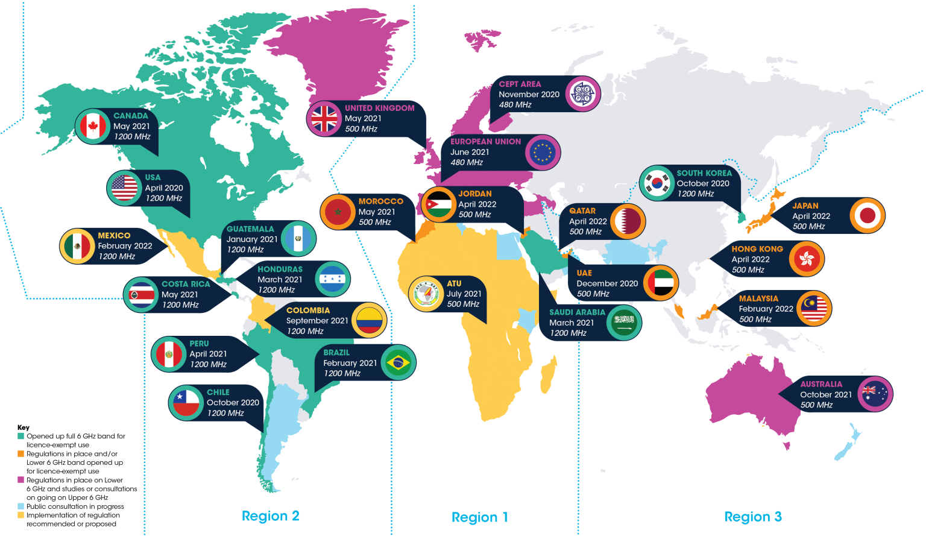
6 GHz is opening globally for unlicenced operation …

Slide 66
… but many cellular stakeholders are advocating that at least the upper 6 GHz band be licensed
  Alexander Sayenko (Apple) has provided a 3GPP status update report after the recent 3GPP RAN#95e meeting
    3GPP has an ongoing Rel-17 WI for the licensed operation in the 6GHz band
    All latest activities focus on the 6425-7125MHz frequency range in accordance with the RCC Recommendation.
    The original 3GPP WI deadline was March 2022, but was extended to June 2022; the WI completion level and status will be revised at the June RAN plenary.
    The latest WI Tdoc and status report can be found in RP-220686 and RP-220684.
    Potential co-existence issues were raised several times during technical discussions (but there was no consensus in 3GPP whether it is going impact any existing requirements)
    An LS to RCC, RP-220039, was sent asking for further technical input.

Slide 67
Submissions are welcome in relation to the battle for 6 GHz …
  The question of licensed vs unlicensed 6 GHz spectrum is closely tied to the coexistence issue …
    More unlicensed spectrum is required
    because:
      90-95% of data uses unlicensed
      spectrum …
      … and yet only about half of
      available spectrum is unlicensed
    If NR-U/LAA becomes popular then
    even more unlicensed spectrum is
    required so that NR-U/LAA & Wi-Fi
    can operate in different channels,
    avoiding coex issues at least some
    of the time
  Submissions in relation to the battle
  for 6 GHz globally are encouraged
European unlicensed situation
  Available unlicensed & licensed spectrum is roughly equal in Europe today …
        More than 1000 MHz in low/mid-band for licensed operation,
        About 1000 MHz for unlicensed operation (excluding upper 6 GHz)
  … & yet licensed spectrum only delivers about 5% of data traffic
    Most of the remaining 95% is delivered by Wi-Fi …
    … based on German data

Slide 68
  Agenda items
  What should we do wrt
  60 GHz scope?

Slide 69
The Coex SC has previously discussed coexistence in 60 GHz …
  At the Coex SC meeting in Mar 2021 a submission was presented that provided the status of 60 GHz work in ETSI BRAN
    See 11-21-0430-00 (Assaf Kasher (Qualcomm))
  In May 2021, the Coex SC heard about Coexistence between radars and communication systems in the 60 GHz band
    See 11-21-0796-00 (Alecsander Eitan (Qualcomm) et al)
  In Jul 2021,the Coex SC heard about Coexistence between radars and communication systems in the 60GHz band – U.S. Update
    See 11-21-1089-00 (Alecsander Eitan (Qualcomm) et al)
  In Sep 2021, the Coex SC heard NPRM work was occurring in 802.18

Slide 70
… but there was not much to report to the Coex SC in relation to 60 GHz coex in May 2022
  An e-mail was sent to Alecsander Eitan (Qualcomm) asking for an update on 60 GHz coex activities …
  … and in May 2022 he responded:
    Unfortunately, there is nothing new that can be reported. Many submissions have been sent to the FCC, and several comments on the other submissions have been also sent. There are some discussions between companies on compromise ideas
    …
    The FCC 60GHz NPRM is still undergoing so it may be premature to close this topic, however we don’t have any details that we can present. We can re-evaluate the situation in the future meeting

Slide 71
… and there is not much to report to the Coex SC in relation to 60 GHz coex in May
  Alecsander Eitan (Qualcomm) provided an update on 60 GHz coex activities in July 2022
    There was no change in the last months.
    The situation is exactly the same:
    “The FCC 60GHz NPRM is still undergoing so it may be premature to close this topic, however we don’t have any details that we can present. We can reevaluate the situation in the future meeting. “
  At this point, the plan is to keep monitoring …
  … thoughts?

Slide 72
  Coex SC
  Plans for next meeting

Slide 73
The Coex SC will continue its normal business in Sep 2022 (hybrid meeting in Hawaii)
Possible agenda items for Hawaii …
  Discuss coexistence measurement studies
  Review ETSI BRAN coex activities
    EN 301 893 (5 GHz)
    EN 303 687 (6 GHz)
  Discuss changes to 802.11 for ETSI BRAN HS compatibility
    Discuss ED-only at -62 dB option
  Hear 3GPP update
    Especially wrt SL-U
  Hear 60 GHz update
  Hear 6 GHz update
… but as usual, submissions are requested!

Slide 74
Sumit Roy (UofW) is planning to provide some new coex results in Sept
Abstract
  tbd

Slide 75
The IEEE 802.11 Coexistence SC virtual meeting in July 2022 is adjourned!

