Slide 1
DMG/EDMG Link Level Simulation Platform
Authors:
Date: 2022-05-24

Slide 2
Outline
Abstract
Integrated Sensing And Communication Physical Layer Model (ISAC-PLM)
Integration with existing channel models or measurements
Summary

Slide 3
Abstract
In [1], an example of link level simulation using ray tracing channel at 60GHz in indoor scenario is presented and discussed.
In [2], an open-source mmWave suite of tools (DMG/EDMG) has been presented, as well as a 60GHz channel model for representing sensing scenarios [3].
However, a common framework to compare TGbf proposals is not available yet.
In this contribution, the newly released open-source ISAC-PLM is shown and discussed as a possible simulation modeling platform.

Slide 4
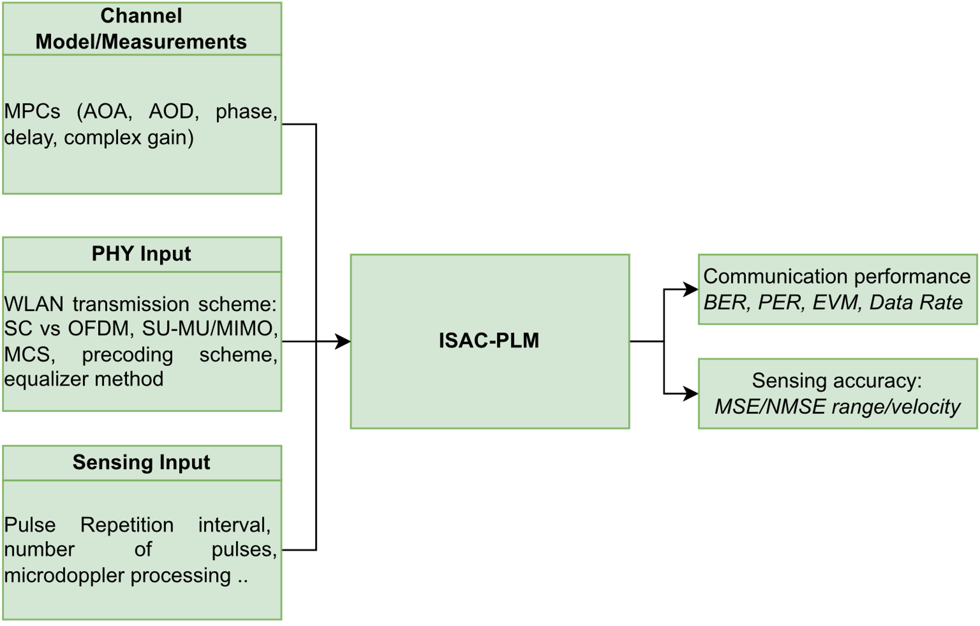
ISAC-PLM overview

Slide 5
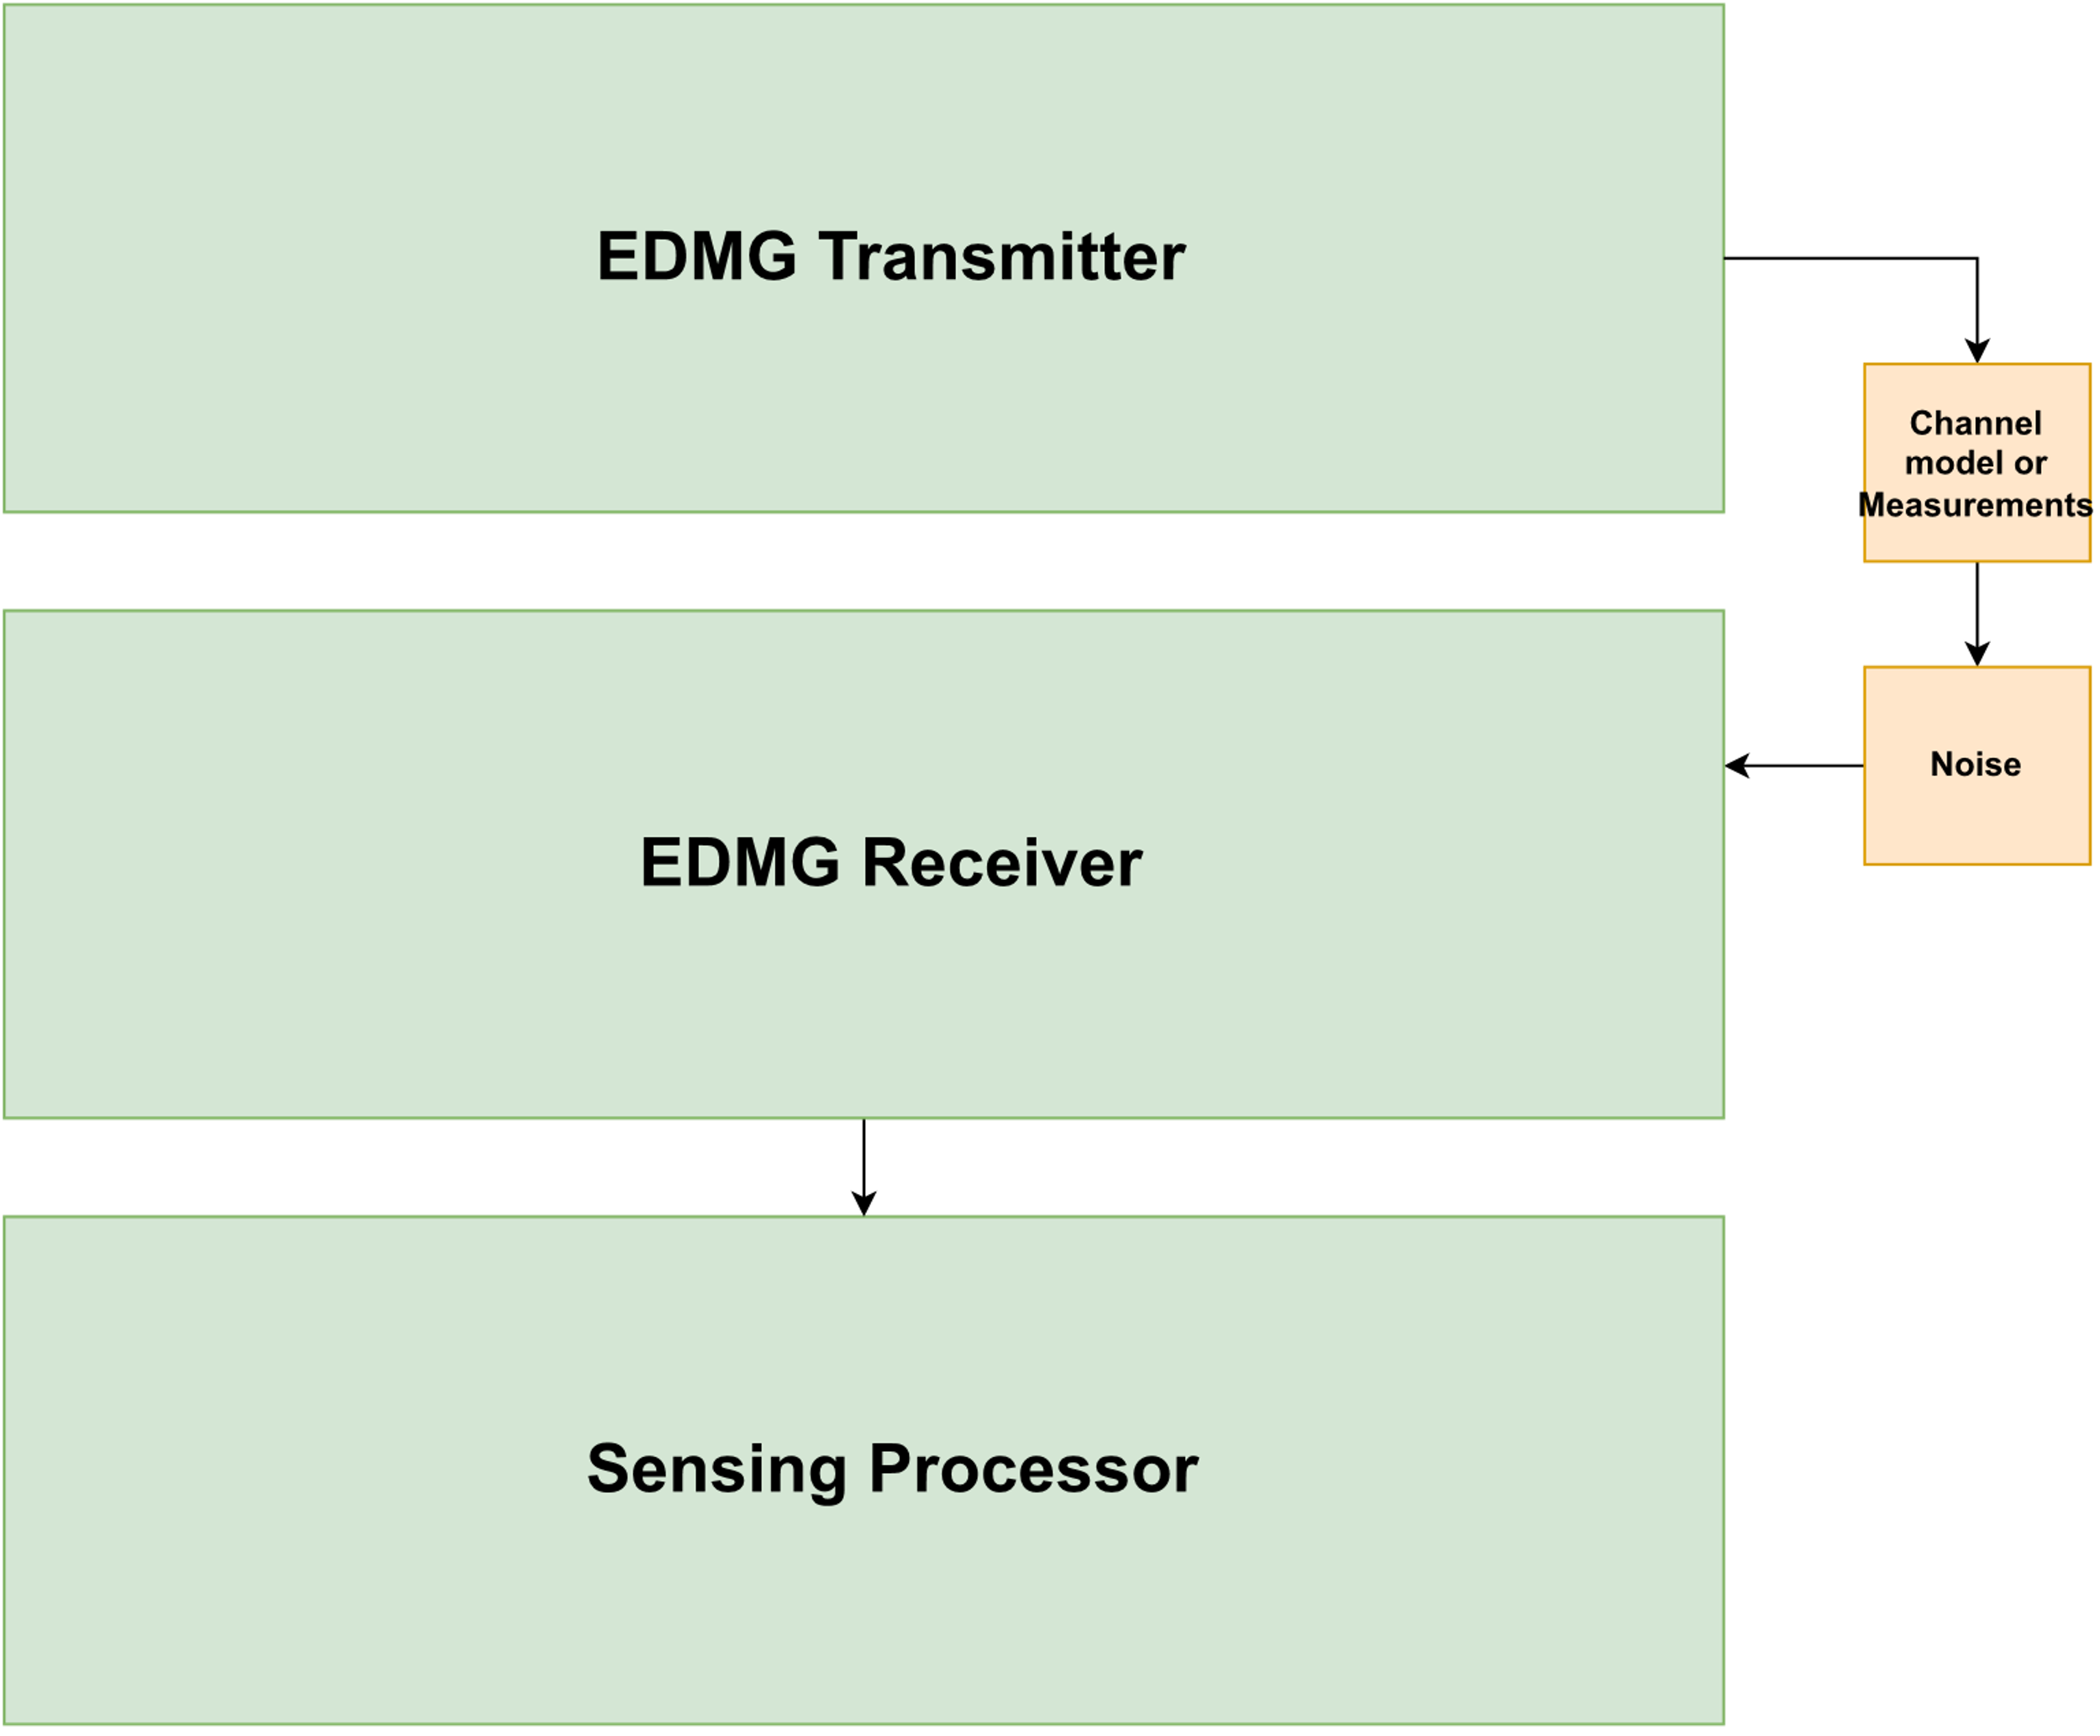
ISAC-PLM main components
Available: https://github.com/wigig-tools/isac-plm/

Slide 6

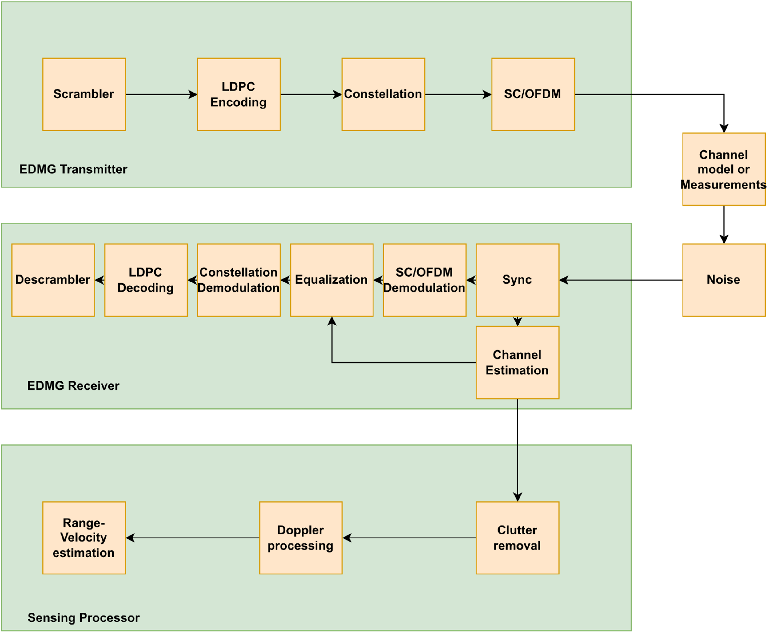
EDMG Transmitter
Generated sequence
  Waveform Type: DMG/EDMG SC/OFDM

Slide 7
EDMG Receiver
Frame detection
Frame synchronization
Carrier Frequency Offset estimation
Channel Impulse Response (CIR) estimation

Slide 8
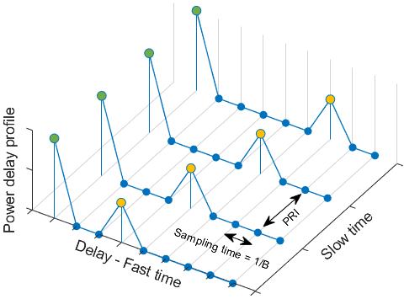
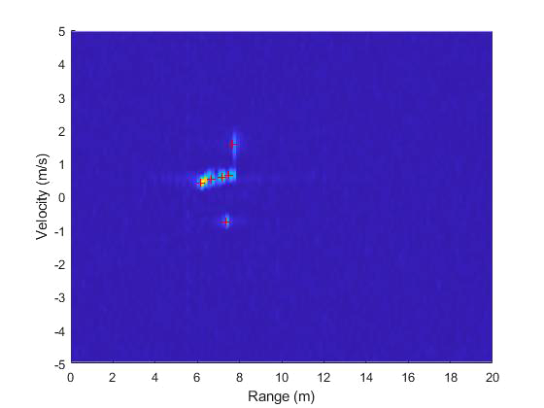
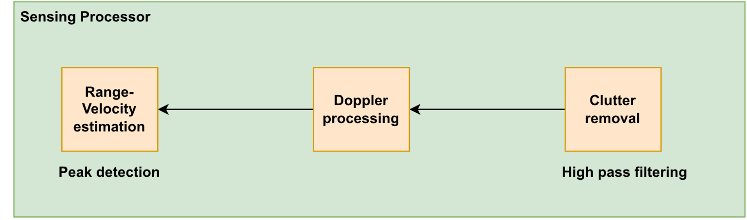
Sensing processor
Radar data matrix
Multiple CIRs corresponding to multiple PPDUs received
DFT
DFT
DFT
DFT
DFT
DFT
DFT
DFT
CIRs
Channel estimation after clutter removal

Slide 9
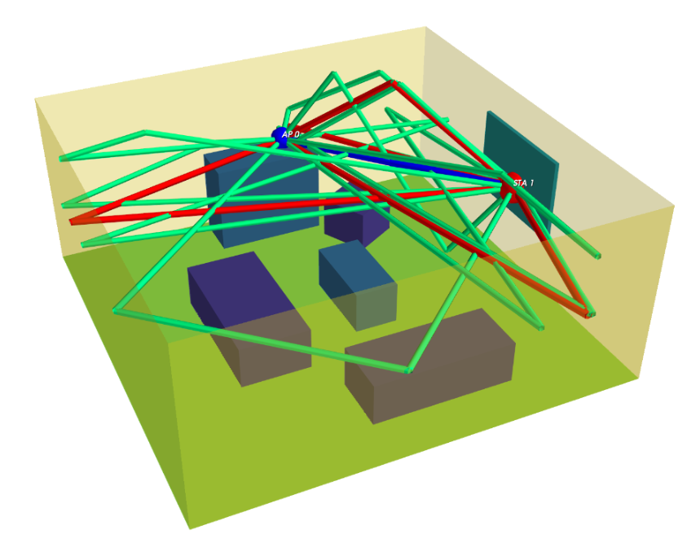
Interfacing ISAC-PLM with Existing or New Channel Models

Slide 10
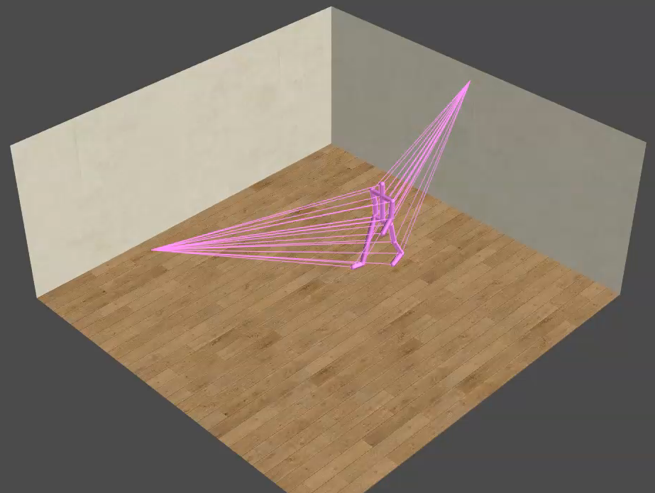
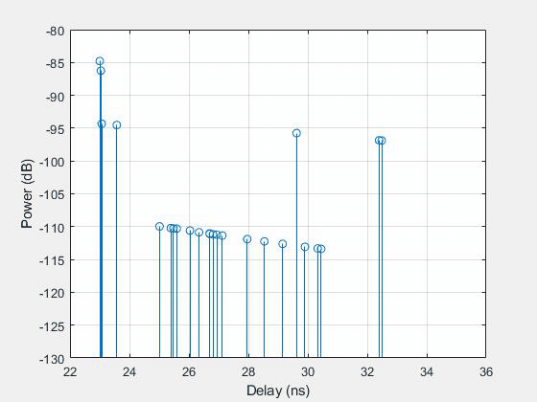
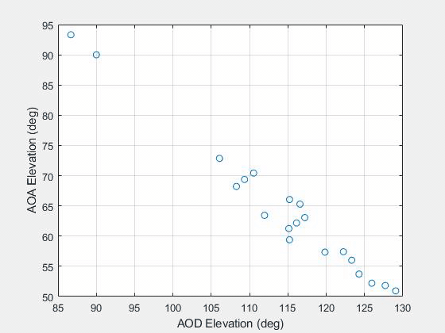
Example: Using the NIST QD-Channel Realization Software [2]-[3]
https://github.com/wigig-tools/qd-realization
Static D-Rays (interaction signal-environment)
Dynamic T-Rays (interaction signal-target)

Slide 11
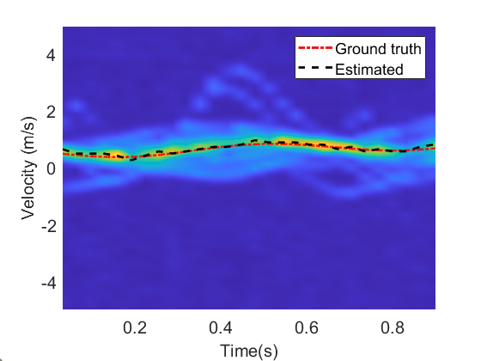
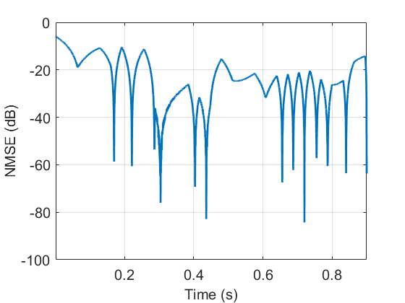
Example: Target velocity estimation using NIST Q-D channel model
EDMG Bi-static sensing
CSI sensing using SC-EDMG CEF
Pulse Repetition Frequency: 2KHz
Pulses in a Coherent Processing Interval: 64
Doppler FFT length: 128
Doppler FFT window: Blackman-Harris
Doppler FFT window length: 64

Slide 12
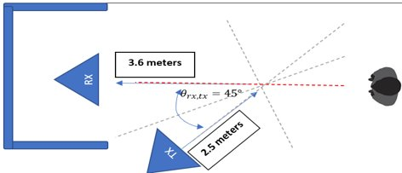
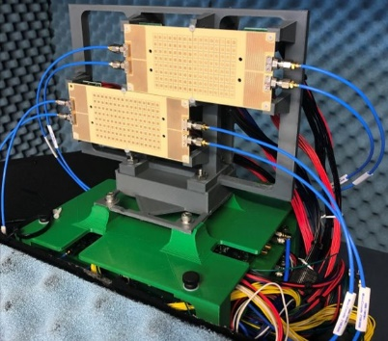
Interfacing the ISAC-PLM with Channel Measurements
[4]

Slide 13
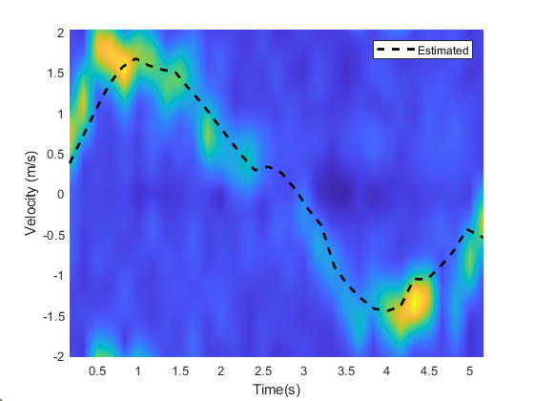
Example: Target velocity estimation using OTA Measurements
EDMG Bi-static sensing
CSI sensing using SC-EDMG CEF
Pulse repetition frequency: 385 Hz
Pulses in a Coherent Processing Interval: 64
Doppler FFT length: 512
Doppler FFT window: Blackman-Harris
Doppler FFT window length: 64

Slide 14
Summary
In this presentation a common WLAN EDMG sensing link level simulation platform is proposed.
ISAC-PLM can be used for evaluating end-to-end performance.
ISAC-PLM is fully integrated with the NIST Q-D channel realization software, but it can also be used with any other measurements or channel propagation models.

Slide 15
References
[1] 11-21-0352-01- WLAN sensing link level simulation - follow ups.pptx
[2] 11-21-0746-01-00bf-q-d-simulation-modeling-framework-for-sensing.pptx
[3] 11-21-0747-01-00bf-a-preliminary-channel-model-using-raytracing-to-detect-human-presence.pptx
[4] 11-21-1675-00-00bf-mmwave-phased-array-channel-sounder-for-human-sensing.pptx

