Slide 1
Changes in EDMG Multistatic PPDU
Date: 2022-05-15
Authors:

Slide 2
Abstract
After document 11-22-464 (PDT EDMG Multi-Static PPDU structure) have been presented there was some offline discussion that led to some changes in the document.
This presentation shows what changes have been made to the presentation as a result of the discussion.

Slide 3
PPDU Structure
Old structure
New structure
In the new structure the EDMG-CEF and Data fields are removed and a sync field for STA1 is added.

Slide 4
Sync Subfield Structure
Old Structure
New Structure
The new structure has 8 Golay sequences for detection and fine frequency offset estimation.
The total number of Golay sequences is 18 (like 3 TRN subfields)

Slide 5
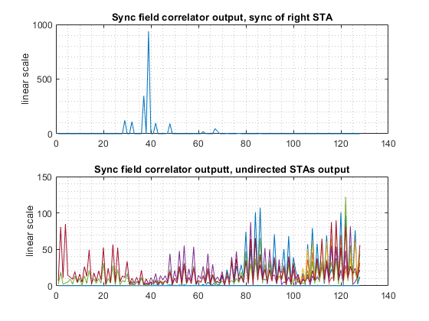
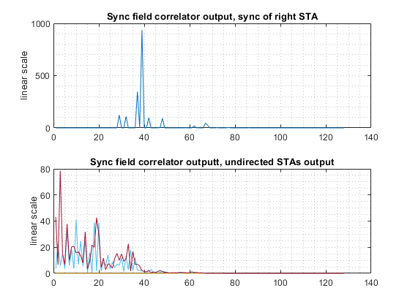
Old sync field – left, New sync field – right (no noise)

Slide 6
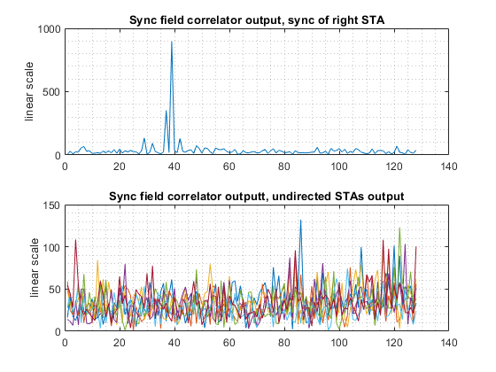
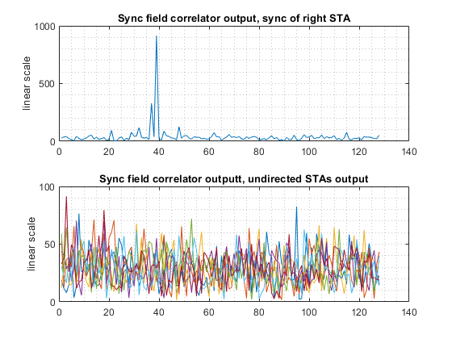
Old sync field – left, New sync field – right (0dB SNR)

Slide 7
References
11-22-464-02-00az-PDT EDMG Multi-Static PPDU structure
11-22-464-03-00az-PDT EDMG Multi-Static PPDU structure

