Slide 1
802.11bx: Enabling Metaverse
-- Metaverse, AR/VR, and Wearables
Date: 2022-05-16
Name | Affiliations | Address | Phone | email
Chunyu Hu | Meta Platform, Inc. | 1808 Discovery Way, Sunnyvale, CA 94086 |  | chunyuhu@fb.com

Slide 2
Abstract
Discuss the key requirements for next generation WLAN standard to enable Metaverse
  Metaverse
  AR/VR applications
  Wearables
Agile network/BSS operation and management
  Robust QoS over WLANs
  Ubiquitousness: capacity, area, mobility
  Spectrum efficiency, and graceful handling of coex with legacy STAs

Slide 3
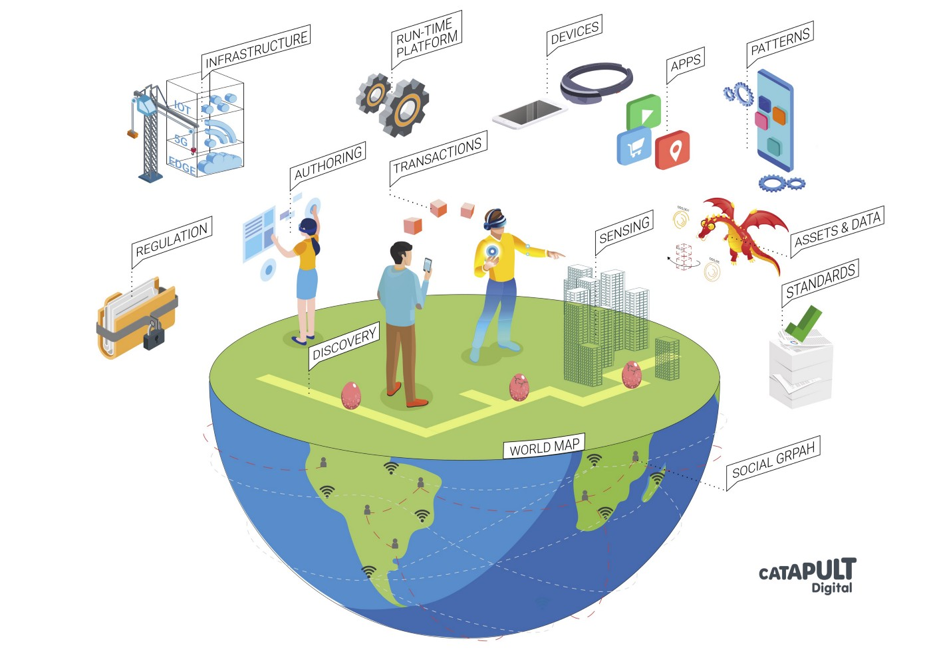
Metaverse
A giant digital world that CONNECTS PEOPLE in virtual/augmented/mixed reality
[Source]

Slide 4

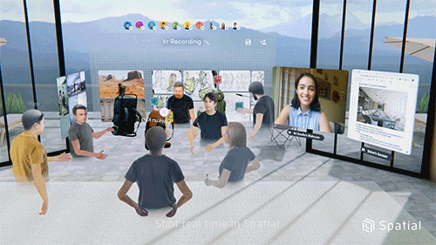
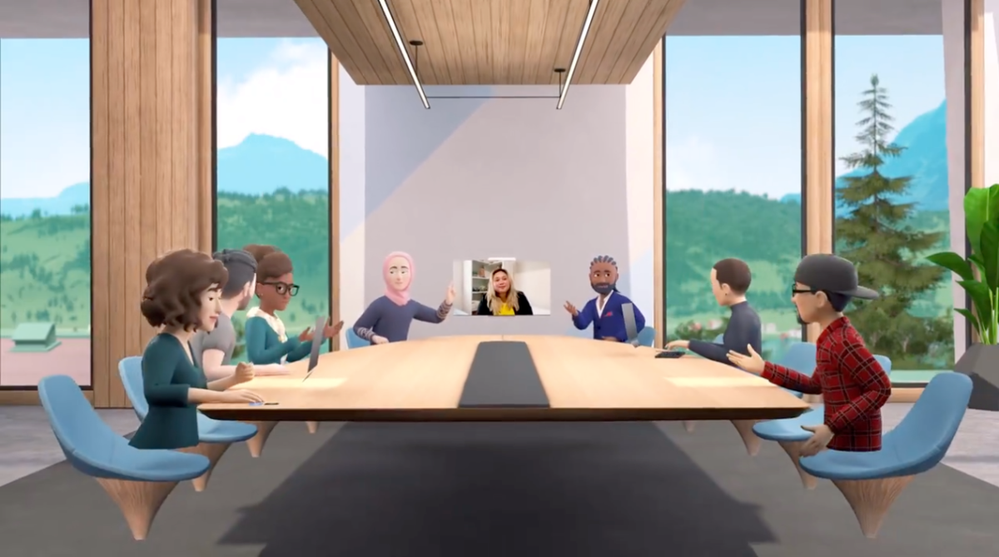
AR/VR Applications
A large variety of AR/VR applications
  Entertainment: gaming, virtual sight/shop touring
  Education: surgery training, pilot training, study at school/home
  Work: collaborative VR e.g Spatial, workroom, enhanced e-meeting
  Everyday life: social VR, augmented/hologram calling
Different devices/applications provide a large varying degree of fidelity and sensational experiences, from very high to low:
  Environmental/user input: what you see, hear, feel/touch, where you stand, how you move …
  Display: VR shows 360º virtual environment while AR does that partially
Source-1
Source-2
Source-3
Notes:
Source-1: https://healthcare-mittelhessen.eu/trend-report-virtual-reality-digital-training-for-real-medicine?lang=en
Source-2: https://news.mit.edu/2020/spatial-vr-collaboration-0710
Source-3: https://vr-expert.com/a-new-era-of-work-facebook-horizon-workrooms/

Slide 5
Network Requirements
Common network requirements, including:
  Sustainable throughput: doesn’t fluctuate as violently as network load
  Stable low latency: predictable, low jitter
802.11be amendment introduced features e.g. (but not limited to) to that end in WLAN:
  r-TWT scheduling
  Enhanced QoS signaling
  TXOP sharing
  MLO
Scalability is increasingly important for AV/VR to become an everyday life’s companion tool to access Metaverse. This can be translated to:
  AR/VR service capacity in a WLAN: SP/schedule utilization, spectrum efficiency
  Coverage area: multi-BSS coordination, mobility
  Local rendering transitioning to remote/split/cloud rendering

Slide 6





Network Latency: One to One
A very simplified view of end-to-end network connection
Last mile
Last mile
Network delay
Network delay
Broadband, cellular access/core network, ISP …
End-to-end network latency is composed of delays in multi-segments (of different technologies) / multi-hop network connections, easily reaching tens of milliseconds or more.
Verizon monthly latency report Feb-2022 [source]:
  {45ms, 30ms} or less for regional RTT within {North America, Europe}, respectively
  90ms or less for transatlantic RTT between London and New York
  99.5 percent or greater packet delivery for regional/transatlantic round trips
FCC measurement report of fixed broadband latency [MBA program: source, 12/31/2021] (chart 7):
  Measured DSL median latencies: 21-37 msec
  Measured cable median latencies: 12-26 msec
  Measured fiber ISPs median latencies: 8-13 msec

Slide 7



One (Multiple)-to-Multiple Users
Cloud computing
{Server, storage}
Internet
Add additional delay
Applications that involves a group of users would naturally require a server-based architecture where cloud computing provides scalable solution
The to/from server/storage connection adds additional hop(s) and hence delay to the end-to-end network latency
  In addition, the computation at server, e.g. cloud rendering common scene that users rendezvous, adds delay

Slide 8
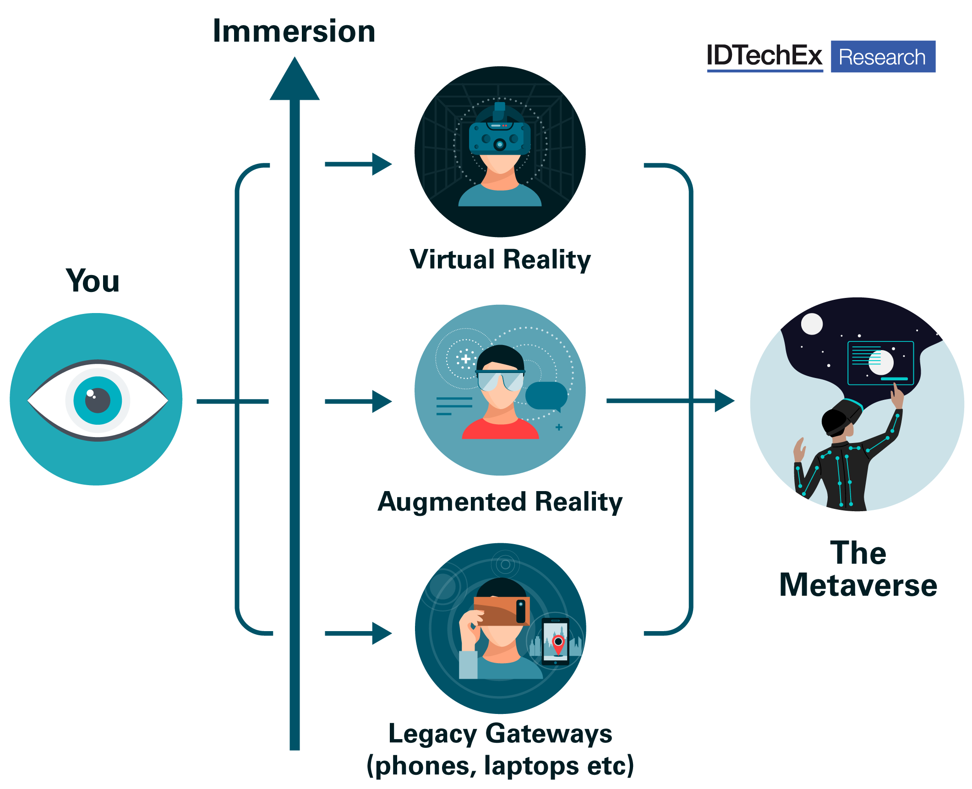
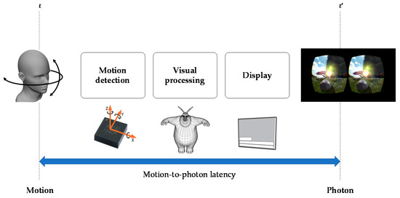
Immersive Experience ➔ MTP Latency
source
Human perception demands
Less than 20 msec Motion-to-Photon (MTP) latency
Some trained/skillful users may require less, 7-15 msec.
How to reconcile the reality and requirement (tens of msec e2e delay) (<20 msec MTP)???
Localize computation in the MTP path
Notes:
[1] 3GPP SA4 Contribution: TR 26.928-122. [https://itectec.com/archive/3gpp-specification-tr-26-928/]
[2] Motion to Photon Latency in Mobil AR and VR. DAQRI. [https://medium.com/@DAQRI/motion-to-photon-latency-in-mobile-ar-and-vr-99f82c480926]
[3] Latency mitigation strategies, by John Carmack [https://www.wired.com/2013/02/john-carmacks-latency-mitigation-strategies/]

Slide 9
Wearables
Form factor constraint: weight, size.
They have to be light, comfortable and natural to wear
Standard glasses averages 114g (4 ounces) (by google search)
Battery operation lifetime
Augmented call: minutes to a few hours
Daily companion: last one day or longer
Thermal limit
IEC defines the damage threshold (for skin) as 43 degrees [ref]
Specific Absorption Rate (SAR) limit in US: 1.6 watts/kg
AR/VR applications involve: sensor/camera data processing, rendering, display …
Wearables have very limited computation capability, cannot do all!
Notes:
https://www.silextechnology.com/unwired/sar-testing
What is SAR?
Specific Absorption Rate (SAR) refers to the amount of radio frequency electromagnetic field absorbed by the body while using a wireless device. SAR is defined as the power absorbed per mass of tissue and is expressed in units of watts per kilogram (W/Kg). SAR is typically measured over a small sample volume (1 gram or 10 grams). The SAR limit is a measure of the electric and magnetic field strength and power density for a given transmitter over its operating frequency range. In the US, SAR limit for FCC/IC is 1.6 W/Kg over a 1g sample and in Europe, the SAR limit for CE is 2.0 W/Kg for a 10g sample. Any portable products require SAR testing and reports.

Slide 10
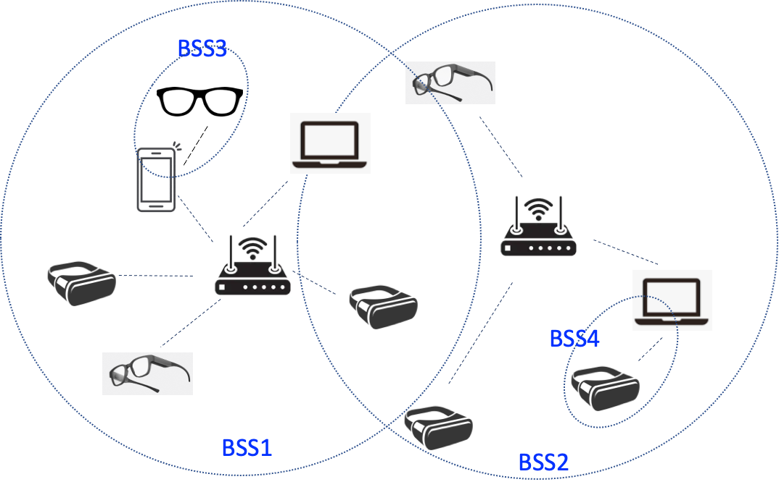
Offload Computation To Nearby Devices
Localize the critical components in the Motion-To-Photon path
  Edge computing: bring computation source in network closer to device
  Tether a wearable device to a {mobile phone, pad, laptop, PC, router/gateway}
To enable Metaverse at scale, we expect to see a lot of localized network traffic in addition to Internet traffic in a WLAN
Single/multi-family residential area
Office building, campus
School classrooms
Hospitals
Shopping mall
…
Notes:
Techniques to mitigate latency
Prevent GPU buffering
Late frame scheduling
View bypass
Time warping ⬅ shortcut path to avoid network delay in the critical path, also known as ATW
Continuously updated time warping

Slide 11
Native Support of Hybrid WLANs
A better support of peer-to-peer communication in WLAN becomes essential
  With such MANY peer-to-peer links, the challenge in providing satisfying QoS goes beyond just optimizing AP/STAs links
  A native support of p2p links is desirable
An agile network/BSS operation and management is needed to share and coordinate resources utilization over a time period, and that may have to be done at a finer granularity (finer than connection based):
  Spectrum: channel, sub-channel, RU
  Schedule: e.g. r-TWT
  TXOP
STA1
STA1a
STA2
STA2a
STA3
STA3a
.
.
.
STA4
STA4a
STA5
STA5a
.
.
.
Nearby AP
Provide a stable QoS-warranted wireless link to a static or mobile user at sufficient scale
Notes:
Techniques to mitigate latency
Prevent GPU buffering
Late frame scheduling
View bypass
Time warping ⬅ shortcut path to avoid network delay in the critical path, also known as ATW
Continuously updated time warping

Slide 12
Conclusion
Emerging industry efforts: building and supporting AR/VR devices and application to connect people in Metaverse
Next gen WLAN should continue to grow and scale robust QoS support to beyond a single BSS
  Native support of multiple BSS and peer-to-peer links
  Mobility
Wearables AR/VR devices favors power/spectrum efficient solutions
  Limited computation resource
  Battery operation time and thermal limit
  -> not super high-end Wi-Fi devices
Others:
  Graceful handling coex with legacy STAs

