Slide 1
Resolutions for Figures
Date: 2022-05-13
Authors:

Slide 2
Abstract
This presentation is proposed resolutions for figures.

Slide 3
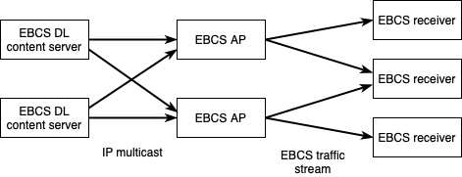
Figure 4-16a (CID 3005, 3161)

Slide 4
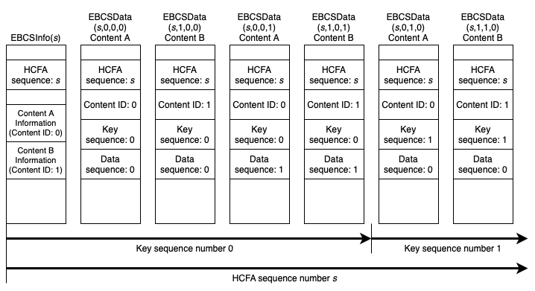
Figure 12-55e (CID 3119)

