Slide 1
802.11 GEN8 Study Group
May 2021
Date: 2022-05-10
Authors:
Name | Affiliation | Address | Phone | Email
Laurent Cariou | Intel | 2111 NE 25th Ave, Hillsboro OR 97124, USA | +1-503-712-5560 | laurent.cariou@intel.com
Robert Stacey |  |  |  | robert.stacey@intel.com
Carlos Cordeiro |  |  |  | carlos.cordeiro@intel.com
Laurent Cariou, Intel

Slide 2
GEN8 Study Group
May 2021
Key drivers
  XR applications
    Demand for higher throughput
    Combined with low and predictable/deterministic latency
  More P2P links
  More devices
    Laptops/tablets/phones/watches
    Gaming consoles/Displays/Cameras/Personal assistants, Etc.
    Usage everywhere (densification issue)
Laurent Cariou, Intel

Slide 3
GEN8 Study Group: key objectives
May 2021
Where should Wi-Fi be in 2028, six years from now?
Real-life and practical improvements in terms of:
  Per-device and system-wide throughput
  Deterministic/worst-case latency and further reduce latency
  Improve throughput/deterministic latency in dense environments
    Achieve consistent experience whether in a dense or sparse environment
Laurent Cariou, Intel

Slide 4
GEN8 Study Group – main candidate lighthouse features
May 2021
Multi-AP set of features in sub-7 GHz
  different flavors of cooperation between APs. (C-TDMA, C-OFDMA, C-SR, C-BF, MU-MIMO JP). Targets multiple objectives: throughput, latency, range, area throughput, reliability, …
  Coordination with P2P
New spectrum
  Only meaningful way to improve throughput/latency is to reduce congestion
  MLO framework makes it easy to add new bands
Some Low latency/QoS features
Note: Other features (A-PPDU, …) not raising to the level of a lighthouse feature
Note: Increasing BW in 5/6 GHz will not deliver real-life gains
  dense deployments require high frequency reuse, 320 MHz already not usable in enterprise deployments because of not enough frequency reuse - 21/1536-some-observations-on-optimizing-802-11be-release-1-with-respect-to-enterprise-ap-use-cases.pptx
Slide 4
Laurent Cariou, Intel

Slide 5
May 2021
Some applications throughput/latency requirements
3GPP TS 22.261 v18.5.0
Table 7.6.1-1 KPI Table for additional high data rate and low latency service
Use Cases | Characteristic parameter (KPI) |  |  | Influence quantity
 | Max allowed end-to-end latency | Service bit rate: user-experienced data rate | Reliability | # of UEs | UE Speed | Service Area (note 2)
Cloud/Edge/Split Rendering (note 1) | 5 ms (i.e. UL+DL between UE and the interface to data network) (note 4) | 0,1 to [1] Gbit/s supporting visual content (e.g. VR based or high definition video) with 4K, 8K resolution and up to120 frames per second content. | 99,99 % in uplink and 99,9 % in downlink (note 4) | - | Stationary or Pedestrian | Countrywide
Gaming or Interactive Data Exchanging (note 3) | 10ms (note 4) | 0,1 to [1] Gbit/s supporting visual content (e.g. VR based or high definition video) with 4K, 8K resolution and up to120 frames per second content. | 99,99 % (note 4) | ≤ [10] | Stationary or Pedestrian | 20 m x 10 m; in one vehicle (up to 120 km/h) and in one train (up to 500 km/h)
Consumption of VR content via tethered VR headset (note 6) | [5 to 10] ms (note 5) | 0,1 to [10] Gbit/s (note 5) | [99,99 %] | - | Stationary or Pedestrian | -
NOTE 1: Unless otherwise specified, all communication via wireless link is between UEs and network node (UE to network node and/or network node to UE) rather than direct wireless links (UE to UE). NOTE 2: Length x width (x height). NOTE 3: Communication includes direct wireless links (UE to UE). NOTE 4: Latency and reliability KPIs can vary based on specific use case/architecture, e.g. for cloud/edge/split rendering, and may be represented by a range of values. NOTE 5: The decoding capability in the VR headset and the encoding/decoding complexity/time of the stream will set the required bit rate and latency over the direct wireless link between the tethered VR headset and its connected UE, bit rate from 100 Mbit/s to [10] Gbit/s and latency from 5 ms to 10 ms. NOTE 6: The performance requirement is valid for the direct wireless link between the tethered VR headset and its connected UE.
Laurent Cariou, Intel

Slide 6
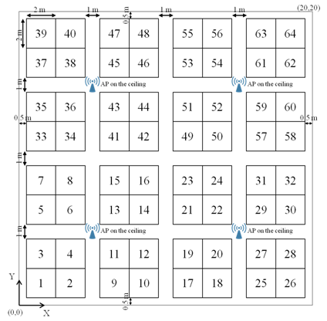
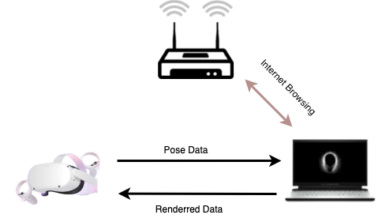
Example of enterprise scenario capturing some key challenges
One among many representative dense scenarios (e-learning, auditorium, hospital…)
May 2021
Cubicle scenario
  16 cubes within a 10m square
  XR P2P links in some cubes:
    LOS, around 1m range
    Requirements: DL up to 10Gbps (average 1Gbps), UL low throughput but 2ms latency
  Infrastructure APs to serve fixed or mobile users in the area
Deployment in 5/6GHz:
  Spectrum needs to be shared between infrastructure APs and all P2P links that are in the same area
  Interference between XR P2P links
  Interference with infrastructure BSSs
Even with full 6 GHz band: not enough capacity
XR HDM
Slide 6
Laurent Cariou, Intel

Slide 7
Lessons learned on most effective types of features
May 2021
Analysis shows clearly that big leap forward on real life performance are generated by new bands and larger bandwidths with sufficient freq reuse
  802.11ax as a good example trying to solve the densification issue
    Multi-user operation (OFDMA) brought densification benefits, but did not bring significant throughput gains in the end in most of the scenarios
    6 GHz operation generates many user experience gains
      enabler for larger BW (160MHz) even in enterprise
      More channels, less contention -> better throughput, better latency, …
      However, not enough 320MHz channels available to be used on enterprise deployments (need reuse 8-9)
This is even more true now as we are getting closer to the spectrum efficiency enhancement limits and every application requires more throughput and bandwidth as we highlighted in previous presentation (22/0046r1)
  We reached a point where it becomes very hard to increase capacity/density by adding more antennas, wider channels, higher order modulation..
Laurent Cariou, Intel

Slide 8
Challenges for GEN8 SG/TG
May 2021
Benefits from Multi-AP features will likely resemble Multi-user benefits seen with MU features in 11ax
  Limited gains for the reasonable M-AP features
Latency/throughput in 2.4/5/6 GHz will be limited by channel load
  M-AP and other coordination tools mostly try and preserve efficiency until a slightly higher load
  Limitations will be seen very quickly on representative scenarios
Most efficient tool will be to get more spectrum to get more 160 MHz channels or to enable deployments of 320 MHz channels
  Again, 320MHz won’t be usable in real life enterprise deployments because of only 3 channels available. If we manage to get more channels, that becomes possible
Laurent Cariou, Intel

Slide 9
Demand for new spectrum
May 2021
Mainstream Wi-Fi has expanded into new spectrum over generations:
  2.4 GHz band: Through 2007 meets most consumer needs. Almost all devices are single band.
  5 GHz band: Starting with 11n deployments and rapidly accelerating with 11ac deployments, consumers increasing turn to 5 GHz band to reduce congestion. By 2021 [probably earlier] nearly 100% of device are dual-band.
  6 GHz band: With 11ax deployments there is increasing use of the 6 GHz band. This ramp is much faster than we saw with 11n/11ac. By 2028 we expect all devices to be tri-band.
We expect that around 2028 there will be significant demand for new spectrum, driven by:
  The increasing demand for increased throughput and reduced latency from new applications
  The increasing number of devices using the spectrum
  The limited availability of 160/320 MHz channels and the need to share this spectrum
In some regions this demand will hit sooner, for example:
  Some regions don’t have access to the upper 6 GHz band (e.g., EU)
  Other regions don’t have access to 6 GHz band at all (e.g., China)
Laurent Cariou, Intel

Slide 10
Spectrum for 802.11 GEN8
May 2021
While we can make some tweaks to 802.11 to increase throughout and slightly reduce latency, we believe the only real, future-proof solution is to increase capacity
We believe a primary goal of the study group should be to identify the additional bands (beyond 2.4/5/6 GHz) for mainstream Wi-Fi circa 2028
  To us, the 60 GHz unlicensed band looks compelling
    Up to 14 GHz of available unlicensed spectrum and worldwide allocations
    Even in dense environments links are isolated from each other
    Competitive with 3GPP
    Goal to reuse the 2.4/5/6 GHz design in 60 GHz to keep complexity within the bounds of lower band 802.11
  Investigate opportunities for additional unlicensed or lightly licensed spectrum in this timeframe
Laurent Cariou, Intel

Slide 11
Conclusion
May 2021
Form study group at the July session
Suggest calling it the GEN8 SG
  Aligns with broader Wi-Fi market generational naming
  Does not emphasize one performance metric over another
Propose the scope to be focused on improving throughput and deterministic/worst-case latency especially in dense environments
A primary goal of the study group should be identifying bands beyond 2.4/5/6 GHz that we target for mainstream Wi-Fi circa 2028
Slide 11
Laurent Cariou, Intel

