Slide 1
Discussion on the length of Measurement Setup ID
Date: 2022-05-07
Authors:
Name | Affiliation | Address | Phone | Email
Pei Zhou | OPPO |  |  | zhoupei1@oppo.com
Lei Huang
Chaoming Luo
Ning Gao

Slide 2
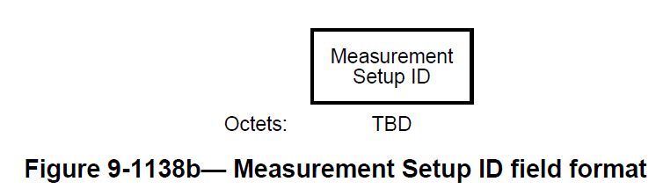
Motivation
According to 802.11bf SFD [1], the Measurement Setup ID may be used to identify attributes of the sensing measurement instances (Motion 24, 21/0644r4).
However, the length of Measurement Setup ID is still TBD in 802.11bf D0.1 [2].
Because many frames/elements (e.g., Sensing Measurement Setup Request frame, Sensing Measurement Setup Termination frame) contain Measurement Setup ID field, it is better to determine the length of Measurement Setup ID first, which will make the design of related frames/elements more convenient.
The length of Measurement Instance ID is also discussed in this contribution.

Slide 3
WLAN Sensing Use Cases [3]
Index | Name | details | Max range (m) | Range Accuracy (m) | Max Velocity (m/s)/Velocity Accuracy | angular Accuracy (deg) | 60GHz Only
Room Sensing
2.1.1 | Room Sensing | presence detection, counting the number of people in the room | 15 | 0.5-2 | 2/0.1 |  | N
2.1.2 | Smart meeting room | presence detection, counting the number of people in the room, localization of active people | 10 | 0.5-2 | 1/0.1-0.3 |  | N
2.1.3 | Motion detection in a room | Detection of motion of in a room (of Human) | 10 |  |  |  | N
2.1.4 | Home security | Detection of presence of intruders in a home | 10 | 0.5-2 | 3/0.1-0.3 | medium | N
2.1.5 | Audio with user tracking | Tracking persons in a room and pointing the sound of an audio system at those people | 6 | 0.2 | 0.5/0.05 | 3 | Y
2.1.6 | Store Sensing | Counting number of people in a store, their location, speed of movement. Accuracy less important | 20 | 0.5-2 | 1/0.1-0.3 | 3 | N
2.1.7 | Home Appliance Control | Tracking person and motion/ gesture detection | 10 | <1 |  |  | N
Gesture Recognition
2.2.1 | Gesture recognition - short range (finger movement) | Identification of a gesture from a set of gestures - range < 0.5m | 0.5 |  | 7 | 3 | Y
2.2.2 | Gesture recognition - medium range (hand movement) | Indentification of a gesture from a set of gestures - range > 0.5m | 2 |  |  |  | Y
2.2.3 | Gesture recognition - large range (full body movement) | Indentification of a gesture from a set of gestures - range > 2m | 7 | 0.2 | 2/0.1 | 5 | N
2.2.4 | Aliveliness detection | Determination whether a close by object is alive or not | 1 | 0.05 |  |  | Y
2.2.5 | Face/Body Recognition | Selection of the identity of a person from a set of known persons | 1 | 0.02 |  |  | Y
2.2.6 | Proximity Detection | Detection of object in close proximity of device | 0.5 | 0.02-2 | 1.5/0.2 | none | N
2.2.7 | Home Appliance Control | Gesture Detection | 3 | <1 | 3/0.1 |  | N
Index | Name | details | Max range (m) | Range Accuracy (m) | Max Velocity (m/s)/Velocity Accuracy | angular Accuracy (deg) | 60GHz Only
health care
2.3.1 | health care - Fall detection | Fall detection - abnormal position detection | 10 | 0.2 | 3/0.1 |  | N
2.3.2 | Health case - remote diagnostics | measurements of breathing rate, heart rate etc. | 5 | 0.5 | 2/0.1 |  | N
2.3.3 | Surveillance/Monitoring of elder people and/or children | Tracking person and presence detection | 10 | 0.2-2 | 3/0.1 |  | N
2.3.4 | Sneeze sensing | Detecting and localizing the target human and sneeze droplet volume | 10 | 0.2-0.5 | 20/0.1 |  | Y
3 D vision
2.4.1 | 3d vision | buiding a 3d picture of an environment , using multiple STA | 10 | 0.01 | 5/0.1 | 2 | Y
In car sensing
2.5.1 | In car sensing - detection | detection of humans in car | 5 | 0.1 | 1/0.1 | 3 | N
2.5.2 | In car sensing | Driver sleepiness detection/detetion aid | 3 | 0.01 | 1/0.1 | 3 | Y
802.11bf defines 5 scenarios with 21 use cases
  Sub-7GHz may support 4 scenarios with 13 use cases (exclude 60GHz only)
Some scenarios/use cases have similar/same attributes, e.g., 2.1.1, 2.1.2, 2.1.4 and 2.1.6

Slide 4
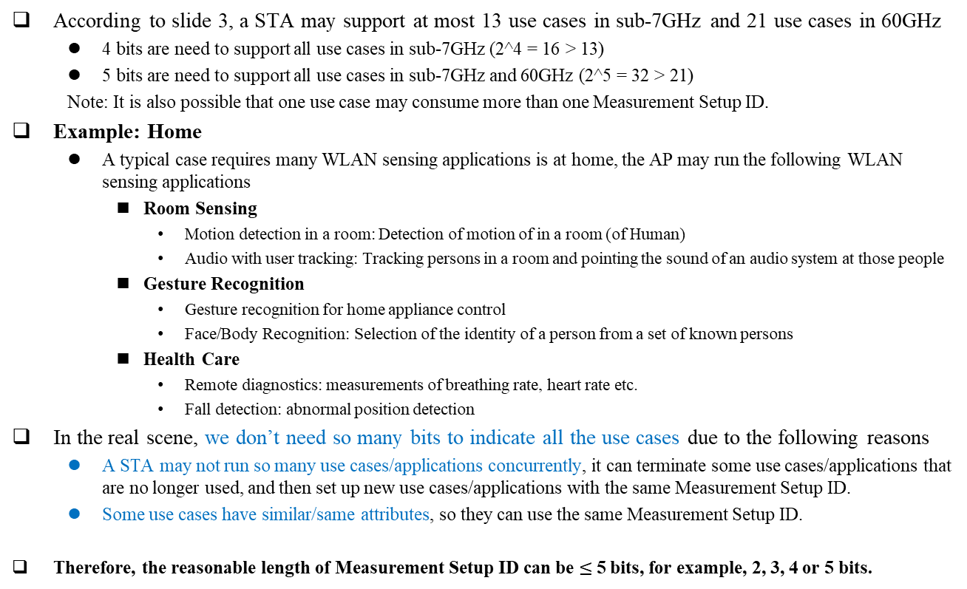
Possible length of Measurement Setup ID
According to slide 3, a STA may support at most 13 use cases in sub-7GHz and 21 use cases in 60GHz
  4 bits are need to support all use cases in sub-7GHz (2^4 = 16 > 13)
  5 bits are need to support all use cases in sub-7GHz and 60GHz (2^5 = 32 > 21)
  Note: It is also possible that one use case may consume more than one Measurement Setup ID.
Example: Home
  A typical case requires many WLAN sensing applications is at home, the AP may run the following WLAN sensing applications
    Room Sensing
      Motion detection in a room: Detection of motion of in a room (of Human)
      Audio with user tracking: Tracking persons in a room and pointing the sound of an audio system at those people
    Gesture Recognition
      Gesture recognition for home appliance control
      Face/Body Recognition: Selection of the identity of a person from a set of known persons
    Health Care
      Remote diagnostics: measurements of breathing rate, heart rate etc.
      Fall detection: abnormal position detection
In the real scene, we don’t need so many bits to indicate all the use cases due to the following reasons
  A STA may not run so many use cases/applications concurrently, it can terminate some use cases/applications that are no longer used, and then set up new use cases/applications with the same Measurement Setup ID.
  Some use cases have similar/same attributes, so they can use the same Measurement Setup ID.
Therefore, the reasonable length of Measurement Setup ID can be $≤$5 bits, for example, 2, 3, 4 or 5 bits.

Slide 5
SP 1
Which option do you prefer when defining the length of Measurement Setup ID?
  Option 1: The length of Measurement Setup ID is 2 bits.
  Option 2: The length of Measurement Setup ID is 3 bits.
  Option 3: The length of Measurement Setup ID is 4 bits.
  Option 4: The length of Measurement Setup ID is 5 bits.
  Option 5: Abstain.

Slide 6
Possible length of Measurement Instance ID
According to 802.11bf D0.1 [2], the Measurement Instance ID may be used to identify the sensing measurement instance that utilizes attributes of the same tuple <Sensing Initiator’s MAC address, Measurement Setup ID>.
In the Reporting phase (Clause 11.21.18.6.4 in [2]):
  When negotiated, the sensing transmitter which is a sensing initiator shall send a Sensing Trigger Report frame during the reporting phase and assign RUs to the sensing receiver which is a sensing responder to obtain a Sensing Measurement Report frame containing sensing measurement results. The sensing receiver which is a sensing responder shall provide a Sensing Measurement Report frame in the assigned RUs with either results obtained from the I2R NDP of the current measurement instance, when negotiated to deliver immediate feedback reporting, or results obtained from the I2R NDP of the previous measurement instance, when negotiated to deliver delayed feedback reporting.
  Ideally, we need two Measurement Instance IDs. One is used to indicate the report of the previous measurement instance, the other is used to indicate the attributes of the current measurement instance.
  One bit is enough to define Measurement Instance ID.

Slide 7
Possible length of Measurement Instance ID
However, the conclusion in the previous slide of using just one bit to define Measurement Instance ID may be too strict for implementation or practical scenario. We can consider leaving more margin for Measurement Instance ID, for example, including but not limited to the following reason(s):
  After obtaining the sensing measurement results (from Sensing Measurement Report frame), a sensing device may cache the sensing measurement results and not report them to the upper layer immediately.
  Therefore, we may define Measurement Instance ID as more than 1 bit, for example, 2 or 3 bits depend on how much margin we need.

Slide 8
SP 2
Which option do you prefer when defining the length of Measurement Instance ID?
  Option 1: The length of Measurement Instance ID is 1 bit.
  Option 2: The length of Measurement Instance ID is 2 bits.
  Option 3: The length of Measurement Instance ID is 3 bits.
  Option 4: Abstain.

Slide 9
References
[1] 11-21-0504-09-00bf-specification-framework-for-tgbf.docx
[2] Draft P802.11bf_D0.1.pdf
[3] 11-20-1712-02-00bf-wifi-sensing-use-cases.xlsx

