Slide 1
Next-generation WLAN technology inspired by XR
Date: 2022-05-04

Slide 2
Abstract
This proposal mainly introduces:
XR related application scenarios
XR current technical application scheme
Multi AP technology scheme inspired by XR application

Slide 3
Background
In the future, Wi-Fi technology should have the characteristics of high capacity, low latency.[1]
Put forward the prospect of the next generation PHY / Mac task group, with low delay, high throughput and communication reliability.[2]
Put forward the needs of the next generation Wi-Fi Technology10x throughput, 0.1ms latency, spectral efficiency, Spatial reuse - area efficiency, Energy efficiency.[3]
The next generation technical standards are discussed, especially the characteristics of low delay.[4]
[5] is intended to provide preliminary perspectives on the need for a new MAC/PHY amendment, relevant market context and a potential standards timeline
[6] provides some applications with low delay in Wi-Fi scenarios.

Slide 4
Introduction
Mixed reality solutions, including virtual reality and augmented reality solutions, have transformed the modern world and opened up new possibilities.
The mass adoption of connected devices, technological advances in healthcare, and significant adoption of remote collaboration in enterprise, educational, and industrial environments are becoming drivers for AR and VR technologies to become key applications of the future. In addition, the outbreak of COVID-19 has driven the development of AR and VR applications.
The global AR and VR market is expected to reach $571 billion by 2025. The global AR market size alone is expected to reach $26.75 billion by 2021, with a compound annual growth rate (CAGR) of 43.8% from 2021 to 2028 and $340.16 billion by 2028.[7]
In summary, the prospects for XR in the future are huge, and the corresponding Wi-Fi technology should be upgraded to meet XR's requirements for high throughput and low latency scenarios.
As a popular research direction of 802.11be, Multi-AP technology can well meet the needs of XR scenarios, and can improve system throughput and reduce system latency. In this technology, the main research directions include multi-AP cooperative orthogonal frequency division multiple access (C-OFDMA), cooperative spatial multiplexing (CSR), cooperative beamforming (CBF), etc.

Slide 5
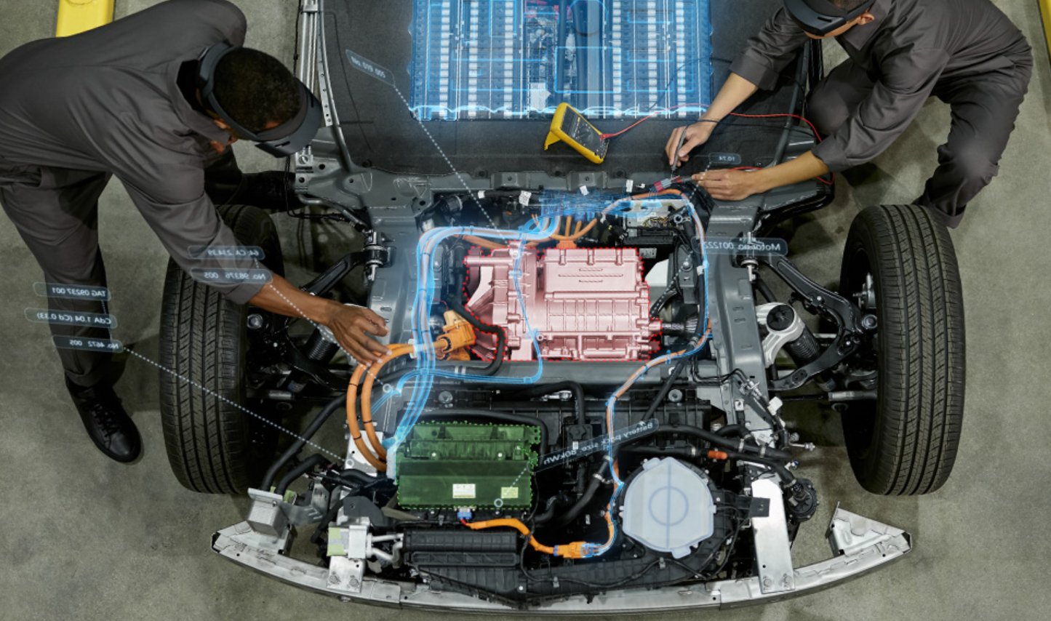
XR Scenarios
A group of workers shared a repair model with a remote expert via an XR device, and the remote expert worked with them on repairs through his own XR device.
Use Case Description: AR guided assistant at remote location
Requirements
Reliable delivery
Sufficient bandwidth to delivery compressed 3D objects >100Mbps
Synchronized rendering of audio and video/graphics
Less than 20 millisecond latency
Notes:
A group of workers shared a repair model with a remote expert via an XR device, and the remote expert worked with them on repairs through his own XR device.

Slide 6
XR Scenarios
When holding online meetings with colleagues, the surrounding environment is captured by depth cameras, and each person builds his or her own 3D model in a 3D space to communicate in real time.
Use Case Description: 360-degree conference meeting
Requirements
Bandwidth: As minimal bandwidth it is expected at least 3Mbit/s (this is for a single 2D user stream with chroma background), however this requirement can increase with more complex and higher resolution streams.
Delay: The delay has to be suitable for real-time communication <10ms
Notes:
When holding online meetings with colleagues, the surrounding environment is captured by depth cameras, and each person builds his or her own 3D model in a 3D space to communicate in real time.

Slide 7
XR Scenarios
Use Case Description: Online shopping from a catalogue – downloading
......
Use Case Description: Emotional Streaming
Requirements
- Accurate and low latency rendering
Reliable and fast download of the 3D model to be rendered.
High throughput
Notes:
Figure1 shows that When consumers want to buy furniture, they can project a complete and detailed 3D model at home through AR technology to observe whether it is appropriate in real time.
Figure 2 shows that vr devices can obtain the user's physical reactions to dynamically design the next episode that the user sees, and send the plot story to other viewers in real time.

Slide 8
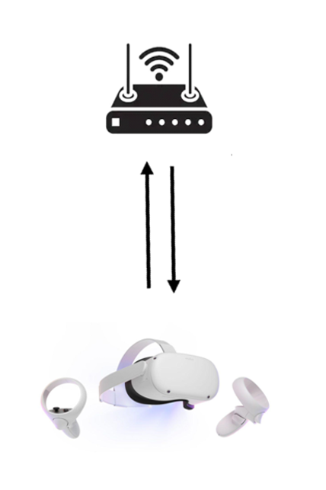
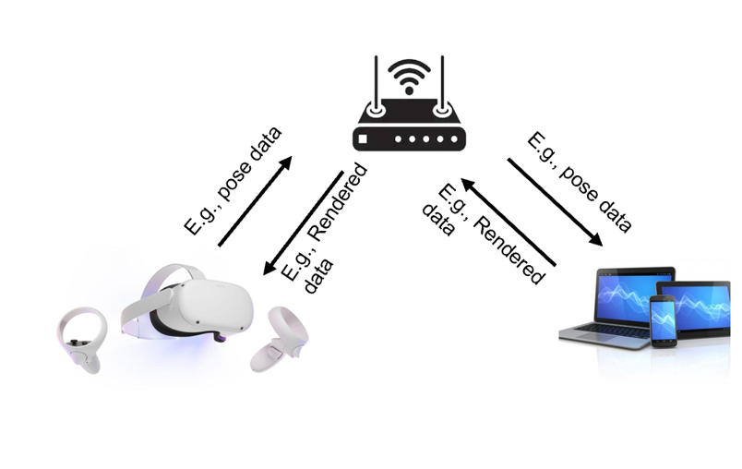
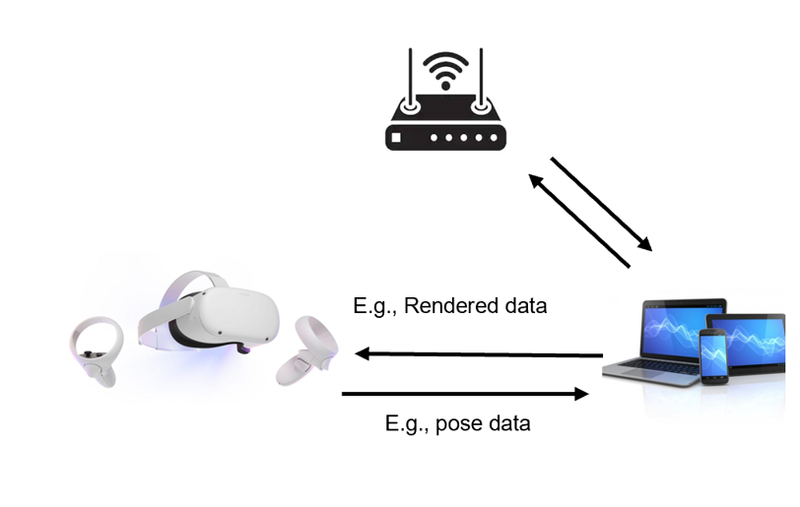
XR Technology Scenario
Communicate directly with the AP (as shown in Figure 1).
XR and PC jointly perform computational rendering (as shown in Figure 2)
The communication between the two is implemented through the AP (as shown in a), the final data is sent to the remote server through the AP.
XR directly connected to the PC (as shown in b), and the interaction data with the remote server is sent to the AP through the PC, and then forwarded to the remote server.
(a)
Figure 1
(b)
Figure 2
Notes:
At present, XR applications are broadly divided into two categories:
The first is that the XR communicates directly with the AP (as shown in Figure 1), taking the data returned by the remote server and rendering it directly on the XR.
The second type is the XR and PC jointly perform computational rendering (as shown in Figure 2), the way is divided into two categories, one is that the communication between the two is implemented through the AP (as shown in a), the final data is sent to the remote server through the AP, the other is the XR directly connected to the PC (as shown in b), and the interaction data with the remote server is sent to the AP through the PC, and then forwarded to the remote server.

Slide 9
XR Technology Scenario
The first type of chip has higher requirements for XR devices, although the communication time is shortened, but the rendering time is significantly longer.
The second type is direct data processing by computer, which reduces the rendering time, but the communication time is longer, which also causes high latency.
In any case, in order to meet the needs of the current XR market, Wi-Fi needs to greatly improve the throughput of the system, reduce the latency, and improve the reliability of the system.
Notes:
The first type of chip has higher requirements for XR devices, although the communication time is shortened, but the rendering time is significantly longer. The second type is direct data processing by computer, which reduces the rendering time, but the communication time is longer, which also causes high latency.

Slide 10
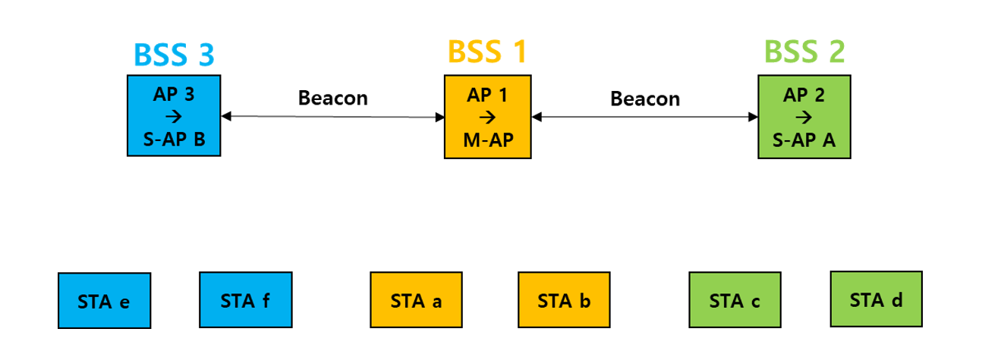
Multi AP collaboration
It can be seen in the appeal scenario that future communication quality will rely more on low latency and high throughput. In the next-generation Wi-Fi standard IEEE 802.11be, through the cooperation between multiple APs, high throughput (EHT) and low latency performance are provided to achieve efficient utilization and balanced allocation of wireless resources. At present, the main research directions include multi-AP cooperative orthogonal frequency division multiple access (C-OFDMA), cooperative spatial multiplexing (CSR), cooperative beamforming (CBF), etc. The predecessors also put forward their own ideas [9][10][11], such as the establishment process of multi-AP cooperation, combined with the transmission process of BF, but these ideas also bring about the problems of high complexity[6]. Next, we introduce some of our thoughts on multi-AP collaboration.

Slide 11
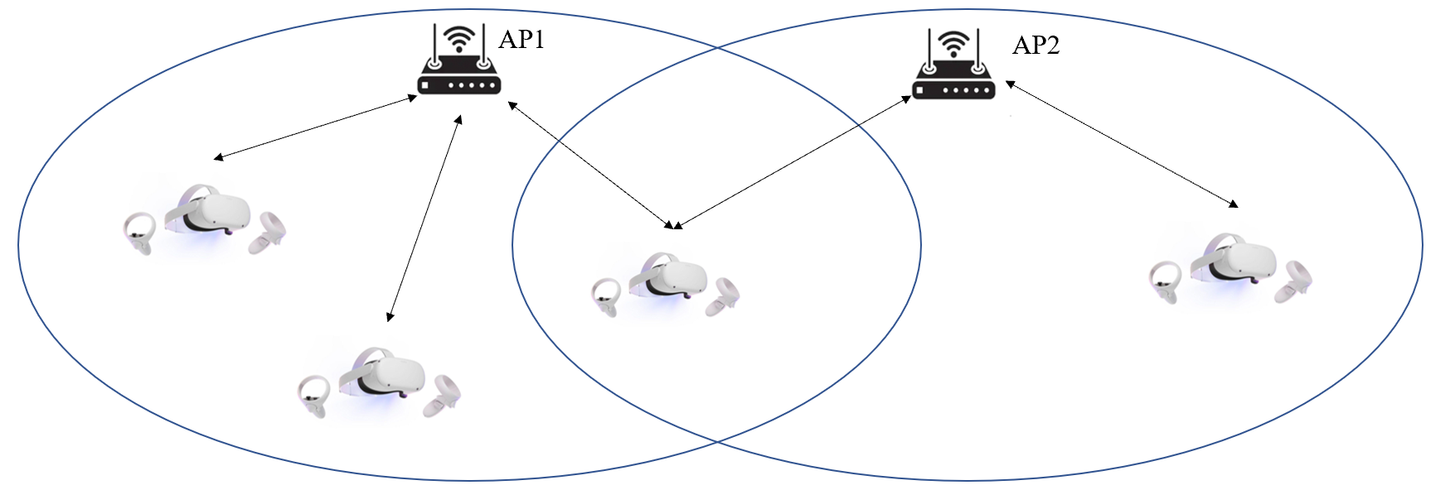
Multi-AP directions for possible future research
Multi-AP directions for possible future research
In AP cooperative communication, resource utilization and user communication quality can be improved through user offloading.
Under the high-density AP networking, the channel information of each AP can be exchanged through AP collaborative communication, and then the APs can be beamformed based on deep reinforcement learning to reduce the interference between APs, increase the overall throughput of the system, and reduce the system latency.
Under the high-density AP networking, when it is difficult to estimate CSI，RU allocation scheme based on reinforcement learning can be used to resist interference and system throughput can be improved.

Slide 12
References
[1] 11-22-0030-01-0wng-look-ahead-to-next-generation
[2] 11-22-0032-00-0wng-next-gen-after-11be
[3] 11-22-0046-01-0wng-next-generation-after-802-11be
[4] 11-22-0059-00-0wng-beyond-be
[5] 11-22-0418-00-0wng-considerations-of-next-generation-beyond-11be
[6] 11-22-0458-01-0wng-looking-ahead-to-next-generation-follow-up
[7] Latency Requirements in Wi-Fi 7 Interoperability Testing: An XR MSTG Proposal.
[8] Extended Reality (XR) in 5G (3GPP TR 26.928 version 16.1.0 Release 16)
[9] Roya Doostnejad (Intel), “Coordinated beamforming for 802.11be,” 20/0099r1, April 2020.
[10] 11-19-1895-02-00be-setup-for-multi-ap-coordination
[11] 11-19-1931-02-00be-multi-ap-group-formation-follow-up

