Slide 1
Discussion on NDP Transmission in TF Sounding Phase
Date: 2022-04-20
Authors:

Slide 2
Abstract
TF Sounding phase in TB Measurement Instance solicits NDP transmissions from different sensing transmitters in the uplink
In this contribution, we discuss several methods for NDP transmission, all of which are valid alternatives that may be supported by 11bf
We focus on one NDP transmission method which may improve the sensing efficiency
  The same NDP PPDU may be transmitted from different sensing transmitters on the same uplink resource
  Channel estimation of the aggregate link between the sensing receiver and the sensing transmitters may be performed on the received combined NDP PPDU

Slide 3
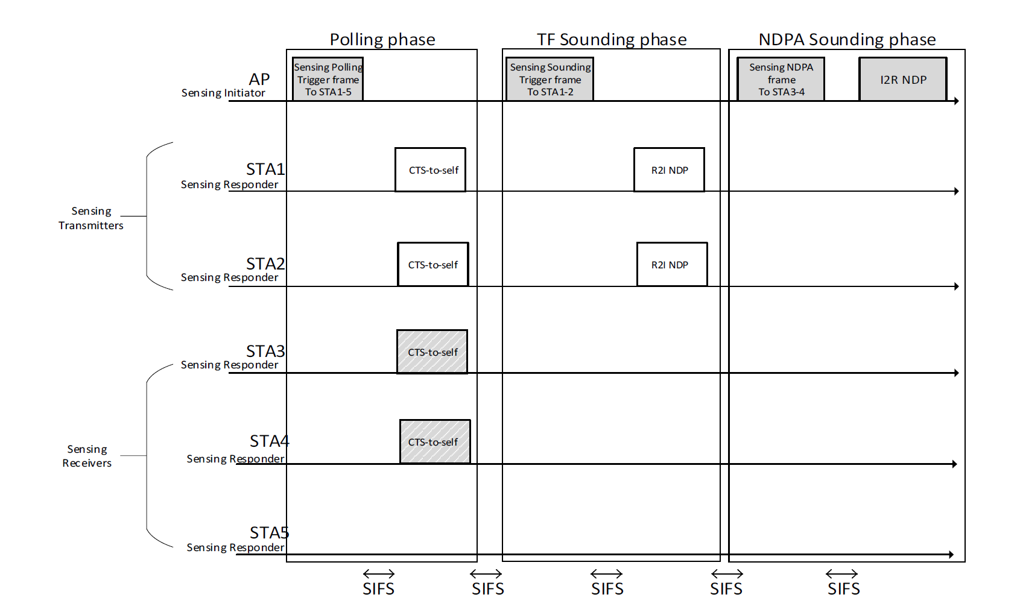
Recap of TF Sounding Phase
TB Measurement Instance[1]:
  In TF Sounding phase:
    The AP shall transmit a Sensing Sounding TF to solicit R2I NDP transmissions
    The Sensing Sounding Trigger frame shall allocate uplink resources for one or more STA’s R2I NDP transmission covering the full bandwidth
    NOTE—If the number of available sensing transmitters exceeds the available uplink resources, multiple sequential trigger frames can be transmitted within the acquired TXOP
Notes:
- State the problem clearly.

Slide 4
Methods to Transmit R2I NDP in TF Sounding Phase
Method 1: Sensing Responder Transmitters transmit the NDP sequentially
  The NDP PPDU covers the full bandwidth
Method 2: Sensing Responder Transmitters transmit the NDP parallelly
  The NDP PPDUs are sent at the same time and multiplexed either in the frequency domain or in the spatial domain
Method 3: Sensing Responder Transmitters transmit the NDP parallelly
  The NDP PPDUs are sent at the same time using the same frequency and spatial resource
Method 4: Combination of Methods 1-3
Note- All the methods above are valid and may be supported by 11bf. In this contribution, we focus on Method 3, and we will extend the discussion to cover other methods in later contributions.

Slide 5
Methods to Transmit R2I NDP in TF Sounding Phase

Slide 6
Motivation
Orthogonal transmission (Method 1 and 2) of NDP PPDUs from different sensing transmitters may be necessary for ranging and sensing applications that require accurate CSI, but may not be necessary or efficient for some sensing applications, e.g., Room Sensing [2]
  Detection of motion in a room
  Detection of people falling
  Detection of presence of intruders in a house
Triggering a large number of sensors in multiple triggering sequences may increase the time required to perform the sensing measurement instance
  The average number of connected devices per household may reach 40+ by 2025 [3]

Slide 7
Use Cases
Many smart home devices or consumer electronics may exist in the same room
  Using the same resource for the devices that are collocated may be desirable such that all the sensors may be triggered in one triggering sequence
Large conference rooms may host a quite large number of STAs
  Triggering all the sensing transmitters on different resources in multiple sequential triggering sequences may increase the sensing time and negatively impact the system performance
Large Warehouses may have hundreds of Wi-Fi connected sensors
  Providing an efficient way to include many sensors in an efficient sensing measurement instance may significantly impact the communication performance

Slide 8
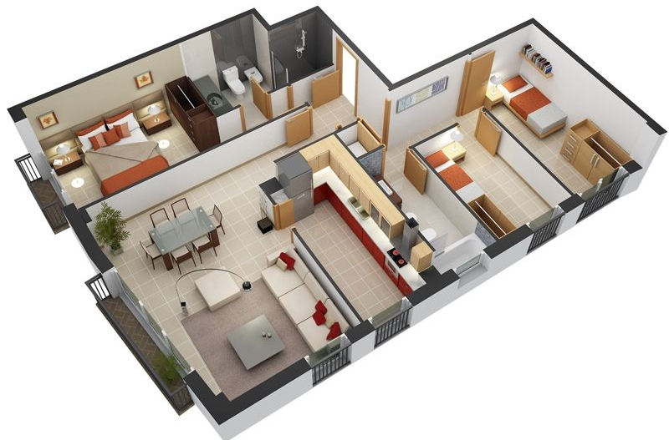








Aggregate Channel Sensing
Sensing transmitters located in certain proximity (e.g., in the same room) may be allocated the same resource to send their NDP in the uplink
Instead of collecting per-link CSI, we may acquire a channel which is the aggregated channel between multiple sensing transmitters and one sensing receiver
H1
H2

Slide 9
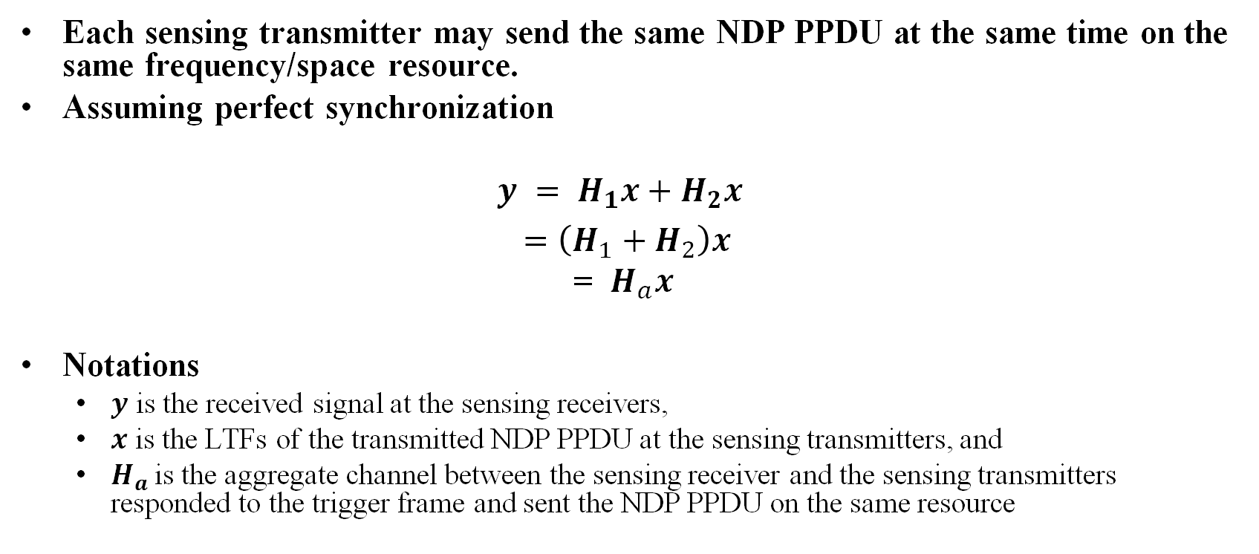
System Model
Each sensing transmitter may send the same NDP PPDU at the same time on the same frequency/space resource.
Assuming perfect synchronization
$$y = H_{1}x+H_{2}x$$
$=\left(H_{1}+H_{2}\right)x$
= $H_{a}x$
Notations
  $y$ is the received signal at the sensing receivers,
  $x$ is the LTFs of the transmitted NDP PPDU at the sensing transmitters, and
  $H_{a}$is the aggregate channel between the sensing receiver and the sensing transmitters responded to the trigger frame and sent the NDP PPDU on the same resource

Slide 10
Benefits
No need for multiple sequential trigger frames to accommodate large number of sensing transmitters
May provide a preferable mode of sensing for some use cases
    Sensing via aggregate channel state monitoring
Sensing contends the radio medium with communication and optimizing the time needed for sensing would improve the overall system performance
  Efficient and low overhead WLAN sensing allows for more time for communication
  Reducing the footprint of sensing in favor of improved system performance is desirable

Slide 11
Potential Issues
Power Control
  Power control may be needed to guarantee balanced received signal power from different sensing transmitters
Time Synchronization
  How fine is the required time synchronization between different sensing transmitters?
  How the synchronization between different sensing transmitters may impact the sensing results?
Notes:
11ax already enable this, add one slide to elaborate on this in 11ax.

Slide 12
Feasibility
The legacy fields in 11ax TB PPDUs sent from different STAs may be transmitted on the same resources and the aggregate channel estimation is used to decode the SIG field
  Small RUs (less than 20 MHz) may be allocated to different STAs, and the legacy fields are sent on the same 20 MHz
Channel variations due to small mismatches in the time synchronization of the received NDPs may be distinguished from channel variations due to environment changes
  This may be left for higher layers (e.g., the sensing application)
Notes:
Check the specs and provide details
Add figure to explain this
In sensing we need to monitor changes in the channel not to decode the signal.

Slide 13
Conclusions
There may be several methods to transmit R2I NDP
In this contribution we focus on one of the methods (Method 3)
  Aggregate channel sensing via using the same uplink resource to transmit NDP PPDUs from different sensing transmitters
  Efficient sensing is desirable to improve the overall system performance

Slide 14
SP 1
Do you agree that, in the TF Sounding phase of TB measurement instance, the R2I NDPs transmitted from different sensing responder transmitters are allowed to use the same time, frequency and spatial resource.
  The format of the transmitted NDP PPDU is TBD

Slide 15
References
[1] “IEEE P802.11bf™/D0.01, Amendment 2: Enhancements for WLAN Sensing”, Mar. 2022.
[2] 802.11-20/1712r2, Wi-Fi Sensing Use Cases, Assaf Kasher (Qualcomm)
[3] Safaei, B., Monazzah, A.M.H., Bafroei, M.B. and Ejlali, A., 2017, December. Reliability side-effects in Internet of Things application layer protocols. In 2017 2nd International Conference on System Reliability and Safety (ICSRS) (pp. 207-212). IEEE.

