Slide 1
Information Exchange of WLAN Sensing Link
Date: 2022-04-14
Name | Affiliation | Address | Phone | Name
Rui Du | Huawei Technologies Co. Ltd | F3, Huawei Base, Shenzhen, China |  | ray.du@huawei.com
Wei Ruan
Naren
Mengshi Hu
Stephen McCann
Rentian Ding

Slide 2
Outline
Abstract
Link for WLAN Sensing
Tx Power and information exchange
Rx Gain and information exchange
Summary
References
SP

Slide 3
Abstract
The Tx Power Control and reporting in WLAN sensing has been discussed in previous contribution [1].
In this contribution, the power of the entire WLAN sensing link is further discussed.

Slide 4
Link for WLAN Sensing
The simplified structures of the WLAN sensing transmitter and receiver are shown in above figures (the oscillator and filter are omitted).
The ideal case for WLAN sensing is that every component in the transmitter and receiver should remain constant during the measurement. Under this condition, the change of the estimated CSIs only represent the channel variation caused by target movement.
But, in actual scenarios, fixing Tx power and AGC may introduce additional problems. Instead of fixing Tx power at transmitter and AGC at receiver, make Tx power and AGC changes to minimum and exchange the information when Tx power and AGC adjust is a more practical approach.

Slide 5
Tx Power
In reference[1], the effect of Tx Power on sensing has been discussed thoroughly and LMR is requested as feedback in 11az.
Actually, the Tx power could be further divided into two parts: digital power and the Tx power. These two powers are defined as follows.
Digital power is defined as the power before the DAC.
Tx power is defined as the power at the antenna connector.
 | Digital Power | Tx Power
Pros | Good Linear property | Large dynamic range
Cons | Small dynamic range | Linear property is not good

Slide 6
Tx Power
There is possibility that even if the Tx power remains constant, the digital power changes and RF power changes. Under this condition, the CSI will also be affected.
A general rule could be added for the Tx power adjustment:
adjust the Digital Power first (which has better linear property),
if it is not enough, adjust the Tx Power in RF then.
And, besides the Tx power, the digital power of the PPDU also can be exchanged in WLAN sensing. The information of Digital Power could be used for compensation because of its good linearity.

Slide 7
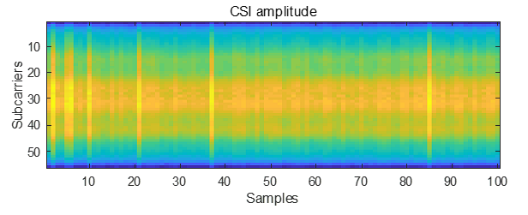
Rx Gain
Before a CSI is estimated, the AGC will be adjusted to a proper level for the following sampling and processing.
So, actually, the estimated CSI has included the effect of the AGC adjustment. The effect of the AGC adjustment would introduce extra error to WLAN sensing.
The data is collected within an empty room, and we can find that even for the ‘static’ environment, the AGC adjusts sometimes.
It is clearly shown that the when the VGA adjusts, the amplitude of the CSI on difference subcarriers is different. This will introduce extra errors for WLAN sensing and decrease the sensing performance.
If the AGC adjustment information could be exchanged in the WLAN sensing measurement report, the information of the AGC could be further adopted to help the following sensing processing.

Slide 8
Information exchange of Rx Gain
Actually, the AGC consists of an LNA and a VGA. The information of the LNA/VGA adjustment could be exchanged during the sensing measurement feedback.
The information could be
the level of LNA and VGA,
or if the LNA and/or VGA changes,
or if the LNA and VGA make the signal saturate for the following ADC,
or if the LNA and VGA adjustment exceed certain threshold (implementation specific and depends on the chip design).
…

Slide 9
Summary
To improve the performance of WLAN sensing, the Tx Power and Rx Gain should remain constant during the sensing measurement to avoid introducing extra errors.
For Tx power adjustment:
  it is better to adjust the digital power first, then the RF power.
  exchange the digital power and Tx power during the WLAN sensing.
For Rx Gain, the AGC adjustment information should be feedback with the WLAN sensing measurement results to provide additional information for the following sensing processing.

Slide 10
References
[1] 11-22-0381-01-00bf-tx-power-control-and-reporting.pptx

Slide 11
SP 1
Do you support to add the following to the 11bf SFD.
The digital Tx power could be exchanged in the WLAN sensing.
A general rule should be adopted during the Tx power adjustment:
adjust the Digital Power first (which has better linear property),
if it is not enough, adjust the Tx Power in RF.
Yes
No
Abs

Slide 12
Comparison of information exchange approaches
Options | Pros. | Cons.
Option 1 Exchange the level of LNA and VGA of each CSI. | Abundant information E.g. LNA and VGA levels and maybe helpful for further compensation. | More bits are needed A few bits for LNA level indication and a few bits for VGA level indication.
Option 2 Exchange if the LNA and/or VGA level changes from previous CSI. | Less bits are needed E.g. 1 bit for the indication of LNA changes and 1 bit for the indication of VGA changes, or 1 bit for the indication of AGC(LNA+VGA) changes. | Limited information The change is indicated, but the variation range is still unknown.
Option 3 Exchange if the LNA and VGA adjustment exceed certain threshold(s) from previous CSI. | Less bits are needed E.g. 1(a few) bit(s) for the indication of AGC adjustment exceed certain threshold(s). | Non-unified threshold The threshold(s) could be vendor specific and depend on the nonlinear properties of the LNA and VGA adopted.
Option 4 Exchange if the LNA and VGA make the signal saturated or too small for the ADC. | Less bits are needed E.g. 1 bit for the indication of ADC saturation and 1 bit for the indication of signal is too small. The indication is very important when it(saturation or too small) happens, because in this case, the error is ‘unknown’. | Happens occasionally If AGC is not fixed for ‘long time’ during sensing, this happens occasionally.

Slide 13
SP 2
Do you support to add the following to the 11bf SFD ?
The following optional features are defined.
Both RF gain and digital gain of each Rx antenna should be reported in the sensing measurement report frame.
RF gain and digital gain should be reported in separate fields.
The sensing measurement report frame provides an indication about the AGC change.
Note:
RF gain is defined as the gain in analog domain mainly contains the gain of AGC and other components.
Digital gain is defined as the gain in digital domain.
If the device is not able to provide the RF and/or digital gain, it may indicate the if the AGC changes.
Yes
No
Abs

Slide 14
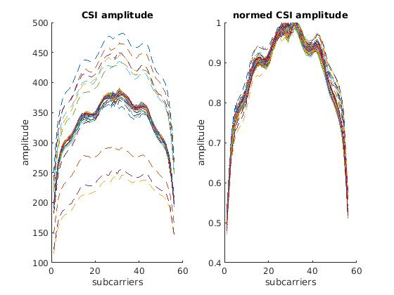
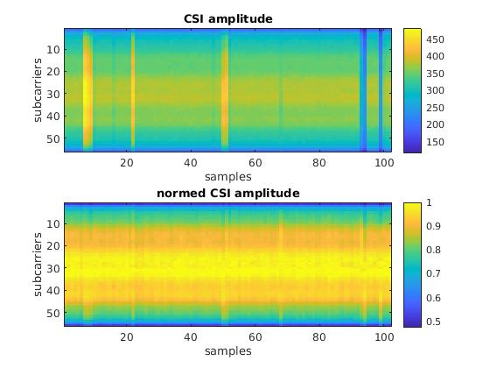
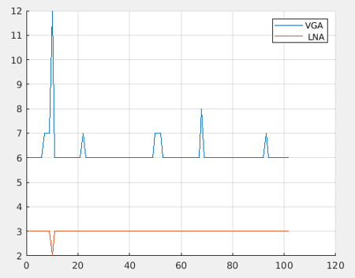
Backup: the effect of AGC adjustment
Similar with slide 7, the data is collected within an empty room, and we can find that even for the ‘static’ environment, the AGC adjusts sometimes.
It is clearly shown that when the VGA adjusts at some CSI samples, the amplitude of the CSI on difference subcarriers changes nonlinearly. And this effect introduced by AGC adjustment cannot be eliminated by normalization.

Slide 15
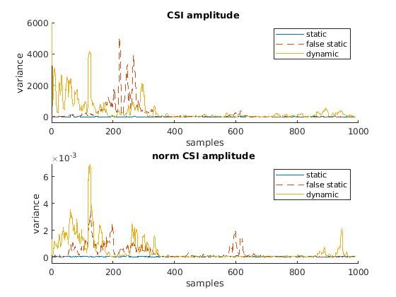
Backup: the effect of AGC adjustment
Considering the presence detection application as an example.
We collected data from empty room, room with dynamic target. The data is divided into three groups to analysis the effect of AGC adjustment in static scenarios, say static (no AGC adjustment), false static (AGC adjustment), dynamic.
The amplitude variance of corresponding scenarios are presented bellow, it is clear that the variance of ‘static’ data with AGC adjustment will bounce up as ‘dynamic’ data.
The effect introduced by AGC cannot be eliminated by normalization per CSI sample (as indicated in the bottom figure).

