Slide 1
Ambient Power Enabled IoT for Wi-Fi
May 2022
Doc.: IEEE 802.11-22/0645r1
Date: 2022-05-16
Authors:
Name | Affiliation | Address | Phone | Email
Lei Huang | Lei Huang (OPPO) |  |  | huang.lei1@Lei Huang (OPPO).com
Weijie Xu
Chuanfeng He
Zhisong Zuo
Shengjiang Cui
Rongyi Hu
Zhi Zhang
Notes:
1）target use case 2)802.11ah 如何支持这些use case(EL STA) 3)EL STA 与我们target use case 的GAP 4）新类型EL STA ，需求？（功耗1mw），。。。技术挑战（PHY,OOK）,共存的挑战 初步的思路（Backscattering）可能的例子的流程图

Slide 2
Outline
May 2022
Doc.: IEEE 802.11-22/0645r1
Available IoT technologies within 802.11 family
What is ambient power-enabled IoT?
Why considering ambient power-enabled IoT?
Use cases of ambient power-enabled IoT
Illustration of ambient power-enabled IoT for WLAN
Challenges of ambient power-enabled IoT for WLAN
Technology and standardization gaps
Summary

Slide 3
Available IoT technologies within 802.11 family
May 2022
Doc.: IEEE 802.11-22/0645r1
802.11 ah (specifically for IoT applications)
  Operate in sub-1GHz band.
  low-data rate, low-duty cycle, long-battery life, long-range applications, e.g.
    Sensors and meters, including smart grid, environmental/agricultural monitoring, industrial process sensors, healthcare, home/building automation, home sensors
    Backhaul sensor and meter data
  Main technical features
    Support narrower BW PPDU transmission (e.g. 1/2/4/8/16 MHz BW S1G PPDU).
    Support low power consumption operation (e.g. TWT/RAW, Energy limited operation )
    Support simplified MAC (e.g. NDP CMAC PPDU, PV1 MPDU, RID)
    Support thousands of STA’s per BSS
    Support range up to 1km, outdoor
    Standard Wi-Fi (802.11a/b/g/n/ac/ax/be)
  Operate in 2.4/5/6 GHz bands.
  Include some features which are useful for IoT applications (e.g. OFDMA, triggered UL access, TWT, support of 20 MHz only STA)

Slide 4
What is ambient power-enabled IoT?
May 2022
Doc.: IEEE 802.11-22/0645r1
Ambient power-enabled IoT definition
  Ambient power-enabled IoT is an IoT service with an IoT device powered by energy harvesting from radio waves, solar/light, or any other possible power sources.
Key point
  battery-less IoT devices powered by energy harvesting and equipped with (ultra-) low-power transceiver (e.g., power consumption of less than 1mW)
  Ambient power-enabled IoT is not within the scope of 802.11ah and standard Wi-Fi
  Wi-Fi devices typically are powered by a battery.
  Considering their power consumption and complexity, battery cannot be replaced by ambient power.
    e.g. power consumption of S1G devices is about tens of to hundreds of mw, while the typical ambient power is less than 1mw (considering the restriction of device form factor).
    OFDM used in Wi-Fi devices restricts their complexity and power consumption.

Slide 5
Why considering ambient power-enabled IoT? (1/3)
May 2022
Doc.: IEEE 802.11-22/0645r1
  The Wi-Fi IoT network is competitive from the perspective of deployment cost, due to widespread deployment and free use of unlicensed frequency band.
  However, there are still lot of use cases and applications that can not be met by using existing Wi-Fi IoT technologies:
  A device driven by a battery is not applicable, e.g., under extreme environmental conditions (e.g., high pressure, extremely high/low temperature, humid environment) or maintenance-free devices are required (e.g., no need to replace a battery for the device)
  A device with ultra-low complexity, very small device form factor (e.g., thickness of mm), and longer life cycle etc. is required
  Combining ambient power-enabled IoT with Wi-Fi will enable a new kind of IoT service in many to-B and to-C areas, which will be beneficial for the Wi-Fi ecosystem.
  Note: 3GPP begin to study ambient power-enabled IoT since Rel-19 [S1-220192 New SID: Study on Ambient power-enabled Internet of Things, Lei Huang (OPPO)]

Slide 6
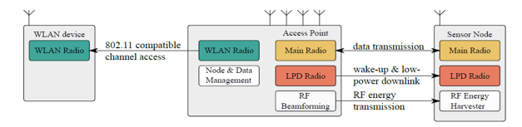
Why considering ambient power-enabled IoT? (2/3)
May 2022
Doc.: IEEE 802.11-22/0645r1
  There have been lots of study of ambient power-enabled IoT in IEEE community. In addition, many prototypes have been developed.
  Optimizing M2M Energy Efficiency in IEEE 802.11ah, IEEE GLOBECOM 2015
  “the battery dependency of an 802.11ah sensor is significantly lowered by energy harvesting provided that the sensor size and energy harvesting efficiency are sufficient for the utilized ambient energy source.”
  Low-Power Downlink for the Internet of Things using IEEE 802.11-compliant Wake-Up Receivers, IEEE INFOCOM 2021

Slide 7
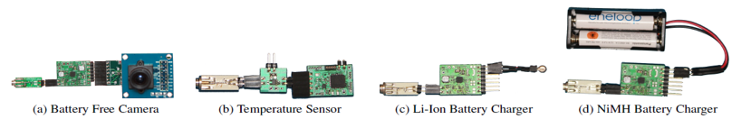
Why considering ambient power-enabled IoT? (3/3)
May 2022
Doc.: IEEE 802.11-22/0645r1
Powering the Next Billion Devices with Wi-Fi, Communications of the ACM, March 2017
“A harvester hardware that efficiently receives power across multiple 2.4 GHz Wi-Fi channels. ”
Feasibility of Wireless Sensors using Ambient 2.4GHz RF Energy, 2012 IEEE Conference on Sensors
“Energy harvesting is a promising way to supplant batteries, the most common sources of energy harvesting being photovoltaic, thermal, and vibrational energy sources, or a hybrid of these sources. Human motion energy harvesting has also been shown to be realistic, which can provide energy for mobile or wearable sensor networks. Lately, the feasibility of harvesting ambient RF energy, particularly from the crowded 2.4GHz ISM band, has been the subject of speculation in the literature.”

Slide 8
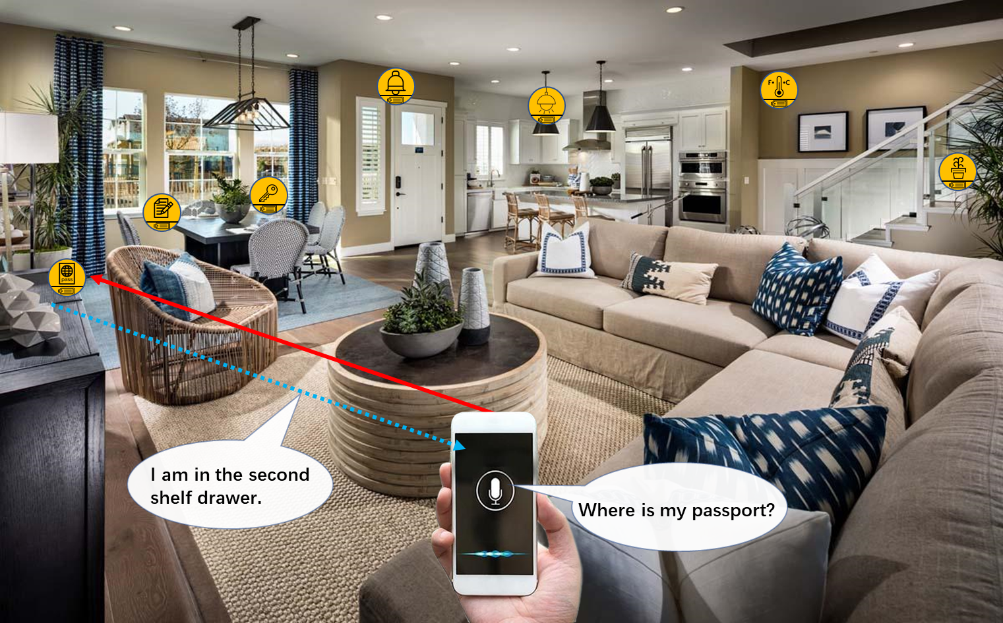
Use cases of ambient power-enabled IoT (1/3)
May 2022
Doc.: IEEE 802.11-22/0645r1
    Smart home
    Ambient power-enabled IOT device can be used in the following applications:
  Home monitoring: monitoring house environment, e.g., temperature, humidity, gas leakage etc.
  Home security: detecting intruders approaching house/home.
  Asset management: finding things
    Requirements of the devices:
  Ultra-low power consumption, e.g., less than 1mW
  Battery-less, thus no need to replace a battery
  Small form factor, e.g., thickness of 1mm and area of several cm²
Notes:
EL 对这类设备支持的情况。
支持限于MAC层，功耗还可能比较高（？）

Slide 9
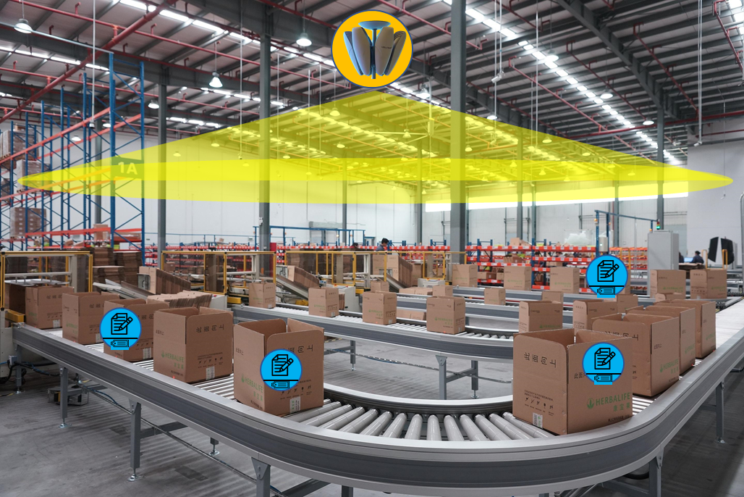
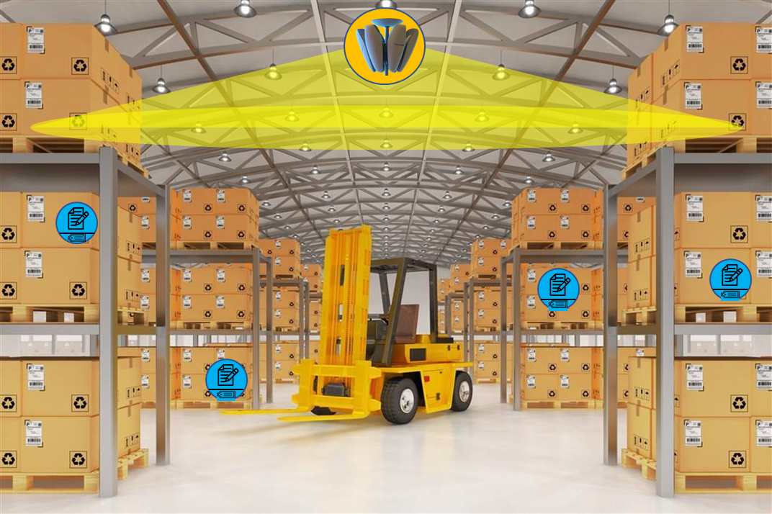
Use cases of ambient power-enabled IoT (2/3)
May 2022
Doc.: IEEE 802.11-22/0645r1
    Logistics and warehousing
Ambient power enabled IoT devices can be attached to the packet of the goods for goods tracking during the whole logistics procedure.
Requirements of the devices:
  Ultra-low power consumption, e.g., less than 100uW
  Battery-less, thus no need to replace a battery
  Small form factor, e.g., thickness of 1mm and area of several cm²

Slide 10
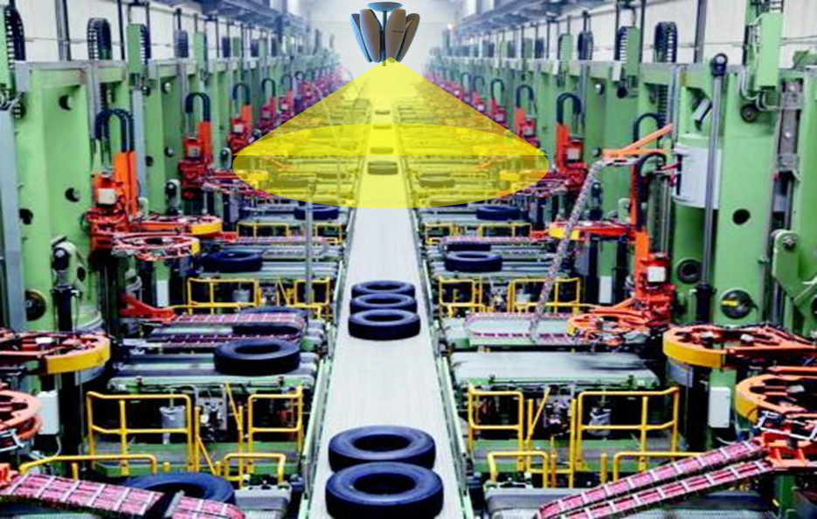
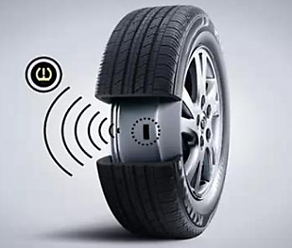
Use cases of ambient power-enabled IoT (3/3)
May 2022
Doc.: IEEE 802.11-22/0645r1
Industrial Wireless Sensor Network (IWSN)
In IWSN, ambient power enabled IoT devices can be used for
  Environment/product line monitoring
  Asset tracking
Requirements of the devices
  Battery-less, to enable maintenance-free IoT network
  Ultra-low power consumption, less than 1mw

Slide 11
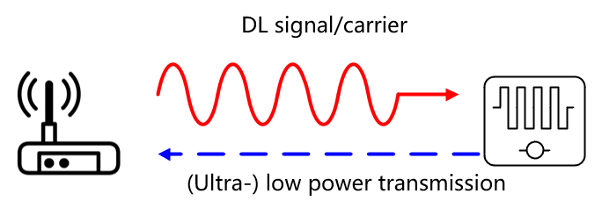
May 2022
Doc.: IEEE 802.11-22/0645r1
Illustration of Ambient Power Enabled IoT for WLAN(1/2)
AP
STA
Battery-less
Small form factor
Ultra-low cost

Slide 12
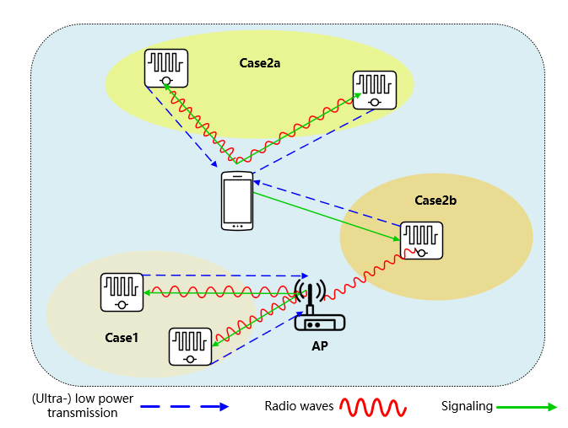
May 2022
Doc.: IEEE 802.11-22/0645r1
Illustration of Ambient Power Enabled IoT for WLAN (2/2)
The target is to support: 1) the communication between AP and the IoT devices or 2) the communication between STA and the IoT devices

Slide 13
Challenges of Ambient Power-Enabled IoT for WLAN
May 2022
Doc.: IEEE 802.11-22/0645r1
Support of devices with extremely-low complexity
  simplified RF and baseband architecture, limited memory etc.
  may not be able to support OFDM
Support of devices with ultra-low power consumption
  only several to tens of uW power can be harvested using radio waves
  less than 1 mW power can be harvested using solar panel of 1cm²
Compatibility and coexistence with legacy Wi-Fi system

Slide 14
Technology and Standardization Gaps (1/2)
May 2022
Doc.: IEEE 802.11-22/0645r1
  Target frequency bands could be
  Sub 1GHz (i.e. the same band as 11ah)
  Other frequency band, e.g., 2.4GHz, can also be studied.
  Technology and standardization gaps
  Simpler waveform/modulation/coding scheme, e.g.
    ASK/FSK, Manchester coding
    WUR PPDU like PPDU format which enables ultra-low power transceiver design
  Simplified MAC protocol design to support ultra-low power operation
    could be new or enhanced protocols
  Coexistence and compatibility schemes with legacy Wi-Fi system

Slide 15
Technology and Standardization Gaps (2/2)
May 2022
Doc.: IEEE 802.11-22/0645r1
  Example candidate techniques
  Ultra-low power receiver + Backscattering
    device harvests energy from radio waves (e.g., send from AP or other equipment) or light etc.
    device receives DL signals from AP using ultra-low power receiver
    device sends UL signals to AP with backscattering (please see slides 21 & 22)
      AP needs to provide incident carrier to device for backscattering
  Ultra-low power receiver + Ultra-low power transmitter
    device harvest energy from radio waves (e.g., send from AP or other equipment) or light etc.
    device receives DL signals from AP using ultra-low power receiver
    device sends UL signals to AP using ultra-low power transmitter
      Support simple waveform, e.g., ASK/FSK

Slide 16
Summary
May 2022
Doc.: IEEE 802.11-22/0645r1
  This presentation discusses the following topics:
  Definition, motivation, use cases, and challenge of ambient power-enabled IoT for Wi-Fi
  Technology and standardization gaps for ambient power-enabled IoT for Wi-Fi
  Distinguished competitiveness can be expected for ambient power-enabled IoT for Wi-Fi.
  To enable richer Wi-Fi applications and expand the Wi-Fi ecosystem, it is the right time for the IEEE 802.11 working group to study and standardize ambient power-enabled IoT for WLAN.

Slide 17
Straw Poll 1
May 2022
Doc.: IEEE 802.11-22/0645r1
  Do you think ambient power-enabled IoT for WLAN would be an interesting topic for 802.11 to study?
  Yes:
  No:
  Abstain:

Slide 18
Straw Poll 2
May 2022
Doc.: IEEE 802.11-22/0645r1
  Do you support the formation of a new 802.11 SG (Study Group) for “Support of Ambient Power-Enabled IoT for WLAN” ?
    with target frequency band of Sub 1 GHz and TBD for 2.4GHz
  Yes:
  No:
  Abstain:

Slide 19
May 2022
Doc.: IEEE 802.11-22/0645r1
Appendix

Slide 20
May 2022
Doc.: IEEE 802.11-22/0645r1
Energy is harvested by the RF part in the principle of electromagnetic
induction
Energy Harvesting
Take RF Power Harvesting as example
The energy is used to drive low power-consumption circuit and sensors
Two important values for RF power harvesting
  -20dB
    DL signal of at least -20dB mw is needed for the terminal to get sufficient energy to drive its low-power circuit
  -30dB
    DL signal of at least -30dB mw is needed for the RF power harvesting module to harvest and reserve energy
    The power harvesting efficiency degrades rapidly as the DL signal becomes weaker, not linearly

Slide 21
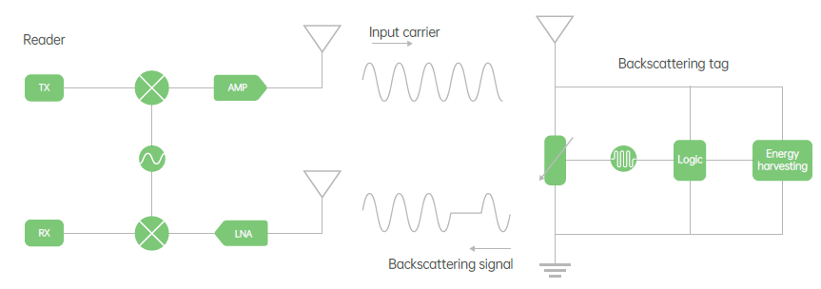
May 2022
Doc.: IEEE 802.11-22/0645r1
Backscattering Transmission
The terminal itself does not have a transmitter, it transmit uplink signal in a backscattering manner.
The signal is modulated on the received carrier by adaptation of properties(e.g., impedance) of the circuit of the terminal.
Information bits string(i.e., 0,1, 1,0) is used to control the adaptation.

Slide 22
May 2022
Doc.: IEEE 802.11-22/0645r1
Coexistence with Legacy Wi-Fi System When Considering Backscattering based technique
UL transmission from tag
  AP: TXOP holder
    AP sends a trigger frame to solicit UL transmission from tag
    AP sends preamble and carrier wave to the tag.
  Tag: TXOP responder
    Tag backscatters the preamble part and modulates data information using backscattering manner based on the carrier wave, with a frequency offset with respect to the DL signal

