Slide 1
Consideration on the TSN capabilities and XR applications in Wi-Fi
Date: 2022-04-12
Authors:
Name | Affiliation | Address | Phone | Email
Liuming Lu | OPPO |  |  | luliuming@oppo.com
Lei Huang
Lin Wang
Chaoming Luo
Pei Zhou
Liuming Lu (OPPO)

Slide 2
Introduction
This contribution focuses on the XR applications and reviews the Wi-Fi features for XR KPIs (such as high throughput, low latency and high reliability) , and then considers in-car XR entertainment/navigation to be an entry level of TSN applications for Wi-Fi.
This contribution also provides the trial results on wireless display connection (such as Miracast), and evaluates the gap to reach the XR KPIs and proposes to incorporate the latest Wi-Fi technologies (such as 11be features for high throughput and low latency) to P2P (such as Wi-Fi Direct) and Miracast.

Slide 3
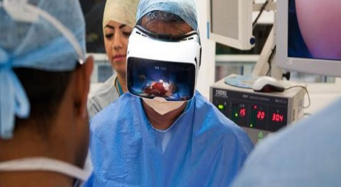
XR Applications
XR - an important type of TSN applications for real-time video
VR Gaming
VR and AR in Healthcare
Office collaboration using VR
AR in Interactive and Cognitive Immersive Applications
Throughput, low latency(Jitter) and high reliability are KPIs for the requirements of XR applications
 | Data rate | Time Synchronization Accuracy | Bounded Latency | Reliability
AR/VR | 100 ~ 28,000 Mbps | ~1 µsec | 3 to 10 msec | 99.9 to 99.99%

Slide 4
Wi-Fi Features for XR KPIs
Throughout the growth cycle, Wi-Fi technology advances its capabilities in optimized performance of multimedia content and real-time traffic such as voice, video and graphic-intensive gaming and XR applications.
Wi-Fi 5 (802.11ac)
Wi-Fi 6 (802.11ax)
Wi-Fi 7 (802.11be)
5 GHz spectrum band
20 MHz, 40 MHz and 80 MHz channelization （160 MHz optional）
LDPC
Receive (Rx) Aggregate MAC protocol data unit (A-MPDU) and transmit (Tx) A-MPDU
6 GHz spectrum band
160 MHz channelization
Uplink and downlink OFDMA
Uplink and downlink MU MIMO
Per-link enhancement (1024-QAM )
Target wake time (TWT)
Spatial reuse
320MHz channelization
enhanced OFDMA : multiple RUs
Per-link enhancement (4096-QAM )
Multi-link Operation (TID-TO-LINK mapping)
Restricted TWT
Triggered UL access optimization
Wi-Fi technology makes significant progress on increasing the throughput and reliability, and enhancing the intra-BSS scheduled access, but is still confronted with the risk of unpredictable latency due to the OBSS inferences for unlicensed operation.

Slide 5
Controlled Environments are Important
OBSS interferences may exist frequently for uncontrolled environments and would affect seriously the scheduled transmission of latency sensitive traffic.
For the currently specified enhanced supports for the delivery of latency sensitive traffic, such as AP-Triggered UL access optimization, the medium access protection of restricted TWT, focus on the intra-BSS behaviors.
Controlled Environments can avoid or reduce the negative effect caused by OBSS interferences, and lead to the performance improvement of TSN applications.
3GPP support of unlicensed operation – as a reference
especially in controlled environments, which assumes an environment which contains only devices operating on the unlicensed band and where unexpected interference only sporadically happens.

Slide 6
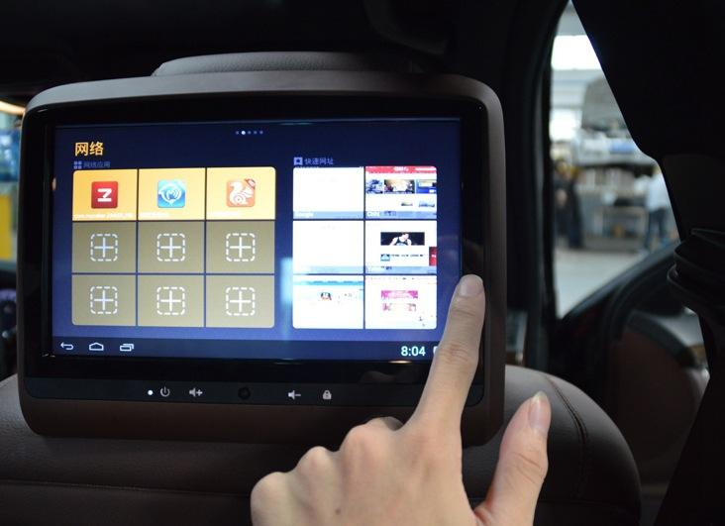
in-car XR entertainment/navigation as an entry level of TSN applications for Wi-Fi
In-car communication provides a relatively controlled environment
In-car inference from other radio systems can be avoided by tunning off the systems or adopting different bands for the systems.
Car body can block the outside unexpected interference to a certain extent.

Slide 7
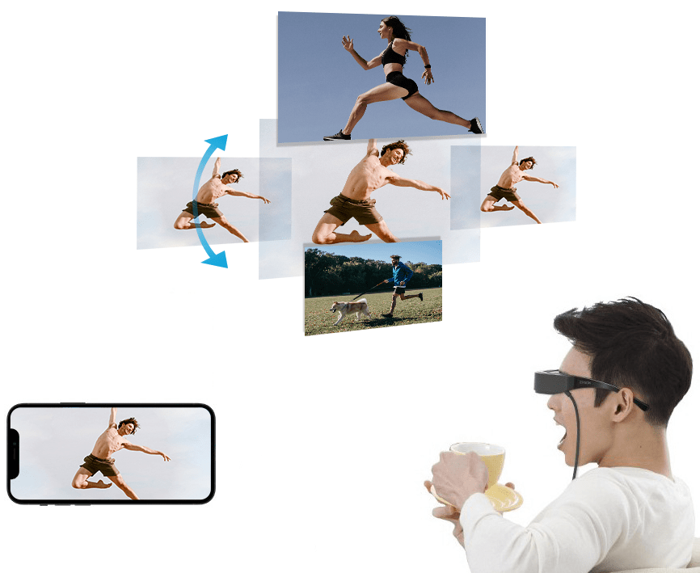
in-car XR entertainment/navigation – Wireless display connection
Wi-Fi Miracast - a mechanism to discover, pair, connect, and render multimedia content sourced from a Miracast Source at a Miracast Sink.
Miracast enables seamless display of multimedia content between Miracast devices. Miracast allows users to wirelessly share multimedia, including high-resolution pictures and high-definition (HD) video content between Wi-Fi devices
Miracast

Slide 8
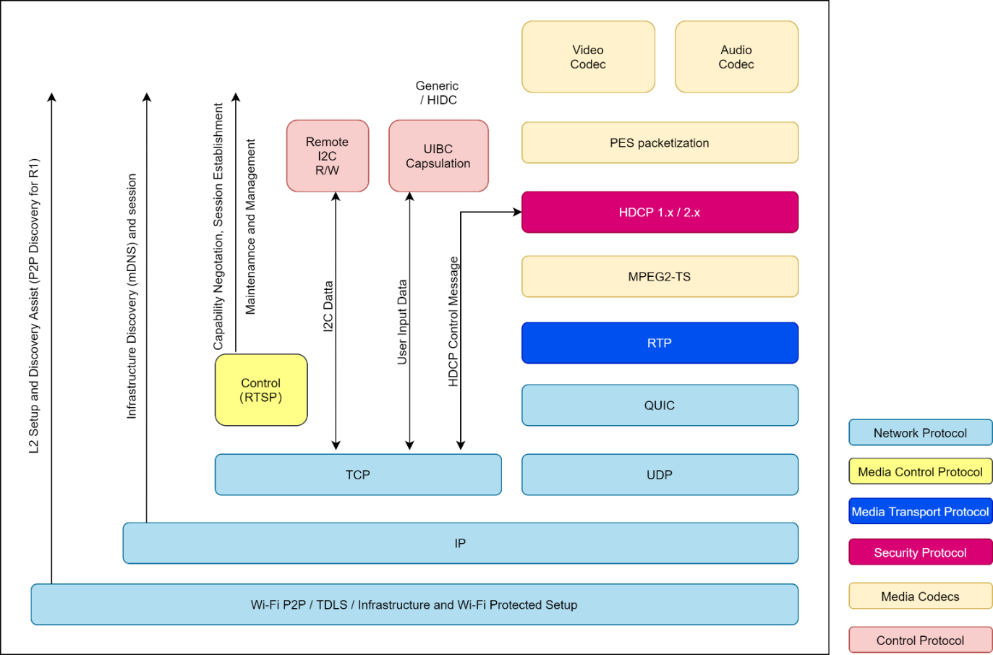
End-to-end latency needs to be considered
The performance and quality of user experience (QoE) depends not only on 802.11 PHY/MAC but also on the higher layers (Network protocol, Media Transport protocol etc.)
An example: Miracast (V2.2) performance depends on Wi-Fi Direct over 11ac and what to be selected for application among TCP/UDP/QUIC.
An example - Miracast Architecture with QUIC extensions

Slide 9
Miracast Trial - Setup
Miracast Specification Version 2.2 (latest version)
A WFD R2 Device that supports Wi-Fi Direct over 11ac
Miracast Demo App
Based on Google AOSP source code for Source & Sink
Support TCP & UDP & QUIC mode（use lsQuic open source implementation）
Use commercial-off-the-shelf chipset devices as Source & Sink devices
3 conditions
Different throughput from 1Mbps ~ 25 Mbps
Different RTT delay from 100ms ~ 700ms
Different data loss rate from 0.08% ~ 5.12%
Measure dimensions
Buff ratio: the buffering time / the total AV streaming time (lower -> better QoE)
Rate buff: the buffering times in one casting (the buffering may cause stutter, lower -> better QoE)
Join time: the time of the first casting (lower -> better QoE)
Rendqual: casting mosaic or distortion or disconnection observed (lower -> better QoE)
QoS parameters
Throughput
Delay (Latency)
Reliability (Data loss rate)
QoE parameters
Buff ratio
Rate buff
Join time
Rendqual

Slide 10
Miracast Trial - Throughput test
With the increasing throughput the buff ratio becomes relatively lower, but would be affected a little
In higher bandwidth scenarios: 2Mbps to 25Mbps, QUIC's buffratio is close to that of udp and better than tcp.
In the low bandwidth scenario of 1Mbps, QUIC has a lower buffratio than tcp and udp because of its FEC ability.
With the increasing throughput the rate buff also becomes relatively lower, , but would be affected a little
At higher bandwidths: 2Mbps to 25Mbps, the ratebuff of QUIC is better than TCP and UDP.
In a very low bandwidth environment of 1Mbps, UDP does not need to guarantee that the data must arrive, TCP and QUIC both need to guarantee that the data must arrive so ratebuff TCP>QUIC>UDP.

Slide 11
Miracast Trial - RTT delay test (1)
With the increasing RTT delay the buff ratio becomes relatively higher，delay has a significant impact on buff ratio and delay less than 100ms is required.
The buff ratio of QUIC is closer to that of UDP when the latency is lower, and higher when the latency is higher because UDP is non-reliable, while QUIC and TCP are reliable: UDP > QUIC > TCP
With the increasing RTT delay the rate buff becomes relatively higher, delay has a significant impact on rate buff and rate buff is not zero even in 100ms delay.
QUIC's rate buff has a smoother CDF as the delay rises, with interval performance 20% lower than TCP and 10% lower than UDP.

Slide 12
Miracast Trial - RTT delay test (2)
With the increasing RTT delay the join time becomes relatively longer, delay has a significant impact on join time and delay less than 100ms is required for better join time
When using TCP or UDP for RTP streaming, the RTSP interactions are still on TCP, so the join time of QUIC is shorter than transporting RTP with TCP or UDP.

Slide 13
Miracast Trial - Data loss test (1)
With the increasing data loss rate the buff ratio becomes greatly higher, data loss rate has a significant impact on buff ratio and data loss rate less than 0.08% is required for better buff ratio
The buff ratio of QUIC is closer to that of UDP when the latency is lower, and higher when the latency is higher because UDP is non-reliable, while QUIC and TCP are reliable.
With the increasing data loss rate the rate buff becomes greatly higher, data loss rate has a significant impact on rate buff and data loss rate less than 0.08% is required for better rate buff.
The rate buff of QUIC has a smoother CDF when the latency rises, and the interval performance is 10% lower than TCP and 5% lower than UDP. Due to the adoption of FEC and NACK, the chance of disconnection is much lower than TCP and UDP in the case of packet loss rate > 5.12%, therefore, the comprehensive performance is better than TCP and UDP.

Slide 14
Miracast Trial - Data loss test (2)
For UDP data loss rate has a significant impact on Rendqual
TCP and QUIC are reliable without mosaic or distortion observed.
Mosaic or distortion observation rises gradually with the packet loss rate for UDP

Slide 15
Throughput and End-to-end latency needs to be improved
Current throughput and end to end latency with high reliability of Wireless display connection (especially for Miracast) needs to be further improved for future XR applications
incorporate the latest Wi-Fi technologies (especially low latency with high reliability) to P2P(such as Wi-Fi Direct) and Miracast
802.11be Features to support the delivery of latency sensitive traffic can narrow the gap.
802.11be Features for low latency
Benefits
Multi-link Operation
(including TID-TO-LINK Mapping)
1. Increase the throughput
2. Provide multiple paths for traffic delivery
3. Convenient for flexible Traffic scheduling
4. QoS traffic prioritization（preferred link for latency-sensitive traffic）
Low latency
Restricted TWT (Target Wake Time )
1. Enhance medium access protection
2. Resource reservation
3. Convenient for flexible Traffic scheduling
High Reliability
Triggered UL access optimization
1. Trigger based on QoS requirements
2. Convenient for flexible traffic scheduling

Slide 16
Summary
This contribution also provides Miracast trial, and evaluates the gap to reach the XR KPIs and proposes to incorporate the latest Wi-Fi technologies (such as 11be features for low latency) to P2P (such as Wi-Fi Direct) and Miracast.

Slide 17
Reference
[1] IEEE 802.11be Draft 1.5
[2] Miracast Specification Version 2.2
[3] 11-22-0080-02-0000-wi-fi-and-tsn-enabling-deterministic-wireless-for-time-sensitive-applications
[4] RP-210854, Enhanced Industrial Internet of Things (IoT) and ultra-reliable and low latency communication (URLLC) support for NR
Liuming Lu (OPPO)

