Slide 1
Sensing Trigger Frame for 11bf
Date: 2022/3/25
Authors:
Name | Affiliation | Address | Phone | Email
Narengerile | Huawei Technologies Co., Ltd. | Shenzhen, China |  | narengerile@huawei.com
Rui Du
Mengshi Hu

Slide 2
Abstract
In [1], two options for Sensing Trigger frames are proposed.
  Opt. 1: Define new Trigger frame variant for sensing
  Opt. 2: Reuse Ranging Trigger frame for sensing
We propose an Opt. 3 for Sensing Trigger frame.
  Opt. 3: Reuse Ranging Trigger frame for transparent sensing [2][3]
    Keep the Ranging Trigger frame format unchanged
    Indication for sensing
    Use reserved bits for Measurement Setup ID and Measurement Instance ID

Slide 3
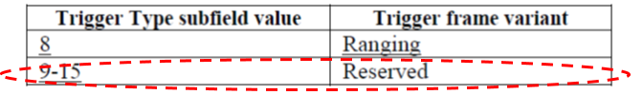

Recap – Opt. 1
Add a new Trigger Type: use value of 9
Trigger Dependent Common Info subfield: Use 3 or 4 bits to define Sensing Trigger Subtype
Pros: Provides flexibility for sensing purposes
Cons: Requires new design of the frame format

Slide 4
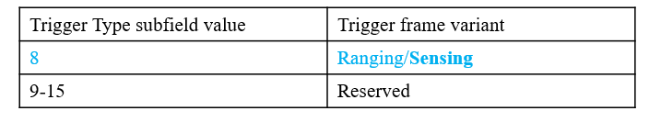
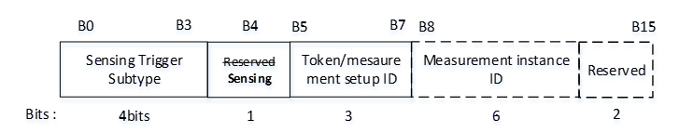
Recap – Opt. 2
Reuse 11az Ranging Trigger frame
Change the Trigger Dependent Common Info field format: Indication, Measurement Setup ID and Measurement Instance ID
Pros: Requires minor changes
Cons: May cause interoperability issues for legacy devices
  The legacy device will interpret the Measurement instance ID as its AID and causes error.
  Only when Ranging Trigger Subtype value = 4 (Passive Sounding), the Trigger Dependent Common Info field contains 2 bytes.
Notes:
Length inconsistent

Slide 5
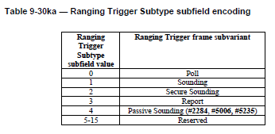
Opt. 3-A: Sensing Trigger frame subtype
Reuse 11az Ranging Trigger frame
Sensing Trigger frame subtype (in Trigger Dependent Common Info)
  Pros: Keep minimum changes to chip vendors and algorithms
    The subtype value and the corresponding subvariant are consistent with that for legacy devices.
Byte (11az)
Sensing Trigger Subtype subfield value | Sensing Trigger frame subvariant
0 | Polling
1 | Sounding
2 | Secure Sensing ? (TBD)
3 | Report
4-15 | Reserved
Byte (11bf)
1
1
1
1
1
1
1
1
2
n/a
n/a
Notes:
Keep purpose consistent

Slide 6
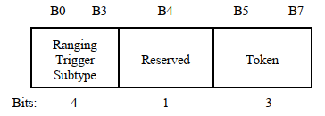
Opt. 3-B: Indication for Sensing
Indication for Sensing Trigger frame (Trigger Dependent Common Info)
  For Sensing Poll Trigger frame
  For Sensing Sounding/Report Trigger frame
 | B0 B3 | B4 | B5 B7
 | Sensing Trigger Subtype | Reserved Sensing | Reserved
Bits | 4 | 1 | 3
11az
11bf
Token field: increment by 1
 | B0 B3 | B4 | B5 B7
 | Sensing Trigger Subtype | Reserved Sensing | Measurement Setup ID
Bits | 4 | 1 | 3
11az
Reserved
11bf

Slide 7
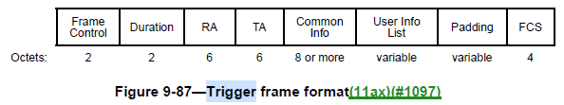
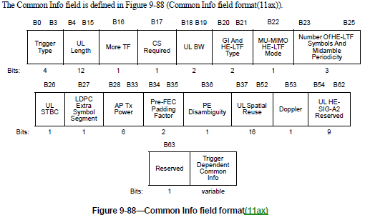
Opt. 3-C: Measurement Setup ID and Measurement Instance ID
Reserved bits in Common Info field in Poll, Sounding and Report Ranging Trigger for 11az

Slide 8
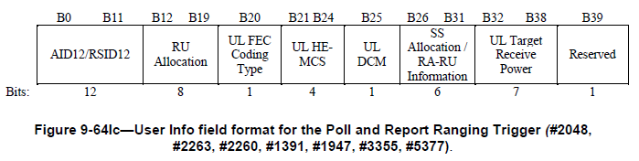
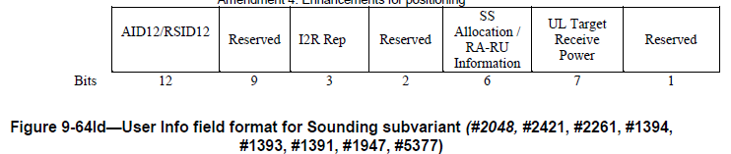
Opt. 3-C: Measurement Setup ID and Measurement Instance ID
Reserved bits in User Info field in the Poll and Report Ranging Trigger for 11az
Reserved bits in User Info field in the Sounding Ranging Trigger for 11az

Slide 9
Option comparison for sensing trigger frames for 11bf
 | Pros. | Cons.
Opt. 1 | Flexible design for trigger | Require new frame design
Opt. 2 | Minor changes to existing trigger frames | Cause interoperability issues for legacy devices (11az)
Opt. 3 | Minor changes to existing trigger frames Transparent to legacy devices (11az)

Slide 10
Straw Poll
Which option do you prefer to define the Sensing Trigger frame format?
  Opt. 1: Define new Sensing Trigger frame (Slide 3)
    Add Trigger Type value of 9
  Opt. 2: Reuse Ranging Trigger frame (Slide 4)
    Reuse Trigger Type value of 8
    Redefine Trigger Dependent Common Info subfield for sensing
  Opt. 3: Reuse Ranging Trigger frame (Slide 5-8)
    Reuse Trigger Type value of 8
    Utilize reserved bits for sensing
  Abstain
Notes:
Slide - slide

Slide 11
Reference
[1] https://mentor.ieee.org/802.11/dcn/22/11-22-0457-00-00bf-trigger-frame-for-11bf.pptx
[2] https://mentor.ieee.org/802.11/dcn/21/11-21-0504-09-00bf-specification-framework-for-tgbf.docx
[3] https://www.ieee802.org/11/private/Draft_Standards/11az/index.html

