Slide 1
PN and SN for sensing
Date: 2022-3-31
Authors:
Name | Affiliation | Address | Phone | Email
Chaoming Luo | OPPO |  |  | luochaoming@oppo.com
Lei Huang
Pei Zhou
Chaoming Luo (OPPO)

Slide 2
Introduction
This contribution proposes a new replay counter, a new bit in CCMP/GCMP header for sensing.

Slide 3
Recap: PN and replay detection
12.5.3.4 CCMP decapsulation
12.5.3.4.4 PN and replay detection
12.5.5.4 GCMP decapsulation
12.5.5.4.4 PN and replay detection: To effect replay detection, the receiver extracts the PN from the GCMP header. See 12.5.5.2 (GCMP MPDU format) for a description of how the PN is encoded in the GCMP header. The following processing rules are used to detect replay:
  a) The receiver shall maintain a separate set of replay counters for each PTKSA, TPKSA, GTKSA, mesh PTKSA, and mesh GTKSA. The receiver initializes these replay counters to 0 when it resets the temporal key for a peer. The replay counter is set to the PN value of accepted GCMP MPDUs.
  b) For each PTKSA,TPKSA, GTKSA, mesh PTKSA, and mesh GTKSA, the recipient shall maintain a separate replay counter for each TID, subject to the limitation of the number of supported replay counters indicated in the RSN Capabilities field (see 9.4.2.24 (RSNE)), and shall use the PN from a received frame to detect replayed frames. A replayed frame occurs when the PN from a received frame is less than or equal to the current replay counter value for the frame’s MSDU or A-MSDU priority and frame type.
  ……
Inference: any out-of-order frame may cause other frames be recognized as replayed frames.
Chaoming Luo (OPPO)

Slide 4
PN and Replay counter
Issue: similar with ranging [1][2], protected sensing measurement report frame may cause losing of other pending individually addressed robust Management frames.
  Protected sensing report frames shall be transmitted in a certain time, e.g., at the end of a measurement instance.
  Assume the STA uses the same replay counter to receive protected measurement report/SBP report as other individually addressed robust Management frames.
  Individually addressed robust Management frames may be retransmitted and pending in the queue, if a protected sensing report frame uses the next PN number and transmitted ahead of the pending individually addressed robust Management frames, the STA receives the individually addressed robust Management frames will drop them since the replay counter is updated.
  Delayed protected sensing report stored in head of the queue with one or more additional individually addressed robust Management frames behind cause the ‘head of line (HOL) blocking’ issue.
Proposal:
  A new replay counter is introduced and applies to the new action category ‘Protected Sensing Frame’.
  Protected sensing measurement report frame belongs to the new action category ‘Protected Sensing Frame’, while other protected sensing Action frames belong to the action category ‘Protected Dual of Public Action’.

Slide 5
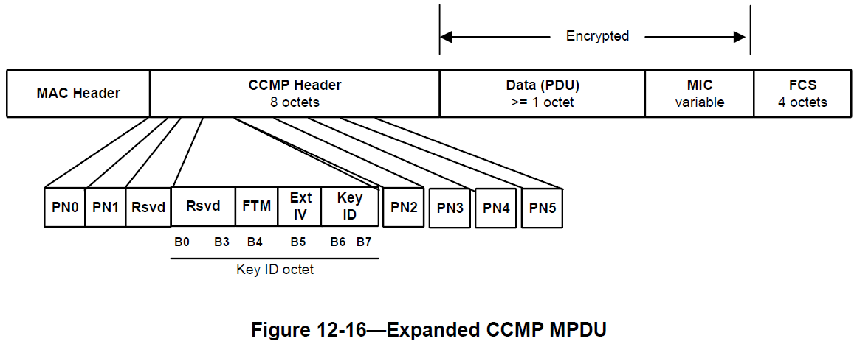
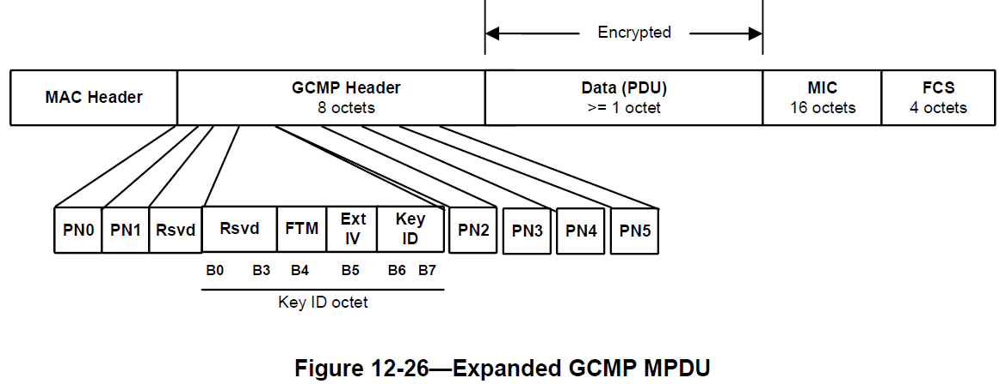
CCMP/GCMP Header
Issue: similar with ranging [1][2], typically replay checking occurs after decryption. However, as an optimization for early discard, without loss of security, some implementations may check for replays before decryption.
Proposal: Use the reserved bit B3 of ‘Key ID Octet’ in the CCMP/GCMP Header to indicate a frame of the new action category ‘Protected Sensing Frame’.

Slide 6
Recap: SNS and RC
10.3.2.14 Duplicate detection and recovery
  Duplicate frame filtering is facilitated through the inclusion of a Sequence Control field (consisting of a sequence number and fragment number) within Data, Management, and Extension frames, a TID subfield in the QoS Control field within QoS Data frames, and an ACI subfield in the Sequence Number field within QMFs, and a PTID/Subtype subfield in the Frame Control field within PV1 Data frames.
10.3.2.14.2 Transmitter requirements
  A transmitting STA shall support the applicable sequence number spaces defined in Table 10-5 (Transmitter sequence number spaces).
10.23.2.12 Retransmit procedures:
  With the exception of a frame belonging to a TID for which block ack agreement is set up, a QoS STA shall not initiate the transmission of any Management or Data frame to a specific RA while the transmission of another Management or Data frame with the same RA and having been assigned its sequence number from the same sequence counter has not yet completed to the point of success, retry fail, or other MAC discard (e.g., lifetime expiration).

Slide 7
SNS and RC
Analysis:
  Sensing measurement report should be Action No Ack frame, so no retransmissions, SN in this frame is implementation specific.
  Other sensing frames (MS request/response, MS termination, SBP request/response, SBP termination, SBP report, session setup request/response) frame transmissions DO NOT occur based on a timing constraint manner, e.g. as a result of a trigger, so they could be queued and (re)transmitted as any other Management or Data frames.

Slide 8
SNS and RC
Proposal:
  For a QMF STA, the ‘SNS4’ (SNS for QMFs) in ‘Table 10-5 Transmitter sequence number spaces’ and ‘RC6’ (RC for QMFs) shall be used for sensing Management frames (both public and protected).
  Two new entries are added into ‘Table 11-18 Default QMF policy’ correspondingly as shown.
  For a non-QMF STA, the ‘SNS1’ (SNS for Baseline) in ‘Table 10-5 Transmitter sequence number spaces’ and ‘RC1’ (RC for Not QoS Data) shall be used for sensing Management frames (both public and protected).
Description | Management Frame Subtype value from Table 9-1 (Valid type and subtype combinations) | Category value from Table 9-51 (Category values) | Action Field | QMF access category
Public Action- Sensing Frame | 1101 | 4 | any | AC_VO for sensing frames excluding Sensing Measurement Report.
Protected Dual of Public Action | 1101 | 9 | any | AC_VO

Slide 9
SP 1
Do you agree to add the following into 11bf SFD ?
  A new replay counter is introduced and applies to the new action category ‘Protected Sensing Frame’.
  Protected sensing measurement report frame belongs to the new action category ‘Protected Sensing Frame’, while other protected sensing Action frames belong to the action category ‘Protected Dual of Public Action’.
  Use the reserved bit B3 of ‘Key ID Octet’ in the CCMP/GCMP Header to indicate a frame of the new action category ‘Protected Sensing Frame’.
  Y/N/A
Chaoming Luo (OPPO)

Slide 10
SP 2
Do you agree to add the following into 11bf SFD ?
  For a QMF STA, the ‘SNS4’ (SNS for QMFs) in ‘Table 10-5 Transmitter sequence number spaces’ and ‘RC6’ (RC for QMFs) shall be used for sensing Management frames (both public and protected).
  Two new entries are added into ‘Table 11-18 Default QMF policy’ correspondingly as shown in slide 8.
  For a non-QMF STA, the ‘SNS1’ (SNS for Baseline) in ‘Table 10-5 Transmitter sequence number spaces’ and ‘RC1’ (RC for Not QoS Data) shall be used for sensing Management frames (both public and protected).
  Y/N/A
Chaoming Luo (OPPO)

Slide 11
Reference
[1] 11-20-0797-00-00az-lmr-ftm-replay-counter
[2] 11-20-0889-05-00az-protected-lmr-replay-counter
Chaoming Luo (OPPO)

Slide 12
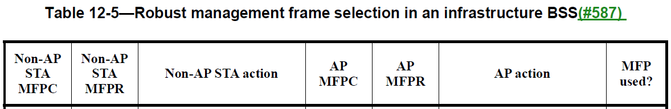
Backup: MFP(management frame protection)
12.6.3 RSNA policy selection in an infrastructure BSS:
  An AP and a non-AP STA shall use Table 12-5 (Robust management frame selection in an infrastructure BSS and the values of the MFPC and MFPR bits advertised in the RSNEs to determine if they may associate, and if so whether management frame protection is enabled.
  If either STA does not advertise an RSNE or does not advertise an RSN Capabilities field in an RSNE, this shall be treated as if its MFPC and MFPR bits were 0.
  A STA in an infrastructure BSS shall, outside the context of TDLS, set the MFPC bit to 1 if dot11RSNAProtectedManagementFramesActivated is true and to 0 otherwise, and set the MFPR bit to 1 if dot11RSNAUnprotectedManagementFramesAllowed is false and to 0 otherwise.
Chaoming Luo (OPPO)

Slide 13
Backup: PN and replay detection for ranging
12.5.3.4 CCMP decapsulation
12.5.3.4.4 PN and replay detection
12.5.5.4 GCMP decapsulation
12.5.5.4.4 PN and replay detection
  e) If dot11RSNAProtectedManagementFramesActivated is true, the recipient shall maintain a separate replay counter for received individually addressed Protected Fine Timing frames (see 9.6.34 (Protected Fine Timing Frame details)) and shall use the PN from the received frame to detect replays.
  i) If the receiver performs replay detection prior to decryption, then the receiver shall check that the replay counter used to detect replays is correct and discard the frame if incorrect. In particular, the separate replay counter for individually addressed Protected Fine Timing frames shall be used if and only if the FTM subfield of GCMP Header (Figure 12-26—Expanded GCMP MPDU) signals that the management PDU is a Protected Fine Timing frame. The replay counter shall not be updated unless the decryption is successful and the frame is accepted.
Chaoming Luo (OPPO)

Slide 14
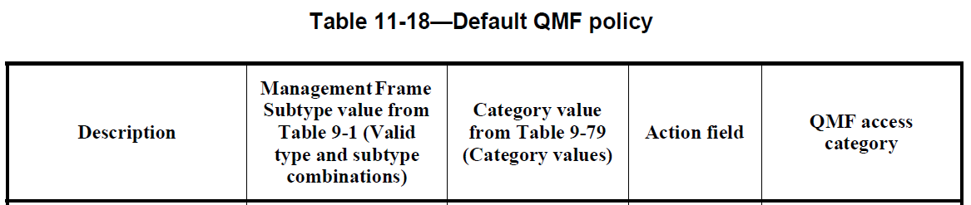
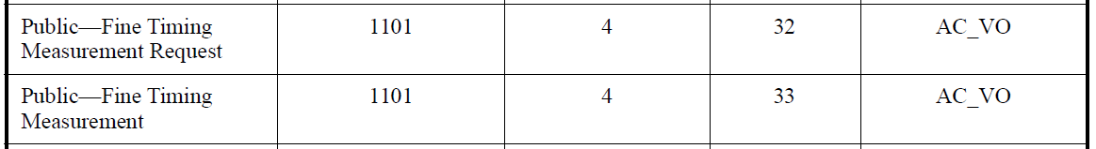
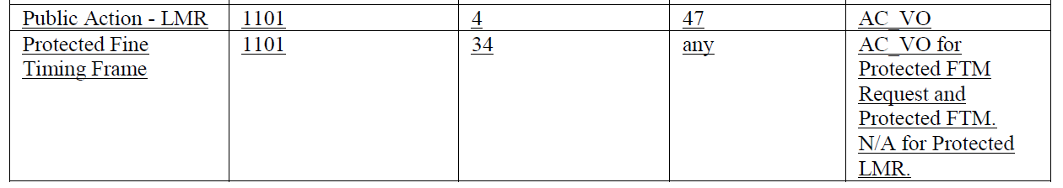
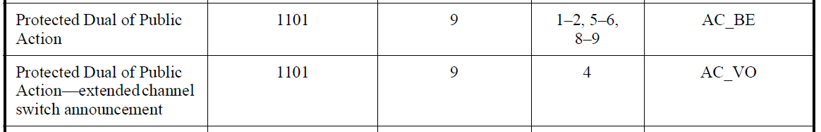
Backup: Default QMF policy
4.5.6.2 Quality-of-service management frame support: A QMF STA uses access category AC_VO to transmit Management frames to STAs that do not support the QMF service.
11.24.1.2 Default QMF policy: QMFs not included in this table shall be assigned an access category AC_BE.
Chaoming Luo (OPPO)

Slide 15
Backup: LMR
9.6.7.49 Location Measurement Report (LMR) frame format: The LMR frame is an Action No Ack frame of category Public.
9.6.34.1 Protected Fine Timing Frame Action field: A protected LMR frame. The format of the frame after the action field is identical to the format of LMR public action 9.6.7.49 (LMR frame format). It is carried in a Management Action No Ack frame.
Chaoming Luo (OPPO)

