Slide 1
Encrypted measurement in WLAN sensing at 60GHz
Date: 2022-3-28
Authors:
Name | Affiliation | Address | Phone | Name
Rui Du | Huawei Technologies Co. Ltd | F3, Huawei Base, Shenzhen, China |  | ray.du@huawei.com
Naren
Mengshi Hu
Stephen McCann
Michael Montemurro
Notes:
September 2012

Slide 2
Outline
Abstract
Security problem in WLAN sensing
Channel estimation in WLAN sensing
How can we realize it in WLAN sensing ?
Simulation validation
Why 60 GHz?
Summary
SP

Slide 3
1. Abstract
    Security is a problem that needs to be considered in the daily application of WLAN Sensing.
    From the perspective of security, in some applications, it is better to keep the sensing results only can be understood by the sensing initiator, but not the unintended STAs and/or the sensing responder.
    In this contribution, an approach is proposed to realize the encrypted measurement and feedback at 60GHz.

Slide 4
2. Security problem in WLAN sensing
    If sensing initiator is also the sensing receiver, no feedback is needed.
    Who can measure the channel and get the real sensing result:
      Sensing initiator/receiver, unintended STAs
    Secure TRN/LTF could be used in this case for security/privacy consideration, so that unintended STAs cannot can get the real sensing result (e.g., for the TRN part).
    If sensing initiator is also the sensing transmitter, feedback maybe needed.
    Who can measure the channel and get the real sensing result:
      Sensing initiator/transmitter, Sensing responder/receiver, unintended STAs
    In this case, Secure TRN/LTF cannot be used to prevent Sensing responder/receiver to get the real sensing result. And this is the issue we want to discuss.

Slide 5
3. Channel estimation in WLAN sensing
    A simple description of the channel estimation is shown here.
    A Certain sequence (e.g. TRN) is transmitted.
    The signal received at the receiver is the production of the transmitted sequence and the channel H (in frequency domain).
    The receiver estimates the channel with a reference sequence (e.g. TRN).
      Usually, the reference sequence is the same as the sequence transmitted by transmitter, and H could be estimated correctly with typical channel estimation methods.

Slide 6
4. How can we realize it in WLAN sensing ?
Sensing initiator/transmitter transmits DMG measurement setup request (with encrypted measurement indicated).
Sensing responder/receiver responds DMG measurement setup response (indicating ’agree’).
    DMG Sensing PPDU with TRN1 (e.g., TRN1 is masked TRN) is transmitted.
    The signal received at the receiver is the production of TRN1 and the channel H (in frequency domain).
    Based on the TRN, the receiver would estimate the channel H’, which includes the information of channel H and the difference between TRN1 and TRN.
    Receiver can not get the real channel H, but only get H', because it has no information about TRN1.
    Transmitter know TRN 1 and TRN, H' can be corrected to H to perform sensing.

Slide 7
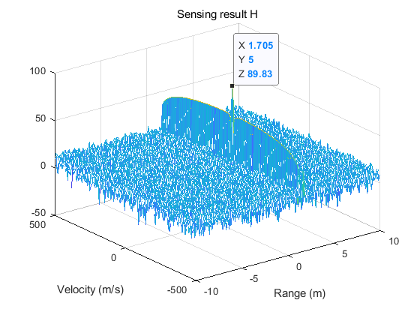
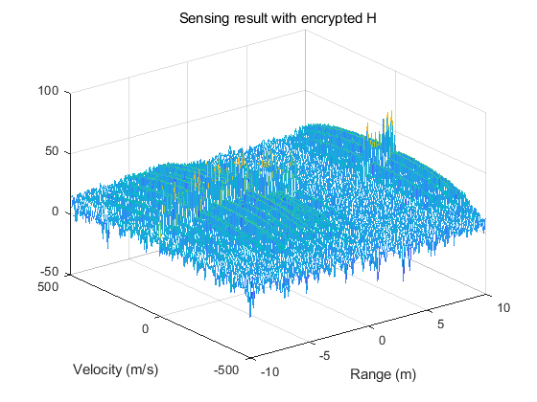

5. Simulation validation
    Sensing with H (Ground truth)
    Sensing with H’ (Receiver)
    Sensing with corrected H (Transmitter)
    One single target (1.7m, 5m/s) is simulated in this simulation.
    The left figure shows the sensing result processed with H which is the ground truth.
    The middle figure shows the sensing result processed with H’(encrypted H) at receiver.
    The right figure show the sensing result processed with corrected H at the transmitter.
    So, with the proposed method, sensing only can be performed correctly at the sensing initiator/transmitter.

Slide 8
6. Why 60 GHz?
    Generally, DMG sensing PPDU will have a similar structure as above.
    The Preamble and Data part will be sent to the sensing receiver along the LOS(or best path) and a TRN will be sent to different directions for sensing.
    With the proposed approach, the sensing responder/receiver is not able to achieve the correct channel measurement (and perform sensing) based on the TRN, it is only able to get the channel estimation result with the preamble.
    But please note:
      although the receiver is still able to get the correct channel measurement result with the preamble, the information is very limited (just one direction).
      and, if the best path is the LOS or near LOS, sensing performance degrades a lot near the LOS due to the poor sensing geometry (the triangle of transmitter, target and receiver). When the bistatic angle approaches 180°, this is a typical forward scattering mode and the estimation of range and doppler is degraded.

Slide 9
7. Summary
A approach that can fulfill encrypted measurement at 60 GHz is proposed in this contribution.
With the proposed approach,
  Only sensing initiator/transmitter can get the real sensing result
  The sensing responder/receiver and the unintended STAs is not able to interpret the sensing.
This approach would also address privacy requirements of the measurements.

Slide 10
SP
Do you support to add the following to 11bf SFD ?
DMG encrypted measurement proposed in slide 6 should be considered in 11bf .
Yes
No
Abs
'

Slide 11
Backup: secure LTF procedure in 11az
'

