Slide 1
Updated Proposal on CSI Formatting for the Sensing Measurement Report
Date: 2022-04-14
Authors:
Name | Affiliations | email
Steve Shellhammer | Qualcomm | shellhammer@ieee.org
Bin Tian |  | btian@qti.qualcomm.com
Qinghua Li | Intel | qinghua.li@intel.com
Christian Berger | NXP | christian.berger@nxp.com

Slide 2
Background
There have been several presentations on CSI formatting for the Sensing Measurement Report [1-7]
Here we have brought together ideas from these presentations into an updated CSI formatting proposal
Outline of this New Proposal
  Per-TX/RF Antenna Pair (per-Link) Scaling
  Fractional Scaling Factor
  Proposals on supported values of Ng
  Proposal on supported values of Nb
  Channel Smoothing rule

Slide 3
1. Per-TX/RX Antenna Pair (per-Link) Scaling
In 802.11n the set of CSI values which share the same scaling factor is the set of in-phase and quadrature values of the MIMO matrix for a given subcarrier (tone)
In [5] it was proposed to use per-TX/RX Antenna Pair scaling (also called per-Link scaling) where the set of CSI values which share the same scaling value are the in-phase or quadrature values of a given TX/RX Pair of antennas
This approach works well even when there is a power imbalance between receive antennas [5]
Also, fewer scaling factors are required in the Sensing Measurement Report
  As an example, in an 80 MHz 2x2 MIMO system with Ng=4, there are four scaling factors needed for per-TX/RX Antenna Pair scaling and 250 scaling factors needed for per-Tone scaling
Here we propose to use per-TX/RX Antenna Pair scaling in the Sensing Measurement Report

Slide 4
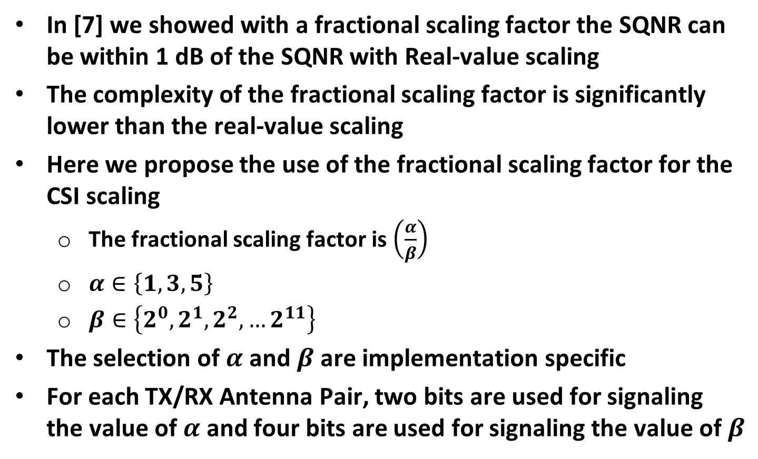
2. Fractional Scaling Factor
In [7] we showed with a fractional scaling factor the SQNR can be within 1 dB of the SQNR with Real-value scaling
The complexity of the fractional scaling factor is significantly lower than the real-value scaling
Here we propose the use of the fractional scaling factor for the CSI scaling
  The fractional scaling factor is $\left(\frac{α}{β}\right)$
  $α∈\left\{1, 3, 5\right\}$
  $β∈\left\{2^{0}, 2^{1}, 2^{2}, …2^{11}\right\}$
The selection of $α$ and $β$ are implementation specific
For each TX/RX Antenna Pair, two bits are used for signaling the value of $α$ and four bits are used for signaling the value of $β$

Slide 5
3. Supported Values of Ng
The IEEE 802.11 standard currently specifies Ng values of 4 and 16
In general, we think these are the values of Ng which we should support in 11bf
However, for cases of large bandwidth and large number of antennas, the memory requirements can become prohibitively large
For large bandwidth and large number of TX antennas we recommend a minimum Ng value of 8 versus 4
  The memory size also grows with the number of receive antennas, but implementations with more receive antennas are generally implemented with larger memory, so we do not think the number of RX antennas should affect the Ng values
Ng = 8 is obtained by decimating the Ng = 4 case (See next slide)
Note, this is all referenced to 4x LTF numerology

Slide 6
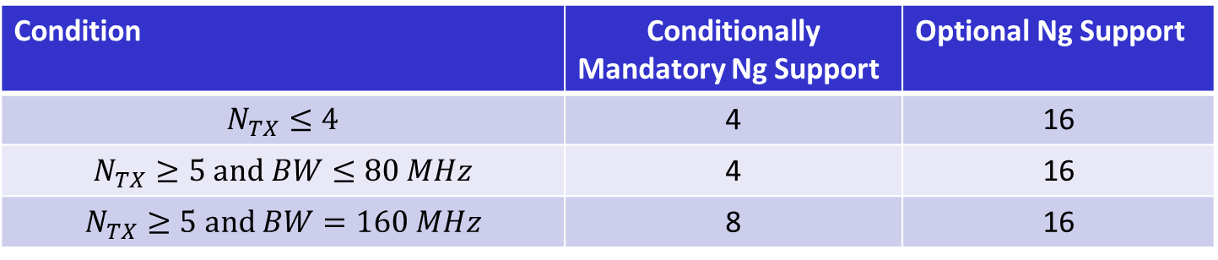
3. Supported Values of Ng (cont.)
If a STA supports the Sensing Measurement report, we propose the following conditionally mandatory and optional Ng value support in 802.11bf based on the following conditions
Condition | Conditionally Mandatory Ng Support | Optional Ng Support
$N_{TX}≤4$ | 4 | 16
$$N_{TX}≥5 and BW≤80 MHz$$ | 4 | 16
$$N_{TX}≥5 and BW=160 MHz$$ | 8 | 16
The indices for Ng = 8 are based on decimating the Ng = 4 indices by 2x, and are provided in the following table
Channel Width | Ng | Indices
160 MHz | 8 | -1012, -1004, … -20, -12, 12, 20, … 1004, 1012

Slide 7
4. Supported Values of Nb
The word size for the in-phase and quadrature CSI values is referred to as Nb
Simulations [6,7] show Nb values of 8 and 10 bits cover the required SQNR levels
The mean SQNR from simulations [7] are:
  Nb = 8 bits. Mean SQNR = 43 dB
  Nb = 10 bits. Mean SQNR = 55 dB
We recommend the Nb = 8 and 10 be supported in the Sensing Measurement report

Slide 8
5. Channel Smoothing Rule
In some circumstances channel smoothing is applied for beamforming
Similarly, it may make sense to apply channel smoothing for some RF Sensing applications
Signaling is currently supported to indicate when channel smoothing is not allowed (See backup)
We recommend that this same rule be applied in 802.11bf for channel smoothing for the Sensing Measurement report

Slide 9
Straw Poll #1
Do you agree to add the following to the 11bf SFD?
  In the formatting of the Sensing Measurement report all the in-phase and quadrature components of each of the tones of the CSI from a given measurement instance for a given TX/RX antenna pair, shall be scaled with the same value.

Slide 10
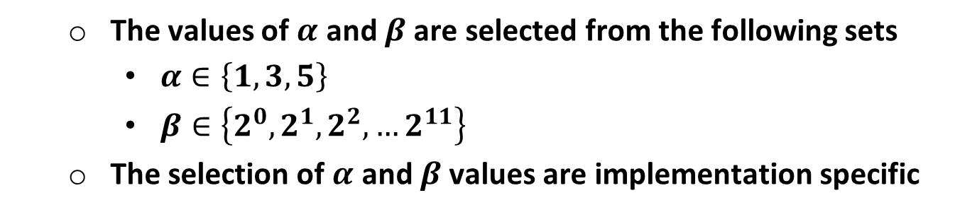
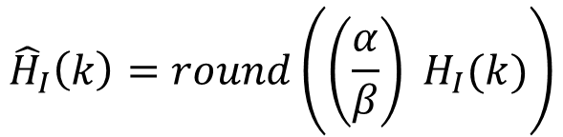
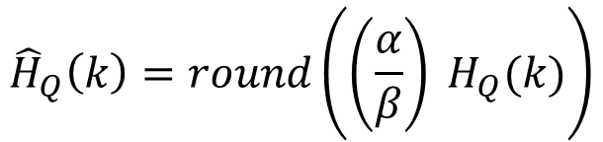
Straw Poll #2
Do you agree to add the following to the 11bf SFD?
  In the formatting of the Sensing Measurement report the scaling and quantizing of the in-phase and quadrature CSI components will be according to the following two equations
$${\hat{H}}_{I}\left(k\right)=round\left(\left(\frac{α}{β}\right) H_{I}(k)\right)$$
$${\hat{H}}_{Q}\left(k\right)=round\left(\left(\frac{α}{β}\right) H_{Q}(k)\right)$$
  The values of $α$ and $β$ are selected from the following sets
    $α∈\left\{1, 3, 5\right\}$
    $β∈\left\{2^{0}, 2^{1}, 2^{2}, …2^{11}\right\}$
  The selection of $α$ and $β$ values are implementation specific

Slide 11
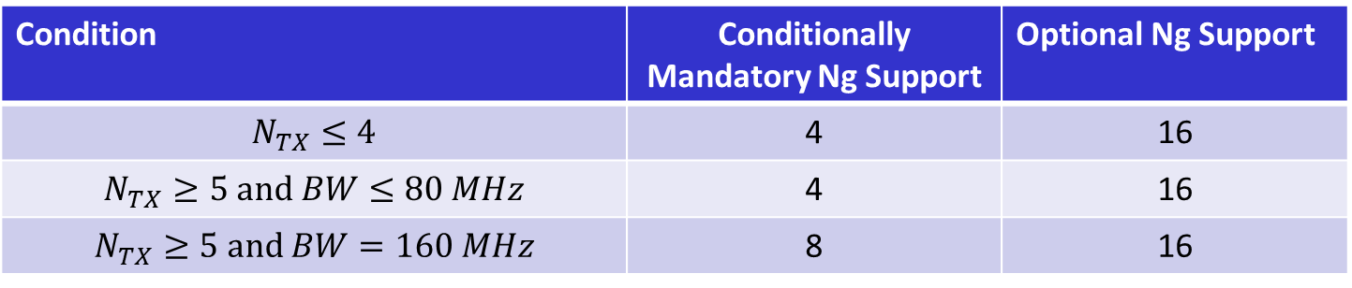
Straw Poll #3
Do you agree to add the following to the 11bf SFD?
  If a STA supports the Sensing Measurement report, then the conditionally mandatory and optional supported values of Ng in the Sensing Measurement report shall depend on the number of transmit antennas and the NDP bandwidth according to the following table:
Condition | Conditionally Mandatory Ng Support | Optional Ng Support
$N_{TX}≤4$ | 4 | 16
$$N_{TX}≥5 and BW≤80 MHz$$ | 4 | 16
$$N_{TX}≥5 and BW=160 MHz$$ | 8 | 16
  The indices for the Ng = 8 for a 160 MHz NDP are specified in the following table:
Channel Width | Ng | Indices
160 MHz | 8 | -1012, -1004, … -20, -12, 12, 20, … 1004, 1012

Slide 12
Straw Poll #4
Do you agree to add the following to the 11bf SFD?
  The Sensing Measurement report shall support word size values for the in-phase and quadrature components of the scaled CSI of both Nb = 8 and Nb = 10 bits.

Slide 13
Straw Poll #5
Do you agree to add the following to the 11bf SFD?
  Smoothing should not be applied prior to scaling and quantization in the CSI formatting for the Sensing Measurement Report, when the beamforming bit in the NDP is set to 1.

Slide 14
References
Steve Shellhammer, et. al., “Low-Complexity Scaling and Quantization for CSI Report,” IEEE 802.11-21/1573r0, September 2021
Steve Shellhammer, “Quantization Error Analysis for CSI Report,” IEEE 802.11-21/1595r0, October 2021
Junghoon Suh, et. al., “Simplified Scaling Factor Feedback for CSI Matrices Quantization,” IEEE 802.11-21/1676r1, October 2021
Rojan Chitrakar, et. al., “Partial CSI Feedback,” IEEE 802.11-21/1921r0, November 2021
Qinghua Li, et. al., “Per-Link Quantization for CSI Reporting,” IEEE 802.11-21/2036, December 2021
Christian Berger, “CSI Feedback Format,” IEEE 802.11-22/XXXXr0, January 2022
Steve Shellhammer, et. al., “Fractional Scaling Factor for Sensing Measurement Report,” IEEE 802.11-22/414r0, March 2022

Slide 15
Backup

Slide 16
Standard Text on Channel Smoothing
HE NDP
“If the Beamformed field in the HE-SIG-A field of an HE sounding NDP is 1, then the receiver of the HE sounding NDP should not perform channel smoothing when generating the compressed beamforming feedback report.” This is B10 of HE-SIG-A2 within the NDP.
EHT NDP
“If the Beamforming field in EHT-SIG of an EHT sounding NDP is 1, then the receiver of the EHT sounding NDP should not perform channel smoothing when generating the compressed beamforming feedback report.” This is B13 in the Common field of the EHT-SIG within the NDP.

Slide 17
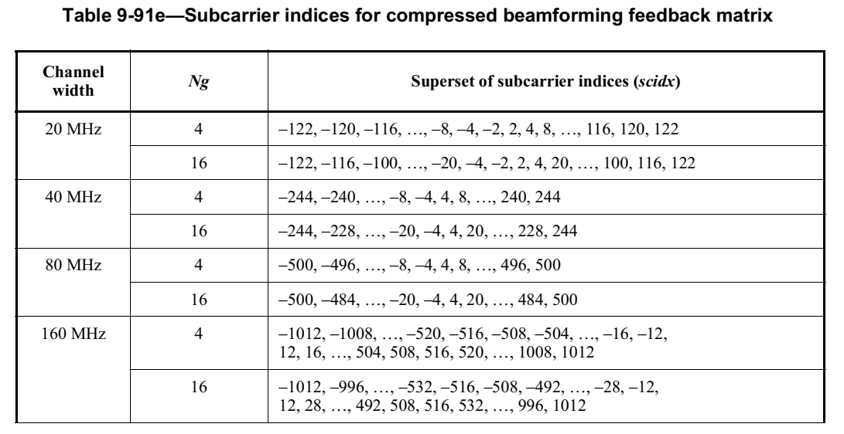
Background
The 802.11 standard specifies Ng = 4, 16
Here we focus on full-bandwidth NDP
To specify the Ng = 8 indices we will decimate (by 2x) the Ng = 4 indices

