Slide 1
TGme April 2022 Adhoc – Supplementary Information

Slide 2
InterDigital - Meeting Facility
Location: 111 W 33rd Street, New York, NY 10120
Walking distance from New York Pennsylvania Station (1/2 block)
Penn Station: Amtrak, NJT, LIRR, PATH, NYC Subway (A, C, E, 1, 2, 3)
Three Major Airports JFK, LGA, EWR
Multiple public transport options from airports to Penn: train, bus, taxi, Limo
Numerous hotels and restaurants – walking distance and via tansit
Conference Room:
Accommodate 8 people with current Covid-19 restrictions (16 without)
Audio/Visual/Conferencing resources - Internet connectivity

Slide 3
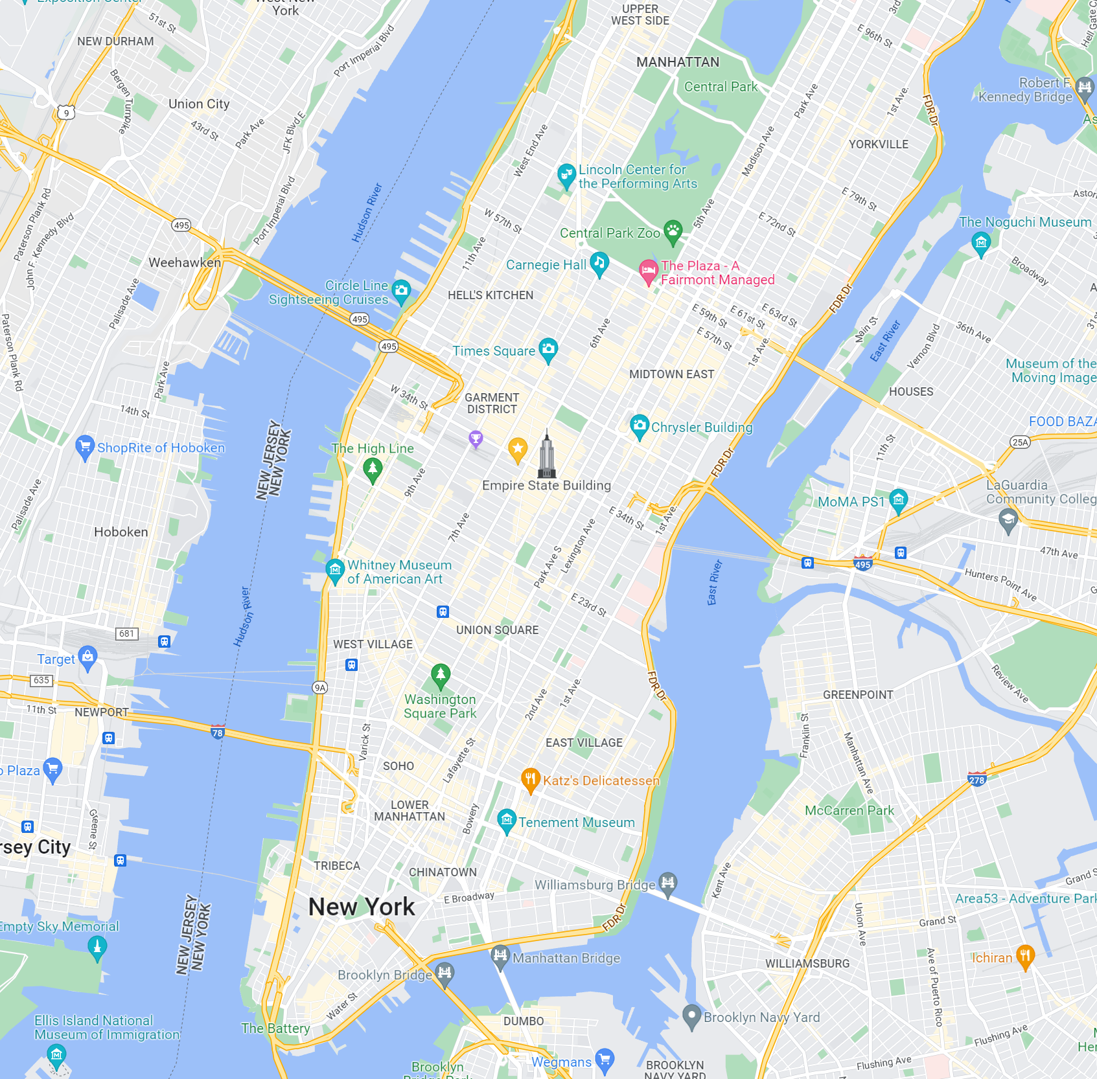
Location
Pen Station
InterDigital
111 W 33rd St.

Slide 4
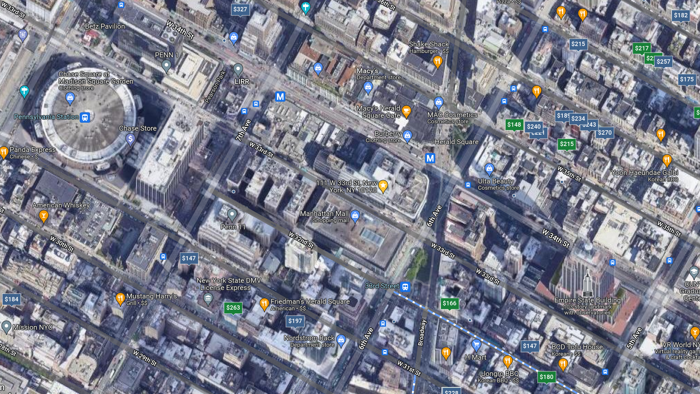

Slide 5
Covid-19 Restrictions (details)
InterDigital:
Attendees must certify that they are vaccinated (no documentation required)
All attendees must wear a mask when in the building
“Social Distancing” should be maintained
Entry to InterDigital requires attendees to use the ENVOY app – to certify they:
Do not have symptoms of COVID-19
Within 14 days have not been in close contact with anyone who has tested positive for Covid-19
Within 14 day they have not tested positive for Covid-19 or if they have they meet the criteria for coming out of isolation
No member of their household (including them) is waiting for results of a COVID-19 test, which was taken because of COVID-19 symptoms.
Will adhere to InterDigital COVID-19 guidelines (regarding masking, vaccination, social distancing)
Acceptance a generic NDA regarding confidential InterDigital information, since no confidential InterDigital information will be discussed or disclosed the NDA is basically a formality
The building has a health and wellness screening requirement, InterDigital is a tenant of the building, the screening may include a temperature check and masking
Drinking and eating are allowed in specific areas if social distancing is observed
Current Masking requirements (2022-03-16):
Masking is not required @ InterDigital
But it is required: When riding public transportation and in stores, restaurants or public spaces where the owner/operator requires mask

