Slide 1
Differential Quantization for CSI Report
Date: 2022-03-15
Authors:
Name | Affiliations | email
Qinghua Li | Intel | Qinghua.li@intel.com
Hao Song |  | Hao.song@intel.com
Xiaogang Chen |  | Xiaogang.c.chen@intel.com
Cheng Chen |  | Cheng.chen@intel.com
Robert Stacey

Slide 2
Outline
Discussions about time-domain TCIR [2]
Frequency-domain differential quantization
Simulations
Conclusions

Slide 3
Time-Domain TCIR
FD channel response
IFFT
Quantizer
Delay
Fed back
Truncated

Slide 4
Assumption
CSI reporter only does simple IFFT and feeds back a few time-domain samples
Multipaths from reflecting objects are of interest
Concern
Signal obtained by simple IFFT differs from the actual multipaths such that the reflecting object of interest can’t be identified

Slide 5
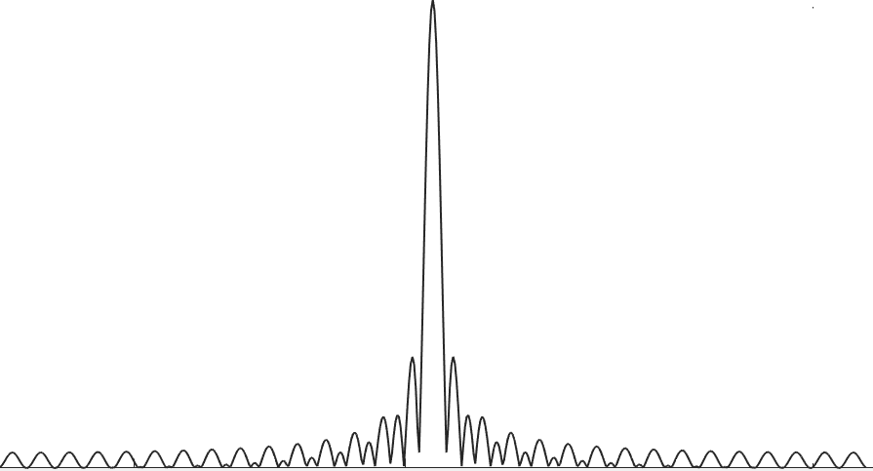
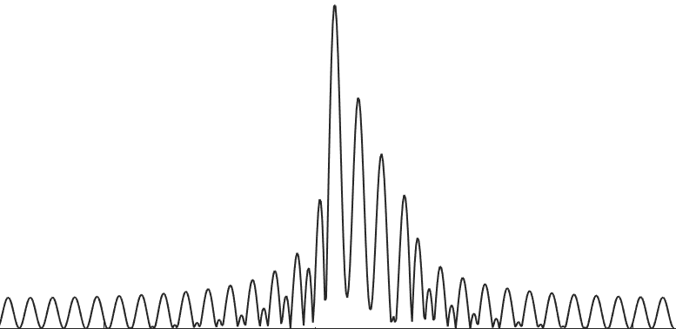

Signal Model
The band limited system serves as a filter concatenated with the multipath channel
The system response can be viewed as another multipath channel that needs to be deconvolved or equalized
$$⨂$$
Multipaths of interest
System impulse response
Channel estimates in time

Slide 6
Long Tail
Side lobe 3 samples away from the peak is still above 10% of the peak
DC
Edge
f

Slide 7
Inter-Path Interference
The impulse response of Tx/Rx system is not time-limited
  The system is band-limited
  No sounding signal on DC and edge tones
  No sounding signal on punctured sub-band
  Discontinuous 80 + 80
  DC notch filtering at Rx
Inter-path interferences are introduced such that interference mitigation is required to identify the multipaths

Slide 8
Ambiguity due to Inconsistent Sampling Time
The same channel results into two different TCIR feedbacks
One main peak
Same object?
Two main peaks

Slide 9
Harder to track variations among multipaths
Which two are the same?
Wraparound side lobes

Slide 10
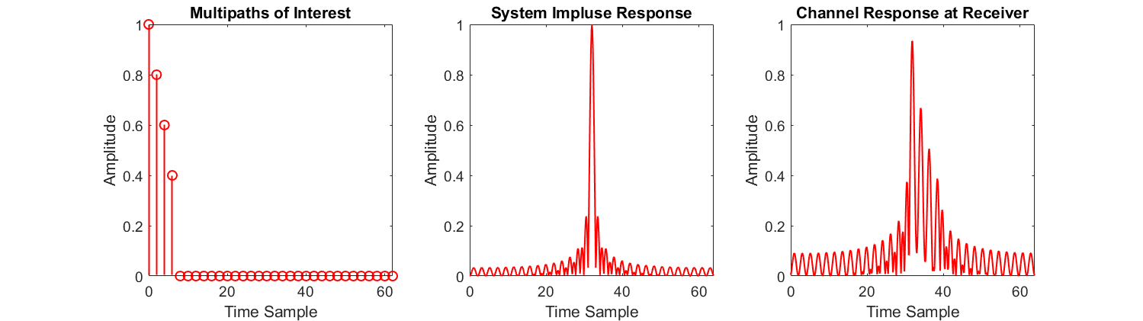
Lack of Identifiability
It is infeasible to identify the multipaths from a few feedback samples

Slide 11
Effect of DC Notching
Receiver filters the time-domain signal for removing DC component

Slide 12
Filtered Signal in Time
The DC notch filter convolves with the channel impulse response and increases the channel memory as if the multipath delay is increased
Increase inter-path interference
Multipaths
DC notch filter
Extended spread

Slide 13
Additional Concerns
The wraparound of the long tails in IFFT window
  Which time samples should be fed back?
Interpolation and extrapolation
  Should DC tones, edge tones, and punctured sub-band be filled before IFFT?

Slide 14
Wraparound Effect of FFT Window
One main peak
Or same object?
Same object?
Two main peaks
Large fake peak

Slide 15
Pros and Cons of TCIR
 | Pros | Cons
Compatibility |  | Incompatible with legacy frequency domain implementation
Complexity |  | High complexity at sounding receiver due to additional IFFT and feedback sample selection
Overhead | Low
Multipath identifiability |  | Poor identifiability and consistency due to inter-path interference, sampling time variation, and FFT window shifting

Slide 16
Frequency Domain Approach
Feed all information back to sounding transmitter with minimum complexity
Be compatible with legacy channel estimation done in frequency domain
Reduce the feedback overhead by frequency domain down sampling
Can further reduce the feedback overhead by differential quantization, exploiting the channel correlation due to the main multipath cluster

Slide 17
Correlation across Frequency
Channel responses of each link are correlated across frequency
The correlation decreases with N_{g} but it always exists thank to the dominant multipath cluster
The correlation can be exploited to improve quantization accuracy
 | N_{g} = 4 | N_{g} = 8 | N_{g} = 16 | N_{g} = 32 | N_{g} = 64
Correlation | 0.95 | 0.90 | 0.82 | 0.55 | 0.32
Feedback subc spacing (MHz) | 0.3125 | 0.625 | 1.25 | 2.5 | 5.0
Dominant cluster provides wideband correlation.
τ
h(f)
f

Slide 18

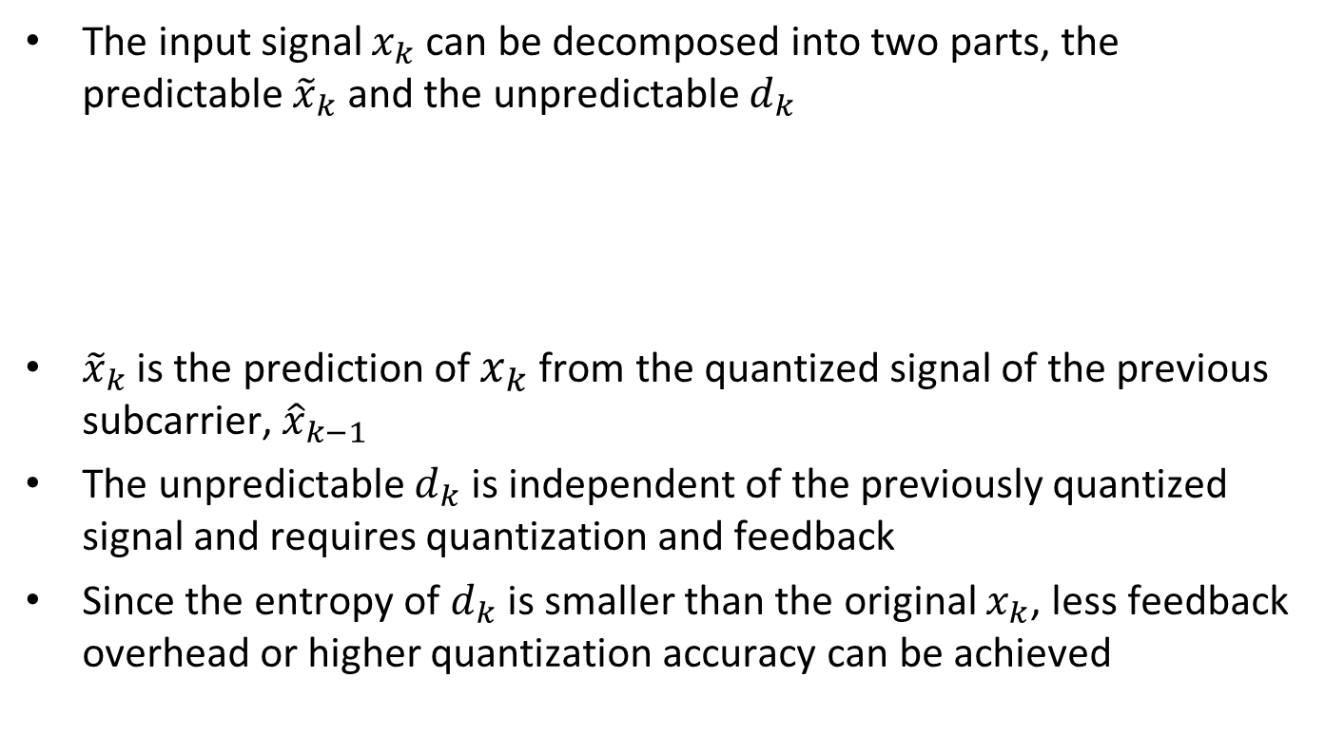


Exploiting the Correlation
The input signal $x_{k}$can be decomposed into two parts, the predictable ${\tilde{x}}_{k}$ and the unpredictable $d_{k}$
${\tilde{x}}_{k}$ is the prediction of $x_{k}$from the quantized signal of the previous subcarrier, ${\hat{x}}_{k−1}$
The unpredictable $d_{k}$ is independent of the previously quantized signal and requires quantization and feedback
Since the entropy of $d_{k}$ is smaller than the original $x_{k}$, less feedback overhead or higher quantization accuracy can be achieved
Predictable part of $x_{k}$
$$x_{k}={\tilde{x}}_{k}+d_{k}$$
Unpredictable part of $x_{k}$

Slide 19


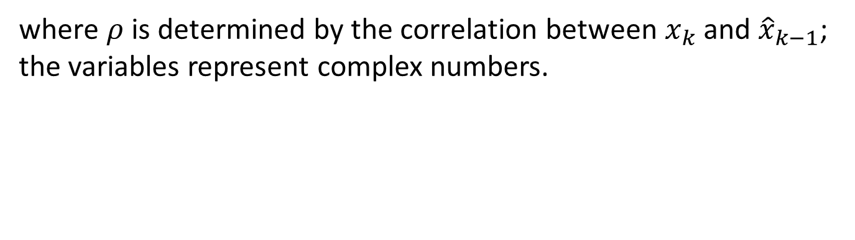
Linear Prediction
Linear prediction of $x_{k}$ using ${\hat{x}}_{k−1}$
Signal model:
$$x_{k}=ρ∙{\hat{x}}_{k−1}+d_{k}$$
Differential signal for quantization:
$$d_{k}=x_{k}−ρ∙{\hat{x}}_{k−1}$$
where $ρ$ is determined by the correlation between $x_{k}$ and ${\hat{x}}_{k−1}$; the variables represent complex numbers.

Slide 20
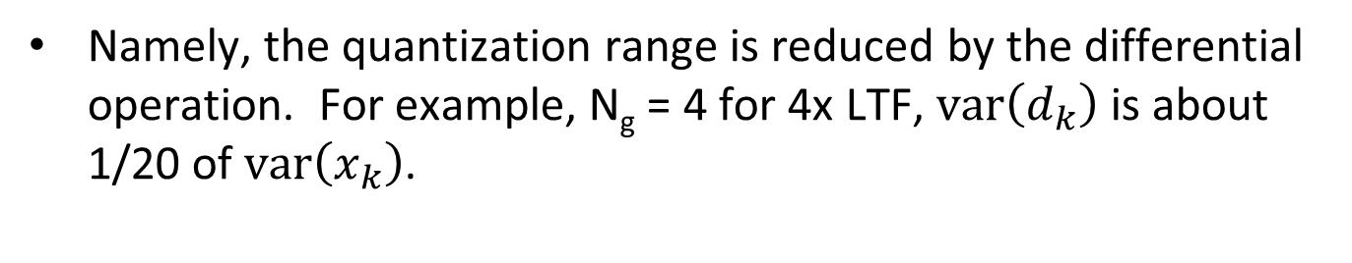

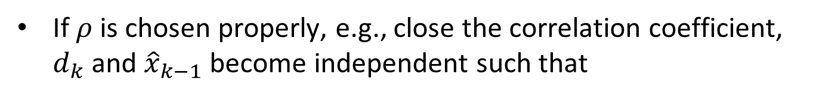


Reduction of Quantization Range
$$x_{k}=ρ∙{\hat{x}}_{k−1}+d_{k}$$
$$d_{k}=x_{k}−ρ∙{\hat{x}}_{k−1}$$
If $ρ$ is chosen properly, e.g., close the correlation coefficient, $d_{k}$ and ${\hat{x}}_{k−1}$ become independent such that
$$var\left(x_{k}\right)=var\left(ρ∙{\hat{x}}_{k−1}\right)+var\left(d_{k}\right)$$
and
$$var\left(x_{k}\right)≥var\left(d_{k}\right)$$
Namely, the quantization range is reduced by the differential operation. For example, N_{g} = 4 for 4x LTF, $var\left(d_{k}\right)$ is about 1/20 of $var\left(x_{k}\right)$.

Slide 21





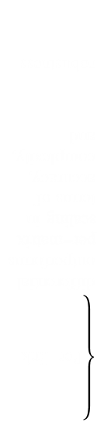






Differential Quantization
Quantization:
$$\left\{\text{Per}\text{−}\text{link} \text{differential} \text{outperforms} \text{per}\text{−}\text{matrix} \text{scaling} \text{in} \text{terms} \text{of} \text{accuracy}\text{, }\text{complexity}\text{, }\text{and} \text{robustness} \begin{matrix} \\ \begin{matrix} \\ \\ \begin{matrix} \\ \\ \end{matrix}\end{matrix} \\ \begin{matrix} \\ \\ \end{matrix}\end{matrix}\right.$$
$$d_{k}=x_{k}−ρ∙{\hat{x}}_{k−1} \underset{→}{Quantize I and Q} {\hat{d}}_{k}$$
Reconstruction:
$${\hat{x}}_{k}=ρ∙{\hat{x}}_{k−1}+{\hat{d}}_{k}$$
$${\hat{x}}_{k}$$
$$x_{k}$$
$$x_{k+1}$$
$$d_{k}$$
$${\hat{x}}_{k−1}$$
$$[2σ_{d},4σ_{d}]$$
$$x_{k−1}$$
$$∆$$
f

Slide 22

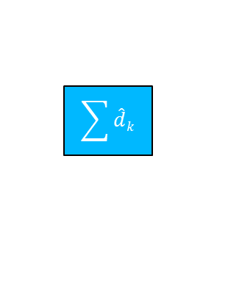
Differential vs Non-Differential
Non-Differential
Quantizer
Differential
$$\sum{\hat{d}k}$$
$$ρ$$
-
Quantizer

Slide 23

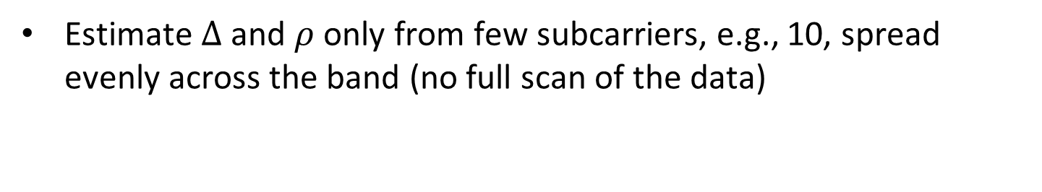


Complexity Reduction
Estimate $∆$and $ρ$ only from few subcarriers, e.g., 10, spread evenly across the band (no full scan of the data)
$$mean\left(\left|d_{1}\right|,⋯,\left|d_{Q}\right|\right)$$
$$→$$
$$∆$$
d_{Q}
d₁
d₂
f

Slide 24
Simulation Configuration (1/2)
Channel D, NLOS, 80 MHz, MIMO with 4 Tx and 2 Rx antennas
4x LFT with DC notch filtering, subcarrier spacing 78.125 kHz
Four schemes are simulated with N_{b} = 6 and N_{p} = 3
  Per-matrix scaling quantization, “Low Complexity Scaling and Quantization” in [1], 3+2x8x6 = 99 bits per H
  802.11n, 3+2x8x6 = 99 bits per H
  FD differential quantization, 2x8x6 = 96 bits per H
  TCIR [2] with the same total number of feedback bits as FD diff. quantization
 | N_{g} = 4 | N_{g} = 8 | N_{g} = 16
Correlation | 0.95 | 0.90 | 0.82
Feedback subc spacing (MHz) | 0.3125 | 0.625 | 1.25

Slide 25
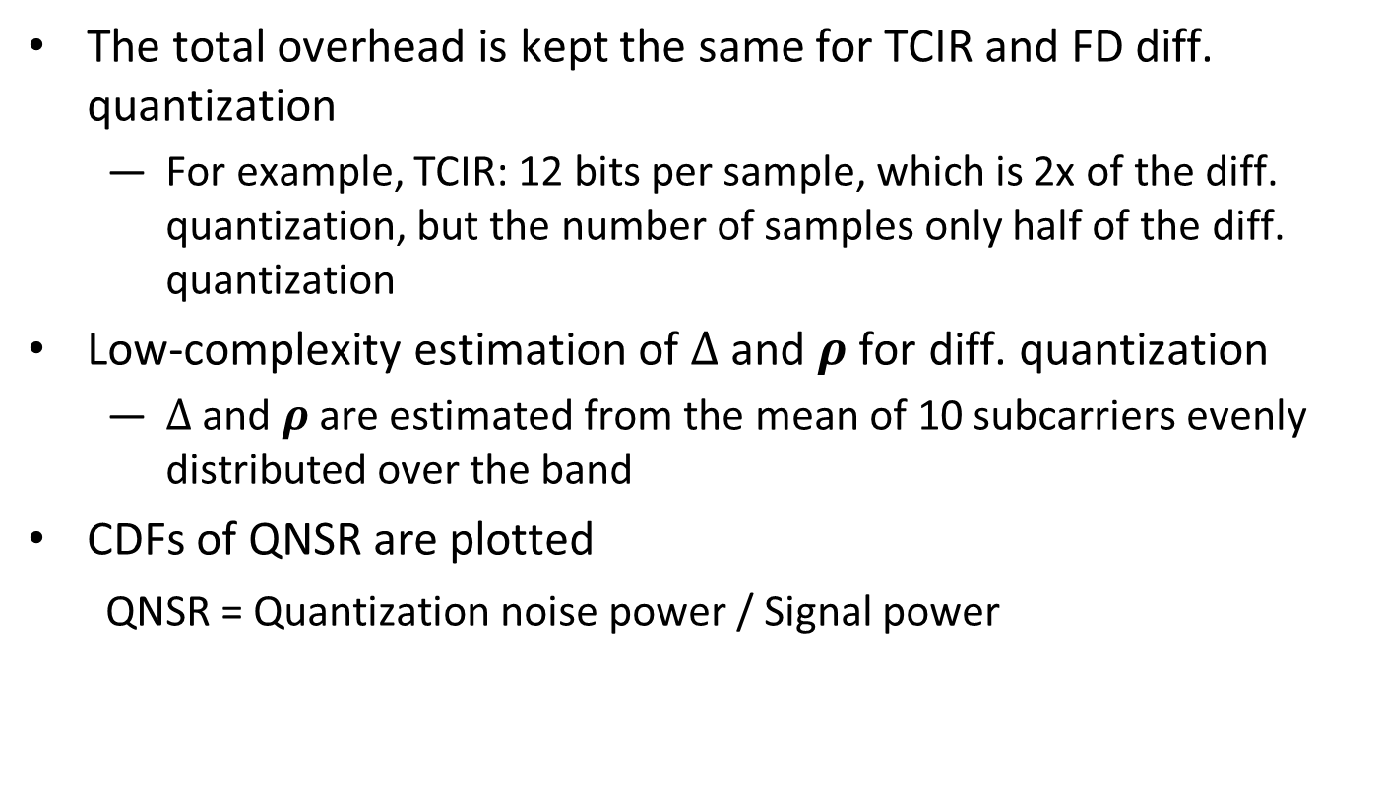
Simulation Configuration (2/2)
The total overhead is kept the same for TCIR and FD diff. quantization
  For example, TCIR: 12 bits per sample, which is 2x of the diff. quantization, but the number of samples only half of the diff. quantization
Low-complexity estimation of $∆$ and $ρ$ for diff. quantization
  $∆$ and $ρ$ are estimated from the mean of 10 subcarriers evenly distributed over the band
CDFs of QNSR are plotted
QNSR = Quantization noise power / Signal power

Slide 26
N_{b} = 6, Ng = 4
With the same feedback overhead, differential quantization and TCIR deliver the highest accuracy

Slide 27
TCIR with different numbers of time samples
Feeding back time samples of 1.6 μs performs the best for Channel Model D

Slide 28
6-bit Differential vs 3-bit Non-Differential
Differential quantization cuts the feedback overhead by half

Slide 29
Conclusions
Time-domain TCIR is incompatible with existing transceiver implementation and incurs high complexity, e.g., IFFT and sample selection. Issues like sample selection need to be addressed for TCIR
In contrast, frequency-domain differential quantization is straightforward and fully compatible with the existing implementation
Frequency-domain differential quantization can either increase the feedback accuracy or cut the feedback overhead by half as compared with non-differential frequency-domain schemes

Slide 30
References
Steve Shellhammer, et al., “Low-Complexity Scaling and Quantization for CSI Report,” IEEE 802.11-21/1573r0, September 2021
Rui Du, et al., “Truncated Power Delay Profile - follow up,” IEEE 802.11-21/1288r5, February 2022

Slide 31
Straw Poll 1
Do you support to include frequency-domain differential quantization as an optional mode for 11bf CSI report?
Y/N/A

