Slide 1
EN 301 893 & 5.8 GHz
Date: 2022-03-11
Authors:

Slide 2
Confidentiality
IEEE-SA
To members of a group developing a standard, draft standards are accessible free of charge
  IEEE-SA depends on the revenue from selling draft and final standards
At IEEE 802, contribution documents are accessible to everyone
ETSI
To members of a group developing a Work Item document, drafts are accessible free of charge
  Draft HSs become accessible to everyone once they are in EN Approval Procedure (ENAP)
At ETSI, access to contribution documents are limited to ETSI members
Access to ETSI’s draft HSs is a privilege granted to IEEE
Please respect the confidentiality of these document and do not make them publicly accessible

Slide 3
Harmonized Standard (HS) EN 301 893
In the EU, manufacturers may use HSs listed in the Official Journal of the EU (OJEU) to put products on the EU market
  To put a product on the EU market, a manufacturer must provide a declaration of conformity that its product complies with all requirements of the related HS
Alternatively, a notified body may approve a manufacturer to put its product on the EU market
Currently, version 2.1.1 of EN 301 893 is listed in the OJEU
At present, ETSI TC BRAN develops a revision of this HS
  As of this month, 2.1.47 is the most recent version
  Because of the memorandum of understanding between ETSI and IEEE, IEEE 802.11 members may access a copy of the HS from the IEEE 802.11 members area

Slide 4
Version 2.1.47 of HS EN 301 893
Latest draft removes a long list of inconsistencies found in all previous versions
  Fixes issues with arbitrary use of abbreviations, definitions, nomenclature etc.
Provides some modifications to technical requirements
  E. g. channel bonding
Addresses decision of one EU member state (Czech Republic) to open 5.8 GHz for WAS/RLAN
  Wireless Access Systems (WAS) including Radio Local Area Network (RLAN) equipment

Slide 5
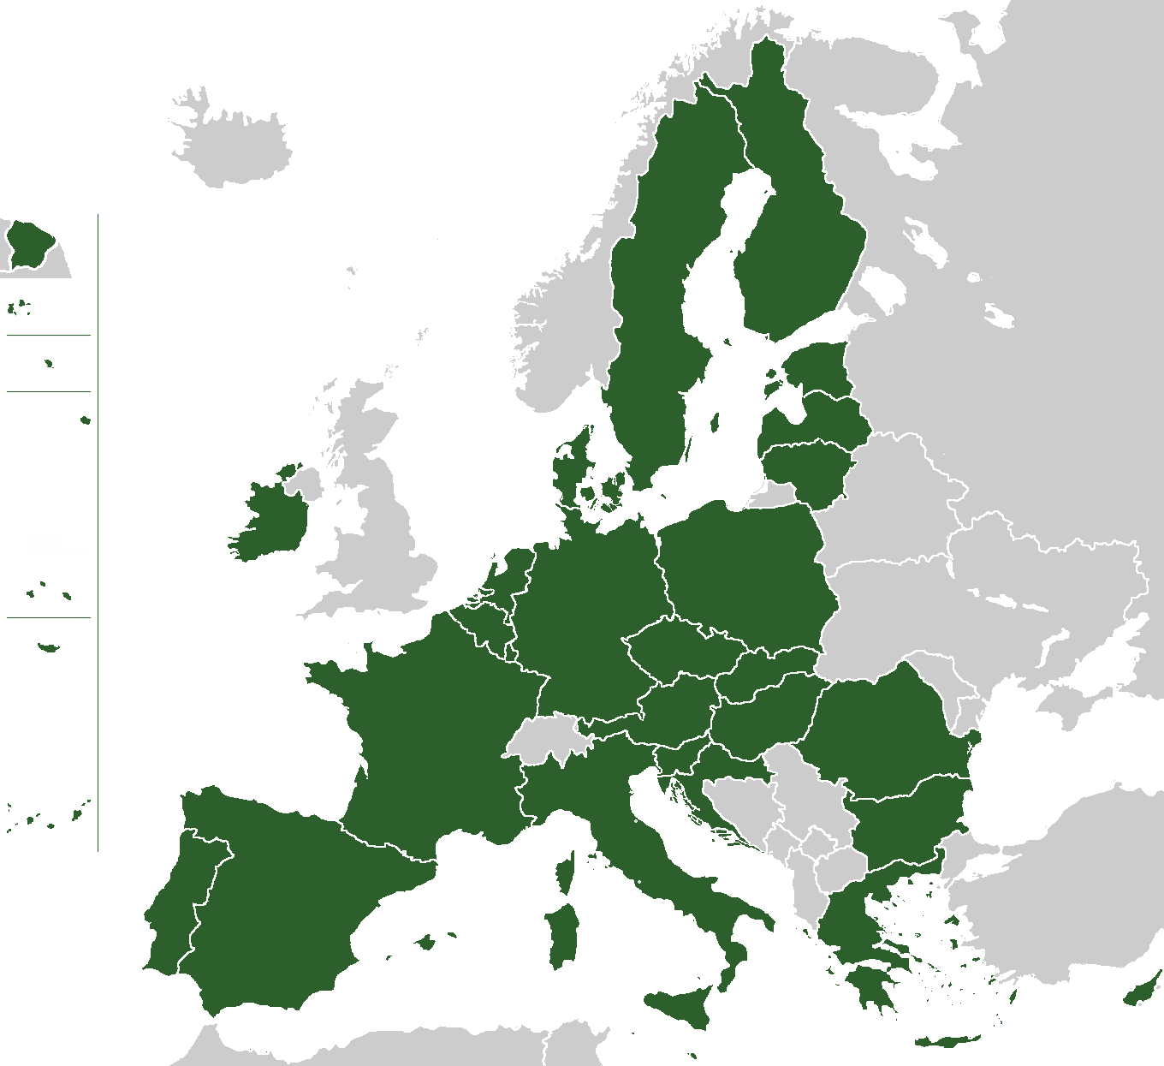
European Union (EU)
EU is a single market
  27 member states
  Ca. 450 million residents
  A product put on the market in any EU member state cannot be stopped from being sold, shipped etc. to any other EU member state
[1]

Slide 6
A brief overview of the 5 GHz band in the EU and US
Dynamic Frequency Selection (DFS)
Transmit Power Control (TPC)
Intelligent Transportation System (ITS)
Short Range Device (SRD)
Effective Isotropic Radiated Power (EIRP)
Broadband Fixed Wireless Access (BFWA)

Slide 7
Radio regulation
Electronic Communications Committee (ECC) consists of 48 countries
  “The ECC considers and develops policies on electronic communications activities in European context, taking account of European and international legislations and regulations”
EU member states responsible for national spectrum regulation
  ECC decisions provide guidance
  EU member states may voluntarily implement ECC decisions
On the basis of EU treaties, member states are required to implement the European Commission’s (EC’s) spectrum decisions into national law
  Such EC decisions are published in the OJEU
  For example, EU 2022/179 contains most recent decision regarding 5 GHz license-exempt band

Slide 8
5.8 GHz in the EU
EN 301 893 covers 5.15 GHz to 5.35 GHz and 5.47 GHz to 5.725 GHz bands
Czech Republic permits WAS/RLAN operation in 5.725 GHz to 5.85 GHz band
  WAS/RLAN is secondary service
  Up to 30 dBm EIRP
  With >23 dBm EIRP, registration with Czech authority necessary
    Operator name, position of device, unique identifier (MAC address) of device etc.
  Not within 1.8 km of Czech borders
At ETSI TC BRAN, other EU member states expressed concerns because of the single EU market
  Not possible to prevent products sold in Czech Republic to reach other EU states
  Operating 5.8 GHz RLAN in other countries would cause interference to services assigned to this band

Slide 9
EN 301 893, Annex B
ETSI TC BRAN developed 5.8 GHz related Annex
  Operation above SRD power (>25 mW) level requires Country Determination Capability (CDC)
CDC is mandatory for 5.8 GHz operation
  Devices must not operate in 5.8 GHz if country cannot be determined or determined country prohibits use of the band
Channel bonding with lower bands is permitted
  Rules for each band apply
No technical requirements how to implement CDC
  Implementations might rely on GNSS, cellular information, IP geolocation etc.
  Decision left to manufacturer
Annex B contains detailed CDC test procedure
  Devices must cease operation if no “location” information is provided, or country determined does not permit use of 5.8 GHz

Slide 10
References
User:rony, “European Union.png,” accessed Mar. 2022, [Online]. Available: https://commons.wikimedia.org/wiki/File:European_Union.png

