Slide 1
(Re)Assoc Protection for 11bi
Date: 2022-03-08
Authors:

Slide 2
Problem Statement
Elements included in the (Re)Association Req/Resp are sent in-the-clear, which may leak privacy info:
E.g., certain device carries certain capabilities combinations
Also [1] also

Slide 3
Potential Approach
Encrypt the (Re)Association Req/Resp to hide these elements from finger printing
Challenges:
What encryption schemes? e.g., symmetric key encryption
What keys to use? e.g., TK
How to establish the keys prior to (re)association? e.g., reuse and extend Preassociation security association (PASN)

Slide 4
Proposals
Extend PASN to generate TK for encryption of (Re)Assoc Req/Resp and to replace the key derivation function of the 4-way handshake
PASN with limited set of allowed parameters (so each device will look very similar, which avoids finger printing of the elements)
Real negotiation occurs in RSNE/RSNXE during (re)assoc req/resp (encrypted)
Deliver GTK/IGKT/BIGTK in the encrypted Assoc Response frame
Use the PTKSA generated from the extended PASN for association
See the different AKMs support in later slides

Slide 5
Benefits
Allow (re)assoc to be encrypted with all AKMs
Enables a normal data connectivity at the completion of the association with all AKMs
Addresses some corner cases with retransmission of 4-way handshake messages
Cleaner separation of “actual” authentication and association

Slide 6
Extended PASN

Slide 7
Extended PASN with Different AKMs
Base AKM
PMKSA exists (e.g., PMK caching) | PASN(PMKSA) + (re)assoc req/resp encrypted + GTK/IGTK/BIGTK in (re)assoc resp
SAE | PASN(SAE) + (re)assoc req/resp encrypt + GTK/IGTK/BIGTK in (re)assoc resp
FILS Shared Key | PASN(FILS Shared Key) + (re)assoc req/resp encrypt + GTK/IGTK/BIGTK in (re)assoc resp
FILS Public Key | PASN(FILS Public Key) + (re)assoc req/resp encrypt + GTK/IGTK/BIGTK in (re)assoc resp Extend PASN to support FILS Public Key
FT | PASN(FT) + (re)assoc req/resp encrypt + GTK/IGTK/BIGTK in (re)assoc resp

Slide 8
Extended PASN with Different AKMs (Cont’d)
Base AKM
OWE | PASN(no-auth) + (re)assoc req/resp encrypt + GTK/IGTK/BIGTK in assoc resp
EAP | EAP in Authentication frames to derive PMKSA + PASN(PMKSA) + (re)assoc req/resp encrypt + GTK/IGTK/BIGTK in assoc resp this could simply use a new Authentication frame algorithm and encapsulate the payload of the EAPOL frames (used today only as Data frames only) would need to decide what to do with reauthentication and rekeying during an association (i.e., whether to use EAPOL frames as Data frames like today or Authentication frames.. the latter could be cleaner and would avoid certain synchronization issues with 4-way handshake, but would not encrypt the EAP reauth exchange))
PSK | Replace with SAE

Slide 9
More Detailed Proposals
Encrypt (Re)Assoc req/resp using CCMP/GCMP just like they are used with PMF; needs TK
Include the GTK/IGTK/BIGTK as IEs inside the encrypted (Re)Assoc resp
When using MLO, replace the BSSID with AP MLD MAC address and SPA with the non-AP MLD MAC address
KCK || TK || KDK = KDF-HASH-NNN (PMK, “PASN PTK Derivation”, SPA || BSSID || DHss ->
KCK || TK || KDK = KDF-HASH-NNN (PMK, “PASN PTK Derivation”, non-AP MLD MAC Address || AP MLD MAC Address || DHss

Slide 10
More Detailed Proposals (Cont’d)
Extended PASN
Use a new authentication algorithm to distinguish from the current PASN
Add KEK in PASN keys generation to allow moving to full association without having to do a new 4-way handshake to derive full PTK
Allow the extended PASN-derived PTKSA to be used as the association-PTKSA-for-RSNA

Slide 11
Reference
[1] 11-21/1060r1 Element Fingerprint issue

Slide 12
Backup Slides

Slide 13
PASN Recap
A protocol that provides Authentication, Key Management, Encryption and Message Integrity in unassociated state
PASN
Sets up PTKSA using a 3-message authentication frame exchange
Always initiated by the STA
Enables tunneling of messages of the Base AKM
An RSNA authentication protocol if PMKSA exists for the AKM specified in the Base AKM
A non-RSNA protocol when there is no PMKSA and the corresponding Base AKM used with it

Slide 14
PASN Recap
If PMKSA exists, use the cached PMKSA to generate PASN PTKSA
Else use the PMKSA established by the AKM specified in the Base AKM to generate PASN PTKSA
Base AKM can be one of the followings (as specified in 11az):
FILS shared key
SAE
FT
PASN (non-RSNA, no mutual authentication)

Slide 15
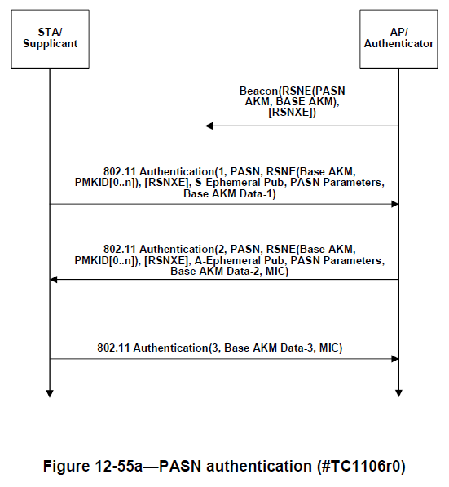
PASN Call Flow

Slide 16
PASN Keys Generation
A successful PASN exchange results in establishment of PTKSA using the ephemeral keys and PMK from the Base AKM (if any)
KCK || TK || KDK = KDF-HASH-NNN (PMK, “PASN PTK Derivation”, SPA || BSSID || DHss):
If the AKM is other than PASN AKM, the PMK = the pairwise master key for the base AKM
If the base AKM is PASN AKM (i.e. the PASN PTKSA is being setup without mutual authentication in a non-RSN), the PMK = “PMKz” padded with 28 0s
KCK is used to protect the 2nd and 3rd PASN frames (generate the MICs)
TK is used for pairwise cipher of subsequent unicast msgs
KDK is to secure the LTF (Long training field)

