Slide 1
Robert Stacey
802.11 WG Vice Chair Candidate
Date: 2022-03-07
Authors:

Slide 2
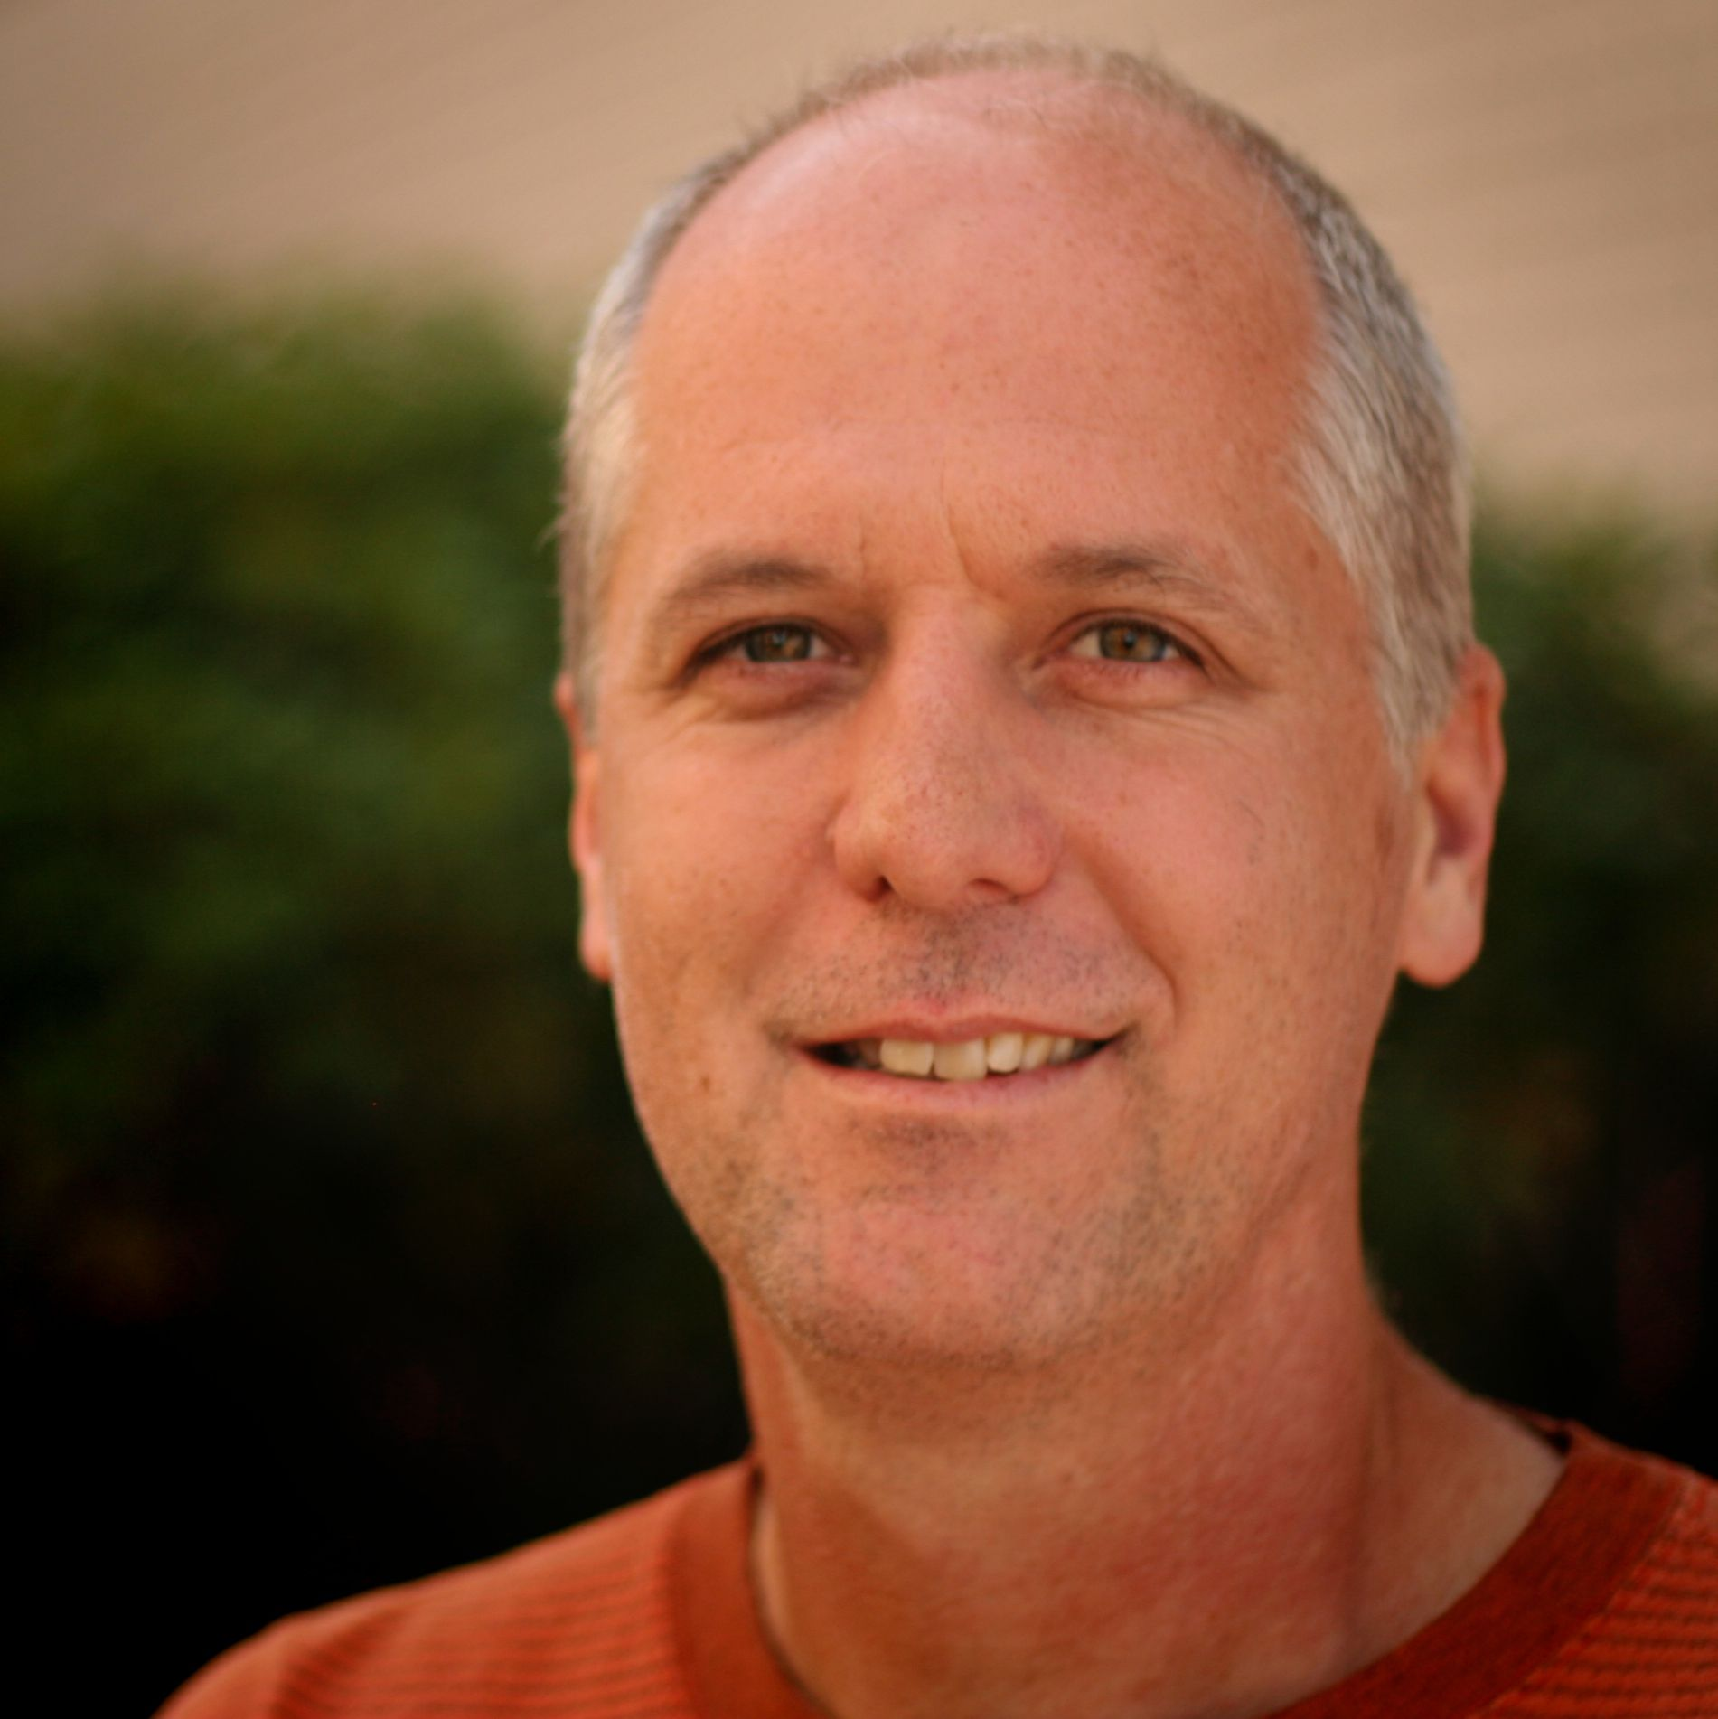
Robert Stacey
802.11 Vice Chair Candidate

Slide 3
Qualifications
802.11 WG Vice Chair since 2018
IEEE SA RevCom member as of this year, 2022
802.11 WG technical editor (2014 – present)
802.11 ANA (2014 – present)
TGax technical editor (2014 – 2021)
TGac technical editor (2009 – 2013)
TGac MU-MIMO ad-hoc co-chair (2009 – 2013)
Active 802.11 member (2003 – present)

Slide 4
I bring to the organization…
A deep understanding of the product we produce --- the technical standard behind a wildly successful innovation that keeps getting better
A deep understanding of our mission and a strong desire further that mission
And most importantly, an ability to support you in furthering that mission
  Support with tools and logistics (comment resolution, online collaboration)
  Support with processes and procedures

Slide 5
Thank You!

