Slide 1
DMG passive sensing based on A-BFT
Date: 2022/3/21
Authors:
Name | Affiliation | Address | Phone | Email
Narengerile | Huawei Technologies Co., Ltd. | Shenzhen, China |  | narengerile@huawei.com
Rui Du
Mengshi Hu
Yan Xin |  | Ottawa, Ontario
Assaf Kasher | Qualcomm

Slide 2
Abstract
Downlink DMG passive sensing:
  In [1], DMG beacon based passive sensing is proposed.
Uplink DMG passive sensing:
  This presentation proposes a method to enable DMG passive sensing based on A-BFT.

Slide 3
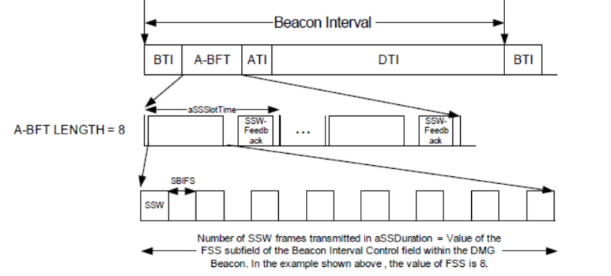
Motivation to use A-BFT for DMG passive sensing
Passive sensing: Transmissions that are not specifically designed for sensing are used by other devices for sensing.
In [1], DMG beacon based passive sensing is proposed.
  Usually in every Beacon interval, e.g., 100 milliseconds.
  DMG Beacon frames.
A-BFT follows the end of a BTI to perform sector-level sweep (SLS), where DMG/EDMG STAs transmit in many directions for R-TXSS.
  SSW frame, or Short SSW PPDU.
A-BFT can be used for passive sensing by AP/PCP.
Notes:
Initial channel access；reconnect

Slide 4
What spec changes do we need?
To make the sensing more effective:
  The sensing device, i.e., AP/PCP, needs to know the direction of the SSW/Short SSW that was transmitted during the A-BFT.
  The sensing device needs to know the location of the STA that transmits the SSW/Short SSW.
By leveraging the Beacon Interval:
  Based on the indication of CDOWN field and A-BFT Length field in the Beacon frame, AP/PCP could know how many SSW/Short SSW transmissions are following to complete the R-TXSS.
  AP/PCP could also know the starting time of each SSW/Short SSW slot in A-BFT.
It is expensive to transmit all the information in the SSW/Short SSW due to large number of bits and low bit rate of the SSW/Short SSW frames.
Notes:
CDOWN: #SSW transmissions to the end of the TXSS – SSW frame
A-BFT Length, FSS: DMG Beacon frame

Slide 5
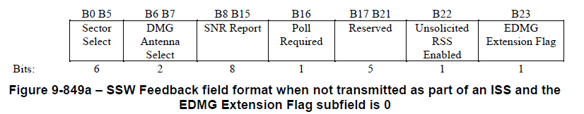
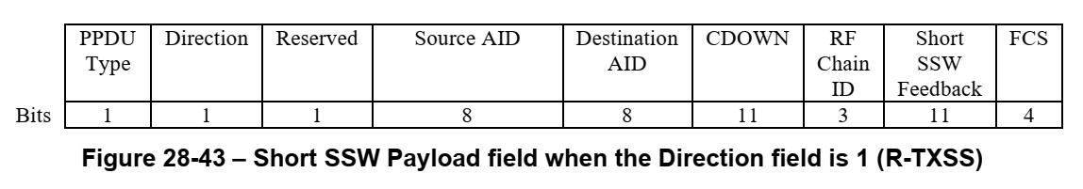
Sensing Information Request
Capability/Indication
  The STA indicates that it supports DMG passive sensing by providing information, e.g., direction of SSW/Short SSW, location of the STA.
    E.g., (Re)Association Request, Probe Request.
    The STA uses one reserved bit in the SSW/Short SSW.
Sensing information request:
  Uplink DMG passive sensing： The PCP/AP could send a sensing information request to the STA (Sensing transmitter) to request such information.
Sensing information response:
  The STA (Sensing transmitter) responds with a frame that includes a sensing information report.
SSW frame
Short SSW
Notes:
In association request, indicate that STA can provide location info and SSW info.

Slide 6
STA sensing information report (same as [1])
The sensing information report will include:
  Location of the STA (Sensing transmitter)
  Direction of each sector:
    Sector ID of SSW/Short SSW
    Azimuth and elevation angles of each sector of SSW/Short SSW
The sensing information request and sensing information response are transmitted in data MCS (MCS>0).

Slide 7
Example of a use case:
AP
Non-AP STA
BTI
DMG Beacon
STA wants to join the BSS.
A-BFT
AP wants to sense the current environment. So it uses the received SSW/Short SSW to do passive sensing.
SSW (bit) or Short SSW (bit)
Association Request/Response
Beacon Interval
AP wants to interpret the obtained sensing results so it requests information on SSW/Short SSW from the non-AP STA.
Information Request
Non-AP STA provides the required information on the A-BFT to the AP.
Information Response

Slide 8
Summary
In this contribution, we propose a DMG passive sensing based on A-BFT, which enables the AP/PCP to perform passive sensing using SSW/Short SSW.
Opportunistic DMG passive sensing during A-BFT
  AP can obtain sensing results from multiple non-AP STAs.
    Provide broader sensing area, given different locations of non-AP STAs.
  Provide sensing results of a sensing snapshot.
    Provide extra information to facilitate DMG sensing in DTI.
  Minor MAC changes to enable DMG passive sensing during A-BFT.
Notes:
During the same Beacon Interval

Slide 9
Straw Poll
Do you agree to add to the SFD:
DMG passive sensing based on A-BFT is enabled by
  Capability bit in the Association Request, Reassociation Request, Probe Request
  Indication bit using one reserved bit in the SSW/Short SSW
  Sensing information request and response that will provide information about the SSW/Short SSW
    Sensing information include:
        Azimuth and elevation for each sector ID of SSW/Short SSW
        Location information of the STA (Sensing transmitter)

Slide 10
Reference
[1] https://mentor.ieee.org/802.11/dcn/22/11-22-0002-00-00bf-dmg-passive-sensing.pptx
[2] https://mentor.ieee.org/802.11/dcn/22/11-22-0241-05-00bf-pdt-dmg-passive-sensing.docx

