Slide 1
Discussion on the NDP format for sensing
Date: 2022-03-03
Authors:
Name | Affiliation | Address | Phone | Email
Yan Xin | Huawei Technologies | Ottawa, Ontario |  | yan.xin@huawei.com
Junghoon Suh |  |  |  | Junghoon.Suh@huawei.com
Michael Montemurro |  |  |  | michael.montemurro@huawei.com
Osama Aboul-Magd |  |  |  | Osama.AboulMagd@huawei.com
Edward Au |  |  |  | edward.ks.au@huawei.com
Ross Jian Yu |  |  |  | ross.yujian@huawei.com

Slide 2
NDP format for sensing - general
Based on 802.11 SENS SG PAR [1],
5.2.b Scope of the project: This amendment defines modifications to the IEEE 802.11 medium access control layer (MAC) and to the Directional Multi Gigabit (DMG) and enhanced DMG (EDMG) PHYs to enhance Wireless Local Area Network (WLAN) sensing (SENS) operation in license-exempt frequency bands between 1 GHz and 7.125 GHz and above 45 GHz.
5.3 Is the completion of this standard contingent upon the completion of another standard? Yes
Explanation: As defined in 5.2.b, to enhance WLAN sensing, this amendment augments PHY and MAC capabilities defined in the IEEE P802.11ax, IEEE P802.11ay, IEEE P802.11az and IEEE P802.11be amendments and the IEEE P802.11 revision standard.
The NDP format for sensing in the sub-7 GHz systems should be chosen from the NDP formats specified in 11ax, 11az, 11be amendments and the IEEE P802.11 revision standard.

Slide 3
Revisit - HE sounding NDP format
HE sounding NDP format is specified in 802.11ax-2021 [2]
Use HE SU PPDU without Data field
The TXVECTOR parameters such as
FORMAT, APEP_LENGTH, HE_LTF_TYPE, GI_TYPE, NUM_STS, CH_BANDWIDTH, etc.
for an HE sounding NDP shall be set.
The maximum HE PPDU bandwidth is 160 MHz.
No secure LTF

Slide 4
Revisit - HE ranging NDP format
HE ranging NDP format is specified in 802.11az D4.0 [4]
Uses the HE SU PPDU format but without the Data field.
No beamforming steering matrix is applied to the waveform
The TXVECTOR parameters such as
FORMAT, APEP_LENGTH, CH_BANDWIDTH, NUM_USERS (NUM_STS), LTF_REP, SECURE_LTF_FLAG,, etc. for an HE ranging NDP shall be set.
Uses HE-LTFs (as defined in Subclause 27.3.11.10 (HE-LTF)) or Secure HE-LTFs when the TXVECTOR parameter SECURE_LTF_FLAG is set to 0 or 1 respectively.
Secure HE-LTFs use randomized LTF sequences, pseudorandom and deterministic per stream phase rotation and a frequency domain flat top window
For Secure HE-LTF transmissions, the number of LTF repetitions LTF_REP shall be greater than 1.

Slide 5
Revisit - HE TB ranging NDP format
HE TB ranging NDP format is specified in 802.11az D4.0 [4]
Uses the HE TB PPDU format but without the Data field.
No beamforming steering matrix is applied to the waveform
The TXVECTOR parameters such as
FORMAT, APEP_LENGTH, CH_BANDWIDTH, NUM_USERS (NUM_STS), LTF_REP, SECURE_LTF_FLAG,, etc. for an HE ranging NDP shall be set.
Uses HE-LTFs (as defined in Subclause 27.3.11.10 (HE-LTF)) or Secure HE-LTFs when the TXVECTOR parameter SECURE_LTF_FLAG is set to 0 or 1 respectively.
Secure HE-LTFs use randomized LTF sequences, pseudorandom and deterministic per stream phase rotation and a frequency domain flat top window
For Secure HE-LTF transmissions, the number of LTF repetitions LTF_REP shall be greater than 1.

Slide 6
Revisit - Examples of HE-LTFs in HE ranging NDP [4]

Slide 7
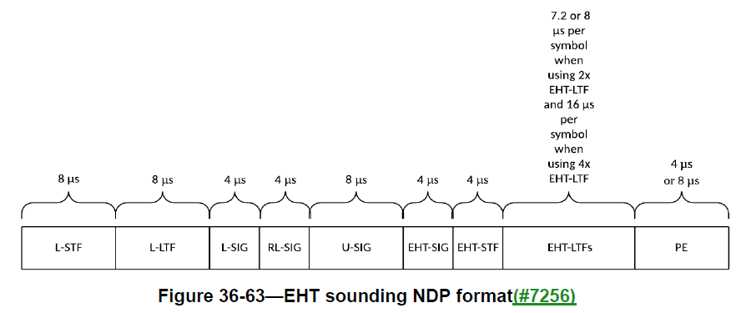
Revisit - EHT sounding NDP format
EHT sounding NDP format is specified in 802.11be D1.4 [3]
A variant of the EHT MU PPDU
The TXVECTOR parameters such as
FORMAT, APEP_LENGTH, HE_LTF_TYPE, GI_TYOE, NUM_STS, CH_BANDWIDTH, etc.
for an EHT sounding NDP shall be set.
The maximum EHT PPDU bandwidth is 320 MHz.
New EHT LTF in a 320 MHz transmission; reuse HE LTF for a 160 MHz or lower transmission
No secure LTF

Slide 8
NDP format(s) for sensing
Candidate NDP format | Discussion
HE sounding NDP | Single NDP format Limit up to 160 MHz PPDU transmissions No secure LTF specified Limited HE-LTF configuration
HE ranging NDP / HE TB ranging NDP | Flexible HE-LTF configuration Secure LTF Limit up to 160 MHz PPDU transmissions Two NDP formats
EHT sounding NDP | 320 MHz PPDU transmissions Preamble puncturing Single NDP format No secure LTF specified Limited EHT-LTF configuration
320 MHz PPDU transmissions and preamble puncturing specified in EHT should be considered in 11bf in order to support the PPDU bandwidth up to 320 MHz and efficient spectrum utilization.

Slide 9
References
[1] IEEE 802.11-19/2103r12, 802.11 SENS SG proposed PAR.
[2] IEEE Std 802.11ax-2021.
[3] IEEE P802.11be/D1.4.
[4] IEEE P802.11az/D4.0

Slide 10
SP
Do you agree to select the EHT sounding NDP format as an NDP format for sensing?
Yes:
No:
Abstain:

