Slide 1
Considerations for Next Generation Beyond 11be
Date: 2022-03-01
Authors:
Name | Affiliations | Address | Phone | Email
Jianhan Liu | Mediatek | 2840 Junction Ave. San Jose, CA, 95134 |  | jianhan.liu@mediatek.com
James Yee
Thomas Pare

Slide 2
Introduction
IEEE 802.11be is in the comment resolution stage and on schedule.
11be contains plenty of features and it is time to consider what features make sense for the Next Generation Wi-Fi
Here we reexamine the market needs and potential technologies for the next generation of 802.11 MAC/PHY.

Slide 3
Summary of Proposed Metrics and Considerations
DCN | Performance Metrics |  |  |  | Considerations and usage scenarios
 | Throughput | Latency | Efficiency | Power
22/0059 | √ | √√ | √√ | √ | XR/metaverse, remote/hybrid workplace, roaming, P2P, better 6GHz utilization, “private cellular” reliability
22/0032 | √ | √ | √√ |  | Cloud AR/VR/XR; 8K/16K video; sensing, better 6GHz utilization.
22/0046 | √√ | √√ | √ |  | XR, P2P links, latency <0.1ms, 10Gbps for a 2SS STA (60GHz)
22/0030 | √√√ | √ | √ |  | XR/VR/MR; home office (coverage); IoT

Slide 4

Reduced Latency
Gaming, especially gaming with multiple players, requires very low latency to give players a good experience.
  Latency can cause a player to lose.
  “Call of Duty” – It’s our duty to reduce latency!
Interactive video applications also require low latency.
  Video contents need to be updated per feedback from the user reactions.
AR/VR also proposes low latency requirements.
  High latency can cause virtual content to be misaligned with real life contents.
CALL of DUTY
LOW LATENCY

Slide 5
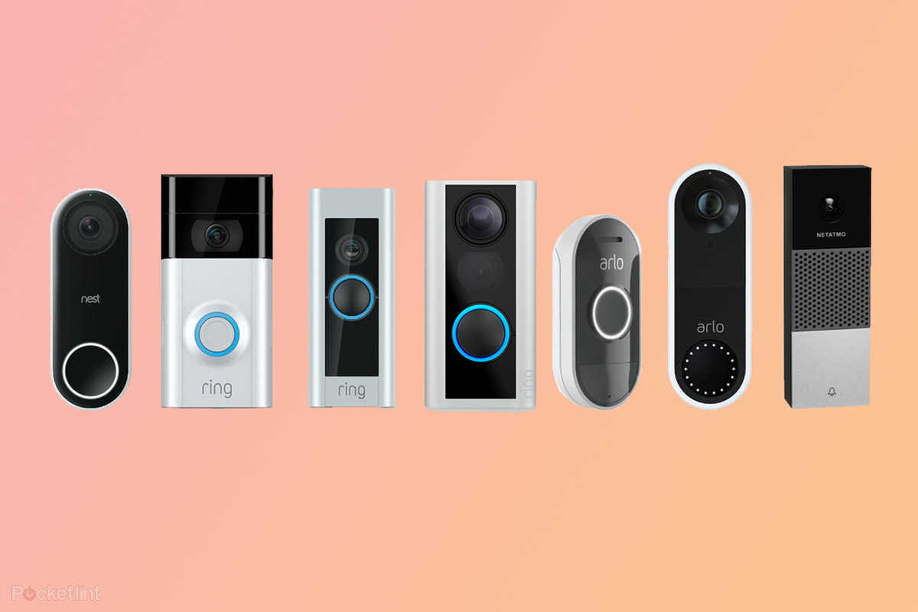

Range Extension
Wireless video doorbells have become a popular home security addition.
  Performance at long range becomes one of the most desirable features for wireless video doorbell.
  If you search on Amazon, you can find most wired video doorbells emphasizing their long-range capabilities.
  Legacy WiFi may deliver on range but not performance.
Wireless video surveillance market is growing at a fast pace.
  Most home video surveillance includes indoor and outdoor cameras.
  One of the biggest obstacles for outdoor wireless video surveillance is the lack of range.

Slide 6
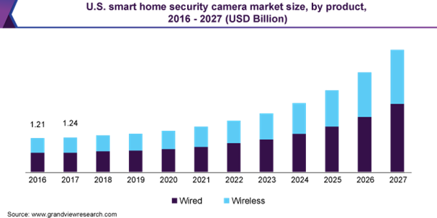
Range Extension (cont’s)
According to Grand View Research, the global smart home security camera market size was valued at USD 3.71 billion in 2019 and is expected to grow at a compound annual growth rate (CAGR) of 15.7% from 2020 to 2027.
Long range WiFi is in dire need to empower the wireless video doorbell and wireless video surveillance scenarios!

Slide 7
Scalability
WiFi has been adopted in vast & diversified markets, from high-end mobile devices to low-cost toys and low-power IoTs.
Different market segments have significant different requirements on data rates, cost, power consumption, coverage and latency, etc.
  There is no single type of product that can meet all the market needs under economic and power constraints.
  For example, an 8 spatial streams product is not suitable for a garage opener, or a smart rice cooker. A one spatial stream product is not suitable for 8K video streaming.
Yes, we can always be downgraded to old generations for tradeoff. But a lot of good features in the latest generation can not applied.
  For example, an 802.11n based products can not achieve lower power consumption because it does not support TWT.
To meet different needs for different market segments, it is time for us to keep the scalability as one of priorities because the standard has become more and more complicated.

Slide 8
Enhanced 6GHz Utilization
6GHz band has opened a great opportunity to WiFi industry and since 11ax we started making efforts to utilize it and utilize it more efficiently.
We introduced 320MHz channel in 11be and we are overcoming the transmit power constraints by introducing MCS 14.
We should continue the efforts to use the 6GHz band even more efficiently.

Slide 9
Improved Throughput
Throughput improvement is always welcome in any generation of wireless standards and the demand for higher throughput never stops.
Maybe it is more important to focus on “practical” throughput improvements:
  By “practical”, we mean to improve throughput for real scenarios instead of just hitting a number on paper.
  By “practical”, we mean to improve throughput for a general popular usage scenario instead of a rare usage scenario .

Slide 10
Summary of Our Consideration for Next Generation
Metric | Market Requirements
Reduced Latency | Gaming, AR/VR, Interactive Video. (latency <0.1ms)
Range extension | Wireless video doorbells and wireless home security surveillance cameras require WiFi to extend its range.
Scalability | Scalable for different market segments, different power consumption requirements.
Enhanced 6GHz utilization | Home Office, AR/VR, 4k/8k video streaming
Improved Throughput | Home Office, AR/VR

Slide 11
Proposal
Start a new 802.11 study group for next generation Wi-Fi during the July 2022 meeting.
Reexamine the market needs and potential technologies for the next generation standard.

